Slide 1
Forecasting Weekend Travel Demand Using an Activity-Based Model System
Bhargava Sana, SFCTA
TRB Planning Applications Conference
May 17, 2017 Raleigh, NC

Slide 2
Acknowledgements
Rosella Picado, WSP
Raghu Sidharthan, WSP
Dora Wu, WSP
Priyoti Ahmed, SFCTA
Joe Castiglione, SFCTA
Notes:
I would like to first acknowledge the contributions of our consultant team and my colleagues at SFCTA, including…

Slide 3
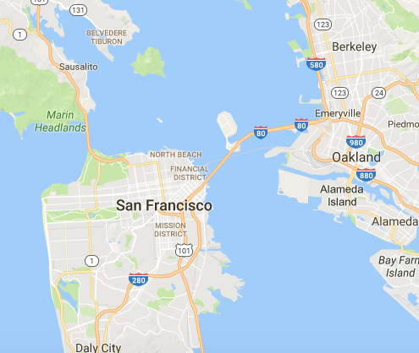
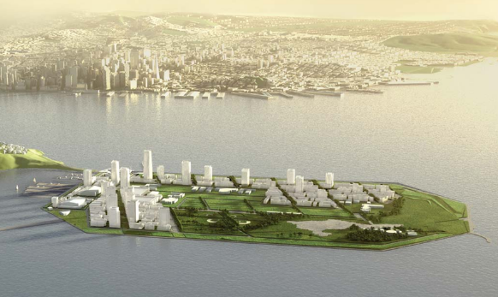
Treasure Island Context
Treasure Island
20,000 residents by 2035
retail, office/commercial, and public space uses.
Access only the San Francisco-Oakland Bay Bridge
Tolling on and off island
Operation and financial solution requires consideration of weekend
Traffic impact analyses
Revenue forecasts
Notes:
Treasure Island is an island located in the middle of the San Francisco Bay. For those of you have been the to the Bay Area it is the midpoint between the eastern and western spans of the San Francisco Bay Bridge. Originally built for an international exhibition, it later became a military base. When the base was closed, redevelopment plans for the island were approved, which will result in over 20,000 residents living on the island by 2035. A critical issue is access on/off the island, as the only existing connection is via the Bay Bridge, which is already saturated with demand throughout most of the day. In order to mange this demand, the SFCTA was identified as the mobility management agency for the island. In this role, the SFCTA will be setting and collecting tolls to access the island, and using these funds for providing alternatives such as new ferry service and increased bus service.

Slide 4
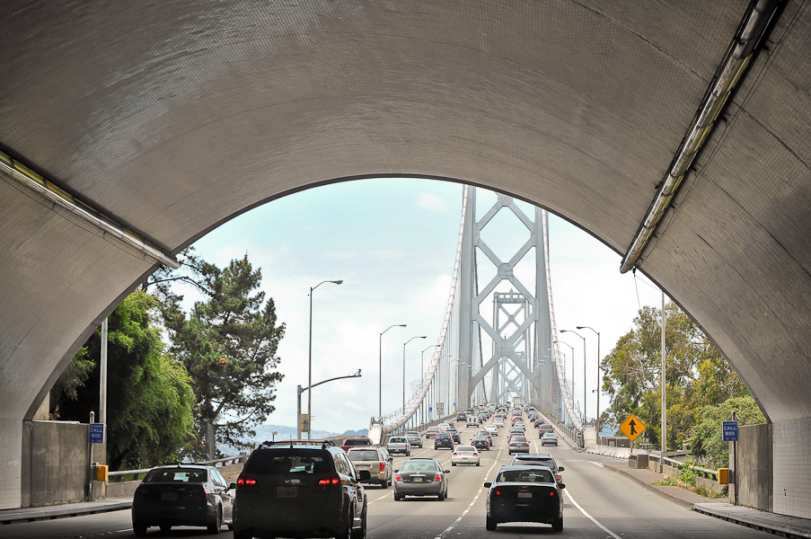
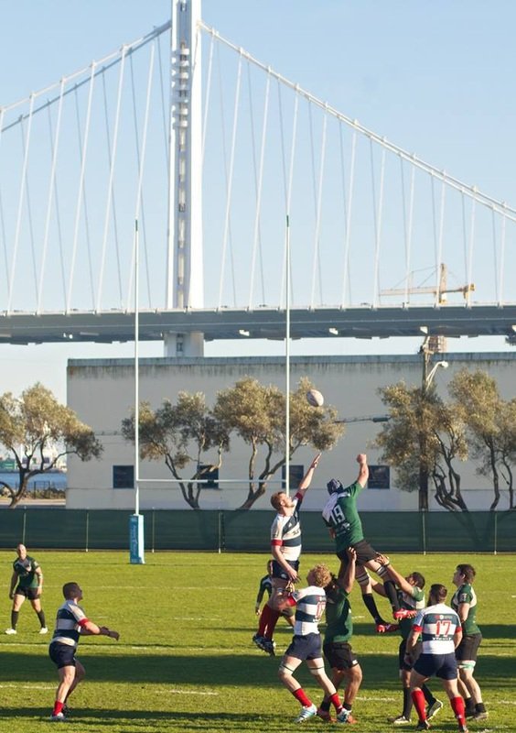
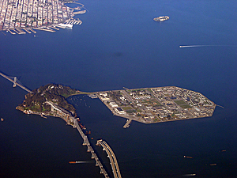
Forecasting Challenge
SF-CHAMP
ABM
Entire Bay Area
Typical weekday
Challenges
Limited observed data on weekend travel
No weekend models estimated
Schedule
Notes:
The SFCTA needed to generate traffic and revenue forecasts to support planning of Treasure Island transportation options. The SFCTA’s primary tool for forecasting travel demand is our SF-CHAMP activity-based travel demand forecast model. This model covers the entire bay area, and includes a rich representation of the regional transportation system including sensitivities to tolls. However, like most travel models, it is a “typical weekday” model. This is a significant limitation, as Treasure Island includes extensive recreation and special event facilities, and many of these types of activities are anticipated to occur on weekend. The limited amount of weekend data, absence of weekend models, and a constrained project schedule represented significant challenges to developing reasonable weekend travel demand and revenue forecasts..

Slide 5
Solution
Network Skim
Tour resampling
Weekday activities (tours) to match weekend travel patterns
Run subsequent choice models
Mode
Destination
Trip models
Recalibrate to weekend targets
Integrate special event demand
Work Location
Vehicle Availability
Weekday Tour Gen
Weekend Resampling
3 global iterations
4 simulations / iteration
Tour Destination
Tour Mode
Stop Location
Trip Mode
Network Assignment
Notes:
In response to these constraints, the modeling team developed and implemented a “tour resampling” approach to generating estimates of weekend demand. Rather than attempt to estimate weekend models with limited data and a tight schedule, instead the team implemented an approach in which weekday tours are resampled to match weekend tour targets, segmented by purpose, person type, and broad time period combination. Once this set of weekend tours has been generated, all of the subsequent choice models in SF-CHAMP are executed, including tour destination and mode, and trip stop location and mode. The model system is run in a manner consistent with the execution of the weekday models, which includes running three global iterations, and four full simulations within each global iteration, to attenuate simulation variation.

Slide 6
Tour Resampling
Tour targets set by person type, purpose, time period combination
For each tour type, target is specified as either
Fractional share
Absolute number (easier)
Based on weekday tourgen results, scale factors calculated
Tours randomly sampled without replacement until target is reached
Tour Targets
 | Worker | Student | Other | Child | Total
Work | 674,465 | 36,254 | 48,398 |  | 759,125
Gradeschool |  |  |  | 57,236 | 57,236
Highschool |  | 8,297 |  | 8,620 | 16,917
College | 12,012 | 11,574 | 8,239 |  | 31,825
Other | 3,830,715 | 567,356 | 1,858,815 | 1,090,011 | 7,346,898
Work-based | 113,681 |  |  |  | 113,689
Total | 4,630,873 | 623,482 | 1,915,461 | 1,155,876 | 8,325,691
Notes:
Resampling tour targets were segmented by person type, purpose, and time period combination. This made it possible to match the observed weekend travel markets reasonably well, These tour targets can be set as either fraction shares or as absolute targets. For the TIMMA project, we used absolute targets, which facilitated easy adjustment to better match observed network volumes. Once the targets are established, tours are randomly sampled without replacement until the target is reached. The charts on the right hand side of this slide illustrate some of the differences between weekday and weekend travel patterns on, with more shared ride tours on weekends, and tours generally happening later in the day. You can also see that there are relatively few work or school tours on the weekend, but a huge number of “other” tours.

Slide 7
Benefits
Weekday
Weekend (sampled)
Implement quickly
Avoid re-estimating weekend demand models
Avoid application code rewrite
Incorporate most of ABM sensitivities
Provides full range of disaggregate ABM outputs
Assessment of the equity impacts of tolling on both existing as well as new island residents.
Work Tours
Other Tours
Notes:
There are a number of benefits to this approach. First, it allowed us to get a weekend model up and running relatively quickly because it avoided the need to re-estimate weekend demand models which would have been challenging given the limited weekend data. This approach also avoided the need for any core application code adjustments, although additional scripting was required to implement the re-sampling, and to integrate the resampled weekend demand with the overall model runstream. A second benefit of the approach was that it incorporated most of the sensitivities to mode, destination, and time-of-day that are incorporated in the weekday model. Finally, it provided the full set of disaggregate model outputs. This was very important, as one of the key policy issues in redeveloping the island is accounting for and understanding the impacts on the current existing residents, many of whom will continue to live on the island after redevelopment.

Slide 8
Calibration / Validation
Tour resampling
Tour destination
Tour mode
Tour time of day
Depart | Return | Survey | Model
Early | Early | 0.2% | 0.2%
 | AM peak | 0.2% | 0.2%
 | Midday | 0.9% | 0.8%
 | PM peak | 0.1% | 0.1%
 | Late | 0.1% | 0.1%
AM peak | AM peak | 2.2% | 2.4%
 | Midday | 11.6% | 11.5%
 | PM peak | 2.5% | 2.1%
 | Late | 2.2% | 1.9%
Midday | Midday | 35.9% | 37.3%
 | PM peak | 14.0% | 13.9%
 | Late | 6.7% | 6.1%
PM peak | PM peak | 7.7% | 7.6%
 | Late | 9.3% | 9.3%
Late | Late | 6.2% | 6.6%
Total | Total | 100.0% | 100.0%
 | Survey | Model
Drive Alone | 26.1% | 26.6%
Shared Ride 2 | 25.7% | 23.5%
Shared Ride 3+ | 30.5% | 31.3%
Walk | 11.8% | 12.6%
Bike | 2.2% | 2.4%
Walk-Local Bus | 1.7% | 1.4%
Walk-LRT | 0.5% | 0.6%
Walk-Premium Bus | 0.1% | 0.0%
Walk-Ferry | 0.0% | 0.0%
Walk-BART | 0.5% | 0.5%
Drive-Local Bus | 0.0% | 0.0%
Drive-LRT | 0.0% | 0.0%
Drive-Premium Bus | 0.0% | 0.0%
Drive-Ferry | 0.0% | 0.0%
Drive-BART | 0.6% | 0.5%
Taxi | 0.2% | 0.4%
Total | 100.0% | 100.0%
Notes:
As often occurs with weekday model implementation, it was necessary to adjust the weekend tour targets to better match observed network volumes. Some additional calibration of the tour and trip mode and destination models was also performed. This recalibration effort did require some additional time, but was completed in approximately one month. The result was a model system that matched weekend-based targets for invidual model components as well network assignments relatively well. The tables on the right illustrate the observed to estimated shares for the tour time period combinations and trip modes.

Slide 9
Results & Conclusions
Results
Higher trip-making on weekend than weekday
Non-resident weekend trips lower in 2020 due to no special events
Resampling Conclusions
Cost-effective
Met schedule
Provided almost all model sensitivity and reporting capabilities
Reasonable results
Notes:
The results showed high levels of trip-making by both residents and non-residents on the weekend. Although it should be noted that some of the non-resident demand is due to special events. In conclusion the tour resampling approach proved to be cost-effective, met our schedule provided almost all the capabilities of the weekday model, and produced reasonable results.

Slide 10
contact: bhargava.sana@sfcta.org

