Slide 1

Preliminary Evaluation of Cellular Origin-Destination Data as a Basis for Forecasting Non-Resident Travel
15th TRB National Transportation Planning Applications Conference
May 19, 2015
Atlantic City, New Jersey
Ronald Milone
Metropolitan Washington Council of Governments (MWCOG)
National Capital Region Transportation Planning Board (TPB)

Slide 2
Overview
Why cellular O-D data?
Specifications of the data purchased
Evaluation of data with respect to
  Travel model outputs
  Land activity
  External traffic counts
Observations and impressions

Slide 3
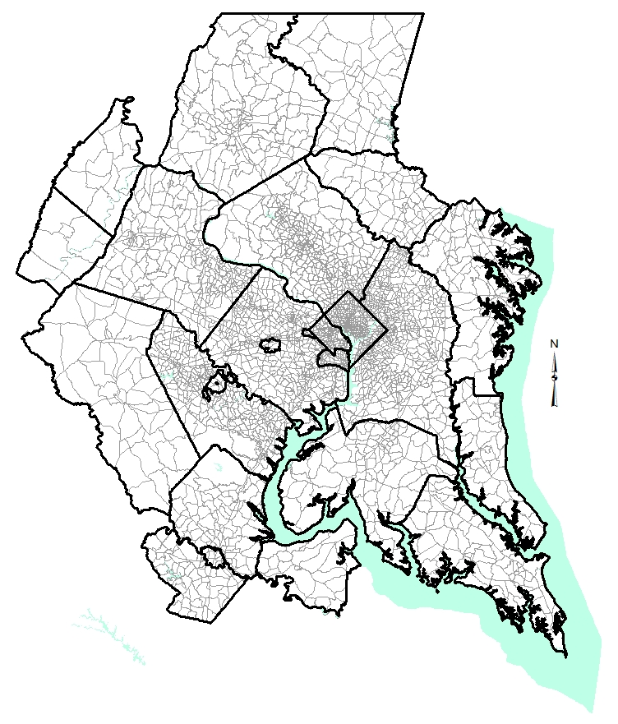
TPB modeled area

Slide 4
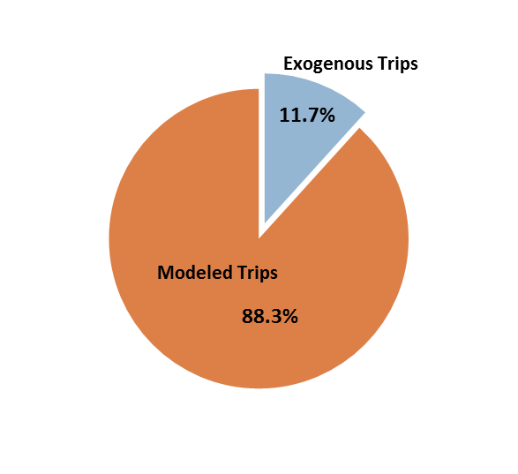
Exogenous trip markets in the travel model
Exogenous trip markets:
External trip-ends
Through trips
Taxi trips
University/School trips
Visitor/Tourist trips
Airport Passenger trips

Slide 5
Selected AirSage Parameters

Slide 6
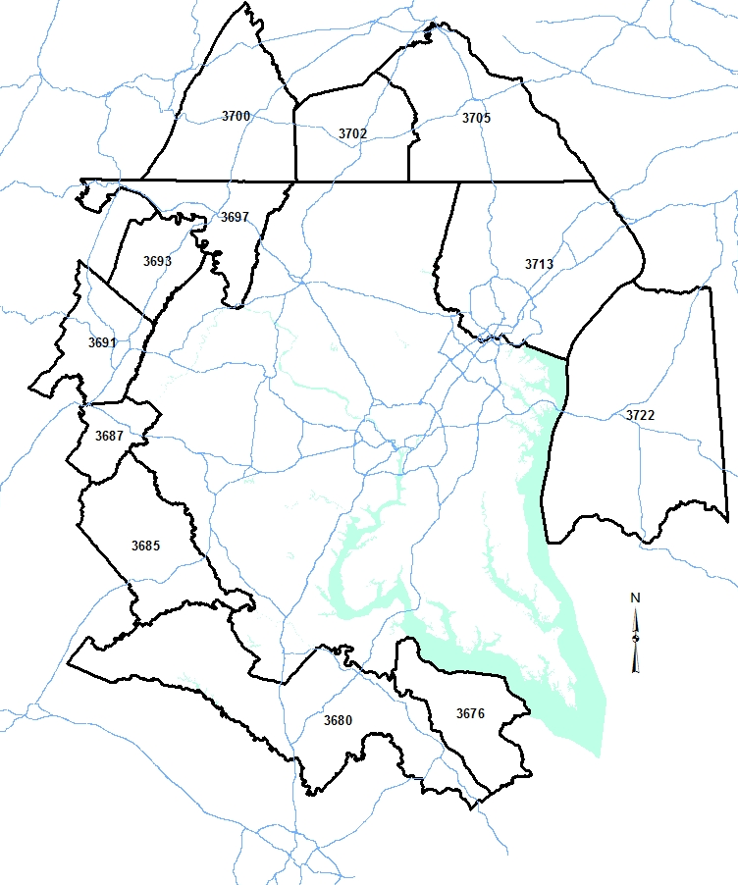
External catchment areas
Geography used for summarizing external and through trips
12 External catchment areas (or “sheds”)
Jurisdiction-based
Designed around 47 external stations

Slide 7
What IS a mobile device trip?
Aggregate market flow
  Individual trip-makers are unknown
  HH characteristics of traveler are unknown
Possibly a combination of linked and unlinked trips
Vehicle type /mode of travel is unknown
Path of O-D is unknown
Subject to cellular signal detection

Slide 8
Assumed equivalency of AirSage trip coding and modeled purposes (P-A format)

Slide 9
Comparison of internal trips by purpose:
AirSage trips vs. TPB modeled motorized person trips
-Overall number of AirSage trips and modeled person trips is about equal
-Number, share of AirSage HB trips is higher than modeled trips
-Number, share of AirSage NH-trips is lower than modeled trips

Slide 10
Comparison of internal trip lengths by purpose:
AirSage trips vs. TPB modeled motorized person trips
-Overall trip lengths and intra-zonal percentages are consistent
-Overall HB trip lengths are consistent, but HBW trips are shorter
-Overall AirSage NH trips are longer that the modeled NH trips

Slide 11
Jurisdictional daily trip flows:
AirSage trips vs. modeled person trips
Total AirSage Trips vs. Modeled Motorized Person Trips
Line of Perfect Agreement
-Overall daily trip flows at jurisdiction levels agree reasonably
-AirSage flows within large suburban jurisdiction are less than modeled flows

Slide 12
AirSage total Home-Based productions vs. households: TAZ level versus district level
AirSage 2014 TAZ Level HB-Productions vs. 2014 Rnd8.3 HHs
AirSage 2014 District Level HB-Productions vs. 2014 Rnd8.3 HHs
Logical TAZ level correlation exists, but scatter is considerable
Data aggregation to the district level reduces data noise

Slide 13
AirSage HBW attractions vs. employment:
TAZ level versus district level
AirSage 2014 Zonal HBW Attractions vs. 2014 Rnd8.3 Jobs
AirSage 2014 District Level HBW Attractions vs. 2014 Rnd8.3 Jobs
-Correlation logical, but weak at the TAZ level
-Data aggregation at the district level reduces data noise (again)

Slide 14
2014 AirSage external/through trips vs.
2013 traffic counts (1000s)
-General distribution pattern is reasonable
-Overall AirSage crossings at external cordon exceed counts by 30%

Slide 15
Distribution (%) of E-I trips by jurisdiction:
AirSage vs. 1994 Auto External Survey
HBW Trips
Daily Trips

Slide 16
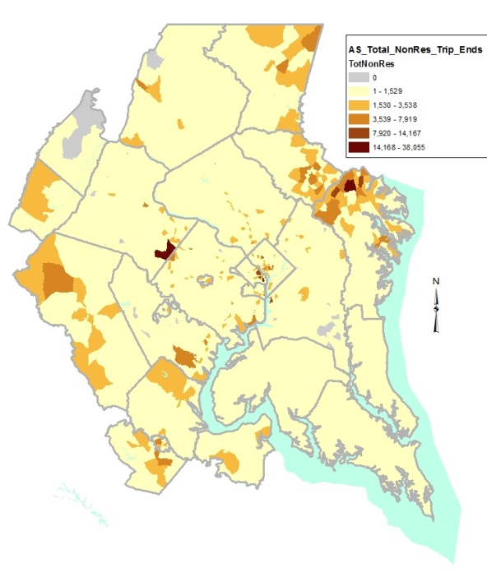
AirSage non-resident trip-ends
Principal generators:
  3 commercial airports & Union Station
  Tourist attractions
    Monuments, museums
    Government buildings
    National Zoo
    Special attractors
      Verizon Center
      National Harbor
      Annapolis Harbor
    Historic Sites
  Mega shopping centers

Slide 17
Findings:
Cellular O-D trips vs. modeled person trips:
  Global trips and trip lengths compare reasonably
  Trips by modeled purpose show differences
Cellular O-D trips correlate logically with land activity, but:
  Inconsistencies are evident at the TAZ level of analysis
  Aggregation to the district level dampens the noise

Slide 18
Findings:
Cellular O-D external and through trips:
  Cellular trip patterns appear reasonable
  Cellular trips crossing the external cordon exceeds counts by 30%
  Ability to “ground-truth” O-D movements by ground counts is limited
Cellular non-resident (visitor) trip generators appear consistent with expectations

Slide 19
Final thoughts
Cellular O-D data is highly sampled, but it’s different from modeling data that planners normally use
Cellular O-D data has inherent uncertainty:
  Household characteristics of travelers
  Mode of travel
  Path choice
The use of this data in practice hinges on:
  Understanding how cellular data is different
  Addressing uncertainties (travel mode in particular)

