Slide 1
Effective Visualization of Dynamic Traffic Information
Robert Tung, PhD
RST International
Metropia
TRB 15th National Transportation Planning Applications Conference
May 20, 2015 Atlantic City

Slide 2
Dynamic Traffic Data
Defining “Dynamic”:
Fast changing, temporally & Spatially
Real Time, up-to-minute
Type of Dynamic Data:
Online real-time traffic data feed
INRIX (region wide, link based)
Mobile phone based GPS trajectory
App based navigator & recorder (metropia app)
Simulation models
Mesoscopic DTA models (DynusT)
RST | Metropia

Slide 3
Effective Visualization Tools
Open Source & Open Format
Google Earth + KML
High definition GIS & 3D mapping
Python + matplotlib
Easy statistical plotting
HDF5 database
Efficient file storage & flexible API
DynusT
Powerful simulation DTA for large network
RST | Metropia

Slide 4
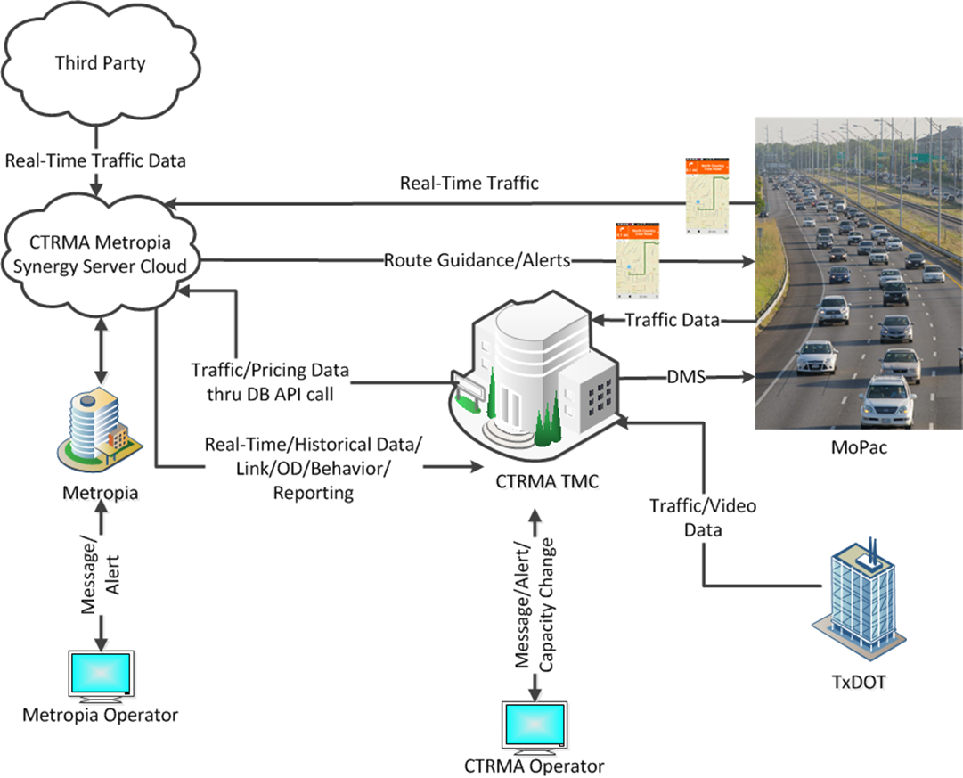
Visualizing Real Time Data
Metropia Synergy Platform
RST | Metropia

Slide 5
Metropia Synergy Applications
Travel pattern analysis
Activity-based model validation
Corridor travel times & speeds
Mobility & reliability measures
Real-time traffic management
Driving behavior & safety analysis
Special event management
Intersection delays
RST | Metropia

Slide 6
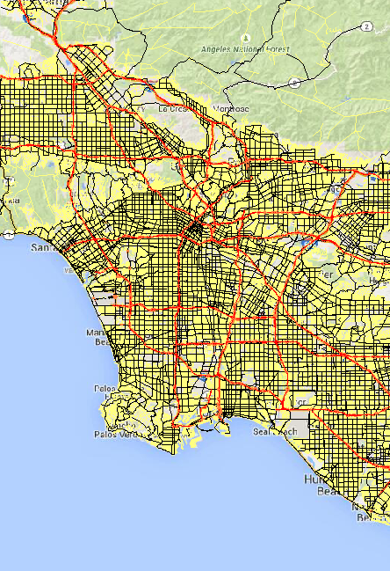
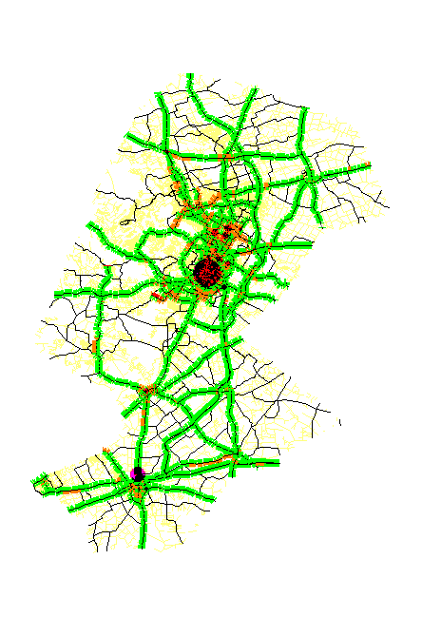
Metropia Synergy Deployment
Tucson
LA
Austin
RST | Metropia

Slide 7
LADOT Real Time Traffic Monitor
RST | Metropia

Slide 8
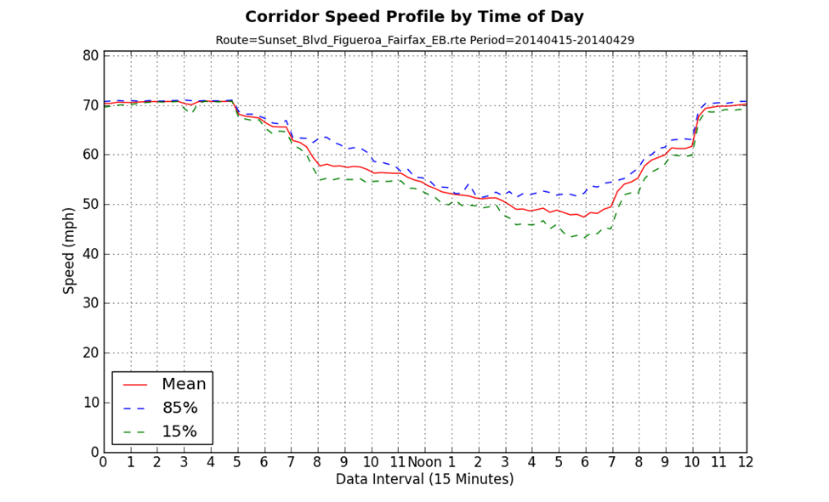
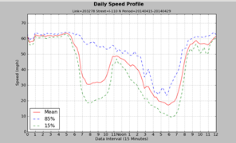
Travel Time Variability Analysis
RST | Metropia

Slide 9
Visualizing GPS Data
Pima Association of Governments (PAG) Travel Times & Speeds Study
Tucson area network
App based data collection
Real-time point to link mapping
400 drivers & 10,000+ trips
~8 million data points
Google Earth Visualizer
HDF5 database
RST | Metropia

Slide 10
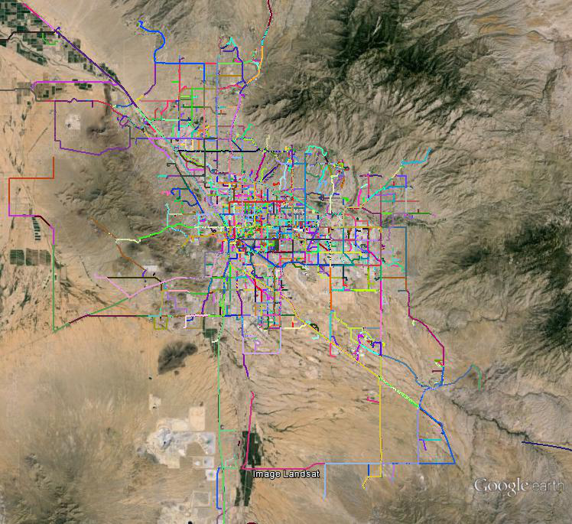
Travel Shed Analysis
GPS Trajectories
AM & PM OD Desire Lines
RST | Metropia

Slide 11
3D View of Zone Data
Total Origins at TAZ
RST | Metropia

Slide 12
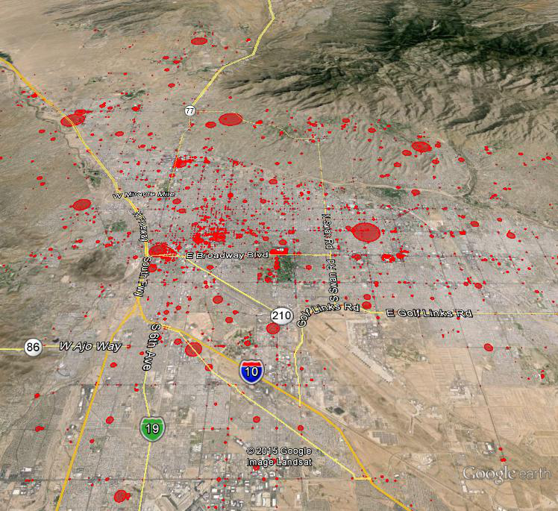
Mapping Delays
Average Node Delays
RST | Metropia

Slide 13
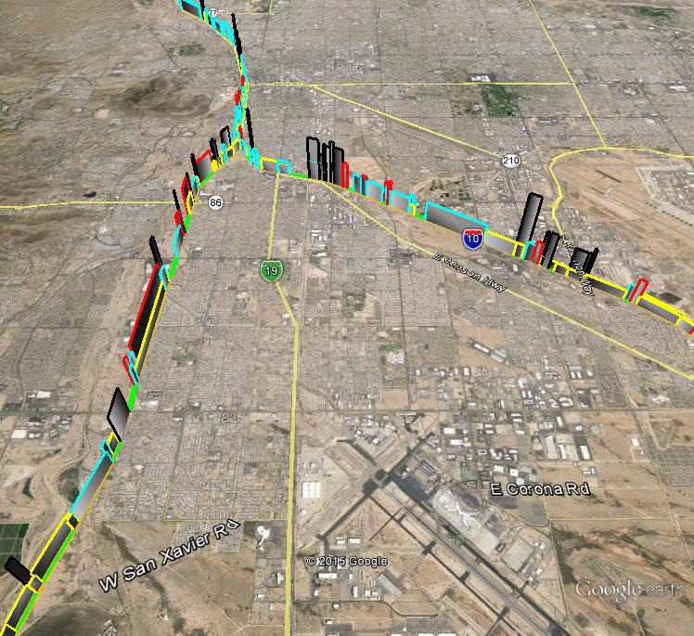
Speed Variability Analysis f_{i} = std_{i} / mean_{i}
RST | Metropia

Slide 14
Link Speed Profile (congested)
RST | Metropia

Slide 15
Link Speed Profile (uncongested)
RST | Metropia

Slide 16
Visualizing Simulation Data
DynusT (Dynamic Traffic Assignment)
Open Source meso-scopic DTA software
Capable of simulating large regional network
Good for ABM integration
Has been widely used for various analyses:
Work Zones, Incidents, Tolling,
Congestion Pricing
Travel time reliability
DynuStudio
Commercial GUI for DynusT to provide high quality visualization and data management
RST | Metropia

Slide 17
Animated Vehicle Trajectories
RST | Metropia

Slide 18
Cumulative Vehicle Trajectories
RST | Metropia

Slide 19
Animated Link MOEs
Link Density & Delay
Link Density & Volume
RST | Metropia

Slide 20
Scenario Comparison
RST | Metropia

Slide 21
Conclusions
As we are entering “Data Rich” & “Big Data” era, data visualization is increasingly important
Visualization is the critical part of data analytics to understand the underlying patterns of the data & to provide the right answers
Effective visualization should be low cost & open format, to encourage data sharing
RST | Metropia

Slide 22
THANK YOU
rst@rstintl.net

