Slide 1
APPLICATION OF TRAFFIC ESTIMATION AND PREDICTION FOR INCLEMENT WEATHER CONDITIONS: NORTHERN VIRGINIA VMS APPLICATION
15th TRB Planning Applications Conference
2015.5.17
Atlantic City, New Jersey
Joyoung Lee, New Jersey Institute of Technology
Byungkyu Brian Park, University of Virginia

Slide 2

Outline
Introduction
Model Development and Calibration
Case Study
Concluding Remarks

Slide 3
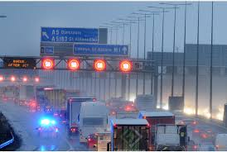
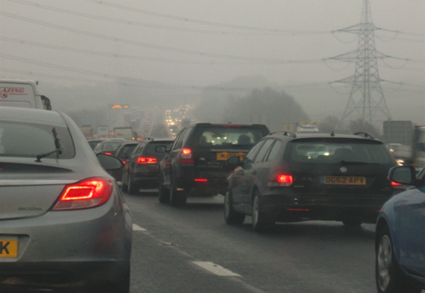
Introduction
Background
  Under inclement weather conditions, the performance of roadways dramatically worsens due to several factors adversely affecting the driving behaviors.
    10-11% roadway capacity reduction due to adverse weather
    Maximum reductions ranged from 8 to 14 percent and 5 to 19 percent for rainy and snowy conditions, respectively
  Low visibility also adversely affects free-flow speeds for all vehicles
    Up to 18.1 percent speed reductions during foggy and snowy conditions

Slide 4

Introduction
Background
  The impact of inclement weather on work trip is less significant than non-work trip
    Up to 6% non-work traffic volume reductions
    Up to 15% work traffic volume reductions
  Inclement weather increases startup lost time, increases saturation headway, and reduces free flow speed
    Startup lost times at intersection
    increased by an average of 23 percent
    Saturation headways also increased
    by a maximum of 30.9 percent.

Slide 5
Introduction
Motivations
  To mitigate the congestion caused by the inclement weather, weather responsive traffic management (WRTM) strategies such as traveler information system based on variable message sign (VMS), broadcast, or 511 service, variable speed limit (VSL), and traffic signal re-timing can be considered
  Providing travelers’ with traffic congestion information through Variable Message Signs (VMSs) can be considered as a viable option.
  However, it has been challenging to assess the impact of VMS under inclement weather conditions due to lack of properly tailored modeling tools.

Slide 6
Introduction
Goal
  Assess the benefits of VMSs as a congestion mitigation tool for severe traffic congestion accelerated by inclement weather through a Dynamic Traffic Assignment (DTA) model based simulation.
Objectives
  To develop a simulation-based DTA model by incorporating a mesoscopic traffic simulator and Weather Adjustment Factors(WAFs)
  To conduct case studies to investigate the impact of VMSs on the traffic congestion mitigation strategies

Slide 7
Model Development
Based on Dynamic Traffic Assignment (DTA) Modeling Approach
Dynus-T
  A mesoscopic traffic simulation model developed by Chiu at the University of Arizona
  Performs dynamic traffic assignment based on a simulation approach
  Applied for several DTA-based analysis dealing with traffic congestion managements and evacuations planning

Slide 8
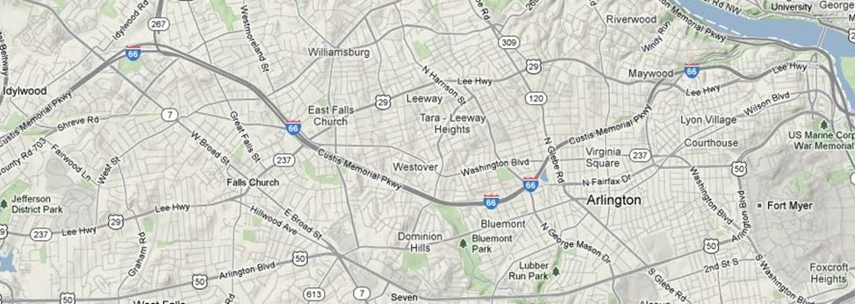
Model Development
Modeling Site: Northern Virginia
  Interstate Highway 66; major local corridors including US 50, US 29, VA-7, VA-287; and several local streets.
  Initial OD table was obtained by a sub-area network analysis capturing all demands passing through the subarea boundary.

Slide 9
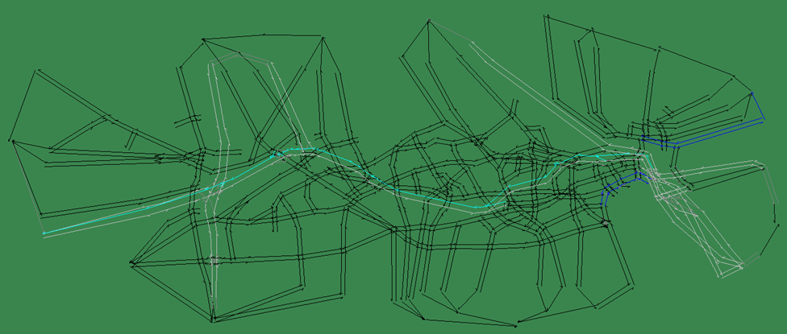
Model Development
Dynus-T Model
  1,281 links and 581 nodes, and102 signalized intersections.
  A total of 37 zones established by a planning model from the Metro Washington Commission of Government (MWCOG).

Slide 10
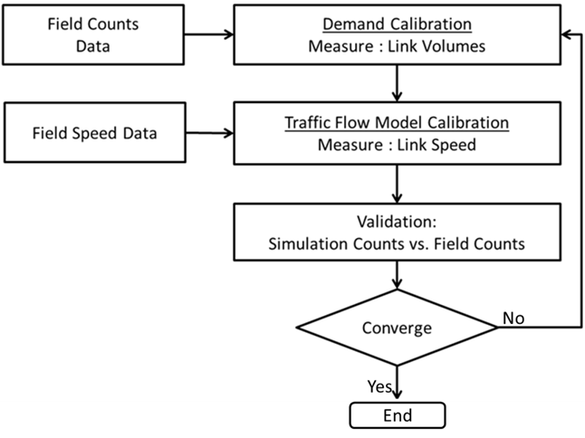
Model Development
Model Calibration
  Two-step iterative approach
    Step 1: Demand calibration
    Step 2: Supply model
    (i.e., speed density equations) calibration
  Data Source
    Traffic Volume: 7 VDOT counts stations; ADMS;
    Speed : 5-min interval INRIX Data

Slide 11
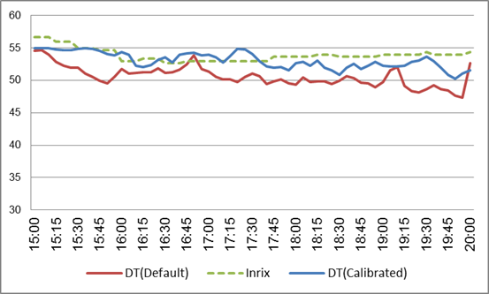
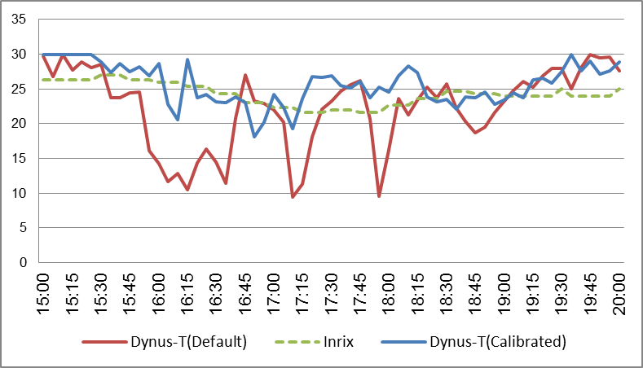
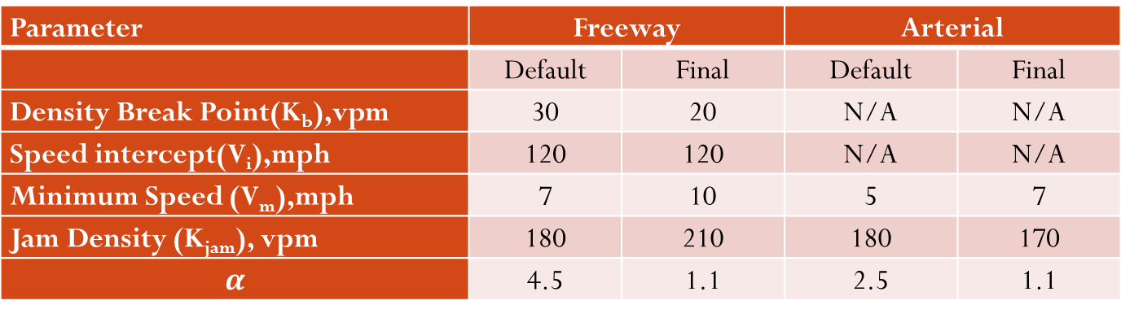
Model Development
Calibration Results
Parameter | Freeway |  | Arterial
 | Default | Final | Default | Final
Density Break Point(K_{b}),vpm | 30 | 20 | N/A | N/A
Speed intercept(V_{i}),mph | 120 | 120 | N/A | N/A
Minimum Speed (V_{m}),mph | 7 | 10 | 5 | 7
Jam Density (K_{jam}), vpm | 180 | 210 | 180 | 170
$$α$$ | 4.5 | 1.1 | 2.5 | 1.1
Freeway Section (I-66 EB) Speed Profile
Arterial Section (US 29WB) Speed Profile

Slide 12
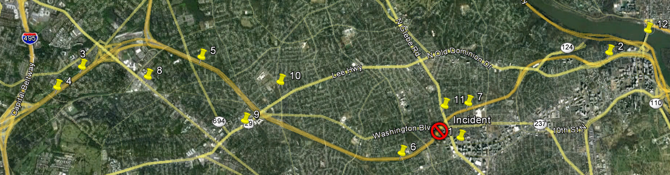
Case Study
Scenario
  A hypothetical incident on I-66
  Normal Weather + Existing VMS (Base case)
  Inclement Weather + Existing VMS
  Inclement Weather + Existing VMS+ 5Freeway VMS
  Inclement Weather + Existing VMS + 5 Freeway VMS+ 5 Arterial VMS
  Inclement Weather + multiple VMSs (5,10,15,20) determined by Latin Hypercube Design
Existing VMS

Slide 13
Case Study
Simulation setting
  A heavy rain condition where the precipitation is approximately 0.3 inches for a PM peak period from 3:30 PM to 8:00 PM
  Demand and Supply Parameter Adjustment based on Weather Adjustment Factor (WAF) by Samba and Park and Mahmassani et al.
    3.8% ~ 4.2% Volume Reduction
    Supply Parameter Adjustment

Slide 14
Case Studies
Results
Scenario | Network-wide Performance
 | Total Travel Time (vhe-hr) | Gain (%) | Through-put | Gain (%)
Base Case(i.e., Normal Weather + Existing VMS) | 107,208 | - | 261,050 | -
Inclement Weather+ Existing VMS | 287,095 | - | 230,092 | -
Inclement Weather+ Existing VMS+ 5Freeway VMS | 292,358 | -1.8 | 229,665 | -0.2
Inclement Weather+ Existing VMS + 5 Freeway VMS+ 5 Arterial VMS | 282,844 | 1.5 | 229,596 | -0.2

Slide 15
Case Studies
Results
Scenario | Performance of VMS Users
 | Average Travel Time (veh-hr) | Gain (%)
Base Case(i.e., Normal Weather + Existing VMS) | 18 | -
Inclement Weather+ Existing VMS | 72 | -
Inclement Weather+ Existing VMS+ 5Freeway VMS | 59 | 18
Inclement Weather+ Existing VMS + 5 Freeway VMS+ 5 Arterial VMS | 54 | 25

Slide 16
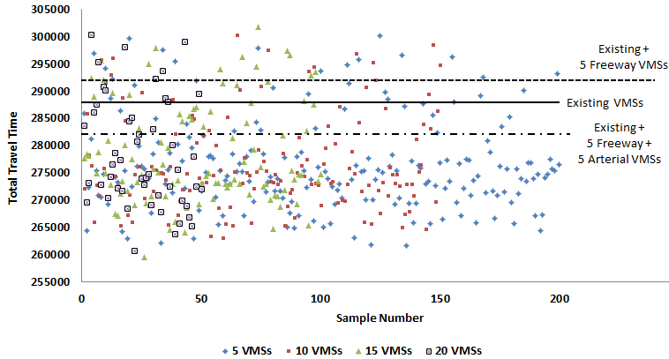
Case Study
Impact of VMS locations

Slide 17
Concluding Remarks
Examined the impact of VMS as a viable weather responsive traffic management strategy to mitigate the congestion caused by inclement weather.
Utilized DTA-based simulation approach for the Northern Virginia area by using the DynusT program under the 100% driver compliance
Conducted case studies dealing with existing VMSs and several potential mobile VMSs.
  No significant network-wide performance improvement
  Dramatically improve the travel times of travelers who actually accessed the traffic congestion information through the VMS, resulting in 18% to 29% of travel time savings for VMS users.

Slide 18
Concluding Remarks
The locations of VMSs could significantly affect the performance of weather responsive traffic management strategy
  It is recommended that a local traffic management agency is necessary to identify the most promising locations before they deploy portable VMSs for inclement weather conditions as an easy-to-implement but cost-effective congestion mitigation strategy.
Additional study dealing with the examination of VMS performance under various demands and weather conditions should be comprehensively investigated under various inclement weather conditions in the future.

Slide 19

Questions?

