Slide 1
Recreational Travel in Los Angeles County
A toolbox for evaluating bicycle related travel
15th TRB Planning Applications Conference
Moby Khan, Srinath Ravulaparthy, Feng Liu and Tom Rossi
Los Angeles County MTA
Robert Cálix, Chaushie Chu, Robert Farley
May 17, 2015

Slide 2
Outline
Background and Motivation
Overall Bike Model – The Bigger Picture
Recreational Bike Model – Demand Generation and Assignment
Results and Discussion
Conclusions and Next Steps

Slide 3
Background and Motivation
Bicycling is healthy and environmentally friendly
Major push among public agencies
Advocating bicycling as a way to improve quality-of-life
Bicycle infrastructure investments and policy programs to promote bicycling
A toolbox for prioritization of infrastructure for active transportation
Pro-bicycling policies
Infrastructure design and implementation (bike paths, parking and bike share programs)
Behavioral responses

Slide 4
Toolbox Capabilities
Policy Sensitivity
Link-level measures of various bicycle facilities and levels of infrastructure investments.
Individual behavioral patterns and responses to changes in built-environment and infrastructure
3-Step Approach
Prototype case and design
Small Area Study
County-wide Implementation

Slide 5
Flowchart Overview
Trip Purposes | Utilitarian |  |  |  |  |  | Recreation
 | Auto | Transit |  |  | Non-Motorized |  | Biking
 | Auto | Walk Access | Bike Access | PnR, KnR | Walk | Bike | @ destination
Home-Based Work
Home-Based Univ
Home-Based Recreation-Biking @ Destination
Home-Based Other
Non-Home-Based
Fair-weather utilitarians

Slide 6
Bicycle Demand Model Process
Output #1: Individuals making recreational bike trips
Output #2: Amount of recreational bicycling per individual
Linear Regression Model – predicts frequency of recreational bike trips
Output #3: Total recreational bicycling miles per zone
Log-Normal Distribution – predicts length of recreational bike trips
Binary Logit Model – predicts whether any recreational trip is made

Slide 7
Key Variables
Independent Variables | Propensity to bicycle for recreation | Weekly recreational bicycling trips
Individual characteristics
Sex | √ | √
Age |  | √
Additional years over 44 | √ | √
Education | √ | √
Household characteristics
Children |  | √
Income |  | √
# Vehicles | √
Bicycle facilities
Density (class 1, 2, 3) | √
Distance to Nearest Facility | √
Other
Transit availability | √
Gradient | √
Employment density | √

Slide 8
Allocation modeling process
Output #1: Total BMT per zone and length of the trip
Output#2: Attraction surface for potential recreational trips
Link-level utility scores – index representing the attractiveness of recreational bicycling
Output #3: Link-level recreational bicycle counts
Demand assignment – BMT assigned to individual network links by distance and utility scores
Demand generation – total amount of recreational bicycling per zone

Slide 9
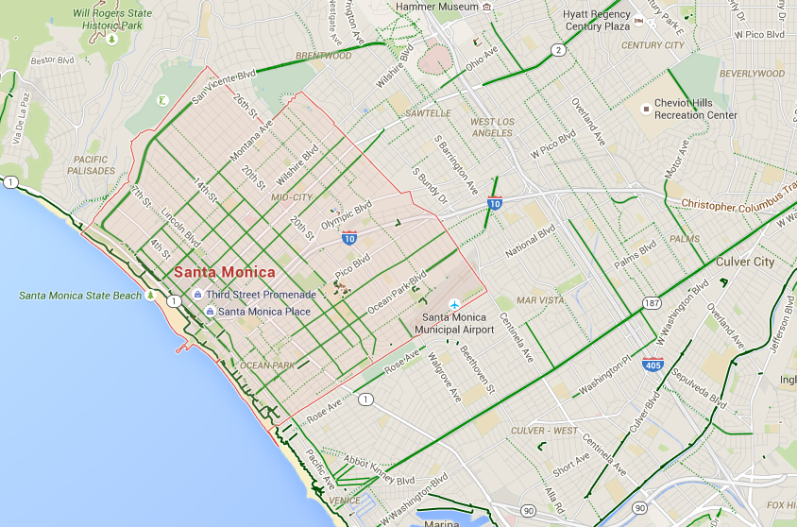
Santa Monica Implementation
Notes:
What data used, characteristics of Synthetic Population

Slide 10
SCAG Synthetic Population
Synthetic population developed by SCAG as inputs into their regional activity-based travel demand model
Synthetic population generation at the TAZ level by controlling for both household and person level constraints simultaneously (Ye et al., 2009; Pendyala et al., 2013)
Year 2008 Santa Monica Synthetic Population Descriptives
Median Household Income | $68,290
Average Household Size | 2.50
Average Household Number of Vehicles | 2.47
Average Age | 42
% Female | 51.3%
Total Population | 95,475

Slide 11
Santa Monica Implementation
Recreational Bike Trip Characteristics
Descriptive Statistics | Propensity | Frequency per Person | Frequency per Biker
Average | 0.13 | 0.32 | 2.46
Std. Deviation | 0.11 | 0.28 | 0.33
Minimum | 0.00 | 0.00 | 1.07
Maximum | 0.57 | 1.73 | 3.80
Total Number of Recreational Bikers | 12,492
Total Number of Weekly Recreational Bike Trips | 30,682

Slide 12
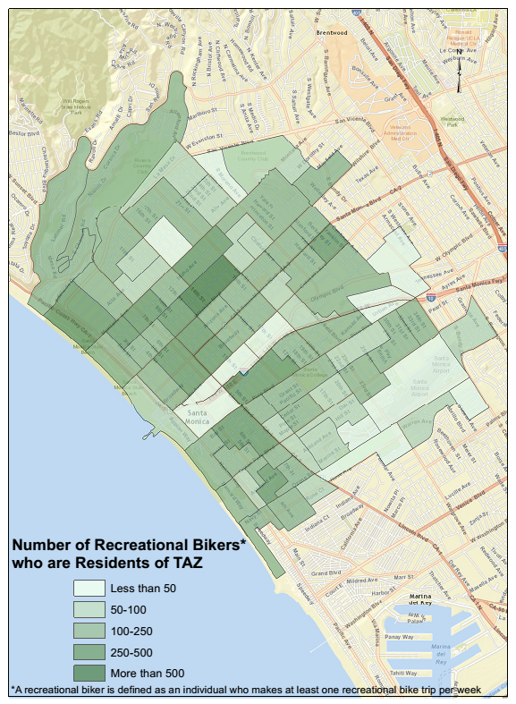
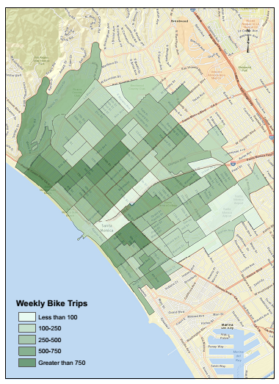
Santa Monica Implementation
Recreational Bike Travel Demand

Slide 13
Recreational Trip Assignment

Slide 14
Conclusion and Next Steps
A novel toolbox for policy evaluation
Sensitive to behavioral responses for policy and infrastructure programs
Address potential demand for varying levels of network level investments
Small area implementation serves as a proof of concept for large scale model application
Next Steps
Validate model by comparing with ground level bike counts.
Perform scenario testing by adding new bike facilities.
Expand to Los Angeles County.

Slide 16
Recreational Bicycle Model Overview
Quantity of Recreational Bicycling
Two-stage, discrete choice and regression model
Propensity Logit Model
Frequency (regression) Model
Trip length sampled from 2009 NHTS
Assignment of Recreational Bicycling
Surface of potential recreational bicycling
Surface representing the attraction of recreational bicycling
F (bike facility, access to recreational parks, beaches, land-use density and proximity to secondary and minor roadways)
Total BMT on bicycle network by facility type and zonal attributes

