Slide 1
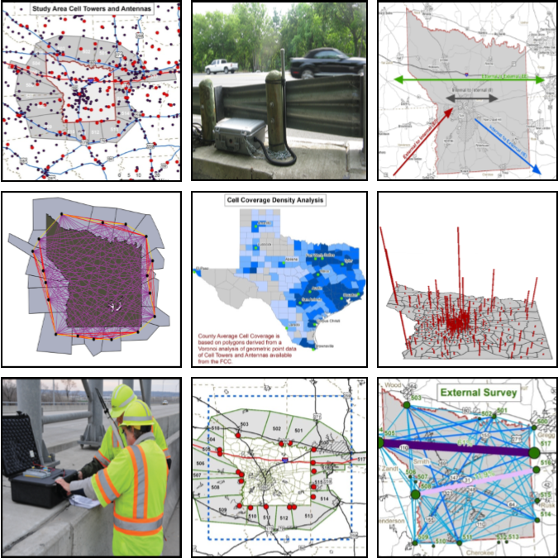
Comparison of Cell, GPS, and Bluetooth Derived External Data
Results from the 2014 Tyler, Texas Study
Ed Hard
Byron Chigoy
Praprut Songchitruksa, Ph.D., P.E.
Steve Farnsworth
Darrell Borchardt, P.E.
15th TRB National Transportation Planning Conference
Atlantic City, New Jersey
May 20, 2015
Notes:
Hi level presentation – separate presentation could be developed for each technology
The methods used to collect external travel survey data have been changing for the past 5 to 10 years, and many traditional methods are now obsolete.
In recent years, new technology methods such as Bluetooth, cellular data mining, and analysis of GPS data streams have emerged as potential means of collecting external travel survey data.
Today, there is no accepted state-of-the-practice method or combination of methods for collecting external survey data.
No one method or technology can capture all of the data elements needed. Until more studies/research is conducted to ground-truth new technology and their results, a combination of some or all of past (acceptable) methods and new passive technology methods may be the best approach for capturing/collecting external survey

Slide 2
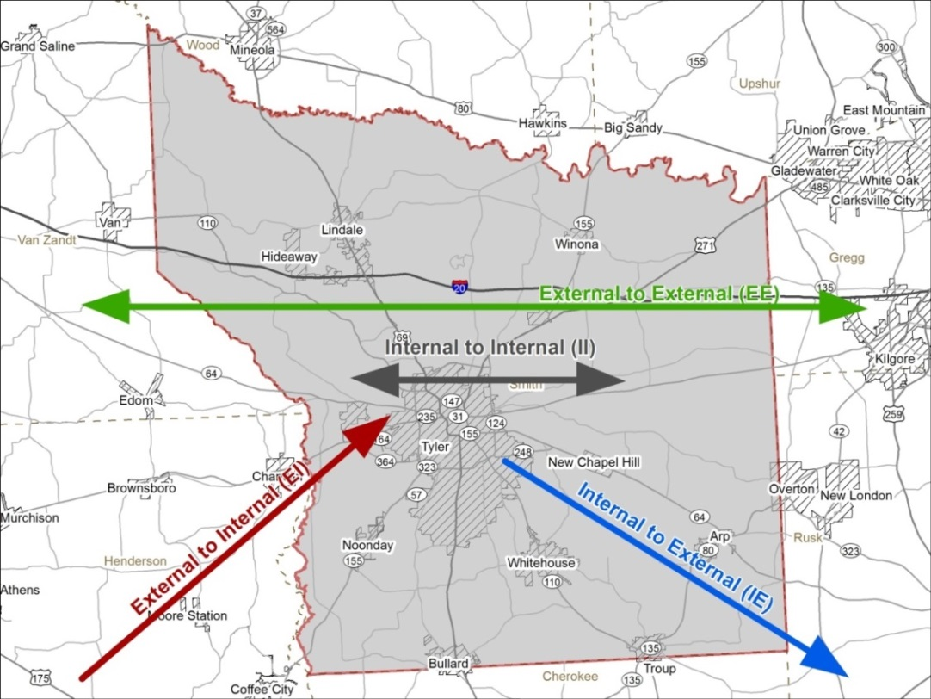
Study Area and Overview
Trial external travel survey using cell, GPS, Bluetooth (BT)
Tyler MPO, Smith County, Texas
Conducted Spring 2014
Focused on:
external trips, E-E, E-I/I-E
average weekday trips
Purpose: To determine if cell and GPS data are viable for use in TxDOT external surveys
Tyler
Notes:
Be sure and define E-E, E-1, I-E

Slide 3
Key Study Objectives
To Compare:
E-E trips between BT, cell, and third party GPS
Commercial/freight E-E trips between BT and GPS
E-I/I-E matrices between cell, GPS, and Tyler model
Trip length frequency’s (TLFs) between cell, GPS, and Tyler model
Study results (where possible) to Tyler’s 2004 external survey results

Slide 4
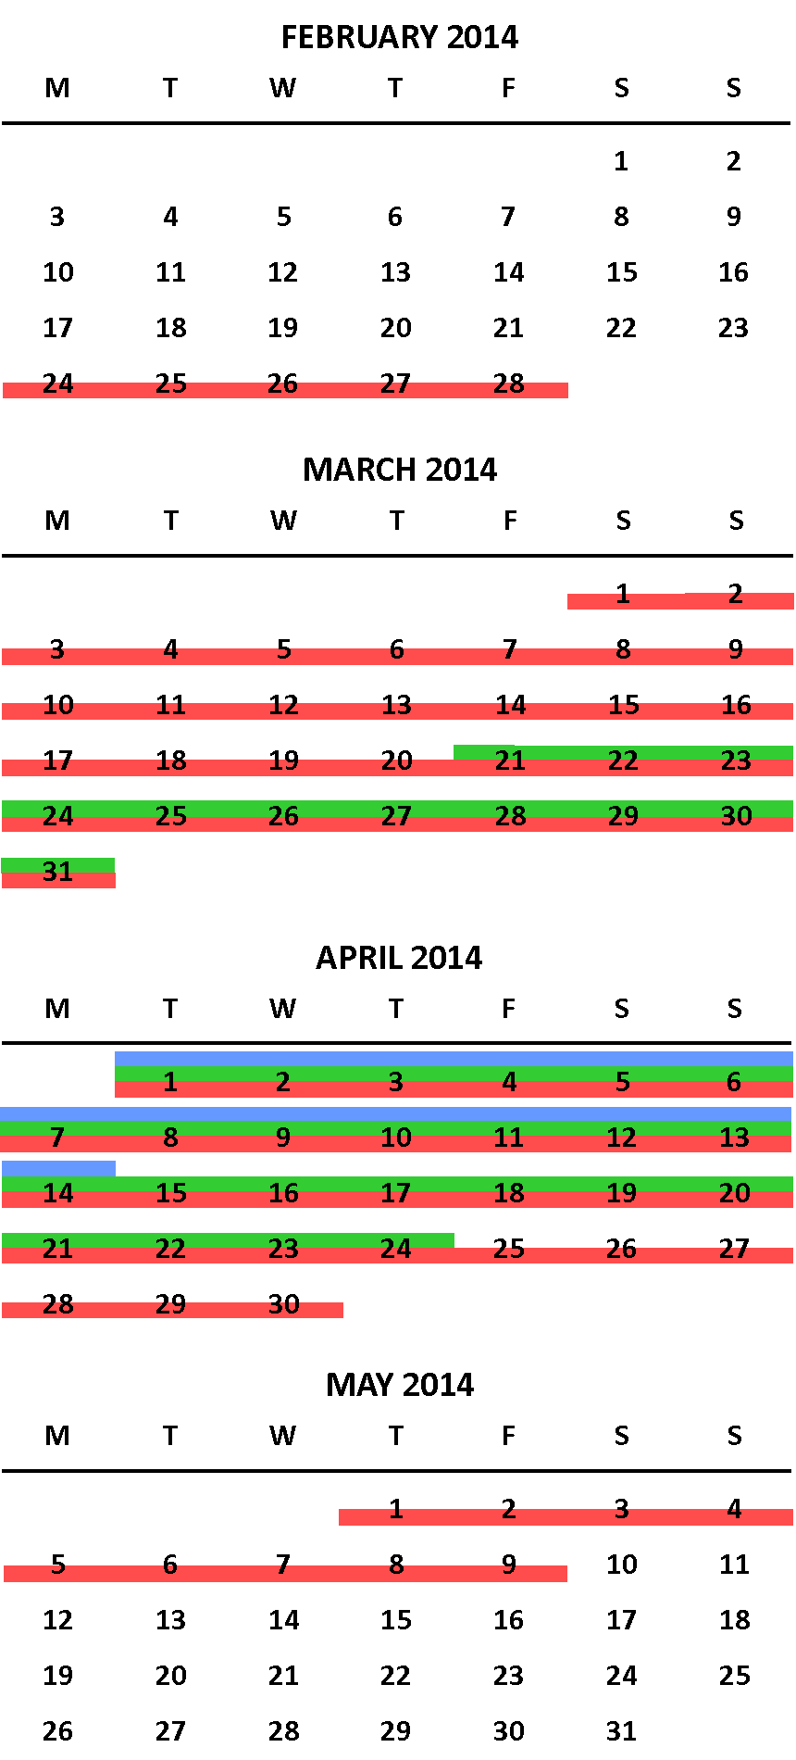
Data Collection/Capture Time Periods
Bluetooth - 2 weeks, April 1-April 14
Cell - 4 weeks, March 21-April 24
GPS - 3 months, February 24 – May 9

Slide 5
Study Area Zones and Capture Areas
420 MPO zones aggregated to 307 cell capture zones
18 Exterior cell data capture areas created
10 mile GPS buffer area utilized
Notes:
Aggregation of internal TAZs based on Airsage’s recommended 500mx500m min size for cell capture

Slide 6
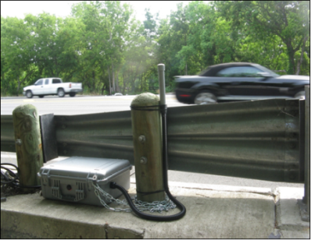
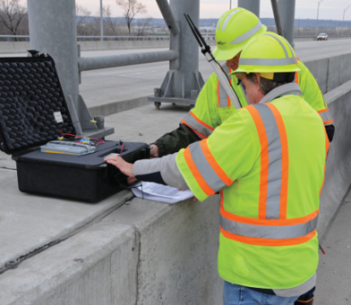
Bluetooth Data Collection
TTI BT technology and E-E data collection vetted, well tested
GPS and Cell E-E results compared against BT E-E
BT and class count data collected at 20 external stations
Obtained E-E data and percent ‘local’ vs. ‘through’ trips by site
Notes:
Wireless technology for exchanging data over short distances
BT frequently embedded in mobile phones and in-vehicle navigation systems
Every BT device has a unique Media Access Control (MAC) address
Commonly used in developing travel time and speed estimates
BT devices can be detected anonymously

Slide 7
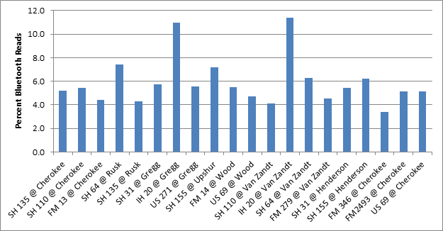
Bluetooth Detection and E-E Matching
Over 170,000 BT observations during study period
24,500 ave. weekday E-E matches
4,000 per ave. weekday matches with time constraints
E-E matches exceeding time constraint removed
BT detection ranged from about 4% to 11%
Matches expanded and balanced to create E-E matrices

Slide 8
Cell Data Basic Overview
198,000 unique resident devices; 17% residential sampling rate
Ave. of 180 device sightings per day
Device trips considered person trips
Data expanded to census tract of device home to account for different penetration rates
Data then must be balanced to traffic counts by client
Notes:
Acquired 1 month of data for 325 zones
Ave. weekdays and weekends
AM and PM peaks, 24-hour totals
HBW, HBO, OBO
Residents vs. visitors
expanded to census tracts of device home location

Slide 9
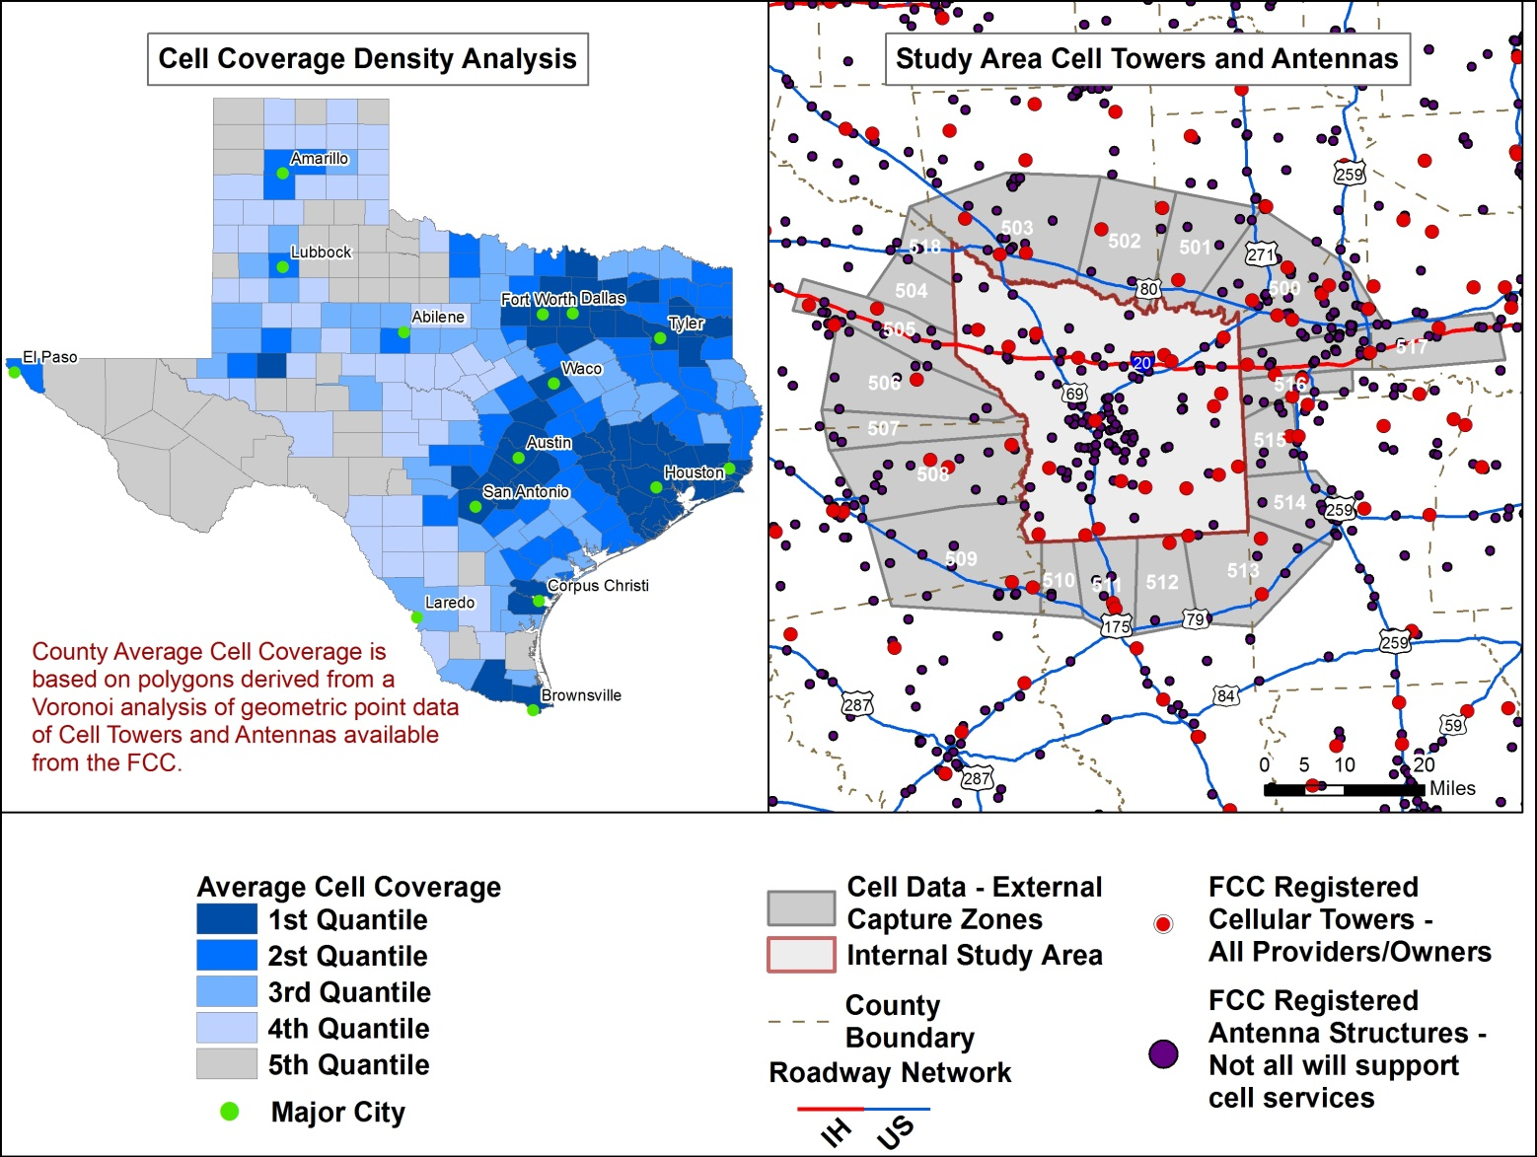
Tyler Area Cell Coverage
Notes:
Used voronoi analysis to look at cell coverage density in Texas
Smith County is # 16 out of 254 counties in Texas

Slide 10
Cell Data Processing, Analyses
Acquired 1 month of data for 325 zones
Data review/processing items:
Removing trips that did not cross study boundary
Defining residency
For E-E: developed trip matrix, counts by station, percent resident vs non-residents by station
For E-I/I-E: developed matrix, trip length frequency distributions (TLFD)
Notes:
Acquired 1 month of data for 325 zones
Ave. weekdays and weekends
AM and PM peaks, 24-hour totals
HBW, HBO, OBO
Residents vs. visitors

Slide 11
GPS Data Background
TTI /INRIX coordinated on
method to process raw GPS data to develop external O-D trips
elements and specifications of data
INRIX delivered O-D data files per specs
Data delivered in 10- minute increments
GPS datasets: freight, cars, apps
‘All vehicle types’ used for most comparisons

Slide 12
GPS Data Processing, Analyses
Sampled about 1.6% of traffic stream
Extra checks, steps needed to ensure anonymization did not result in misclassification of E-E, E-I, and I-E trip types
TTI analyzed files to develop E-E, E-I/I-E trip matrices and count totals by station
Data expanded to counts and matrices balanced
Same E-E time constraints as used for Bluetooth

Slide 13
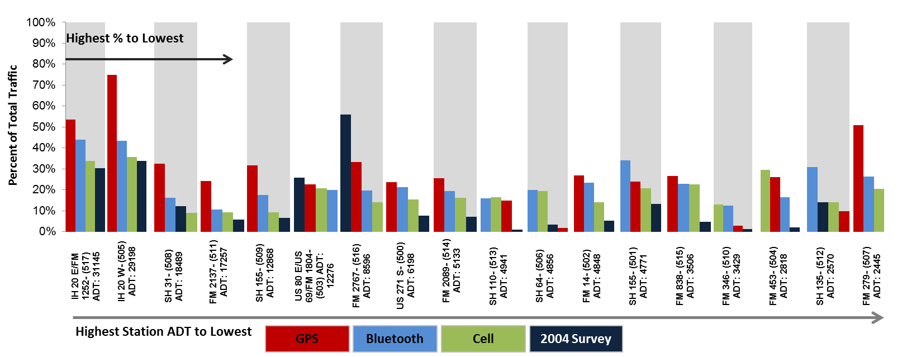
External-to-External Results All Vehicles
Notes:
% of E-E trips to total traffic at each station
Stations organized left to right hi to lowest volume
Results from 2004 survey reflect poor sampling rates and lesser traffic volumes and development
We have highest level of comfort in BT results
GPS generally shows highest E-E results – thought this is partially due to its bias toward commercial vehicles
In most cases cell lower than BT and GPS
Cell shows least amount of variation in %ages across stations

Slide 14
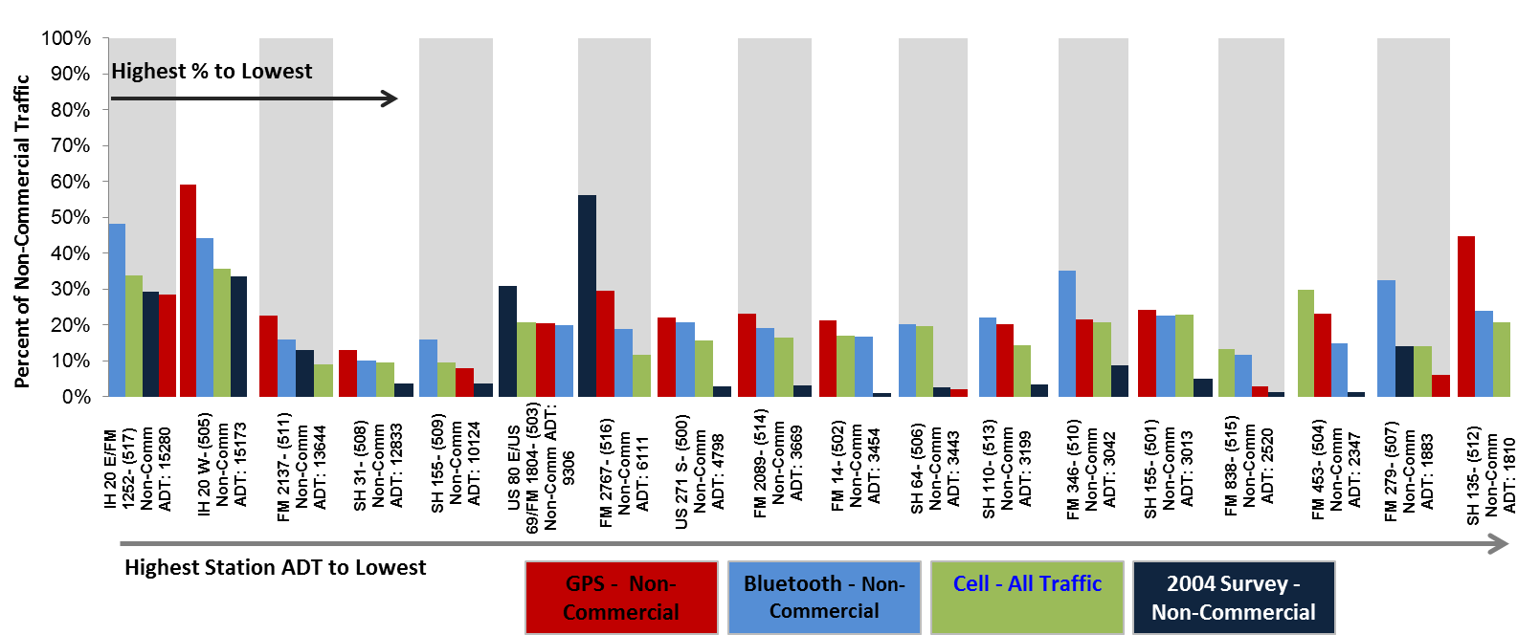
External-to-External Results Non-Commercial Vehicles
Notes:
When we remove freight from the GPS data, you cell see it reduces the GPS trips
However, remember there is some freight/commercial reflected in data
GPS slightly better correlated with GPS results

Slide 15
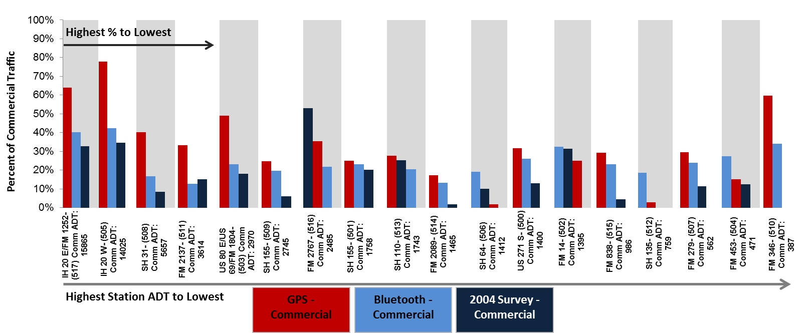
External-to-External Results Commercial Vehicles
Notes:
BT commercial based on VCCs at stations

Slide 16
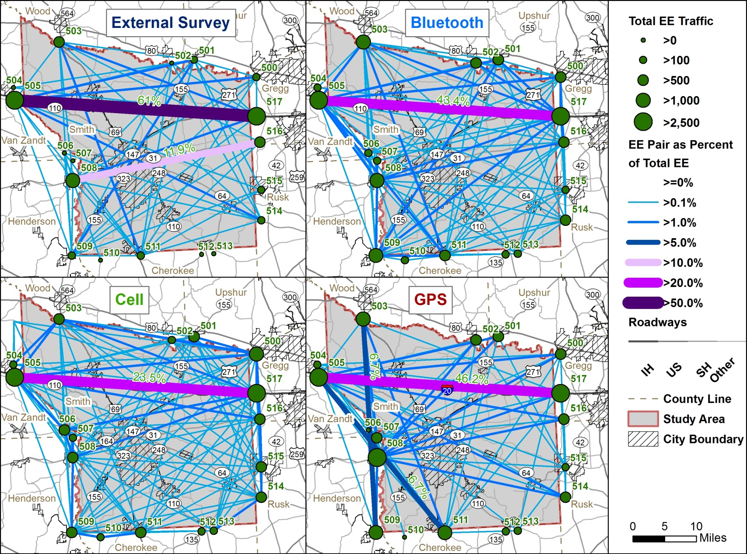
E-E Results
Notes:
BT and cell most similar, good correlation between I-20 results
Cell shows slightly more trips between periphery zones, assumed to be caused by the margin of accuracy
GPS seems to show fewer E-E trips between low volume sites, and slightly more on major roads (commercial bias)

Slide 17
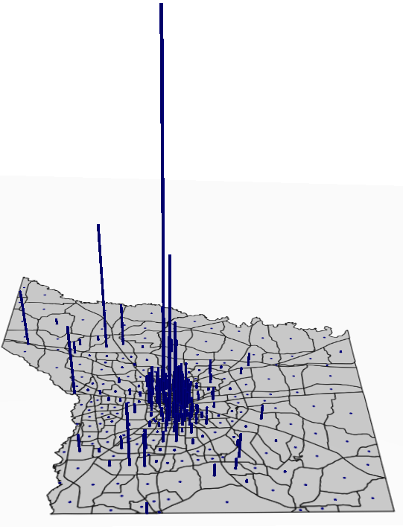
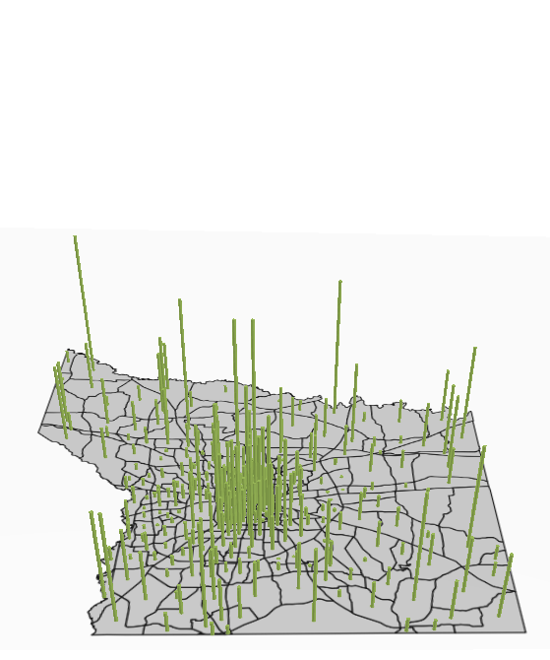
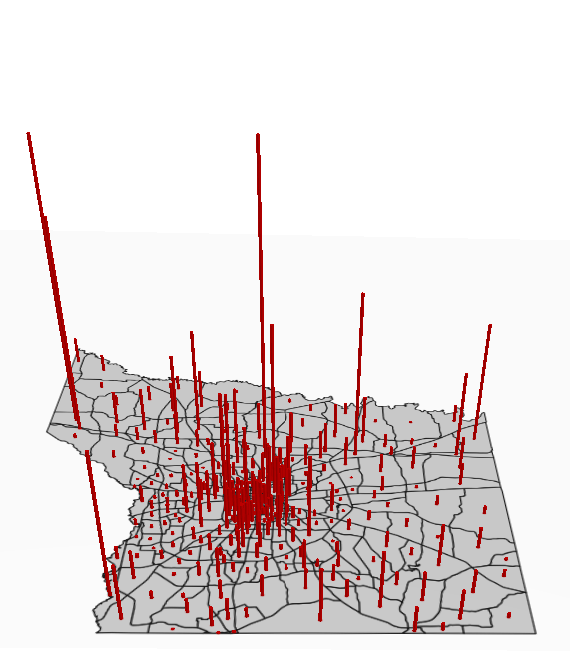
E-I/I-E Results – Total Trips Saturation/Distribution across Internal TAZs
Max Value = 13,500
Max Value = 4,900
Max Value = 3,500
2004 Survey Data
Cell Data
GPS Data
Notes:
Shows distribution, tells nothing about volume
Cell and GPS better distributed that 2004, better sample pop.
Each EE Pair as a Proportion of TOTAL EE Flows
Max value at GPs is a truck stop, GPS shows trips along I-20
What is total # of trips by tech.
Concerns for cell trips in periphery zones of study area
2004 data results in CBS due to low sampling

Slide 18
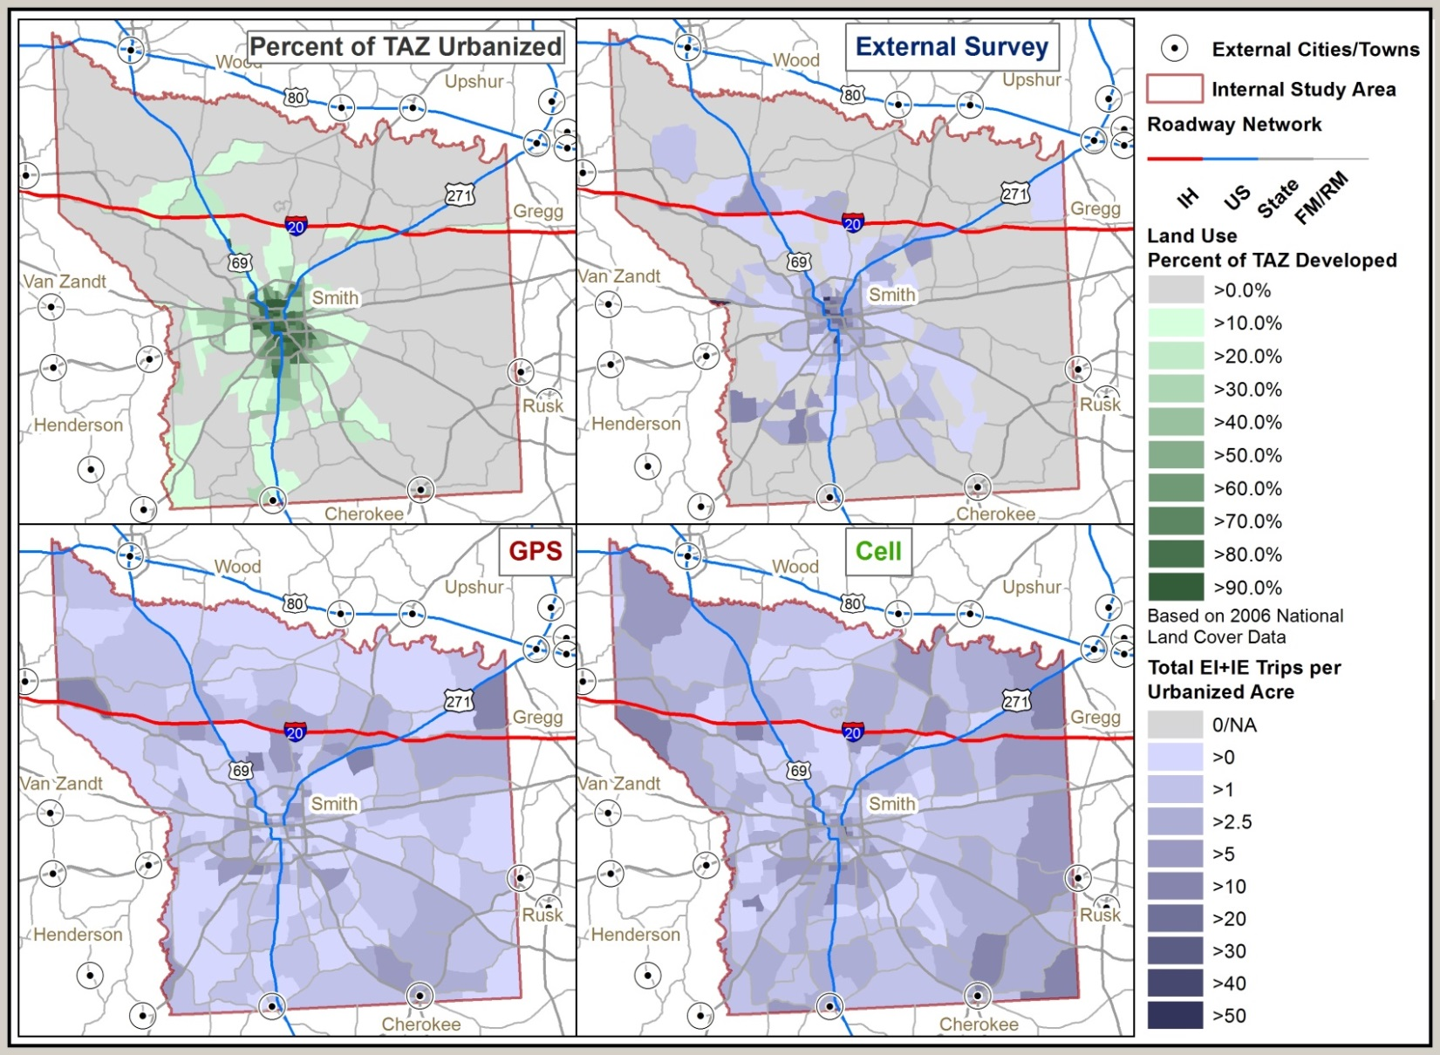
External-to-Internal Results Trips per Urbanized Acre

Slide 19
Residency by Station Comparison of 2004 Results to 2014 Cell Data
Notes:
Residency of cell correlates well with 2004 survey results

Slide 20
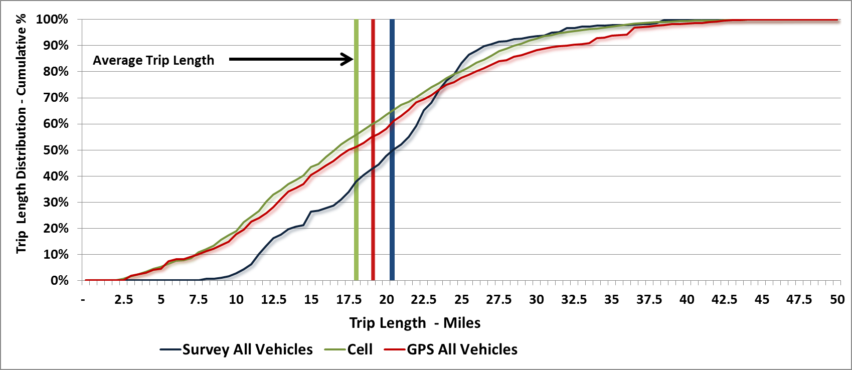
E-I/I-E Trip Length All Stations – All Vehicles
K-S Test
p-value << 0.01
Notes:
TLF appears to be similar, but statistically but they are not
Ave. trip length for GPS slightly higher…perhaps due to commercial bias
However, more variation in TLFD at individual stations

Slide 21
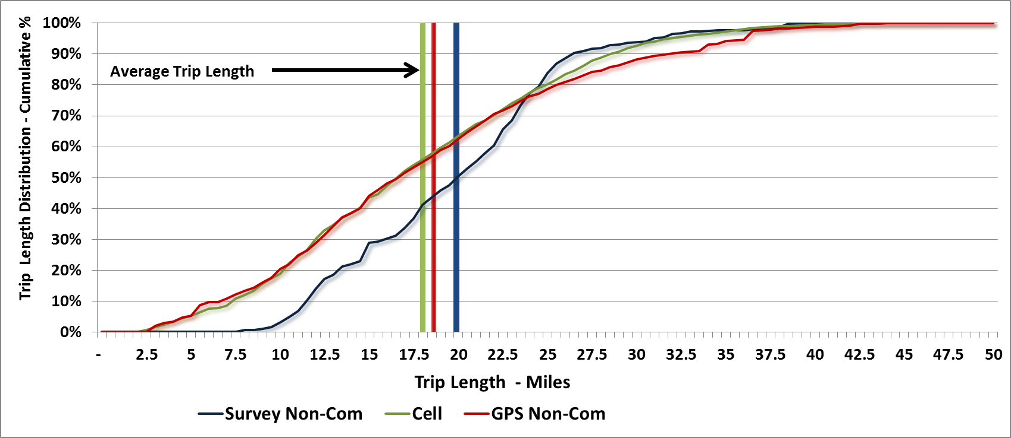
E-I/I-E Trip Length All Stations – Non-Commercial Vehicles
K-S Test
p-value << 0.01
Notes:
TLF appears to be similar, but statistically but they are not based on 2 sample Kolmogorov-Smirnof test
Ave. trip length for GPS slightly higher…perhaps due to commercial bias
However, more variation in TLFD at individual stations

Slide 22
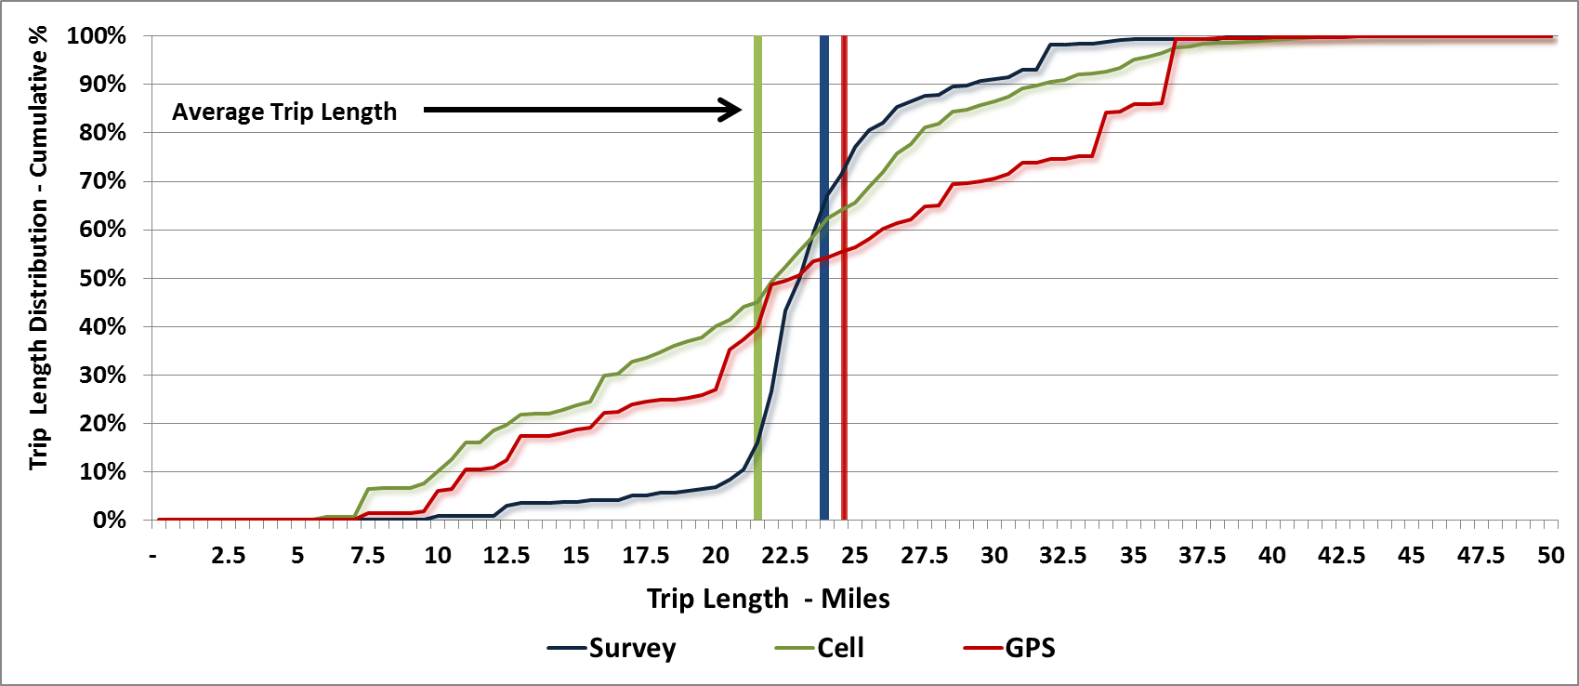
E-I/I-E Trip Length IH-20
Notes:
More variation in cell and GPS on GPS. GPS now exceeds the 2004 survey

Slide 23
General Findings Conclusions E-E
TTI - highest comfort level with BT
Cell
generally lower than BT and GPS
Questionable trips at periphery between capture zones
Good results for resident vs. non-resident
GPS
Higher comfort level with freight E-E
Non-freight will improve as sample size increases
Correlates well with BT results
Notes:
Generalized approach – multi-faceted to develop external trip estimates.

Slide 24
General Findings Conclusions E-I/I-E
Cell
Geographic distribution appears good; some questionable trip ends in rural periphery zones
Lack of positional accuracy impacts smaller urban and rural TAZs
GPS
Geographic distribution appears good, though commercial vehicle bias evident
Non-commercial OK but will improve with sample size over time
GPS accuracy impacted by anonymization
Notes:
Generalized approach – multi-faceted to develop external trip estimates.

Slide 25
General Findings Conclusions Overall
Methods/technologies still evolving
Combination of technologies and providers best approach for external data (currently)
Cell data probably better suited for larger studies areas
Third party GPS appears to be viable option
especially as sample sizes increase
more trials needed
Notes:
The methods and technologies for collecting external data are improving but still evolving.
Right now a combination of these technologies is the best approach considering the different aspects and components of travel collected. For example, with GPS data you can get O-D info by commercial/non-commercial and with cell you can get resident vs. non resident info.
Poor positional accuracy of cell data can impact results, so the larger the study area – the better for cell.
The quality and the sample penetration of GPS data continues to improve, so as time goes on it will become even a better option for external data capture.
This study was for a small/mid-sized MPO.
Comparison of cell, GPS, and BT O-D data is needed for a large metro MPO like DFW – and also for long distance travel. Like the Tyler study, these studies would be the ‘first-of-their-kind’ and would be very valuable to MPOs and DOTs.
If a study were done in DFW that also included studying long distance travel one or two of the interstates through this area, TxDOT may – depending on results – be able to resume the external data collection for MPOs in Texas.
With the Tyler study, TxDOT is now viewed around the country as one the leaders in using new technology for O-D and how best to collect external data for modelling.

Slide 26
Acknowledgments and Special Thanks!
Bill Knowles
Janie Temple
Charlie Hall
Bill King
Vijay Sivaraman
Rick Schuman
Andrew Davies

Slide 27
Questions?
For more Information:
Ed Hard
e-hard@tamu.edu
(979)845-8539
Byron Chigoy
b-chigoy@ttimail.tamu.edu
(512)407-1156
Praprut Songchitruksa
praprut@tamu.edu
(979)862-3559
Steve Farnsworth
s-farnsworth44@tamu.edu
(979)862-4927

