Slide 1
Use of the General Transit Feed Specification (GTFS) in Transit Planning
Hejun Kang, Fairfax County Department of Transportation
Charles Baber, Baltimore Metropolitan Council
May 20, 2015

Slide 2
Overview
Background
Transit Propensity Index
GTFS-based Transit Access Analysis
Results
Conclusion

Slide 3
Background
Key question - “Where should transit service be provided ?”
Transit Use Propensity (TUP) Index
Developed based upon demographic groups who are likely to use public transit
A higher TUP score indicates a higher propensity to use transit

Slide 4
Transit Use Propensity (TUP) Index
The TUP index combines 8 strongest demographic indicators of transit demand (TCRP Report 28)
Zero vehicle housing units
Mobility limitations (going outside the home)
Work disability
Minorities (not “White alone, non-Hispanic/Latino”)
Recent immigrants (< 10 years)
Low income households (< $20,000)
Females
Population density

Slide 5
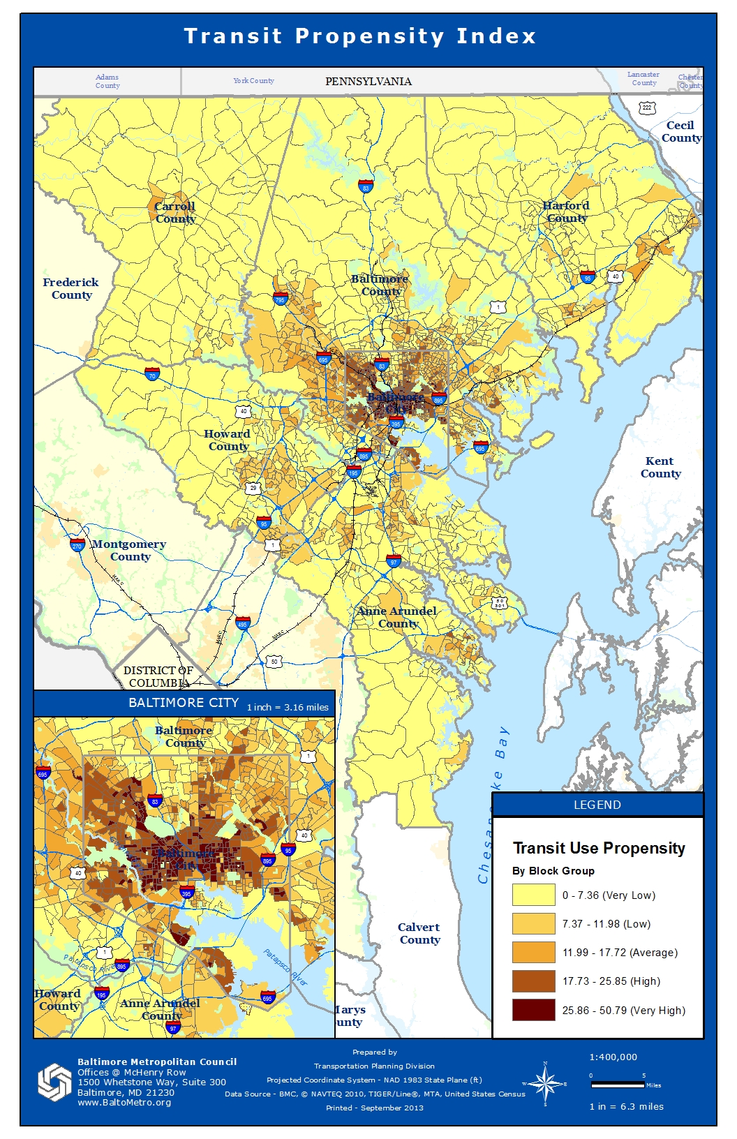
Transit Propensity Index

Slide 6
Jobs at Downtown employment center by NAICS code

Slide 8
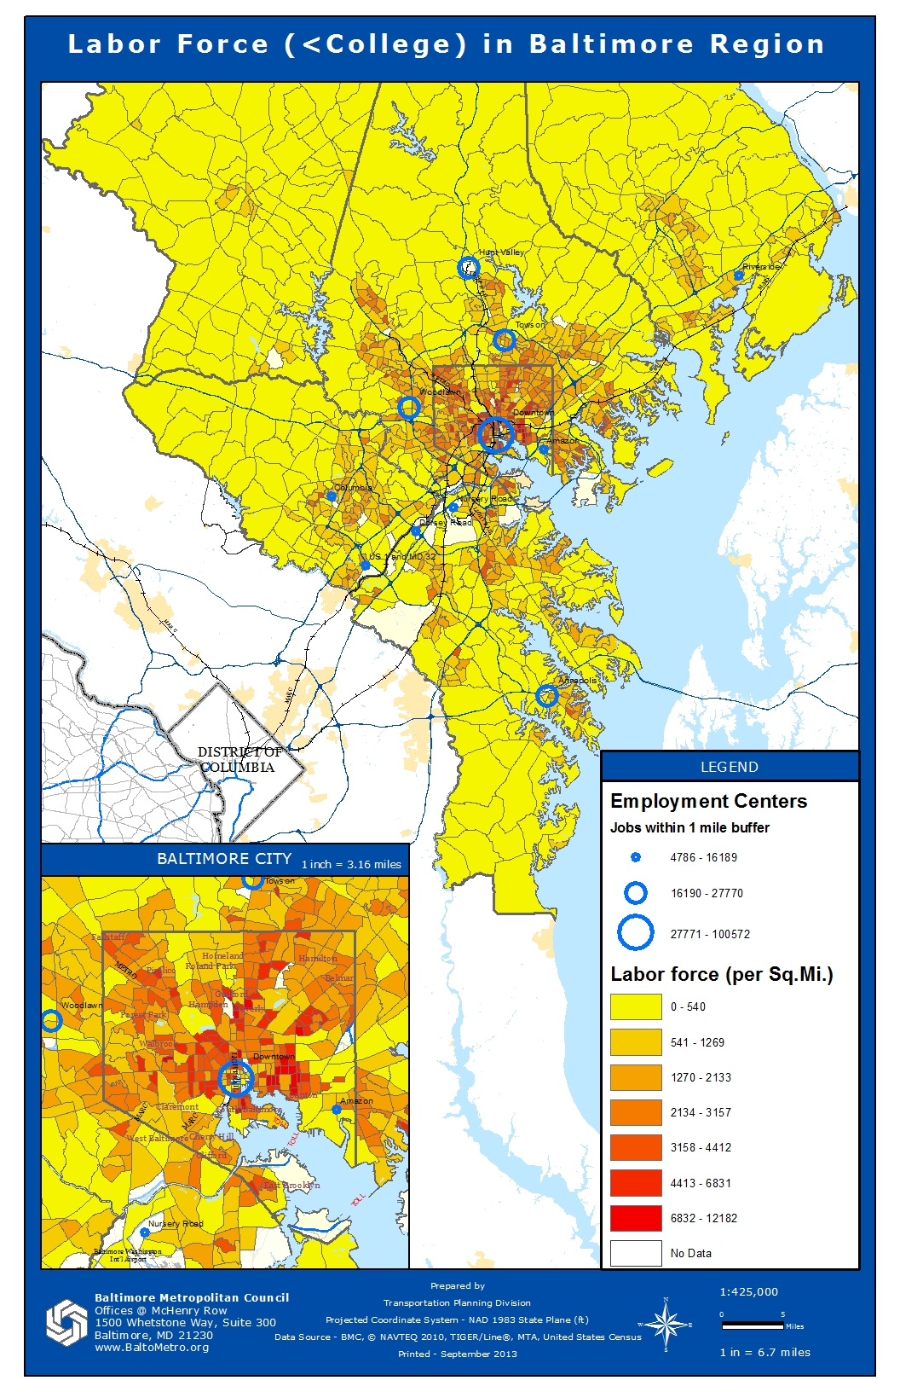
Labor Force Density (Less than College Degree)

Slide 9
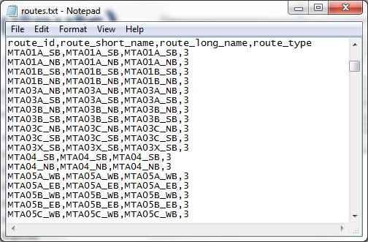
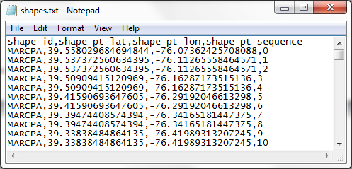
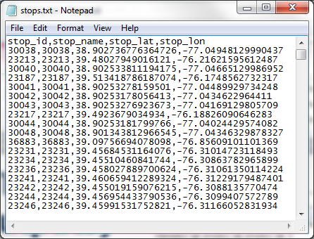
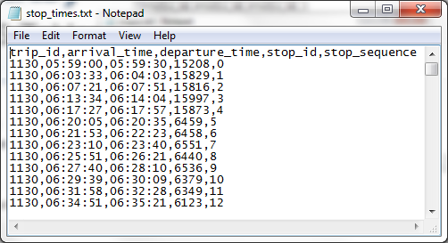
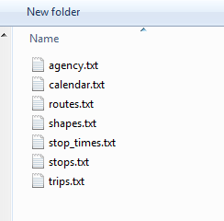
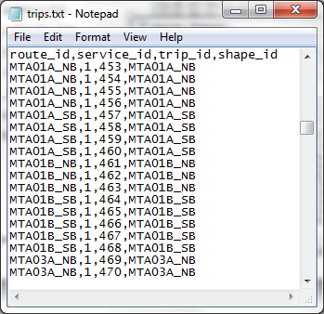
GTFS DATA
GTFS Tables

Slide 10
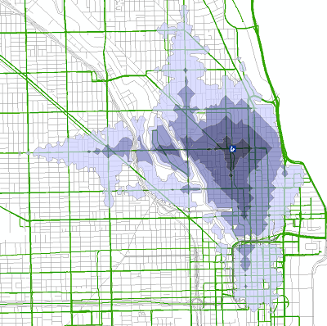
Method
Step 1: Adding GTFS to a Network Dataset
Free ESRI toolkit
Step 2: Use the standard network analysis tool

Slide 11
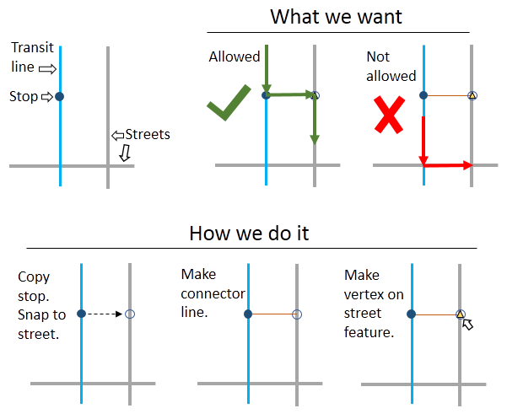
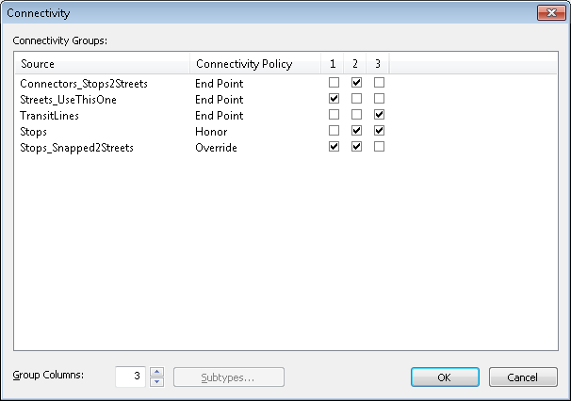
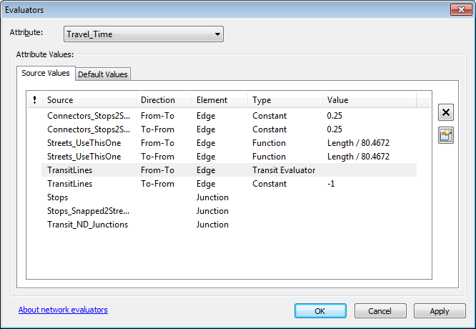

Slide 12
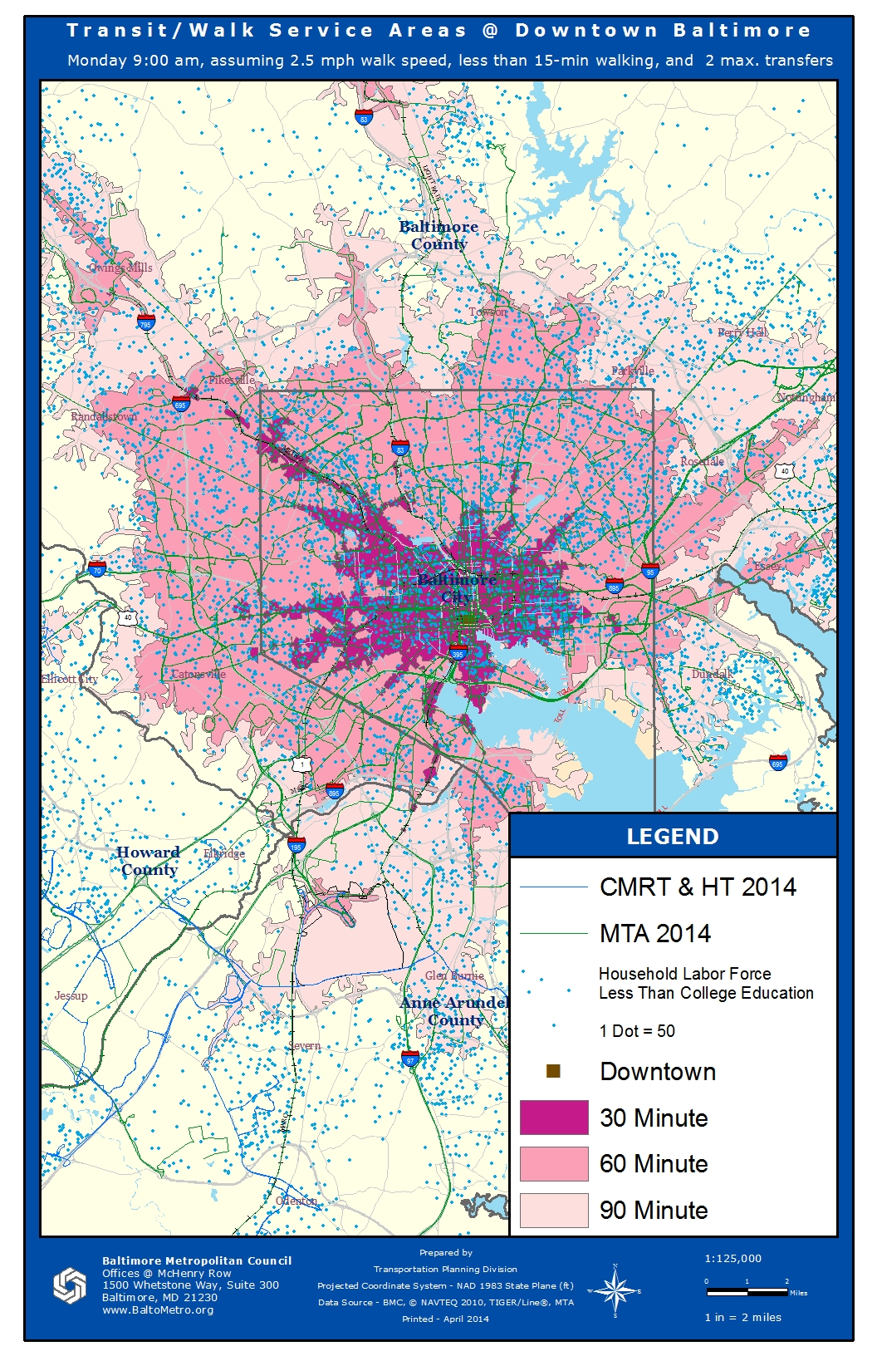
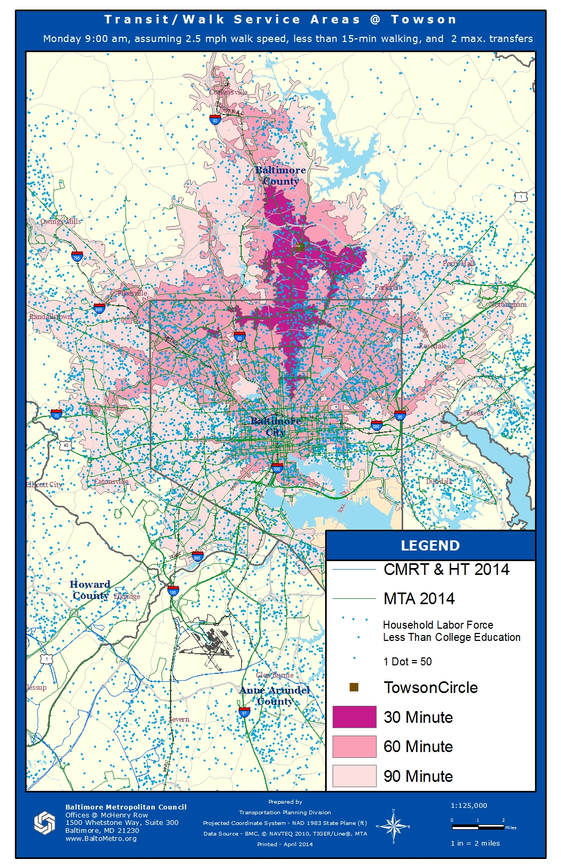
Results: Transit/Walk Access
Transit/walk service access towards the Downtown employment center

Slide 13
Results: Labor Force Transit/Walk Access
Labor force access to the Downtown employment center

Slide 14
Results: Labor Force Transit/Walk Access
Labor force access to the Towson employment center

Slide 15
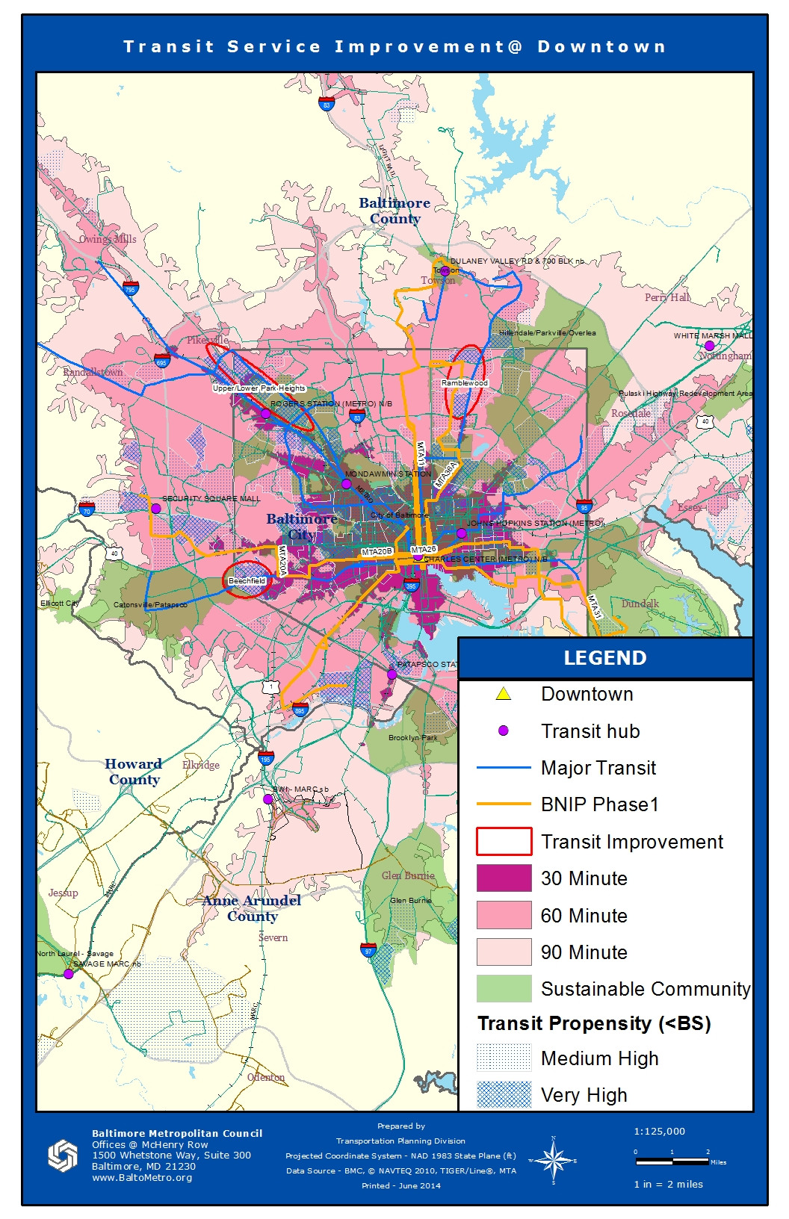
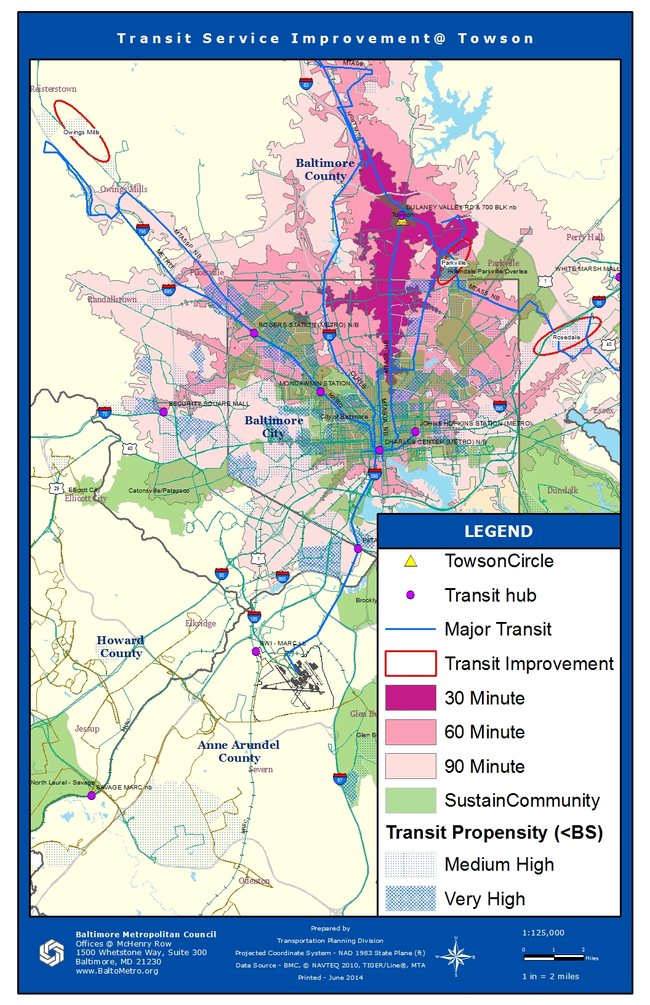
Recommendation

Slide 16
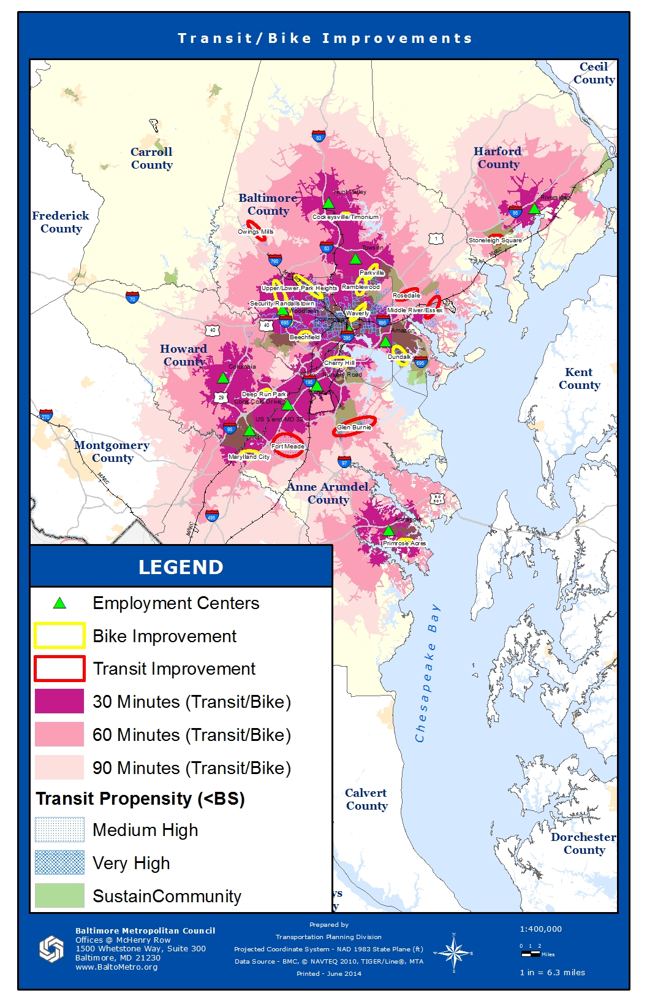
Transit/Bike Improvement

Slide 17
Conclusions
GTFS data are helpful to identify areas for transit improvement, recommendations of which depend on vary across employment centers
Access to jobs can also be enhanced through improved last-mile connections (i.e., biking).

Slide 18
For More Information
Hejun Kang
703-877-5610
hkang2@fairfaxcounty.gov
Charles Baber
410-732-0500 Ext. 1056
cbaber@baltometro.org

