Slide 1

Development of the Idaho STDM Trip Matrices Using Cell Phone OD Data
15th TRB Transportation Planning Applications Conference
May 19, 2015

Slide 2
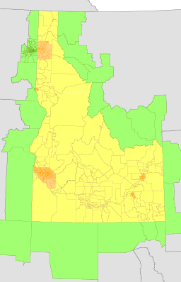
Agenda
Topics
  Idaho Statewide Travel Model
  Cell Phone OD Data
  OD Matrix Estimation
  Discussion
Idaho Statewide Travel Demand Model Zones

Slide 3
Idaho Statewide Travel Demand Model

Slide 4
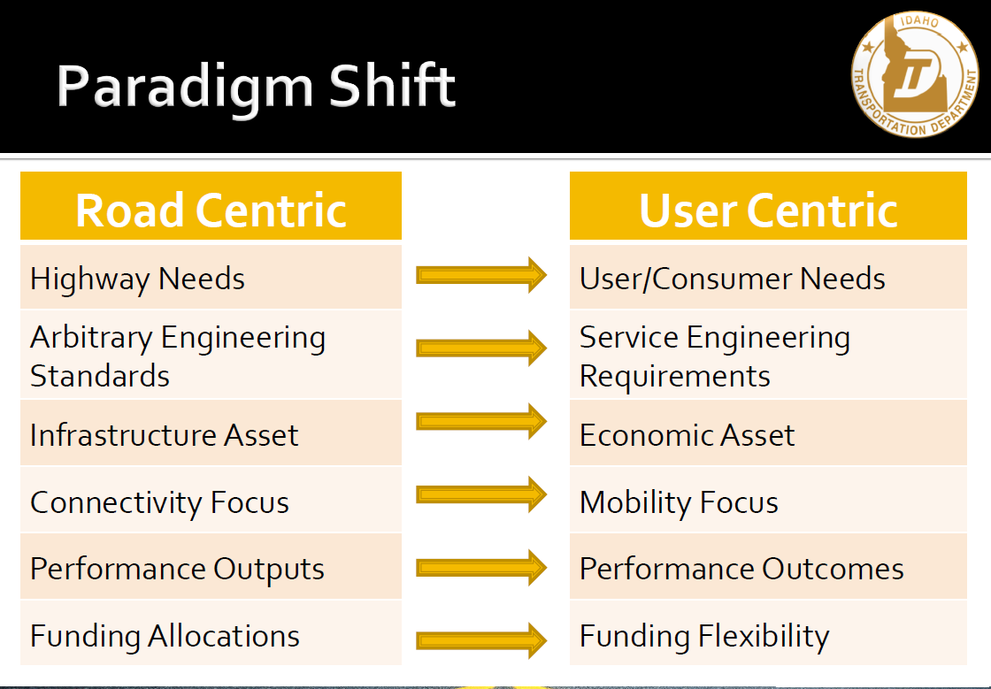
Statewide Travel Demand Model
Why?
Statewide Travel Demand Model (STDM) project started in 2013
As part of ITD’s data-driven, performance-based needs analysis approach
Key model requirement is to forecast auto and truck traffic and network LOS

Slide 5
Network
Started from ITD’s GIS system so LRS coding is maintained in order to join to external data sets
Stitched-in MPO networks and FHWA’s network for areas beyond the state
Built in Cube

Slide 6
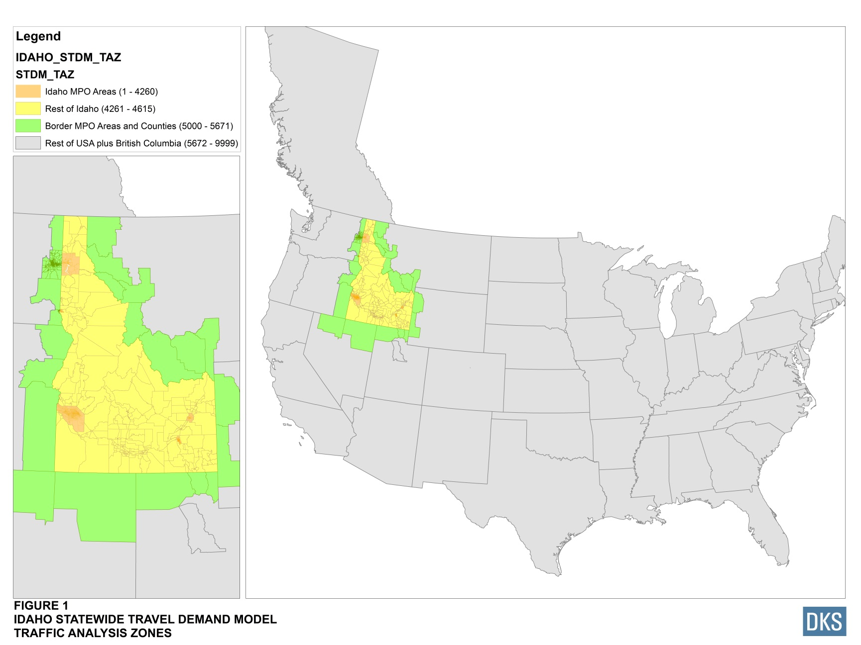
Zone System
Uses MPO zone systems and land use forecasts in order to be consistent
Uses Census + Woods & Poole for other areas
Developed the 4000+ zones in conjunction with MPOs and ITD District Planners

Slide 7
Zone System
MPO zones ~3200
Non-MPO ~350
Buffer area ~600
Remaining US + CA ~55
Total zones 4200+

Slide 8
Estimating Travel Demand
ITD believes in agile development
And since developing a new statewide model is a big undertaking, the project has two phases:
  Phase 1 - we used cell phone origin-destination location data to synthesize travel demand; not a forecast, but useful for estimating and understanding travel and testing networks and zones as well
  Phase 2 – implement models based on surveys and other data that forecast travel based on land use
Cell phone OD data used for external travel estimates as well in phase 2

Slide 9
Phase 1 Model
Cell phone OD matrices and traffic counts
OD Matrix
Estimation
Auto
Truck
Auto trips
Truck trips
Performance
Measures
Network Assignment
Volumes by user class, LOS measures
TREDIS Economic Model
SYSTEM USERS
Auto
Truck

Slide 10
Phase 2 Model
Socioeconomic and FAF data
Person Transport
Freight Transport
Long distance
Short distance
Long distance
Short distance
Non-work trips
Commute and
non-work trips
Commodity flows
Truck trips
Performance
Measures
Network Assignment
Volumes by user class, LOS measures
TREDIS Economic Model
SYSTEM USERS
Tourism*
Employment
Long-haul
Short-haul
Retail
Agriculture*
Agriculture*

Slide 11
Cell Phone OD Data

Slide 12

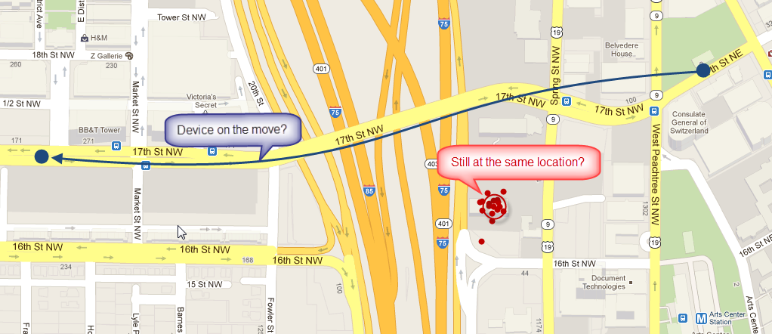
Cell Phone OD Data
AirSage converts cell phone time and location data into trip OD data
Has exclusive agreement with Verizon and others to aggregate and sell the cell phone location data
Extracts the time and location of the cell phone every time it talks to the network - email, texts, phone calls, location, etc.
Identifies cell device usual home and work location based on the cluster of points identifying where the phone “sleeps” at night and “works” during the day

Slide 13
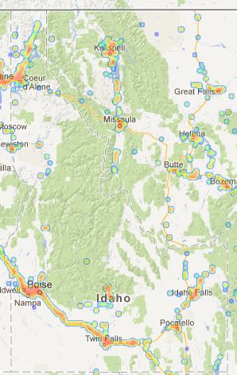
Cell Phone OD Data
Trips are coded with respect to the home and work anchor locations:
  Home-based work
  Home-based other
  Non-home-based
  Resident versus visitor
AirSage expanded the sampled trips to better match the population using various Census data sets
Idaho Cell Coverage

Slide 14
Cell Phone OD Data Purchase
Calendar: Average weekday for the month of September 2013
Markets: Resident HBW, HBO, NHB; Visitor NHB
Time period: Daily
Zones: 750 x 750 super zones to reduce cost
Price: Reasonable
License: Data licensed only for the project; derivative products can be used for other purposes though

Slide 15
Disaggregation to Model Zones and Initial Network Assignment
Disaggregated the 750 zones to 4000+ zones using each model zone’s share of super zone
(pop + 2 * emp)
Results in daily raw cell phone flows between model zones for four markets
Assigned cell phone “trips” through the network using free flow travel time
Compared available trip length data to check results

Slide 16
Cell Phone HBW and Census JTW Trip Lengths
Statewide
Non-MPO Idaho
Similar results within each District as well

Slide 17
Cell Phone OD and COMPASS MPO Survey Trip Lengths
HBW
HBO
NHB
Coincidence Ratio and Average Trip Length Difference by Trip Category
Trip Category | Coincidence Ratio | Average Trip Length (Miles) |  | Avg. Trip Length Difference | % Difference
 |  | COMPASS | AirSage
HBW | 0.72 | 8.65 | 8.84 | 0.19 | 2.20
HBO | 0.91 | 4.94 | 5.33 | 0.39 | 7.89
NHB | 0.68 | 4.19 | 6.24 | 2.05 | 48.93

Slide 18
Census JTW to Cell Phone Resident HBW Trips
Would expect around 2 cell phone trips for each Census work journey
The proportion of Census JTW to AirSage trips should be around 0.5
This is essentially the case, as shown in the figure to the right, when summarized for all zone pairs
The unexplained exception around 1.6 is flows to/from the state of Utah → external station / zone definition issues
Census JTW / AirSage Trips by OD Pair

Slide 19
Trip Length Differences by District and Trip Type
District | Trip Category | Coincidence Ratio | Average Trip Length (Miles) |  | Avg. Trip Length Difference | % Difference
 |  |  | Census JTW | AirSage
1 | Internal-Internal | 0.89 | 15.18 | 15.03 | -0.15 | 0.99
 | MPO Resident | 0.98 | 8.08 | 8.43 | 0.35 | 4.33
 | Non-MPO Resident | 0.89 | 28.69 | 30.60 | 1.91 | 6.66
2 | Internal-Internal | 0.81 | 22.03 | 23.00 | 0.97 | 4.40
 | MPO Resident | 0.89 | 10.67 | 13.16 | 2.49 | 23.34
 | Non-MPO Resident | 0.78 | 29.35 | 30.68 | 1.33 | 4.53
3 | Internal-Internal | 0.92 | 10.48 | 10.76 | 0.28 | 2.67
 | MPO Resident | 0.92 | 8.92 | 9.61 | 0.69 | 7.74
 | Non-MPO Resident | 0.78 | 24.17 | 26.74 | 2.57 | 10.63
4 | Internal-Internal | 0.78 | 20.72 | 21.01 | 0.29 | 1.40
 | MPO Resident | - | - | - | - | -
 | Non-MPO Resident | 0.78 | 20.72 | 21.01 | 0.29 | 1.40
5 | Internal-Internal | 0.88 | 16.54 | 16.75 | 0.21 | 1.27
 | MPO Resident | 0.89 | 9.95 | 11.24 | 1.29 | 12.96
 | Non-MPO Resident | 0.86 | 25.33 | 24.91 | -0.42 | 1.66
6 | Internal-Internal | 0.82 | 13.37 | 13.47 | 0.10 | 0.75
 | MPO Resident | 0.88 | 8.85 | 9.43 | 0.58 | 6.55
 | Non-MPO Resident | 0.79 | 16.30 | 17.00 | 0.70 | 4.29

Slide 20
Observations from Initial Assignment
Reasonable goodness-of-fit between the cell phone TLFs and the Census JTW and Boise MPO travel survey data sets
Significant differences for NHB trips, especially short distance trips
Why? Most likely classification issues:
  Survey NHB trips are just household-based non-home-based trips, where as the AirSage trips are everything else, including commercial vehicles
  Very short trips in terms of distance and time may drop out of the AirSage data set as well
  Difficult to identify non-home or work-based trips
  Simplified procedure to disaggregate super zone flows to model zones likely creating differences for some OD pairs
Remember we’re comparing processed cell phone movements to person reported travel

Slide 21
Origin Destination Matrix Estimation

Slide 22
Origin Destination Matrix Estimation
Assign initial trip matrices to the daily statewide network using free flow travel time for impedance
Adjust the trip demand matrices to minimize the difference between the estimated link volumes and traffic counts by user class
Check difference between observed and estimated traffic volumes by user class (auto and truck) and facility type
Repeat procedure until acceptable convergence
Traffic Counts by Agency
Count Source | Counts
BMPO | 522
BTPO | 434
COMPASS | 2,811
KMPO | 441
LCVMPO | 500
ITD (only 10% used) | 30,497
Total | 35,205

Slide 23
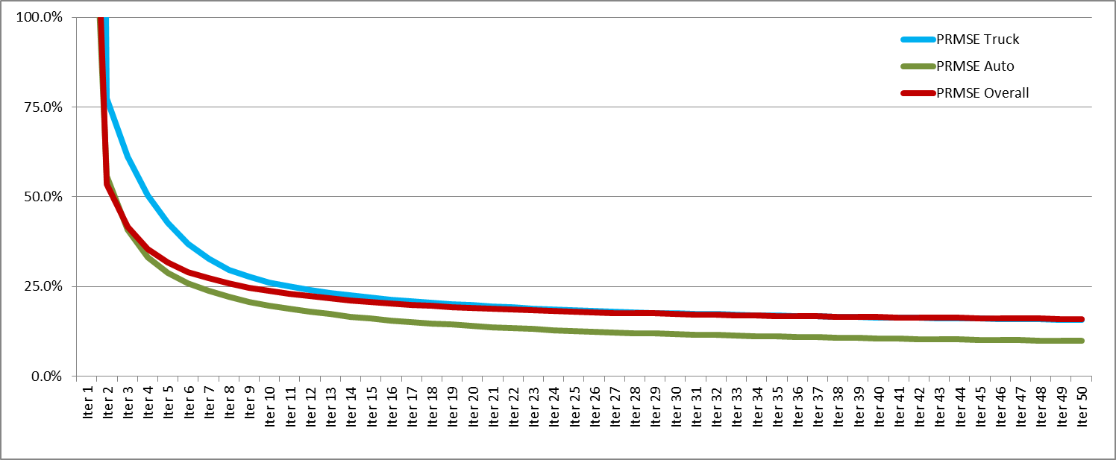
ODME Results
%RMSE (goodness-of-fit measure) by ODME iteration
Final %RMSE: auto 10.0%, truck 15.8%
Truck counts usually percent estimates and initial truck demand is NHB matrix

Slide 24
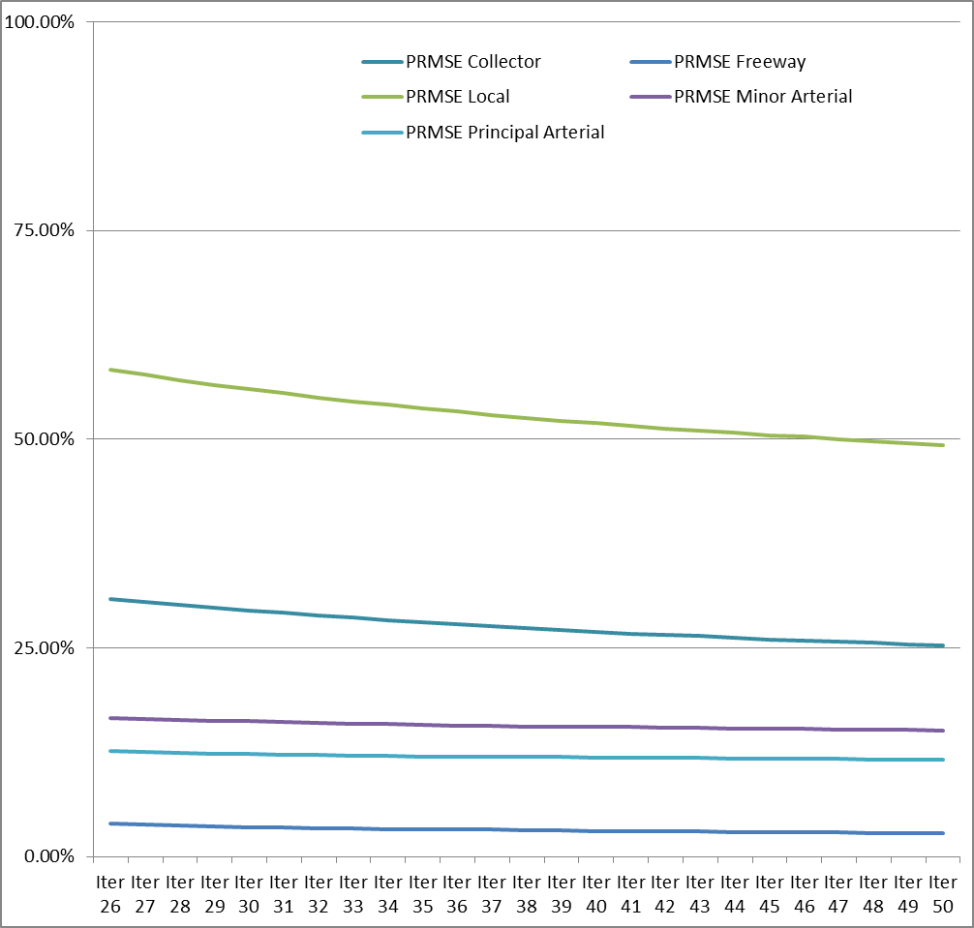
ODME Results
%RMSE by Facility Type
Type | Collector | Freeway | Local | Minor Arterial | Principal Arterial
%RMSE | 25.30% | 2.80% | 49.30% | 15.10% | 11.60%

Slide 25
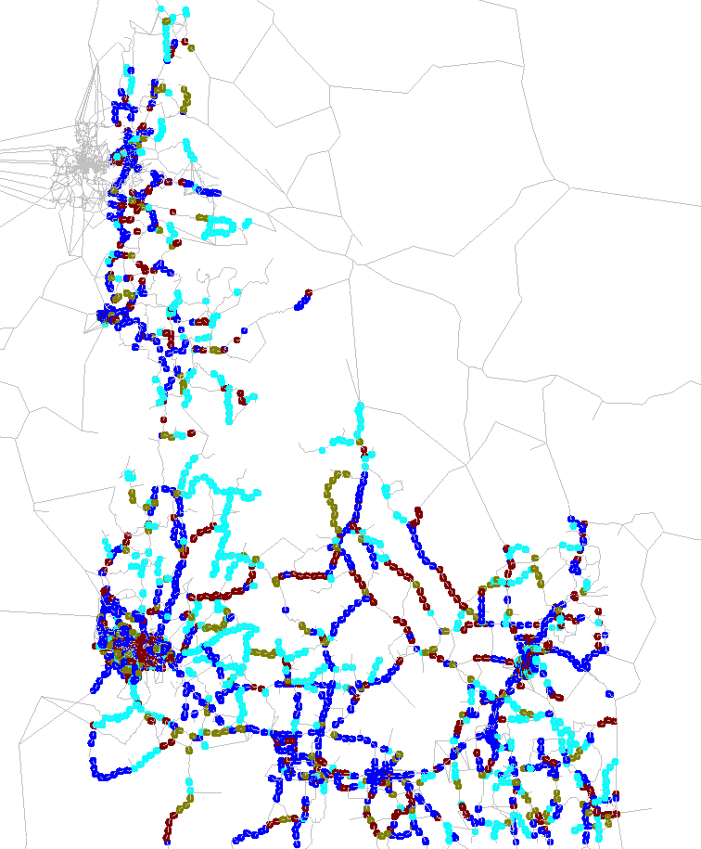

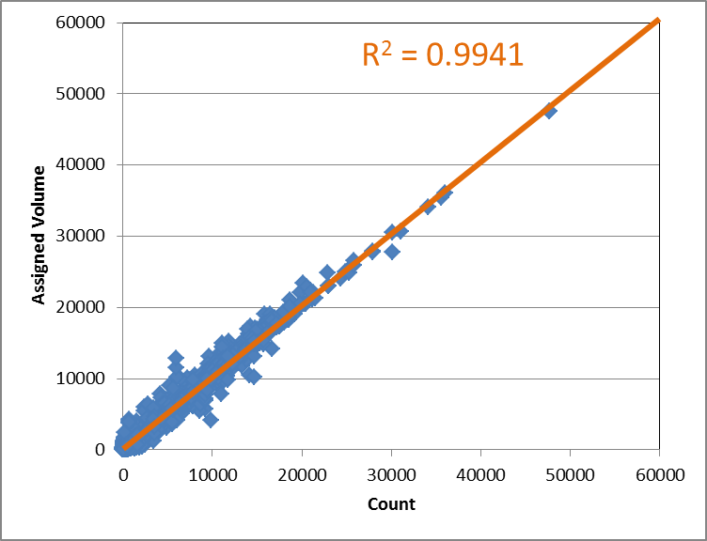
ODME Results
% Difference
Assigned Volumes vs. Traffic Counts

Slide 26
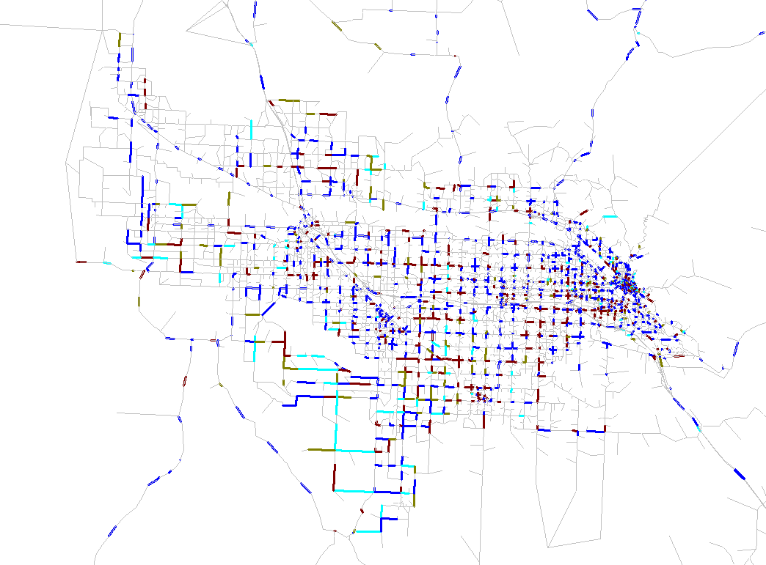
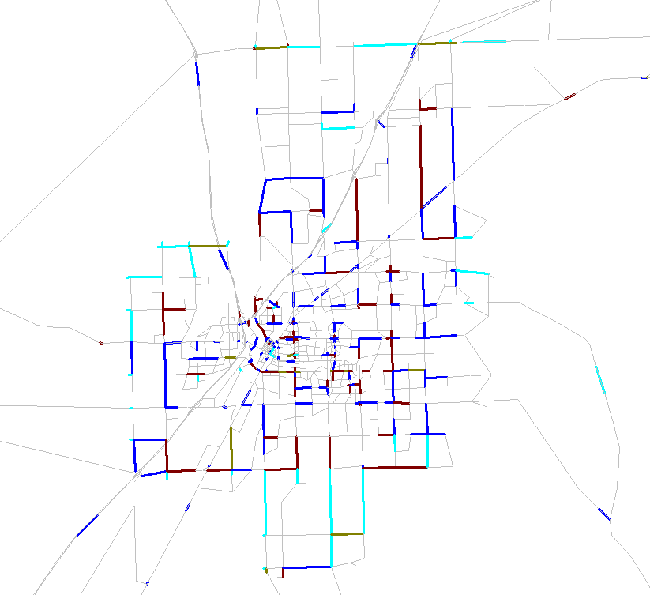
ODME Results
Acceptable results in the MPOs and non-MPO areas as well
All MPOs have similar results to COMPASS
% Difference
COMPASS
Idaho Falls

Slide 27
ODME Results
Reasonable trip length frequency results as well
HBW
NHB
HBO
Visitor

Slide 28
ODME Results
County-to-county HBW flows for COMPASS area
Reasonable goodness-of-fit between synthesized travel demand and limited observed data across multiple dimensions –
user class, facility type, geography
Destination
Origin | Ada |  | Canyon |  | Others
 | Adjusted Trips | Census JTW | Adjusted Trips | Census JTW | Adjusted Trips | Census JTW
Ada | 22.83% | 19.49% | 1.47% | 0.98% | 0.35% | 0.32%
Canyon | 1.89% | 2.83% | 6.00% | 5.32% | 0.21% | 0.26%
Others | 0.29% | 0.83% | 0.17% | 0.36% | 66.79% | 69.62%

Slide 29
ODME Criticisms
ODME “naively” adjusts the travel demand to match the traffic counts
This can result in overfitting
Should only be used for short-term forecasting, in which conditions are similar to today
ODME estimated traffic flows are a best-case scenario for goodness-of-fit since the process explicitly adjusts the input to better match the output

Slide 30
Questions & Discussion

Slide 31
Discussion
ITD wanted an ODME model in order to get components of the system up and running as early as possible and to estimate current year auto and truck volumes
The cell phone OD data is a reasonable starting point for generating statewide trip matrices
Used in conjunction with existing travel modeling tools and techniques, the cell phone OD data has a promising future in our industry
Need to better understand how synthesized cell phone flows are different than traditional travel modeling data sets
The phase 2 demand models only replace some of the travel, so the cell phone trip matrices will still be used to help model external travel

Slide 32
Next Steps
Recently finished implementing the AB person travel model, the FAF-based freight model, and all the Cube-based network procedures
Successfully ran the draft model at ITD a couple weeks ago!
Starting calibration/validation on the phase 2 AB person travel model and FAF-based freight models

Slide 33


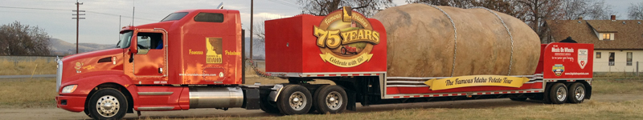
Thanks
Rick Donnelly, DonnellyR@pbworld.com
Ashish Kulshrestha, kulshresthaa@pbworld.com
Bob Schulte, rjs@dksassociates.com
David Tokarski, dmt@dksassociates.com
Joel Freedman, Joel.Freedman@rsginc.com

Slide 34
Contacts
DAVID COLADNER
PRINCIPAL RESEARCH ANALYST
David.Coladner@itd.idaho.gov
208.334.8233
BEN STABLER
SENIOR CONSULTANT
ben.stabler@rsginc.com
503.360.5798
SUJAN SIKDER
TRAVEL DEMAND MODELER
sikders@pbworld.com

