Slide 1
Modeling Every Hill, Bus, Traffic Signal, and Car
How San Francisco Collaboratively Built a Citywide Dynamic Traffic Assignment Model
Elizabeth Sall, Greg Erhardt, Lisa Zorn, Daniel Tischler, Renee Alsup, & Neema Nassir
TRB Planning Applications Conference
May 5th, 2013

Slide 2
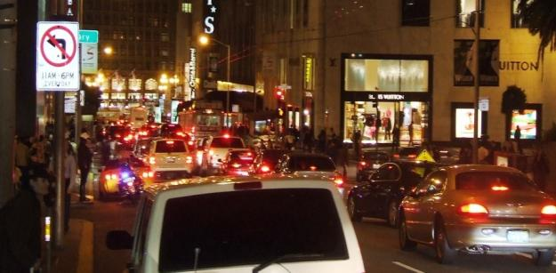
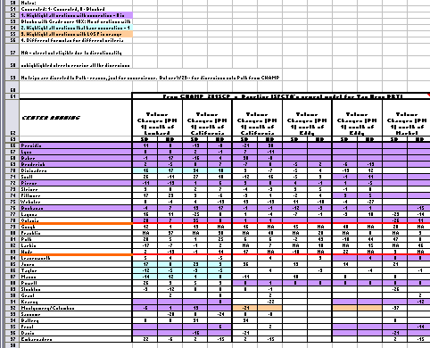
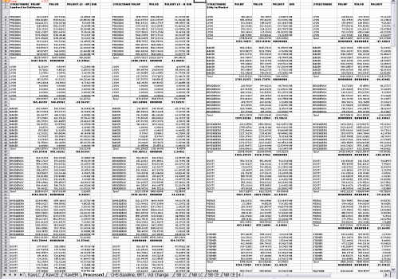

Why DTA? (recap)
Better representation of the real world
$v ≤c$
Queues spill back to adjacent links
Signals & intersection design matter
Transit and cars interact
Less messy spreadsheet work
Less subjectivity
Fewer typos/errors

Slide 3
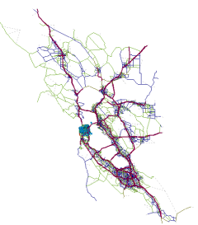
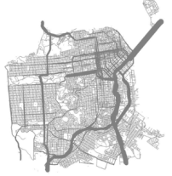
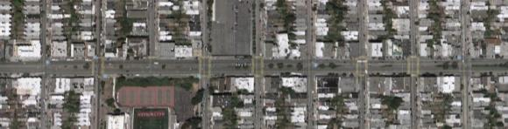
An additional tool in the toolbox - DTA
SF-CHAMP
Regional static user equilibrium within an
activity-based model
Time-dependent user equilibrium
with realistic, but simplified vehicle simulation
Dynamic Traffic
Assignment
Traffic
Microsimulation
Highly realistic simulation of vehicle behavior and interactions

Slide 4
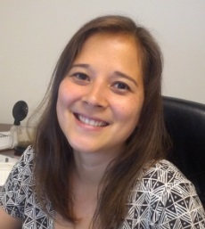
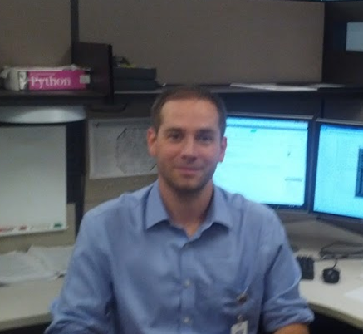

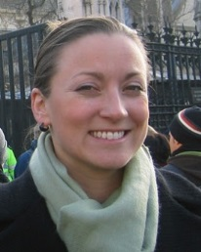
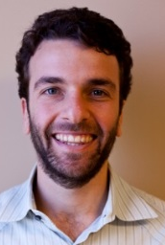


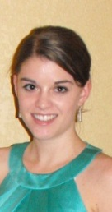
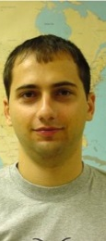
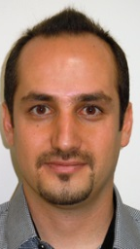
Why Collaboration?
Why not just ask for a “product”?
We have to own it in the end
“This code is inscrutable!”
“How do I do Validation or actually run a scenario?”
Shared ownership / credit makes more people care and understand situation
“We just don’t have the budget to get to that calibration target
“I don’t care, that’s what’s in the scope
We work with planners on real projects in SF every day.
“Shoot, Well what I really hoped DTA would be able to capture was…”
“These results don’t make any sense. I thought DTA was supposed to be useful!
Cool Project – Let lots of interested and smart people take part and learn!
See Lisa Zorn present “The Codebase IS the Deliverable” Monday 10:30

Slide 5
DTA Model Development Objectives
(for now)
Have a working DTA model with results that make sense for the PM Peak period in San Francisco
Have seamless process from SF-CHAMP to DTA results:
  Little human intervention
  Reduce human error
  Use SF-CHAMP demand directly
    Behaviorally consistent
Allow SF-CHAMP to take advantage of all fixes

Slide 6
DTA Model Development Approach
Write code when possible for repeated human tasks
  Don’t re-write code that exists in our DTA package
  Develop in an open source environment
Use as much ‘real’ data as possible
Fix all issues “at the source” if possible

Slide 7
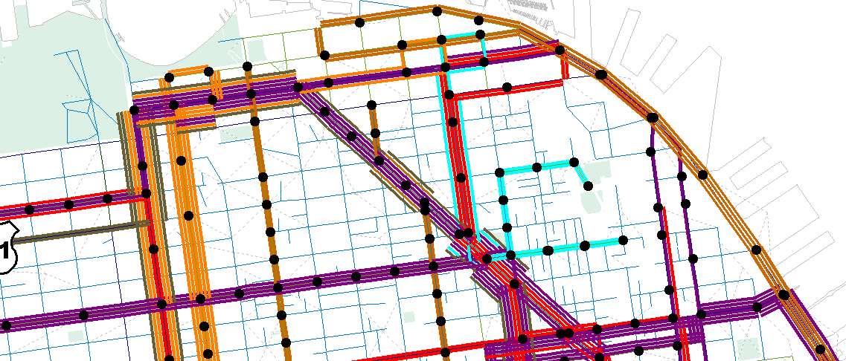
Where we were starting from in SF-CHAMP
Every transit stop
Every transit line
Every street
Every Hill
981 Zones in SF

Slide 8
DTA Anyway CodeBase &
INPUT Development
Input
Codebase
Calibration

Slide 9
DTA Anyway for Automation
Static Network
DTA Network
Python Scripts
Static Network
+ Projects
DTA Network
+ Projects
DTA Anyway
Python Module
Notes:
DTA anyway is there to convert what already exists and add new stuff. We want to automate this, so we can repeat it each time we do a new SF-CHAMP run.

Slide 10
DTA Anyway Capabilities
DTA Anyway Can
Read Cube Networks / text-based static networks
Read/Write Dynameq ASCII files
Write GIS shapefiles
typical network edits
DTA Anyway Cannot
Visualize anything directly
Read/Write DTA networks for other DTA software (but designed to make this easily implementable)

Slide 11
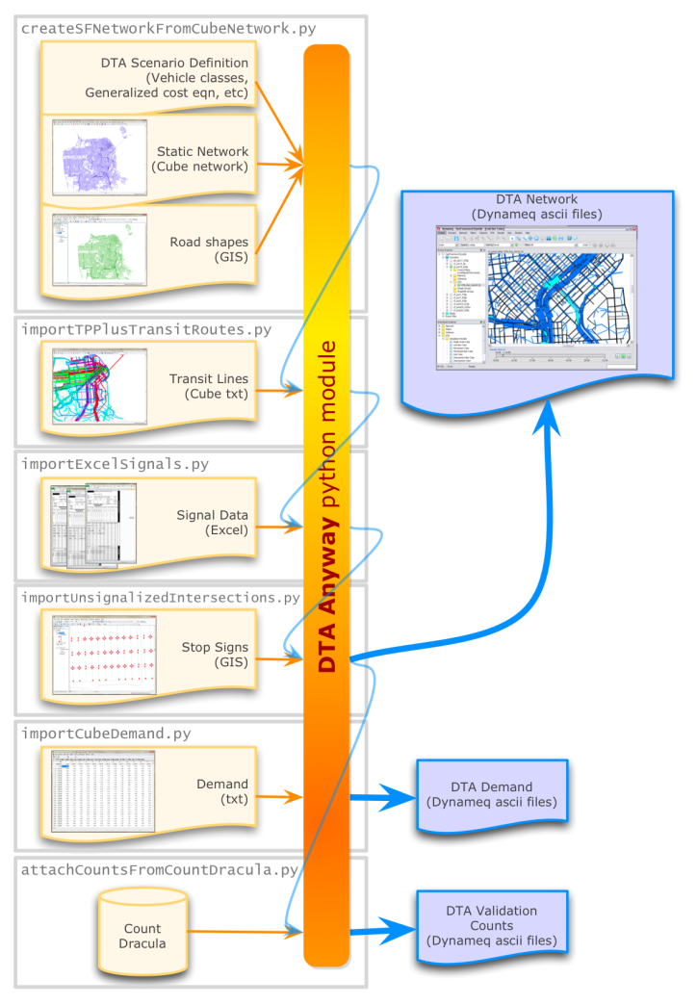
DTA Inputs
New!
New!
New!
http://dta.googlecode.com
Improved!
Notes:
What are the basic inputs needed for a DTA model? (networks, transit routes, signals, stop signs, demand, counts)

Slide 12
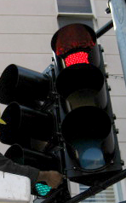
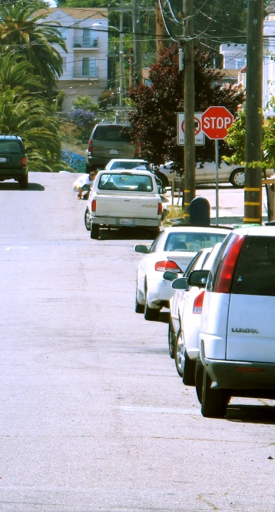
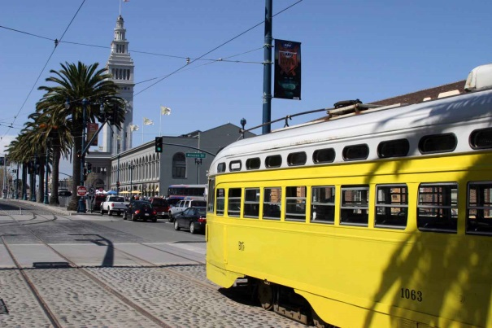
Input Development
(alongside codebase development)
Signals
1,100 signals
Actuated signals approximated to fixed
Source: SFMTA-defined Excel files
Demand
CHAMP Demand
620k vehicles 2:30-7:30 PM
976 zones + 22 Exts
Time profile f(counts)
Stops
1,845 AWSC
919 TWSC
Source: SFMTA GIS
Transit
236 Lines
Source: SF-CHAMP Cube Files

Slide 13
Calibration AND VALIDATION

Slide 14
Model Calibration Approach
  “Model Calibration involves the identification of a set of DTA model inputs and parameters that results in model outputs that are reasonably close to those field observations.”
  - DTA Primer
Inputs for a Specific Scenario
+
Model Parameters
Measured Reality for that Scenario
Hopefully extrapolates to another scenario!

Slide 15
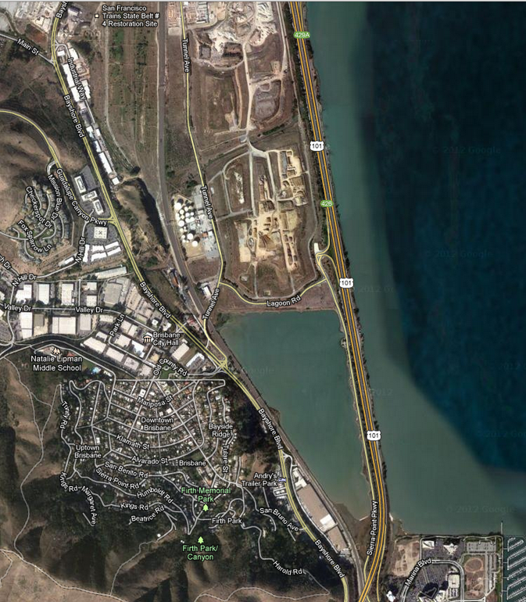
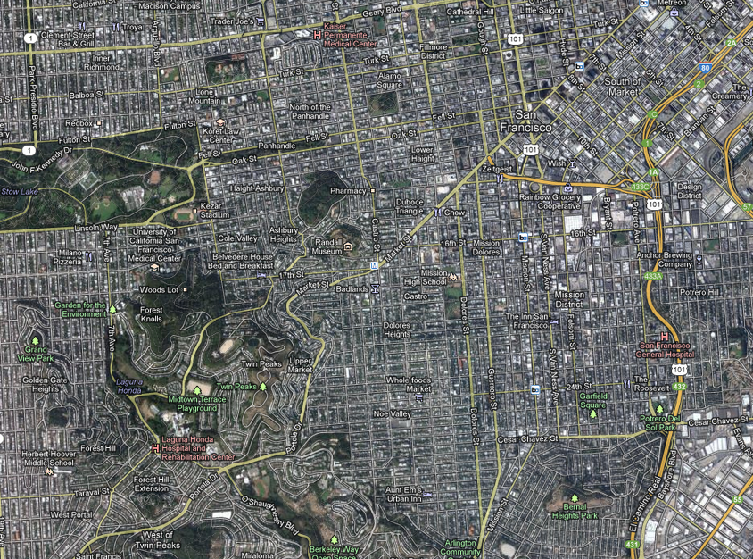
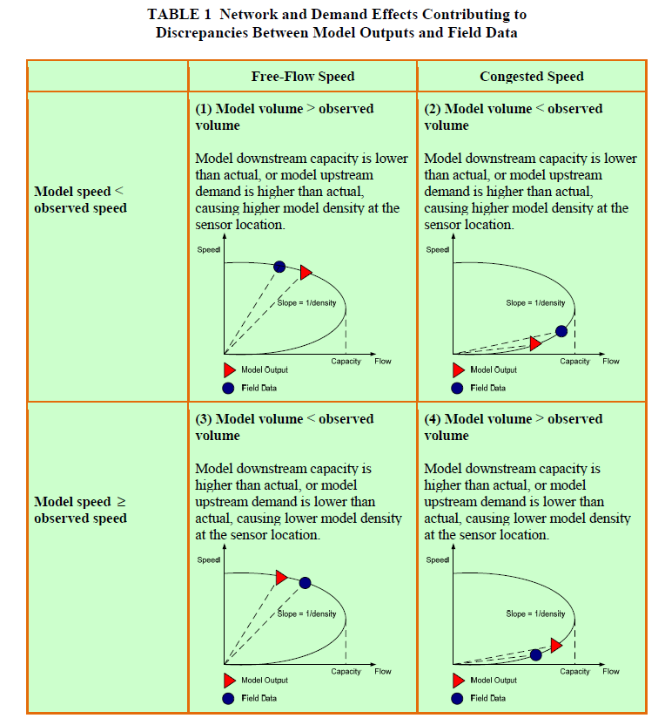
Model Calibration Approach
Downstream
Source: DTA Primer
VS
Upstream

Slide 16
Model Calibration Approach
  Ensure quality inputs
  Measure anything that can be measured
  Evaluate the results qualitatively
  Evaluate the results quantitatively
  Make defensible adjustments
  What factors that affect driver behavior are missing from the model?
For detailed “Adventures in Calibration”:
Dta.googlecode.com Webinar Presentation Slides 25-29
Notes:
Where is the documentation?
Most of papers are focused on changing demand.
Easy to do one-off calibrations…hard to do sustained.

Slide 17
Traffic Flow Parameter Estimation
  Data sources for parameter estimation
Param. FT | Free-flow Speed | Saturation Flow | Response Time | Jam Density
 | PeMS | PeMS | PeMS | Inferred from CBD arterials
Arterials | SFMTA speed surveys | CBD saturation headway observations | CBD queue dissipation observations | CBD arterial queue length observations
Locals & Collectors | Limited SFMTA speed surveys & supplemental observations | Mostly inferred from CBD arterials | Mostly inferred from CBD arterials | Mostly infer red from CBD arterials
Red text = data limitations

Slide 18
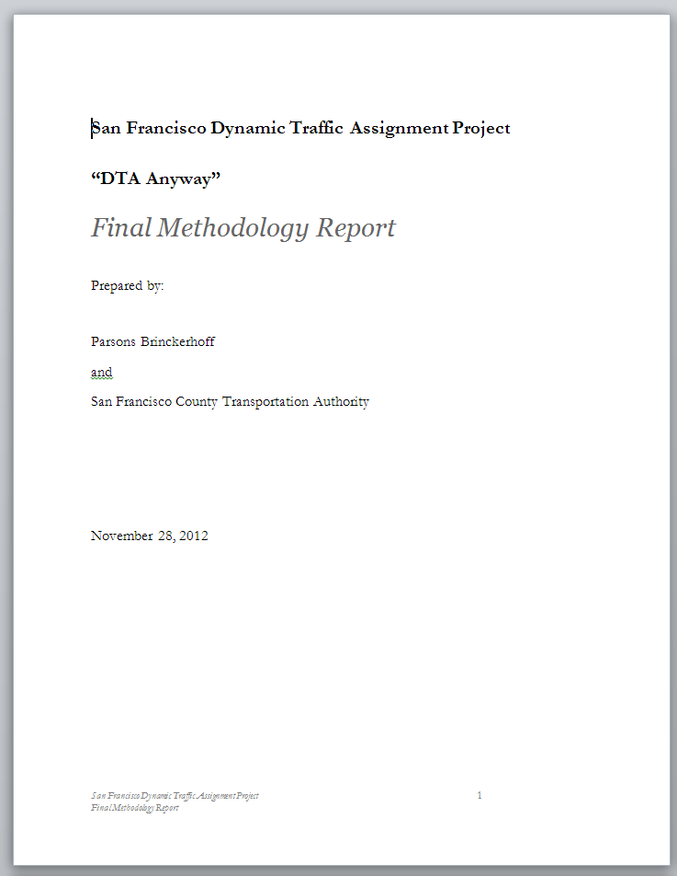
Final Calibration Parameters
  Final generalized cost expression
    Travel Time, Tolls, Turn Penalties
    Distance tried, didn’t work well
  Response times
    Function of uphill and downhill slopes
  Signalized turning movement capacity:
    Function of asserted pedestrian densities
  Read all about the details:
    http://www.sfcta.org/dta
Additional reading material!

Slide 19
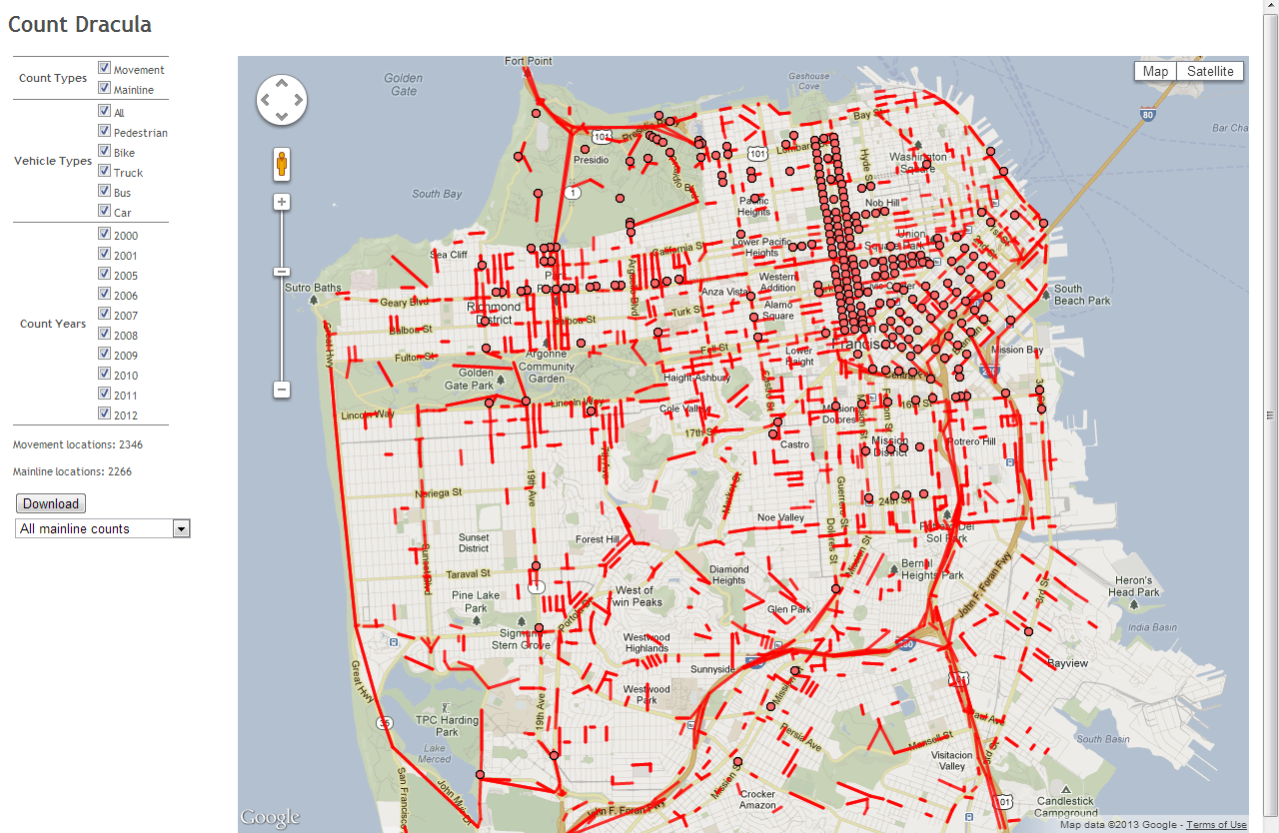
Validation Data - Counts
Count Dracula is SFCTA’s traffic counts database
Recent (2009-2011) midweek (Tue/Wed/Thu) counts queried from Count Dracula API for DTA Validation
97 | 15-minute link counts
22 | 60-minute link counts
864 | 15-minute movement counts
160 | 5-minute movement counts
For more CountDracula
Lisa Zorn presents:
“Sharing Is Caring”
Wednesday, 1:30 PM
https://github.com/sfcta/CountDracula

Slide 20
Validation Data – Travel Times
Spring 2011 Level of Service Monitoring
272 Summary Segments

Slide 21
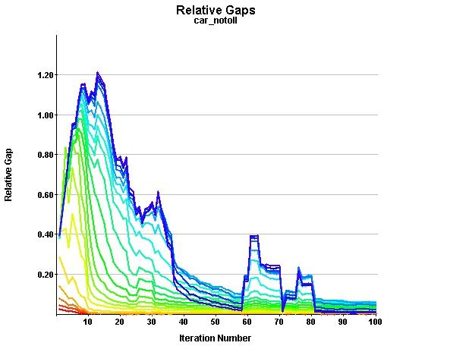
Validation Results
Convergence & Performance
  DTA shows stable convergence for ~20 iterations
  Mean Relative Gap: 2.7%
  109 50ish hours computing
  Max waiting vehicles ~ 350 (1%)
  Demand clears in reasonable time
  No observed gridlock
Convergence Plot for Final Model

Slide 22
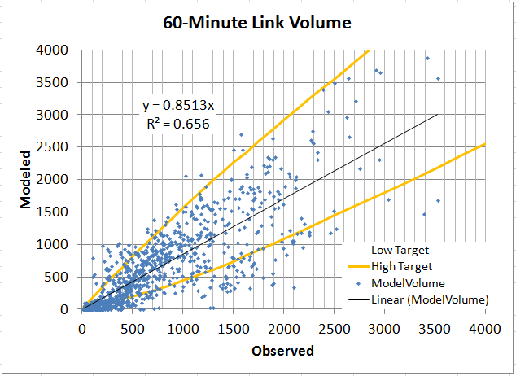
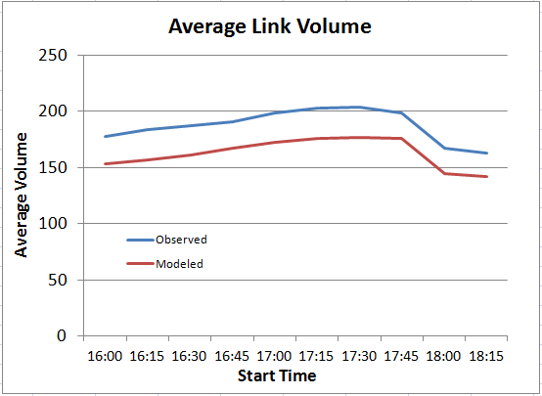
Validation Results
Link Volumes
  Total volume ~13% low.
  55% total RMSE. 40% RMSE for links >500 vph.
  75% of arterials within Caltrans maximum desirable deviation guidelines
What are some good standards? We couldn’t find any and neither could our peer review panel.

Slide 23
Validation Results
Segment Travel Times
  Travel times are reasonable on average
  A few outliers drive differences

Slide 24
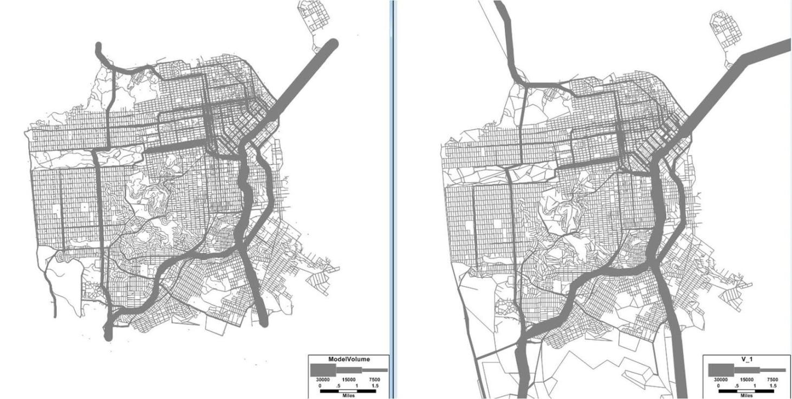
Validation Results
Citywide Flow Patterns
  Overall flow pattern logical, and similar to static model
Map of Total PM Peak Flow from DTA
Map of Total PM Peak Flow from Static Assignment

Slide 25
Sensitivity &
Scenario Testing
Random Number Seeds
Small Network Change
Future Demand
Congestion Pricing
Bus Rapid Transit

Slide 26
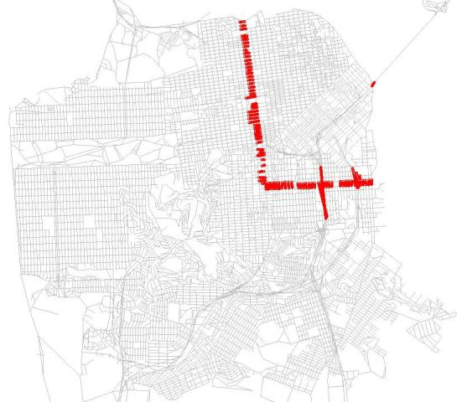
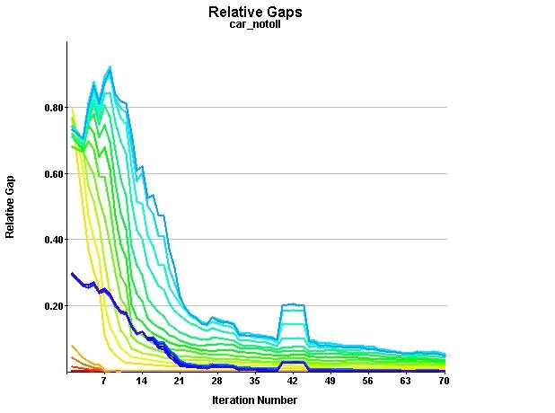
Congestion Pricing Application Test
Added a $3 fee to anyone crossing the cordon to manage congestion in downtown San Francisco
SAN FRANCISCO COUNTY TRANSPORTATION AUTHORITY
26

Slide 27
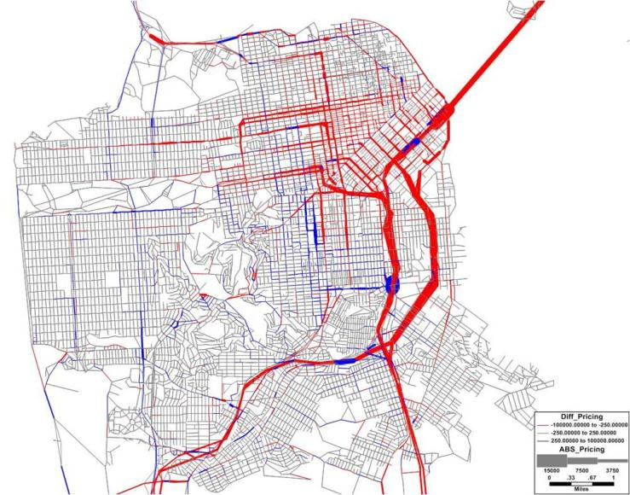
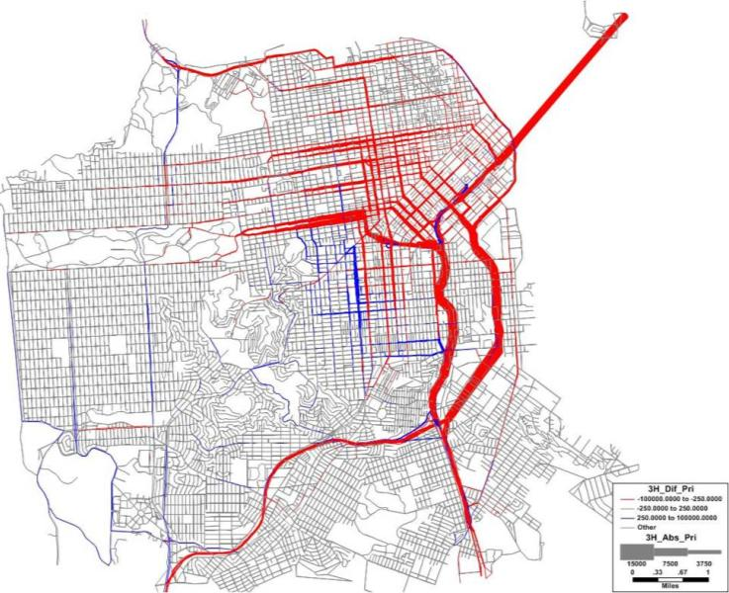
Congestion Pricing Application Test – Static vs. DTA Flow Maps
DTA Model shows a much clearer diversion to paths outside the cordon
Static model shows some odd shifts that in the Northern region including increases in EB traffic going toward the CBD
Static
DTA
Map of Flow Change from Static Pricing Test (Red links – flow loss of at least 250 vehicles, Blue links – flow gain of at least 250 vehicles)
Map of Flow Change from DTA Pricing Test (Red links – flow loss of at least 250 vehicles, Blue links – flow gain of at least 250 vehicles)
Notes:
The DTA model showed a much more clear and expected pattern of flow shifting away from the CBD. The demand change resulted in 8% fewer auto trips and 24% fewer truck trips, so there was almost no congestion in the DTA network due to much lower demand levels. Note the lack of the giant-blue exit ramp form US-101 to Cesar Chavez. Also, generally smoother loadings and diversions.

Slide 28
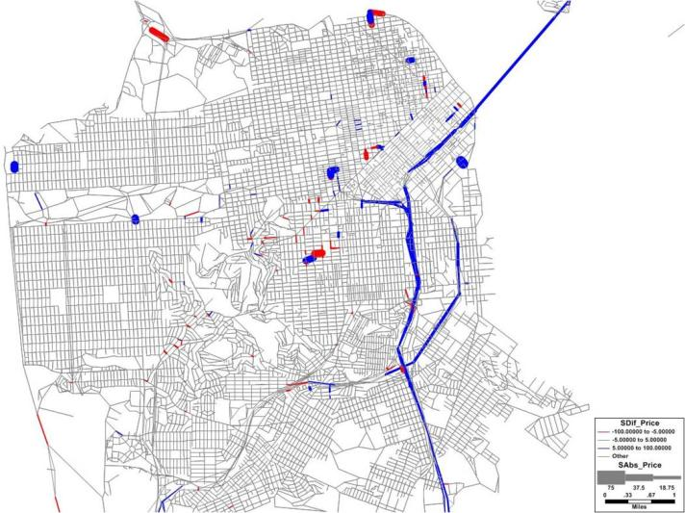
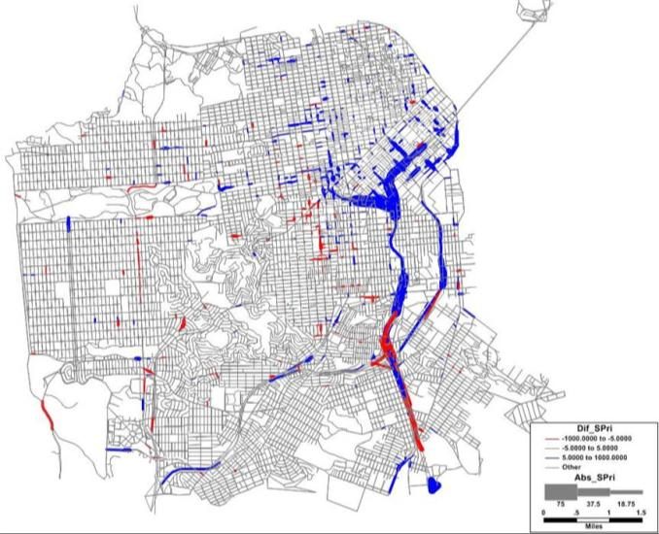
Congestion Pricing Application Test – Static vs. DTA Speed Maps
DTA Model shows more widespread impacts on speed with faster speeds in most of the CBD.
Using the static model results could greatly underestimate the potential travel time impacts in the CBD.
Static
DTA
Map of Speed Change from Static Pricing Test (Red links – speed loss of at least 5 mph, Blue links – speed increase of at least 5 mph)
Map of Speed Change from DTA Pricing Test (Red links – speed loss of at least 5 mph, Blue links – speed increase of at least 5 mph)
Notes:
Given the large changes in flow levels between the two models, the fact that there is little to no speed change in most of the Static network is problematic. If the static results were used as feedback, the impacts on travel times would likely be greatly underestimated. The fact that the static model predicts less travel time savings may also lead to the demand model predicting fewer people to pay the toll. If the DTA model were used for feedback to the demand model, it may indicate higher demand levels and more people willing to pay the toll to balance out the travel time savings they would get.

Slide 29
Credit where it is due…
SFCTA
Elizabeth Sall – Conductor
Lisa Zorn – Code Cowgirl
Daniel Tischler – Calibration Hero
Neema Nassir – Traffic Model Data
Collection Dynamo
John Urgo – Willing data collector
Annie Chung & Matthew Chan – Courageous count coders
Parsons Brinckerhoff
Gregory Erhardt – Consultant PM
Renee Alsup – Calibration Hero
[Michalis Xynatarakis] – the one who had done this before
Jim Hicks & Joel Freedman – Parental Supervision
Peer Review Team
Joe Castiglione
Bruce Griesenbeck
Vassilis Papayannoulis
David Stanek
Xuesong Zhou
Keeping Us Sane
Michael Mahut – INRO
Brian Gardner -- FHWA
www.sfcta.org/dta dta.googlecode.com

Slide 30
Credit where it’s due….
Greg Erhardt (PB) – Consultant PM
Lisa Zorn (SFCTA) –Codebase Lead + CountDracula
Daniel Tischler (SFCTA) – Traffic Flow Calibration Lead
Renee Alsup (PB) – Calibration + Sensitivity Testing
Neema Nassir (SFCTA/U of Arizona) – Traffic Flow Model
Michalis Xyntarakis – Early codebase development
www.sfcta.org/dta dta.googlecode.com

Slide 31
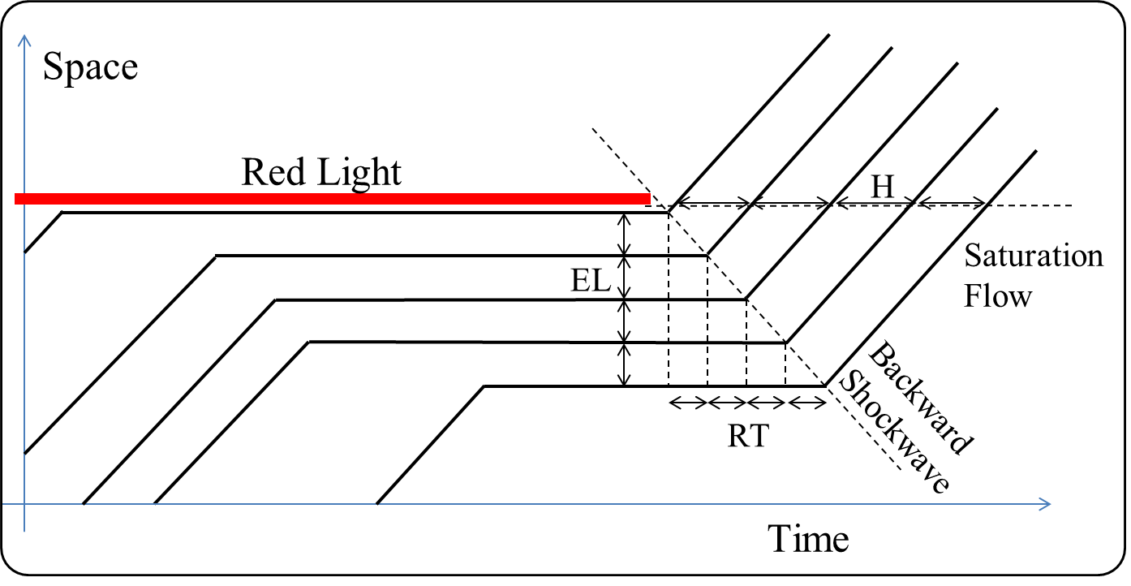
Traffic Flow Parameter Measurement

Slide 32
Future Work
&
ONGOING Research

Slide 33
Future Work: Deployment
Examine stochasticity
  Useful tool for finding ranges
Work with local consultants and agencies
Use with real projects!

Slide 34
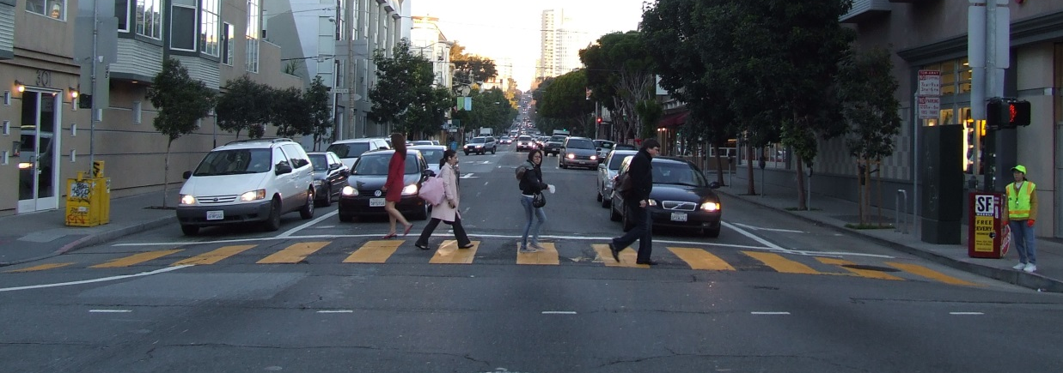
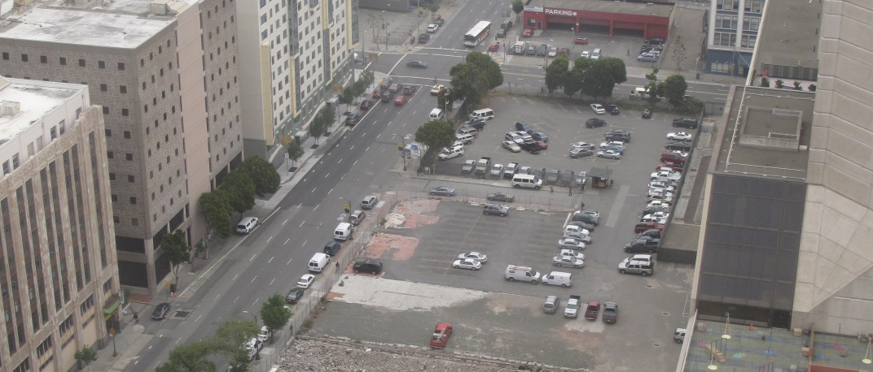
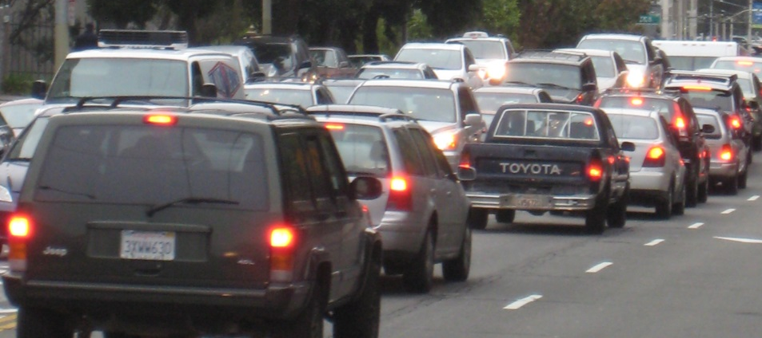
Future Work: Development
Improve pedestrian/bike
interaction representation
Represent actual parking locations
Improve demand in SF-CHAMP

Slide 35
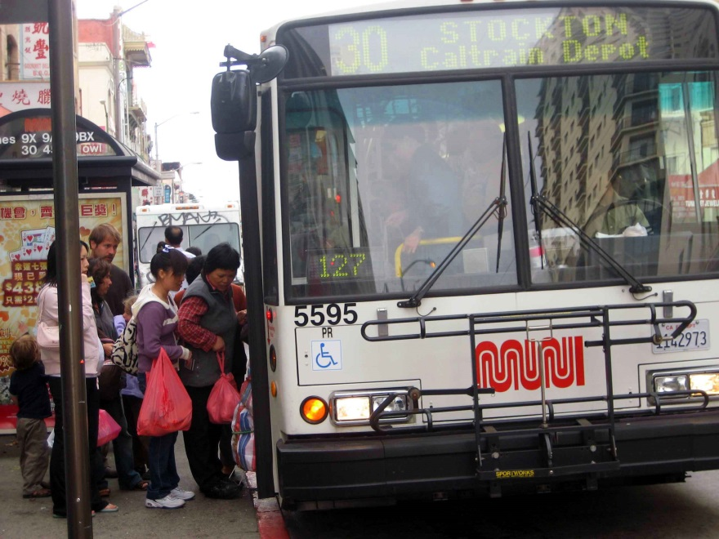
Research: Person-based Transit Assignment
FAST-TrIPs
FAST-TrIPs
DTA
Simulate individual riders, individual buses based on DTA trajectories (or GTFS)
Update transit vehicles’ dwell time f(FAST-TrIPs boarding and alightings)
Why?
  Bus Bunching
  Transit reliability
  Capacities
  Actual schedules
See: Khani, Zorn and Sall, 2013 TRB Annual Meeting

Slide 36
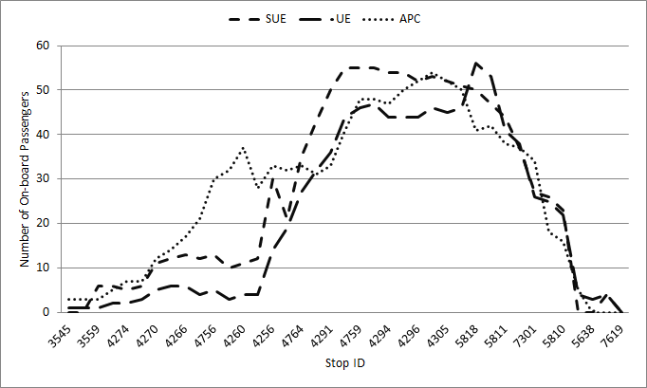
Research: Person-based Transit Assignment
FAST-TrIPs
Route 38 - Geary Blvd, Vehicle Trip Starting at 5:47PM
See: Khani, Zorn and Sall, 2013 TRB Annual Meeting

Slide 37
Research: Transit Reliability / FAST-TrIPs Development
More FAST-TrIPs/DTA Integration
  Convergence methodologies
FAST-TrIPs/CHAMP Integration
  Use static assignment
  Skimming
  Sensitivity tests
Develop Reliability Metrics in FAST-TrIPs
  As function of demand profiles
  As function of network and service characteristics

Slide 38
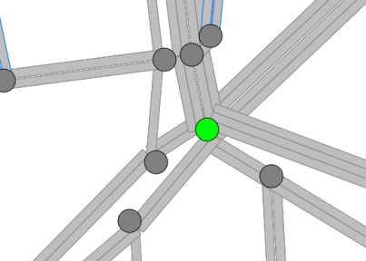
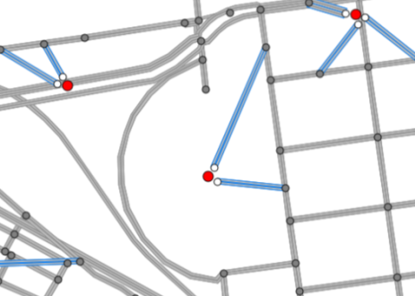
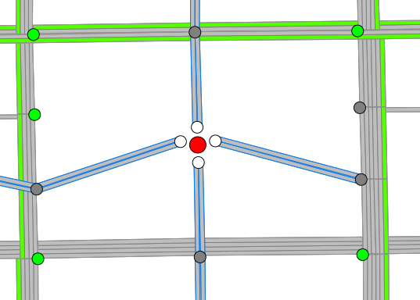
Convert Static Network → Dynamic
Define Scenario: vehicle types and classes, generalized cost
Import Cube network data, defining DTA attributes in terms of Cube attributes
Add all movements, prohibiting most U-Turns, explicitly naming some where geometry is confusing
Read GIS shapefile for road curvature
Add virtual nodes/links between centroids and road nodes
Move centroid connectors from intersections to midblock nodes
Handle overlapping and short links
15,000 | Nodes
37,000 | Links
109,000 | Movements

Slide 39
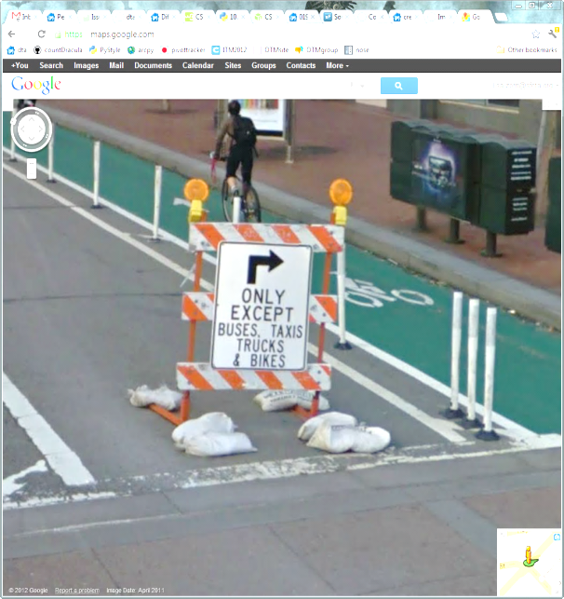
Import Transit Routes
Reads Cube-formatted transit line files and converts into DTA transit lines
Use shortest-path to connect links that may have been split
Where LRT lines go off the DTA network (underground or on separated ROW), they are split into segments (discarding those not on the DTA network)
Movements are explicitly allowed for transit if previously prohibited
236 | Transit Lines

Slide 40
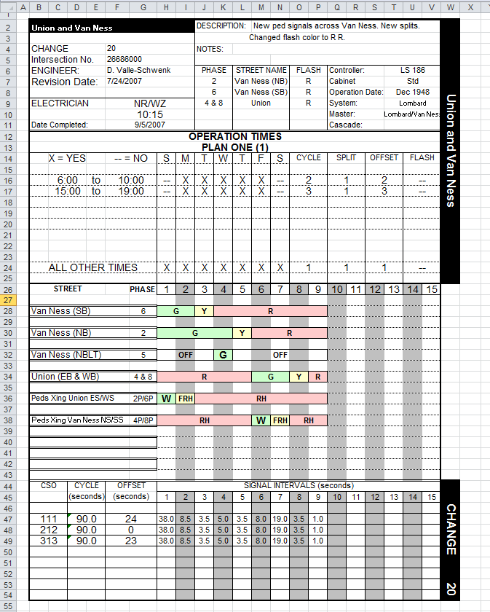
Import Signals
Reads signal card data from Excel files in a SFMTA-defined format
We search for the section specifying the weekday PM peak plan
For errors and unique circumstances encountered (and there were many), responses could be:
  Update signal card itself
  Update signal-card reading code
  Update static network
We approximate the few actuated signals with their fixed time version
Signal-reading code is not very re-usable
1,100 | Signal Time Plans

Slide 41
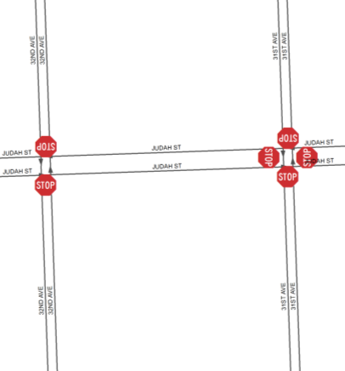
Import Stop Signs
Stop signs are coded as (GIS point, street name, cross street name, and direction the stop sign is facing)
Signal data takes precedence
Mark as all-way stops when # of stop signs for a node matches the # of incoming links
Otherwise, mark as two-way
Custom priorities for two-way stops where facility types tie
1,845 | All-way stop nodes
919 | Two-way stop nodes
1,020 | Custom priority stop nodes

Slide 42
Import Demand
Auto and truck tables are imported from SF-CHAMP MD, PM, EV demand tables
535.2k auto trips, 84.2k truck trips loaded 2:30-7:30p
The DTA network uses same TAZ structure is used as SF-CHAMP because the zones are small (976 within SF, plus 22 external stations)
The PM (3:30p-6:30p) demand is peaked slightly towards 5-6p based on traffic counts
Notes:
Better graphic? Maybe the crazy Dynameq demand graphic with all the little bar charts?

Slide 43
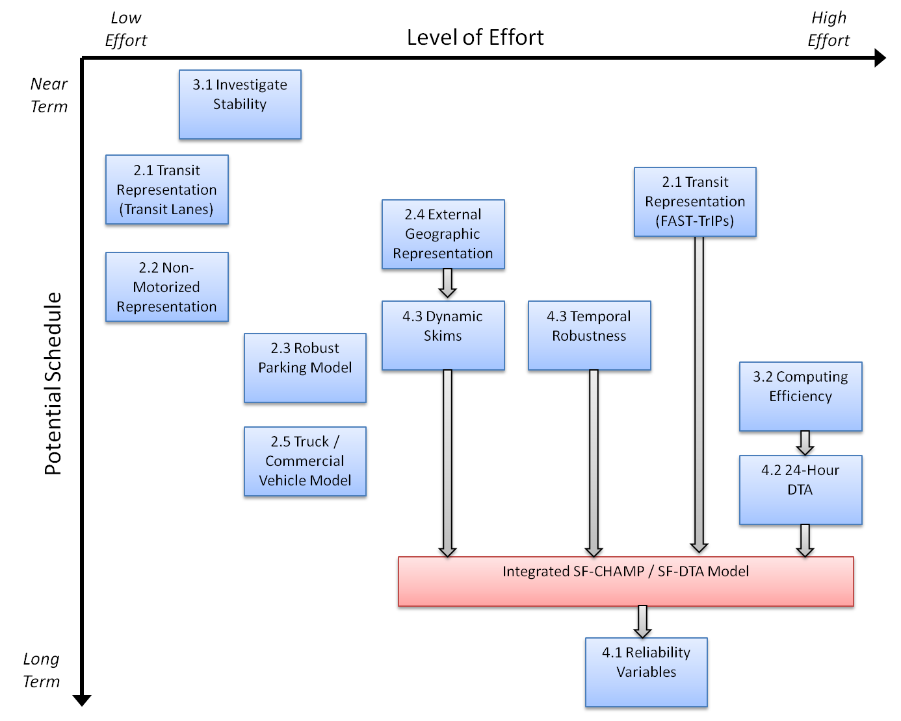
Future Work - Development

