Slide 1
Addressed Based Sampling as an Alternative to Traditional Sampling Approaches:
May 6, 2013
An Exploration

Slide 2
Lucia Lanini, NuStats LLC

Slide 3
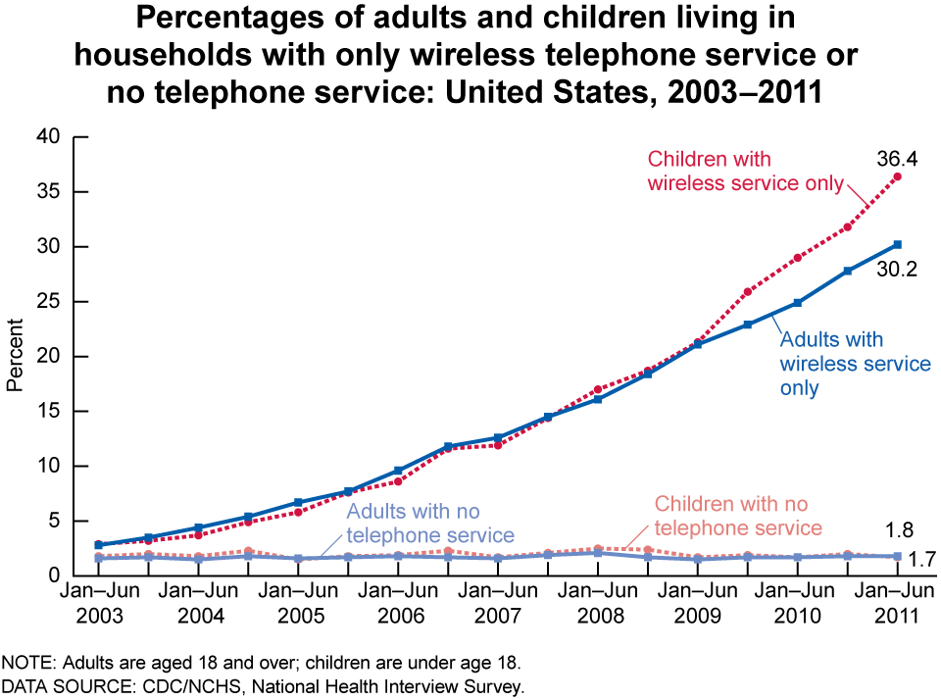
Introduction
Growing resistance to surveys Changing patterns of household telephone use and access Increased need for advanced/innovative sampling strategies

Slide 4
Random Digit Dial (RDD) Sample Frame
Randomly generated with specific area code and exchange combinations.
Opportunities:
Benefit of ensuring every phone number has equal probability of selection for participation
Constraints:
Contains all non-working, unassigned, business, and other telephone numbers, resulting in lower survey response rates and higher survey administration costs than other frames.

Slide 5
General Listed Sample Frame (LHH)
Pulled from Commercial Consumer databases, “White Pages”
Opportunities:
Frame contains a wealth of Household-level socio-demographic information.
Addresses and e-mail addresses can also be appended.
Constraints:
Coverage is limited to those published in the white-page directories.
Result? → The exclusion of households in the study area, including cell-phone mostly, and cell-phone only households.

Slide 6
Address Based Sample Frame (ABS)
An Interesting Alternative to RDD and LHH Frames
Opportunities:
USPS Delivery Sequence File (DSF): Contains over 135 million residential addresses, ensuring virtually 100% coverage of all households in the United States
Sample Frame can be defined by any level of geography from Census Tract up to National
Includes all households regardless of telephone ownership status
Addresses can be “matched” to listed telephone numbers

Slide 7
Address Based Sample Frame (ABS)
An Interesting Alternative to RDD and LHH Frames
Constraints:
Low response rate, especially for unmatched sample
High volume of undeliverable addresses that can affect survey sample universe and/or sampling scheme

Slide 8
Benefits and Constraints of the ABS Frame over Other Sample Frames
Response Rate Comparison
Estimated Accuracy of Addresses
Socio-Demographic Representation
Using ABS Sample to Target “Hard to Reach” Groups

Slide 9
ABS Sample Frame: Response Rate Comparison
Project | Year | % ABS Sample | Recruit Rate | Retrieval Rate | Final Response Rate
NYMTC/NJTPA RHTS | 2010-2011 | 100% | 4% | 61% | 3%
CALTRANS HH Travel Survey | 2012-2013 | 49% | 6% | 70% | 4%
Calgary (CARTAS) Main Study | 2011-12 | 100% | 5% | 66% | 3%
ARC Regional Travel Survey | 2011 | 62% | 9% | 70% | 6%
Massachusetts HHTS | 2010-2011 | 38% | 58% | 59% | 35%
Central Indiana Full Study | 2010 | 19% | 59% | 69% | 41%
Oregon Full Study – Region 2 | 2009 | 17% | 62% | 70% | 44%
*Response Rate Calculated as (Recruitment Rate)*(Retrieval Rate)

Slide 10
ABS Sample Frame: Analysis of Address Accuracy
Comparison of Respondent-provided Addresses and Sampled Addresses
For the purposes of this analysis, 11,117 addresses were analyzed.
Distance in Miles | Count | Percent
Exact to <0.25 | 9,937 | 89.4%
.25-<.5 | 268 | 2.4%
.5-<1 | 168 | 1.5%
1 to <3 | 310 | 2.8%
3+ | 434 | 3.9%
Total | 11,117 | 100.0%

Slide 11
Socio-Demographic Representation
Final Unweighted Data File Analyzed against ACS 2006-2010 for Statistical Significance at 90% Confidence
Key Socio-Demographic Variables Analyzed:
Household Size
Household Vehicles
Household Workers
Household Income
Participant Hispanic Status
Participant Age
The Result?
Very little difference between ABS and Listed Sample Frames

Slide 12
Socio-Demographic Representation
Case Study: Statewide Massachusetts Household Travel Survey
Household Vehicles | Listed Sample |  |  | ABS Sample |  |  | Overall
 | Ret | ACS | Z | Ret | ACS | Z | Ret | ACS | Z
0 | 10% | 12% | -5.704 | 10% | 12% | -4.738 | 10% | 12% | -7.473
1 | 29% | 36% | -13.379 | 36% | 36% | 0.460 | 31% | 36% | -10.973
2 | 39% | 37% | 4.521 | 39% | 37% | 2.172 | 39% | 37% | 5.061
3 or more | 21% | 15% | 17.047 | 15% | 15% | 0.786 | 19% | 15% | 14.711
Unweighted data from Listed Sample and ABS Sample were mostly Significantly Different from ACS, with the exception of 1 and 3+ vehicle households coming from the ABS Frame.

Slide 13
Socio-Demographic Representation
Case Study: Statewide Massachusetts Household Travel Survey
Household Workers | Listed Sample |  |  | ABS Sample |  |  | Overall
 | Ret | ACS | Z | Ret | ACS | Z | Ret | ACS | Z
0 | 21% | 26% | -10.283 | 29% | 26% | 5.765 | 24% | 26% | -5.470
1 | 34% | 36% | -5.030 | 37% | 36% | 0.444 | 35% | 36% | -3.964
2 | 36% | 30% | 12.996 | 29% | 30% | -1.921 | 34% | 30% | 9.823
3 or more | 9% | 8% | 3.899 | 5% | 8% | -6.631 | 8% | 8% | -0.365
Unweighted data from Listed Sample and ABS Sample were mostly Significantly Different from ACS, with the exception of 1 worker households coming from the ABS Frame.

Slide 14
Socio-Demographic Representation
Case Study: Statewide Massachusetts Household Travel Survey
Household Income | Listed Sample |  |  | ABS Sample |  |  | Overall
 | Ret | ACS | Z | Ret | ACS | Z | Ret | ACS | Z
Less than $25000 | 16% | 20% | -10.742 | 18% | 20% | -3.184 | 17% | 20% | -10.622
$25,000–$49,999 | 15% | 19% | -10.469 | 18% | 19% | -2.443 | 16% | 19% | -9.935
$50,000–$99,999 | 29% | 31% | -2.561 | 30% | 31% | -0.987 | 30% | 31% | -2.655
$100,000-$149,999 | 18% | 16% | 3.738 | 14% | 16% | -3.538 | 17% | 16% | 1.320
$150,000 or more | 15% | 13% | 4.514 | 12% | 13% | -2.472 | 14% | 13% | 2.512
Don’t Know or Refused | 7% | - |  | 7% | - |  | 7% | -
Unweighted data from Listed Sample and ABS Sample were mostly Significantly Different from ACS, with the exception of $50k-$100k income households coming from the ABS Frame.

Slide 15
Socio-Demographic Representation
Case Study: Statewide Massachusetts Household Travel Survey
Participant Age | Listed Sample |  |  | ABS Sample |  |  | Overall
 | Ret | ACS | Z | Ret | ACS | Z | Ret | ACS | Z
Less than 20 | 26% | 29% | -6.557 | 21% | 29% | -11.494 | 25% | 29% | -11.376
20-34 | 11% | 22% | -27.599 | 11% | 22% | -16.612 | 11% | 22% | -32.226
35-54 | 33% | 28% | 10.229 | 29% | 28% | 0.787 | 32% | 28% | 9.288
55-64 | 19% | 11% | 25.632 | 19% | 11% | 16.803 | 19% | 11% | 30.581
65+ | 12% | 10% | 5.380 | 20% | 10% | 21.185 | 14% | 10% | 15.172
Unweighted data from Listed Sample and ABS Sample were mostly Significantly Different from ACS, with the exception of participants age 35-54 in households coming from the ABS Frame.

Slide 16
Using ABS to Target Hard to Reach Groups
The capture of “Hard to Reach” population groups is a critical consideration for any regional travel behavior survey in order to ensure a representative data file
Sample drawn proportionate to population can yield survey results with “hard to reach” subpopulations that are disproportionately underrepresented.
Socio-demographic targeting of address-based sample frames is possible!

Slide 17
Case Study: New York-New Jersey-Connecticut Regional Household Travel Survey
Socio-Demographic Targeting
Methodology
Objective:
Oversample Households from Census Tracts with High Concentration of Hard-to-Reach Groups → Hispanic Households
Method:
5,079 Census Tracts were analyzed using Census data for Total Population and Total Hispanic Population counts and classified into four segments by Ratio of Hispanic Population to Total Population.
Tracts with >50% Hispanic Population (100%) and with 25-50% Hispanic Population (50%) were oversampled.

Slide 18
Case Study: Socio Demographic Targeting
Effectiveness
Date | New York (ACS=21%) |  | New Jersey (ACS=16%) |  | Connecticut (ACS=13%) |  | Total (ACS=19%)
 | REC | RET | REC | RET | REC | RET | REC | RET
5/20/2011 | 16.6% | 12.2% | 11.4% | 7.8% | 9.3% | 6.9% | 14.2% | 10.1%
6/7/2011 | 17.6% | 12.1% | 13.2% | 8.0% | 10.5% | 7.3% | 13.8% | 10.2%
6/17/2011 | 17.7% | 12.4% | 13.2% | 8.8% | 10.8% | 7.9% | 15.5% | 10.6%
7/15/2011 | 17.7% | 12.5% | 13.2% | 9.1% | 10.8% | 8.1% | 15.5% | 10.9%
7/30/2011 | 17.7% | 13.1% | 13.2% | 9.6% | 10.8% | 8.1% | 15.5% | 11.3%
9/24/2011 | 17.8% | 13.1% | 13.7% | 9.6% | 11.1% | 8.0% | 15.8% | 11.4%
10/10/2011 | 19.9% | 13.2% | 14.7% | 9.6% | 12.0% | 8.1% | 17.5% | 11.4%
10/21/2011 | 20.2% | 14.3% | 15.3% | 10.1% | 12.6% | 8.5% | 17.9% | 12.3%
11/4/2011 | 20.2% | 15.3% | 15.3% | 11.0% | 12.6% | 9.2% | 17.9% | 13.3%
11/17/2011 | 20.2% | 15.5% | 15.3% | 11.3% | 12.6% | 9.3% | 17.9% | 13.5%

Slide 19
Summary of Results
The inclusion of an Addressed Based sample frame is important for geographic coverage
The analysis demonstrated that addresses are reliable, for the most part (94%)
Recommendation: Future studies should consider implementation at beginning of project for maximum results

Slide 20
Summary of Results
ABS sample drives down participation rates due to very low response rates for Unmatched sample (no phone #)
The analysis demonstrated that as percentage of ABS sample as proportion of total sample increases, overall response rates decrease
Recommendation: Consider the budgetary implications and trade-offs between postage costs and low-recruitment rates, and a100% address-based sampling methodology.

Slide 21
Summary of Results
ABS frame may be slightly better than the Listed frame for acquiring a demographically representative data file, however, the weighting procedure will still be necessary
Recommendation: Frequent sample performance analysis throughout data collection with sample purchases in “waves” will be beneficial for ensuring a more representative sample.

Slide 22
Summary of Results
Preliminary analysis of Census-tract level geographic targeting of Hard to Reach groups, such as Hispanic Households, shows positive results.
Recommendation: While this method was successful at increasing percentage of Hispanic Households, future research would be helpful to determine optimal oversample rates and classification techniques.

Slide 23
Looking Forward
The results of this research effort point to a dual-frame approach, where the lower cost of Listed Sample is combined with the geographic coverage of the Address Based Sample.
More research should be conducted on best practices for optimal balance of the two frames, and implications on weighting and expansion.

Slide 24
Thank you!

