Slide 1
GIS-based Road Network Information in Travel Demand Modeling
Ahmed Mohideen
Abishek Komma
Vipul Modi

Slide 2
Agenda
Data Sources and Vendors → Motivation?
Navteq
TomTom
OpenStreetMaps
Google Transit Feed
Conversion tools (raw data to modeling networks)
Build Network from Shape file (BNFS)
Custom applications for additional control and flexibility
Successful Applications @
Macro-scopic
Meso-scopic
Micro-scopic

Slide 3
Motivation
Increasing trend towards GIS-based networks
True shape networks
Time and cost savings for MPOs → collect, compile & update
Scalable information
Reliable source of consistent and accurate information?
Avoid collection from multiple sources?
Sample information available:
Basic network characteristics
Speed profiles
Heavy vehicle restrictions
Turn prohibitions
HOV\HOT lane availability by time-of-day

Slide 4
Data Sources: NAVTEQ (1/2)
Chicago based provider of GIS data and navigable maps
Why is this important?
Key features/attributes
Geometry Information
Link Attributes – access (type of vehicles) and display (for routing) characteristics
Node Attributes – Z level (relative elevation)
Navigation Information
Roadway Functional Classes (FC1, FC2, FC3, FC4, FC5)
One-way/direction of travel
Speed Information – speed limits, special speed limits
Lane Information – number of lanes
Time of Day, Turn restrictions
Accessibility: Shapefile (.shp), ASCII file formats, etc.

Slide 5
Data Sources: TomTom (2/2)
Netherlands based provider for navigation and location-based services
Why is this important?
Key features/attributes
Network Information
Functional Road Class (FRC)
Route Directional – including Oneway information
Relative elevation (F_Level and T_Level)
Ramp
Speed – Speed Category, dynamic speed
Junction data
Junction type
Elevation
Accessibility: Shapefiles (.shp)

Slide 6
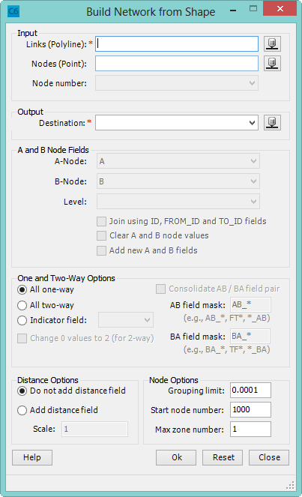
Conversion Tools: BNFS (1/3)
Requirements:
Polyline shape file of links
Node# information: A, B
Directionality
Pre-processing: Filtering
Output:
Create network links based on feature topology and attributes
Retain spatial information
Binary network or
Feature-class in a geodatabase
Cleanup tools:
Generate true shape equivalencies
Copy shape from another layer
Batch mode: BNFS from script

Slide 7
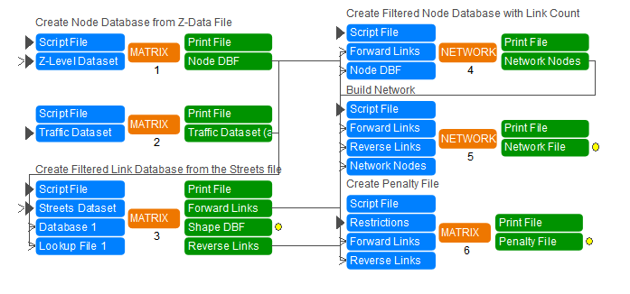
Conversion Tools: Custom Navteq App (2/3)
NAVTEQ street centerline data → Modeling Network
Z-level data → Handle over-passes, under-passes
Options to scale the level of data → Include/Exclude link-classes
Add network attributes (speed, #lanes, distance)
Creates turn penalty data from NAVTEQ restrictions
Consolidate data for optimization

Slide 8
Case Study 1
Mountain View, CA
Realistic travel patterns in Mountain View
Meso-scopic simulation in Cube Avenue
Further, Caltrans count data → Dynamic OD Estimation in Cube Analyst Drive
Network based on Navteq center line → Modeling Network
78 Zones
9000 Links
4000 Nodes
Used the custom Navteq application to create the modeling network

Slide 9
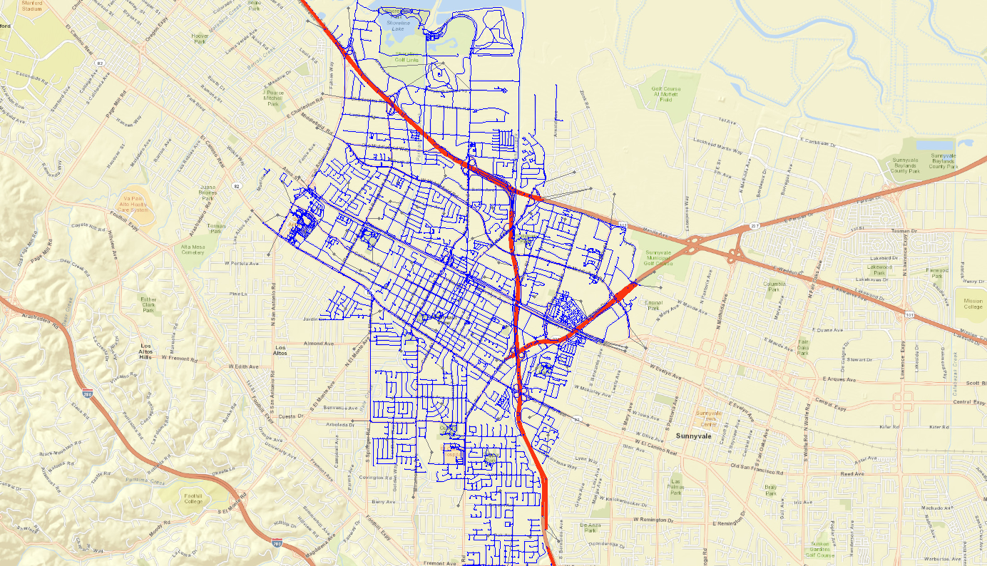
Example: Mountain View, CA: Model Network

Slide 10
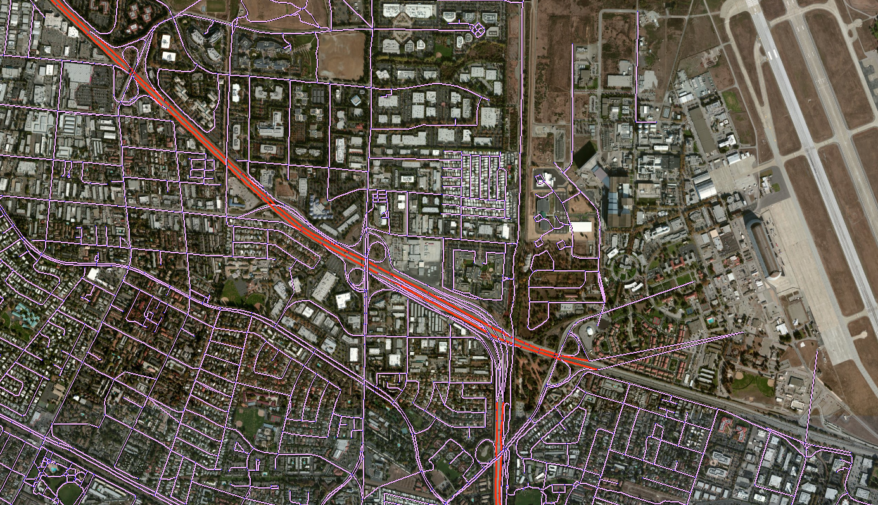
Closer View

Slide 11
Conversion Tools: Custom TomTom App (3/3)
Highway network
- Speed Profile
- Heavy vehicle bans
Turn Prohibitions
Roadway Functional classes
Motorway, freeway or other major Road
Major road less important than a motorway
Other major road
Secondary road
Local connecting road
Local road of high importance
Local road
Link Consolidation

Slide 12
Custom TomTom App – Input Files
Maneuvers Path Index (_mp)
Maneuvers (_mn)
Speed Profile (_hsnp)
ID
ID
JNCTID
NETWORK_ID
ID
ID
Junction (_jc)
ID
Network links (_nw)
T_JNCTID
F_JNCTID
ID
ID
ID
JNCTID
ID
Maneuvers Path Index (_lmp)
Logistics Maneuvers (_lmn)
Logistics restrictions (_lrs)
ID
ID

Slide 13
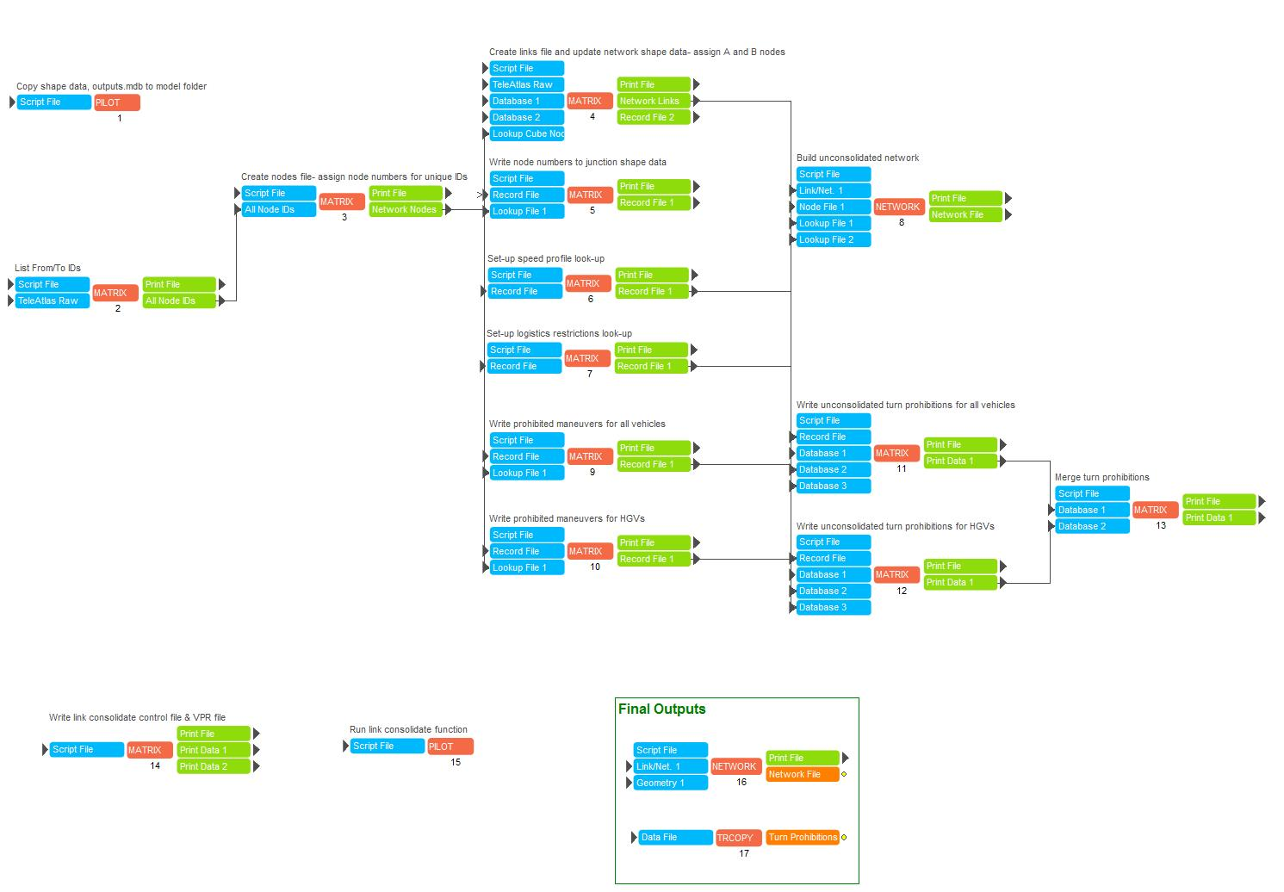
Custom TomTom App - Steps
1. Set-up network node numbers
2. Update link data with speed profile date and heavy vehicle bans
3. Build network
4. Create turn prohibitions
5. Consolidate Network

Slide 14
Case Study 2
Milan, Italy
Functional class → 0-6
Link Consolidation →19 network attributes
Before Consolidation
288,330 Nodes
556,323 Links
After Consolidation
212,772 Nodes
417,313 Links

Slide 15
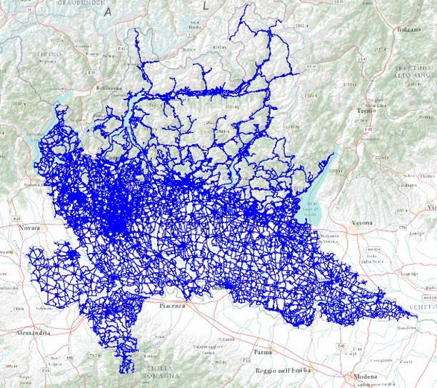
Case Study 2: Milan, Italy

Slide 16
Case Study 2: Speed Profile Data

Slide 17
Case Study 2: Observations
Data quality → Good network coverage, accuracy, topology and connectivity
Navigation data → complex turn movements and lane configurations
Manual post processing of highway network
Functional Class → few and aggregated
Further dis-aggregation using additional attributes such as speed categories, divided/undivided highways
Link Consolidation → highly segmented links.
Limit consolidation to limited number of attributes such as functional class, number of lanes

Slide 18
Future Efforts
Streamline the tools further
Incorporate more data elements like Toll information
Tools to integrate OpenSteetMap data
Tools to integrate Google Transit data
Tools to integrate open count data like Caltrans
Case study for Microscopic simulation

Slide 19
Thank you!
Questions?

