Slide 1
HELPViz: An Integrated Two-Tiered System for Land Use Modeling, Planning and Visualization for a Mid-Sized Midwestern City
Vince Bernardin, Jr, PhD, RSG
John Gliebe, PhD, RSG
Seyed Shokouhzadeh, Evansville MPO
Vishu Lingala, Evansville MPO

Slide 2
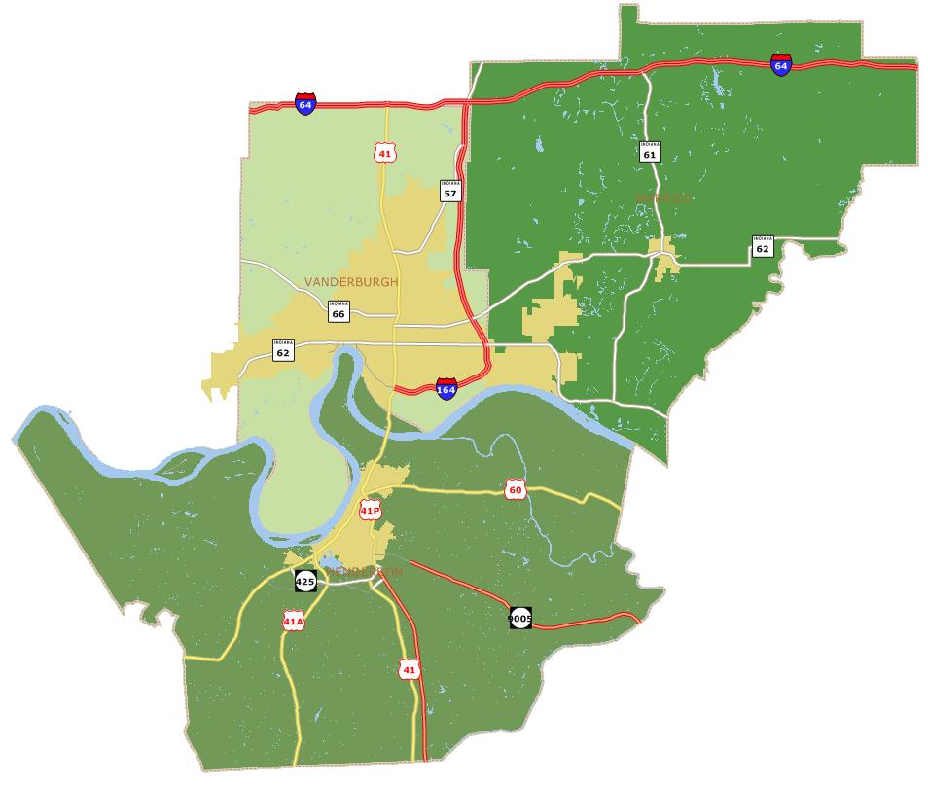
Background: Regional Plan for Sustainable Development
Evansville recipient of one of HUD’s grants to produce a Regional Plan for Sustainable Development
Part of Evansville’s grant application included the development of regional land use modeling tools
Three-county area - 2010 population of 285,600

Slide 3
Evansville: History and Future
Moderate, steady growth overall
For most of the past 40 years, building has outpaced actual growth, resulting in increasing vacant housing and businesses
Between 1950 and 2000 lot sizes doubled from 0.29 to 0.63 acres
SEAC hopes to slow land consumption by encouraging denser and infill development
HELPViz model hopefully adds
Motivation: Look at 2040!
Realism: what difference can zoning vs. codes make?

Slide 4
Land Use Tools vs. Models
Existing options didn’t seem to offer all Evansville wanted
Land Use Planning Tools
I-PLACE3S
EnvisionTomorrow
CommunityViz
Etc.
Great for visualization
Good for public / planners developing scenarios by fiat
Little/no forecasting ability
No realistic policy sensitivity
Land Use Forecasting Models
DRAM/EMPAL
PECAS
Urbansim
Etc.
Rigorous forecasts, grounded in econometrics / regional science
Too much theory?
Estimation problems?
Calibration is challenging, expensive
vs.

Slide 5
Solution: Best of Both Worlds
Evansville chose to use an existing land use planning tool and develop a new forecasting tool designed to work together as a single system
CommunityViz
HELPViz
CommunityViz
Manual Scenario Development
Preferred scenario
Capacities for HELPViz
Impact Calculations
Visualization
HELPViz
Housing, Employment & Land-use Planning & Visualization Support Model
Future baseline / status quo scenario
Policy evaluation scenarios
(What if we…?)
Fill in the blanks in manual scenarios

Slide 6
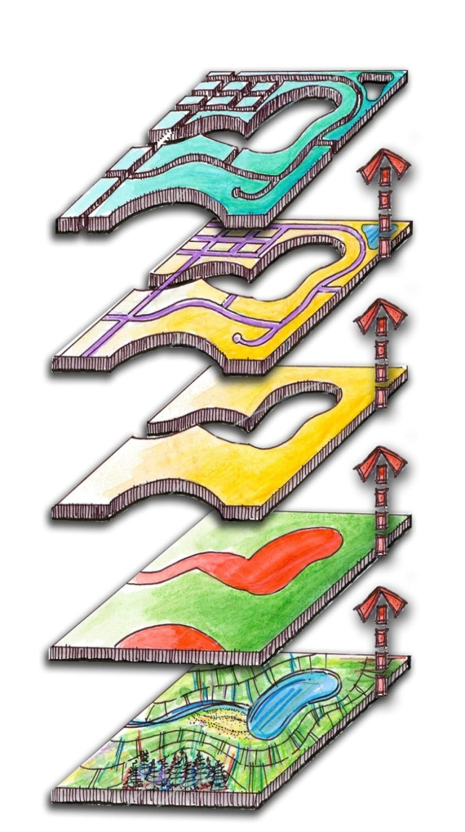
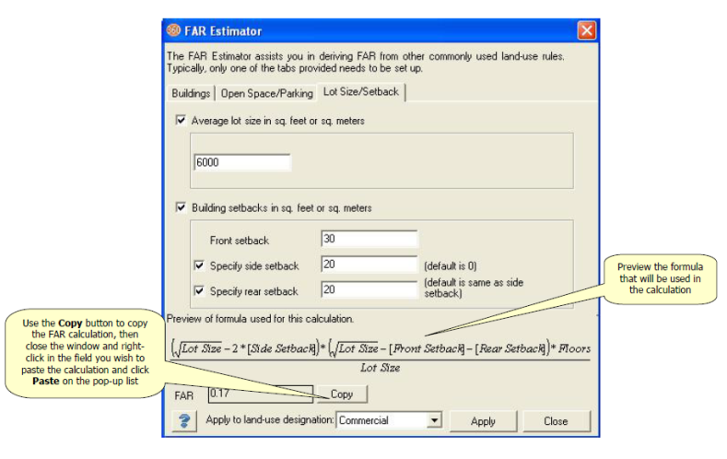
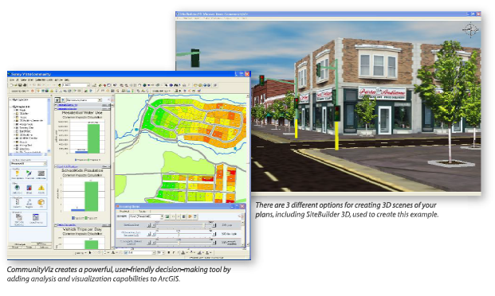
CommunityViz’s Role
CommunityViz’s powerful and easy-to-use Build-Out Wizard is a critical input to the HELPViz forecasting model
Sensitivity to codes:
Setbacks
Parking requirements
Etc.
It’s visualization and impact calculators are powerful tools for communicating results

Slide 7
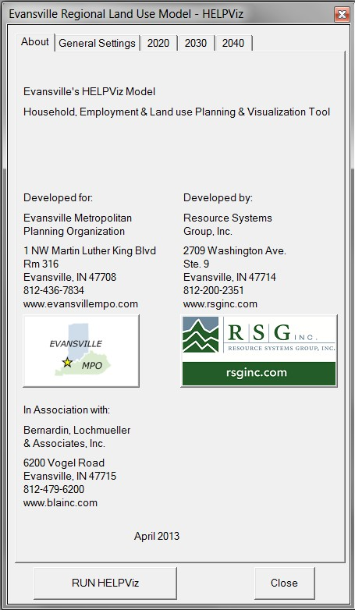
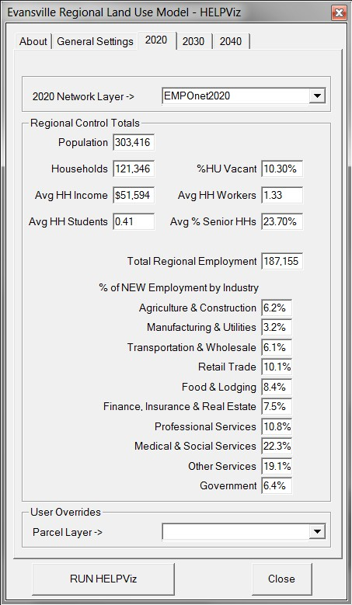
HELPViz’s Role
Policy Sensitive Forecasts
Zoning
Codes
Infrastructure
Transportation
Water
Easily Estimable
Avoid endogeneity
Reasonable Runtimes
TransCAD GISDK application
Inputs:
Regional control totals
Parcel build-out capacities
Model networks
GIS data – slopes, sewerage, etc.
Outputs:
Future TAZ for travel model
Future Parcels for CommunityViz

Slide 8
HELPViz Scale – Both Zones AND Parcels
Existing models use either zones or parcels
HELPViz uses BOTH zones and parcels
Method: Spatial Nested Logit Models
Information about parcels attractiveness influences allocation to zones
Growth allocated first to zones, then parcels within each zone
Some behavioral plausibility
choice of neighborhood and particular property?
Really, econometric framework for:
estimating sensitivities of growth to various factors
accounting for some spatial autocorrelation
handling information, observations at different scales
Information
Allocation

Slide 9
HELPViz – Residential Models
Control Total
Vacancy Model
Takes user HU vacancy rate
Adjusts control total
Allocates any new vacancies
Adjusts residential capacities
Intermediate level nests
Single Family
Multi-Family
Vacancy Allocation
Zone
Single Family
Multi-Family
Parcel

Slide 10
HELPViz – Commercial & Industrial Models
Control Total
Intermediate level nests
Existing Establishment
New Development
Units conversion
Upper levels (TAZ & intermediate) allocate employees
Lower level allocates sq. ft. of new space to parcels
Unit conversion
Zone
New Development
Existing Establishment
Parcel

Slide 11
HELPViz – Theory Scorecard
Growth Allocation Model
Exogenous control totals for regional growth
Only allocates new growth
Misc. Theory
No assumption of equilibrium (or of not)
Path dependence through accessibility to recent growth
No attempt to simulate individual agents/choices
Statistical Method
Logit framework for econometric basis of sensitivities
Allows as many variables as data will support
Sensitivity to Transportation Infrastructure
Sensitive to network
Not sensitive to congestion
Decade time steps

Slide 12
HELPViz – Simultaneous Estimation
Observations at both zonal and parcel level (2000-2010)
Zones: Census, vetted employment
Parcels: Assessor’s data & building permits
Possibly first application to estimate NL with nest observations
Simultaneous, maximum composite log likelihood
LL_{TOT} = LL_{TAZ} + αLL_{PARCEL}
Must weight/convert parcels observations (sq. ft.) to be consistent with zonal observations (employees)
Simultaneity & use of application code -> no calibration
Genetic Algorithm
Population of solutions / starting parameters
Evaluate each member’s fitness (LL)
Fit solutions survive, mate & mutate; otherwise die off
Computationally intense, but eventually finds solution
Allows inequality constraints (upper and lower bounds)

Slide 13
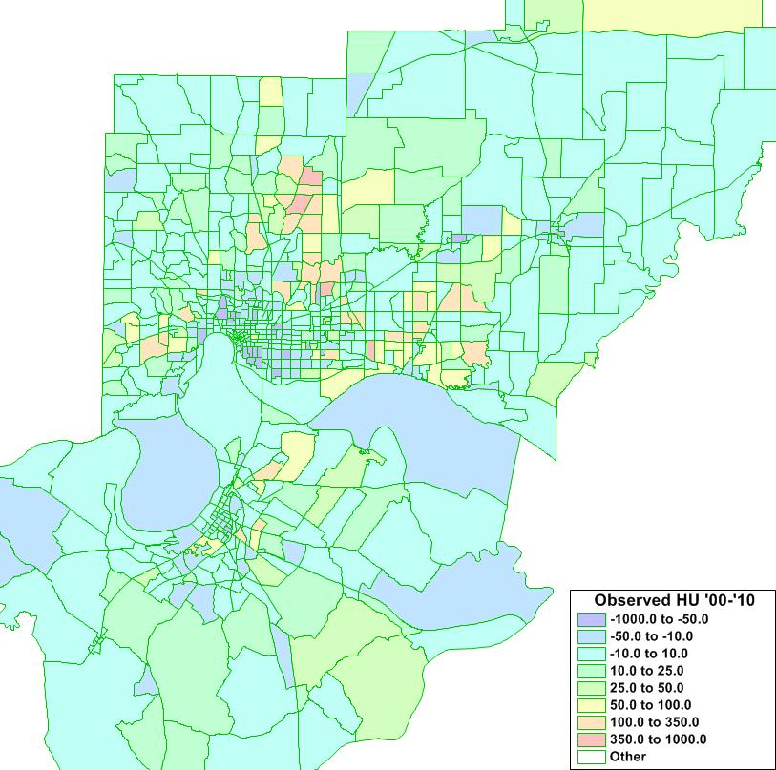
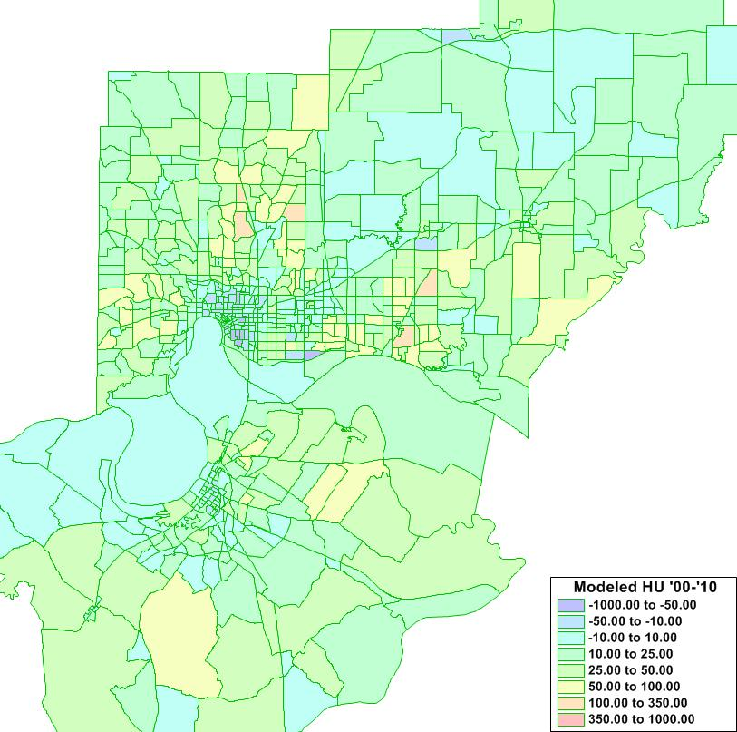
HELPViz – Estimation Results
Goodness-of-fit: rho-squared (vs. 0)
Residential Growth 2000-2010
Observed Modeled
 | TAZ | Parcel | Overall
Residential | 0.441 | 0.409 | 0.423
Commercial | 0.243 | 0.237 | 0.241
Industrial | 0.030 | 0.348 | 0.066

Slide 14
HELPViz – Factors Affecting Growth
Residential Growth
Near new homes last decade
Accessible, but not too accessible
Further from jobs
But close to retail
Walking distance to shopping (MF)
Bias against KY
Not sloped
Not floodplain
Existing sewer
Zoned Agriculture
Zoned Residential
Commercial Growth
Existing Commercial
Bias against KY
Near new homes last decade
Close to arterial intersections
Arterial frontage
Zoned Commercial
Zoned Agriculture
Not sloped
Not floodplain
Existing sewer
Larger parcels
Industrial Growth
Existing Industrial nearby
Access to truck portals
Zoned Industrial
(or Agriculture)
Not sloped
Existing Sewers
Rail access

Slide 15
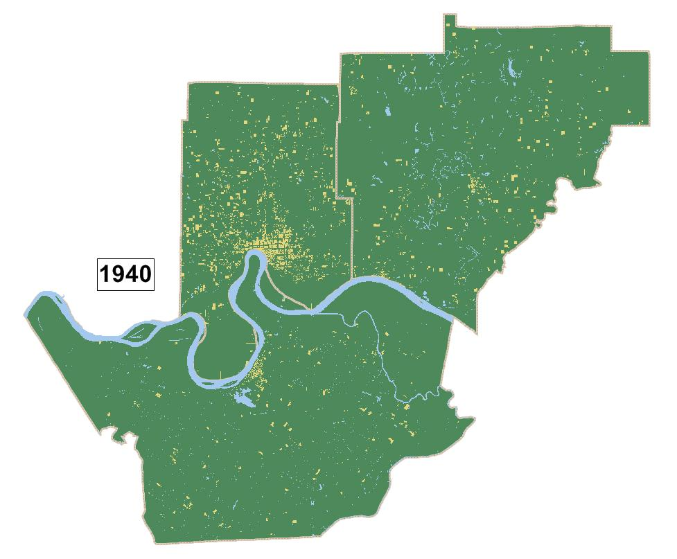
HELPViz – History & Future? (1940-2040)

Slide 16
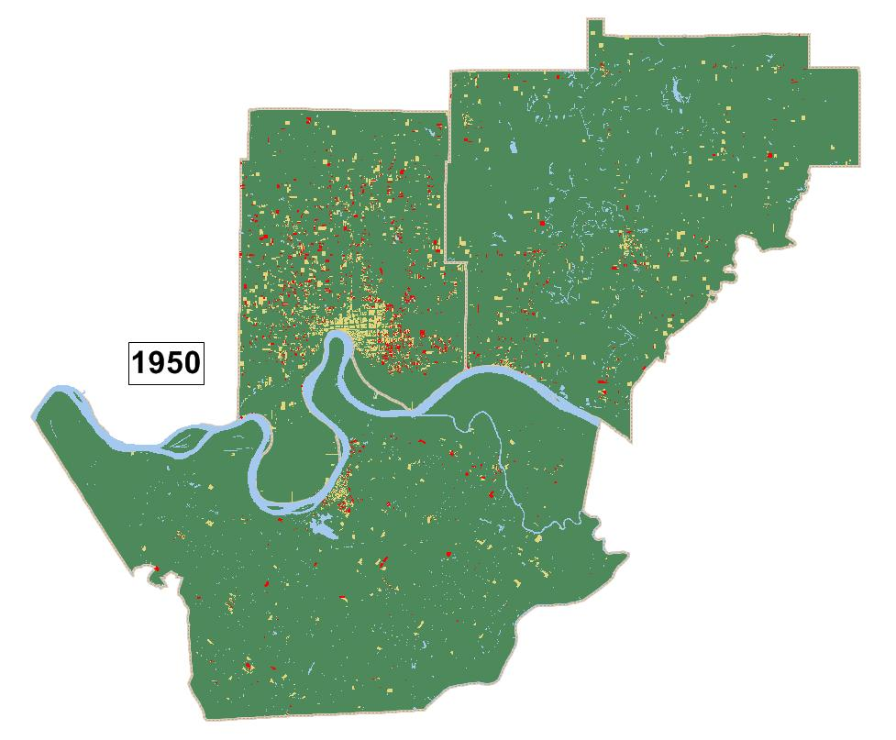
HELPViz – History & Future? (1940-2040)

Slide 17
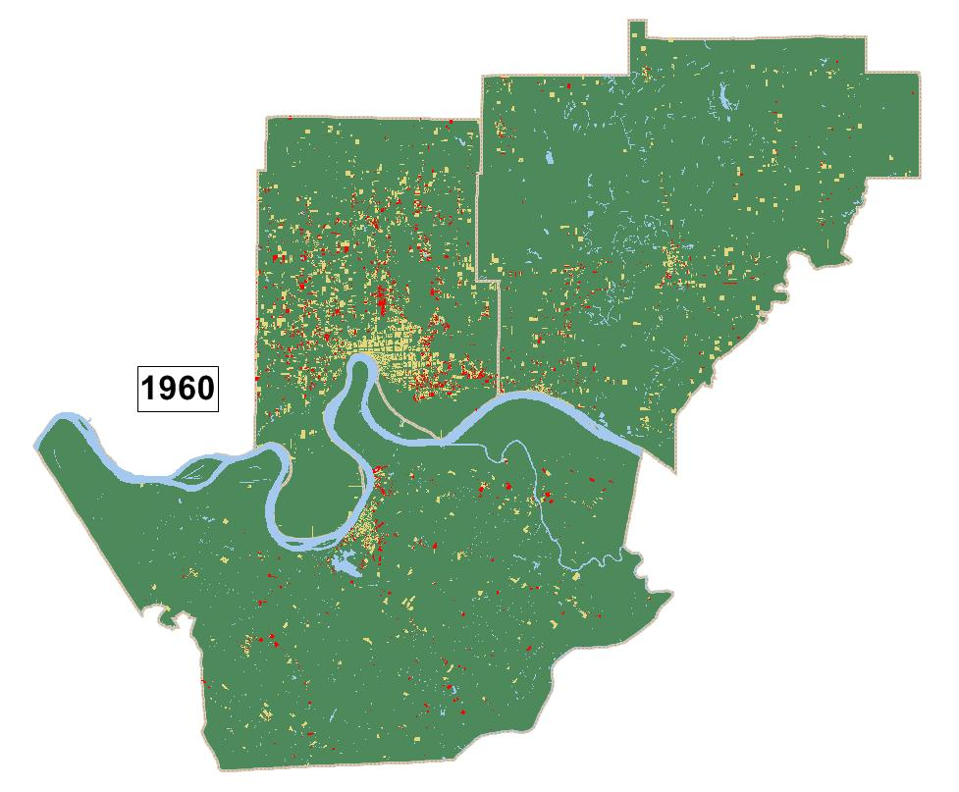
HELPViz – History & Future? (1940-2040)

Slide 18
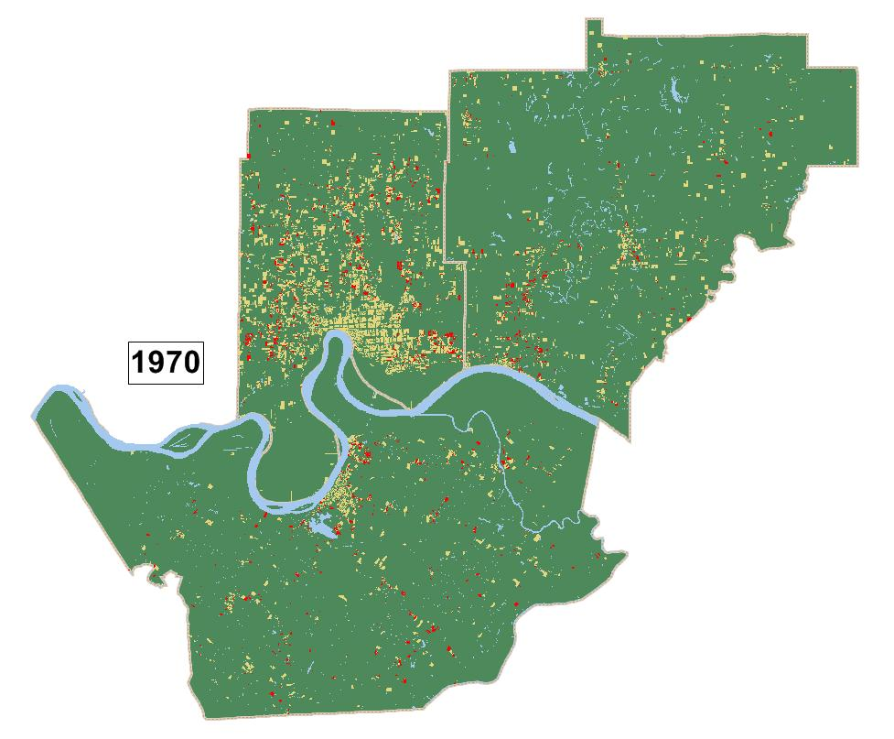
HELPViz – History & Future? (1940-2040)

Slide 19
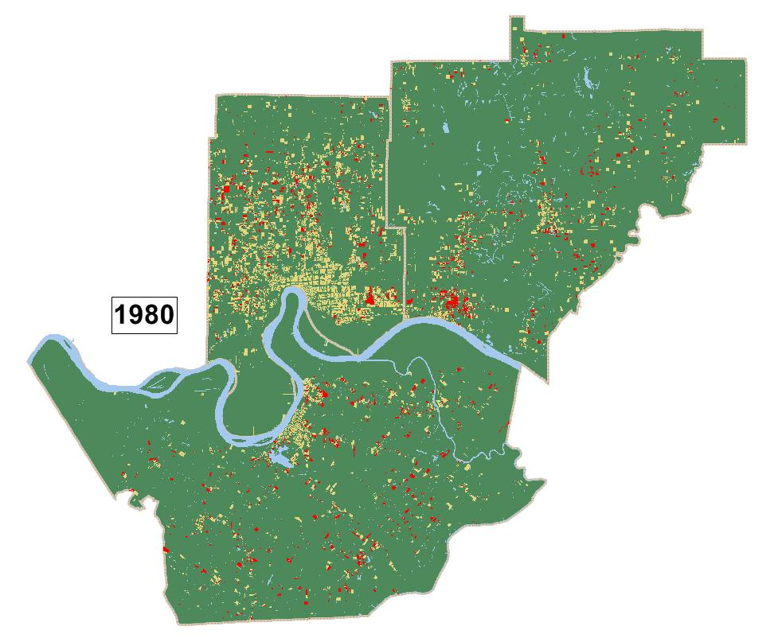
HELPViz – History & Future? (1940-2040)

Slide 20
HELPViz – History & Future? (1940-2040)

Slide 21
HELPViz – History & Future? (1940-2040)

Slide 22
HELPViz – History & Future? (1940-2040)

Slide 23
HELPViz – History & Future? (1940-2040)

Slide 24
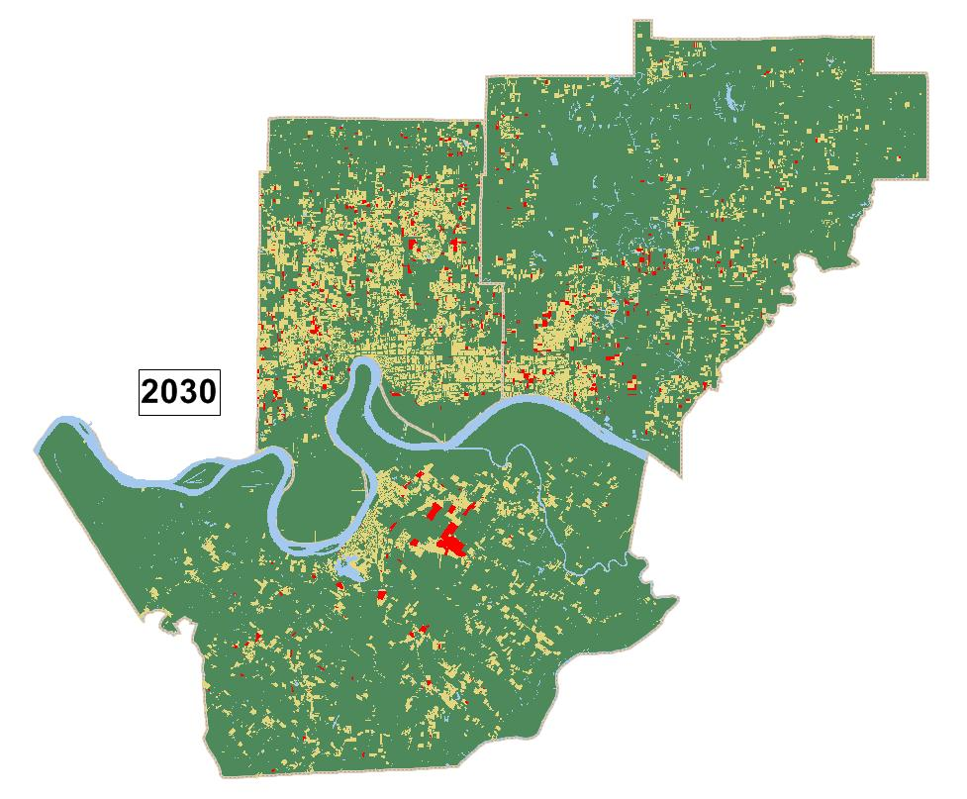
HELPViz – History & Future? (1940-2040)

Slide 25
HELPViz – History & Future? (1940-2040)

Slide 26
HELPViz – Envisioning Alternatives
HELPViz will be used to develop alternative scenarios too
Five main ‘knobs’
Overrides: the user can specify what does (or doesn’t) happen in particular locations and let the model figure out the rest
Vacancy Rate: assuming lower vacancy rates can result in infill (but how to make that happen?)
Codes / Capacities: capacities can be recalculated based on changes to setbacks, parking requirements, etc.
Zoning: the model can be used to test the effect of alternative zoning
Infrastructure: the model can test the effect of providing new roads or sewers

Slide 27
Evansville: Land-use development Scenarios
Transportation and Housing important components of the RPSD
Transportation and Housing scenarios
Four housing development scenarios
Measure transportation demand
Measure fiscal and environmental impacts
Notes:
The Evansville MPO wanted to perform scenario planning as part of the RPSD
Transportation and housing are the major components of the plan along with environment and economic development.
The table in the slide shows 4 housing scenarios being developed
These scenarios will be presented at public meetings with the help of CommunityVIZ
The fiscal, social and environmental impacts of the development will be calculated using the CommunityVIZ common impact wizard
Helps decision makers in making informed decisions about future growth

Slide 28
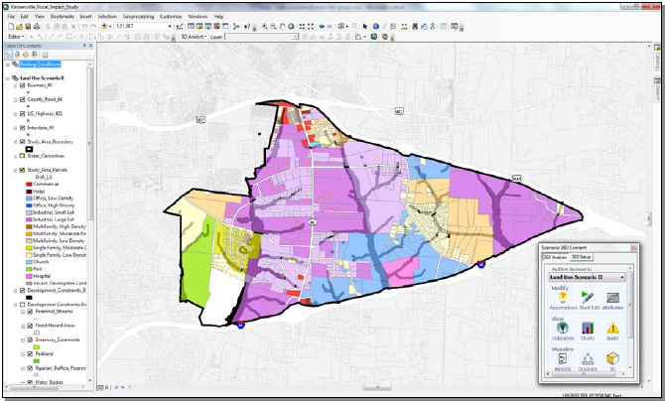
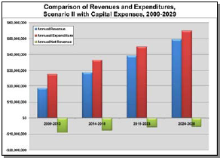
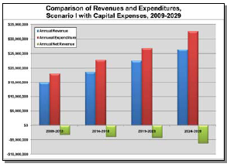
Impacts of Land-use development
Fiscal Impacts
Expansion, future operations and maintenance of infrastructure Transportation: Road network Bike & Ped facilities Transit system Water and Sewage lines
Environmental Impacts
Land consumption Air Quality Water runoff
Pictures show fiscal impacts of 2 development scenarios in Town of Kernersville, NC
Source: http://placeways.com/communityviz/gallery/casestudies/pdf/Kernersville.pdf

Slide 29
HELPViz Scale – Both Zones AND Parcels
Existing models use either zones or parcels
HELPViz uses BOTH zones and parcels
Information is available at both levels
Observations are available at both levels
Zones
Auto-based accessibilities
Households from Census
Vetted employment #’s
Parcels
Many attributes
Assessor’s data
Need to work with both anyway
Information
Allocation

