Slide 1
Myriad Uses of the Ohio Statewide Travel Demand Model for Access Ohio 2040 Strategic Transportation System (AOSTS)
Rob Bostrom
Greg Giaimo
Sashi Gandavarapu
Don Vary
Paul Hershkowitz
May 5 2013

Slide 2
Presentation Overview
Access Ohio 2040 Strategic Transportation System Background
Review of Ohio Statewide Model
Access Ohio Applications
  System conditions
  Corridor study
  Environmental Justice
  Economic modeling
Notes:
We want our clients to notice and understand this important difference.
We want them to see that together, we have more to offer them.
And we can offer these services in an integrated way. Across the entire project life cycle.
Our brand must convey this transformation to our clients.

Slide 3
Access Ohio 2040 Strategic Transportation System

Slide 4

AOSTS- Background
Schedule - March, 2012 – December, 2013
Purpose : support ODOT in producing an update to the Ohio Statewide Transportation Plan (Access Ohio 2030)
Involves assisting ODOT in guiding, informing and supporting transportation investment decision- making throughout the state
Notes:
We want our clients to notice and understand this important difference.
We want them to see that together, we have more to offer them.
And we can offer these services in an integrated way. Across the entire project life cycle.
Our brand must convey this transformation to our clients.

Slide 5
AOSTS - Background
The process involves:
  Determining goals, objectives and performance measures, as well as best practices in statewide planning (done)
  Developing statewide multimodal needs (done)
  Developing alternative investment scenarios to solve these needs (done)
  ID Statewide multimodal corridors and hierarchically rate them based on statewide importance (done)
Notes:
We want our clients to notice and understand this important difference.
We want them to see that together, we have more to offer them.
And we can offer these services in an integrated way. Across the entire project life cycle.
Our brand must convey this transformation to our clients.

Slide 6
AOSTS - Background
AOSTS will outline the funding packages, policies, and implementation processes towards a financially sustainable, modally-balanced, well-connected transportation system (underway)
The effort will also involve a proactive and ongoing process of soliciting public involvement and stakeholder outreach throughout the transportation plan update process (on-going)
The ODOT statewide model (OSTDM) is playing a key role in this effort
Notes:
We want our clients to notice and understand this important difference.
We want them to see that together, we have more to offer them.
And we can offer these services in an integrated way. Across the entire project life cycle.
Our brand must convey this transformation to our clients.

Slide 7
Ohio Statewide Model Overview

Slide 8
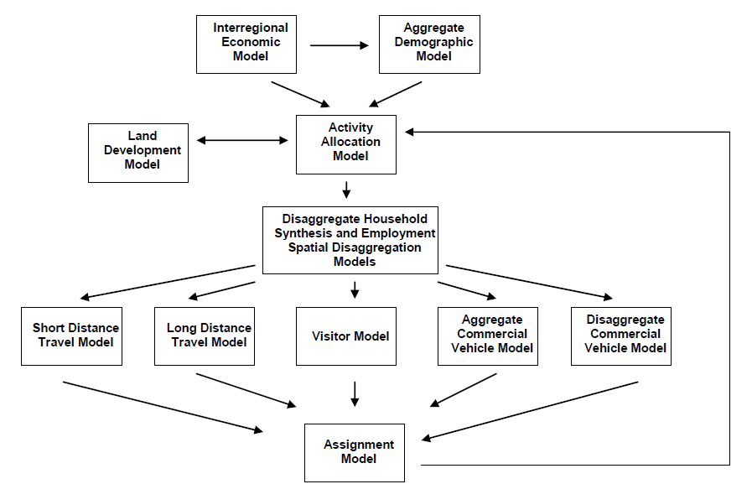
Ohio Statewide Integrated, Economic Land Use and Travel Demand Forecasting Model
Notes:
We want our clients to notice and understand this important difference.
We want them to see that together, we have more to offer them.
And we can offer these services in an integrated way. Across the entire project life cycle.
Our brand must convey this transformation to our clients.

Slide 9
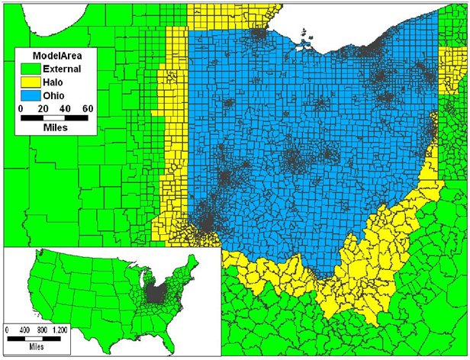
Ohio Statewide Model Overview
Notes:
We want our clients to notice and understand this important difference.
We want them to see that together, we have more to offer them.
And we can offer these services in an integrated way. Across the entire project life cycle.
Our brand must convey this transformation to our clients.

Slide 10
Ohio Statewide Model Overview
Size – see flash drive for loaded network.
Features – see ODOT web site for detailed info http://www.dot.state.oh.us/Divisions/Planning/SPR/ModelForecastingUnit/Pages/TravelDemandModeling.aspx
History
Uses

Slide 11
AOSTS applications

Slide 12
AOSTS Applications
Worked with Greg Giaimo on all applications
System Conditions Team
  CDM Smith: Sashi Gandavarapu, Jeff Carroll, Amanda Spencer, Laura Kulecz
Corridor Study Team
  CDM Smith: Sashi Gandavarapu, Suzann Rhodes, Paul Hershkowitz
Environmental Justice Team
  CDM Smith: Sashi Gandavarapu, Samantha Wright
  CH2MHill: Michelle Maggiore
Economic Modeling Team
  CDM Smith: Eric McClelland, Don Vary
Notes:
We want our clients to notice and understand this important difference.
We want them to see that together, we have more to offer them.
And we can offer these services in an integrated way. Across the entire project life cycle.
Our brand must convey this transformation to our clients.

Slide 13
AOSTS Applications
Statewide model informs long range planning in 4 main ways:
Report system conditions
Inform selection of corridors of importance for future program prioritization
Provide accessibilities for environmental justice analysis
Quantify economic impact of ODOT’s planned construction program
Notes:
We want our clients to notice and understand this important difference.
We want them to see that together, we have more to offer them.
And we can offer these services in an integrated way. Across the entire project life cycle.
Our brand must convey this transformation to our clients.

Slide 14
System Conditions: Performance Measures
Existing and projected levels of congestion from Statewide Congestion Management System
Projections in this system based largely on statewide model forecasts (see Greg Giaimo’s presentation in the model validation session at 1:30 Tuesday for more information on how that works)
Various performance measures reported such as:
  Vehicle miles traveled;
  Vehicle hours traveled; and
  Congested delay
See flash drive for report and maps.
Notes:
We want our clients to notice and understand this important difference.
We want them to see that together, we have more to offer them.
And we can offer these services in an integrated way. Across the entire project life cycle.
Our brand must convey this transformation to our clients.

Slide 15
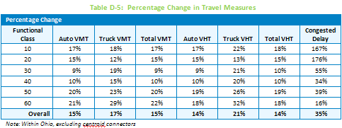
System Conditions: VMT changes 2010-2040
Projects a 15 percent increase in VMT to go with projected 13 percent increase in households. There is a 35 percent increase in overall delay due to congestion by the year 2040 with much higher increases in delays for interstates and expressways.
Notes:
We want our clients to notice and understand this important difference.
We want them to see that together, we have more to offer them.
And we can offer these services in an integrated way. Across the entire project life cycle.
Our brand must convey this transformation to our clients.

Slide 16
System Conditions: LOS Change 2010-2040
Calculate Levels of Service (LOS) at the planning level using methodology from the Highway Capacity Manual. See next two slides.
LOS is generally worse in the 2040 E+C network than the 2010 base conditions due to additional traffic. Urban areas experience worse conditions than rural area in both 2010 and 2040, which is not unusual since urban freeways are normally built to a LOS D standard rather than LOS C for rural highways.
Congestion also increases in the major urban areas such as Columbus and Cincinnati, as well as the Cincinnati-Dayton corridor.
Notes:
We want our clients to notice and understand this important difference.
We want them to see that together, we have more to offer them.
And we can offer these services in an integrated way. Across the entire project life cycle.
Our brand must convey this transformation to our clients.

Slide 17
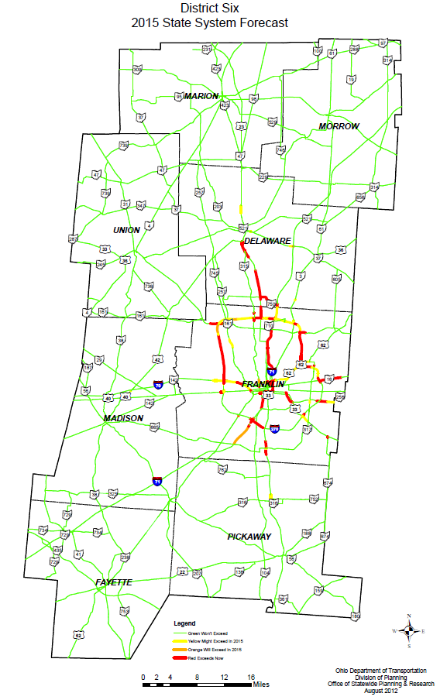
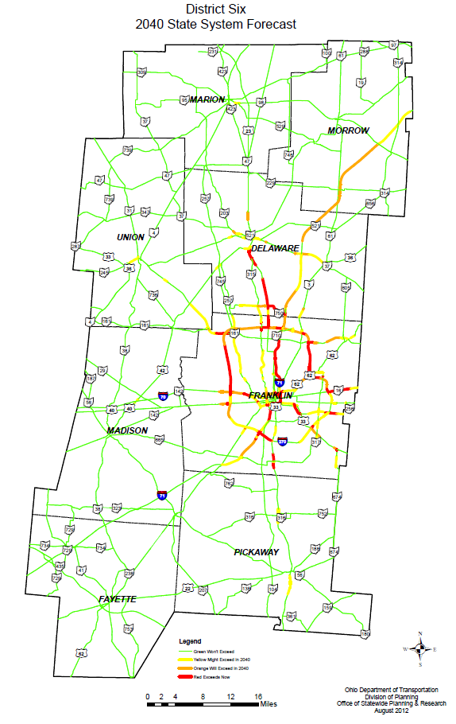
System Conditions: LOS Change 2015-2040
Notes:
We want our clients to notice and understand this important difference.
We want them to see that together, we have more to offer them.
And we can offer these services in an integrated way. Across the entire project life cycle.
Our brand must convey this transformation to our clients.

Slide 18
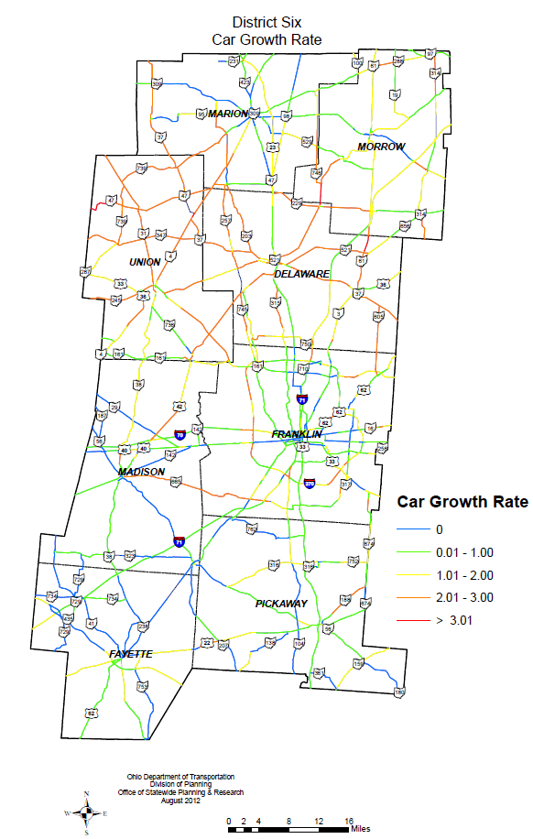
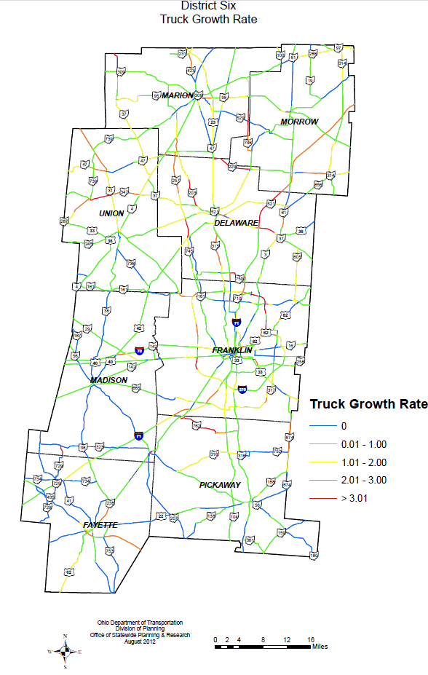
System Conditions: Growth Rates
Notes:
We want our clients to notice and understand this important difference.
We want them to see that together, we have more to offer them.
And we can offer these services in an integrated way. Across the entire project life cycle.
Our brand must convey this transformation to our clients.

Slide 19
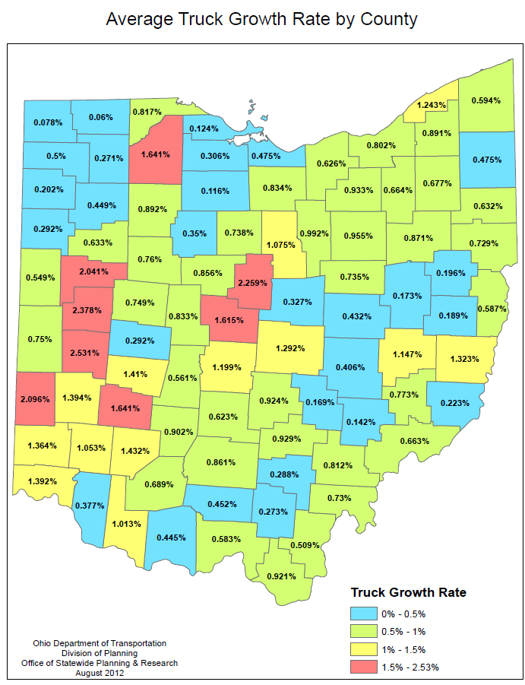
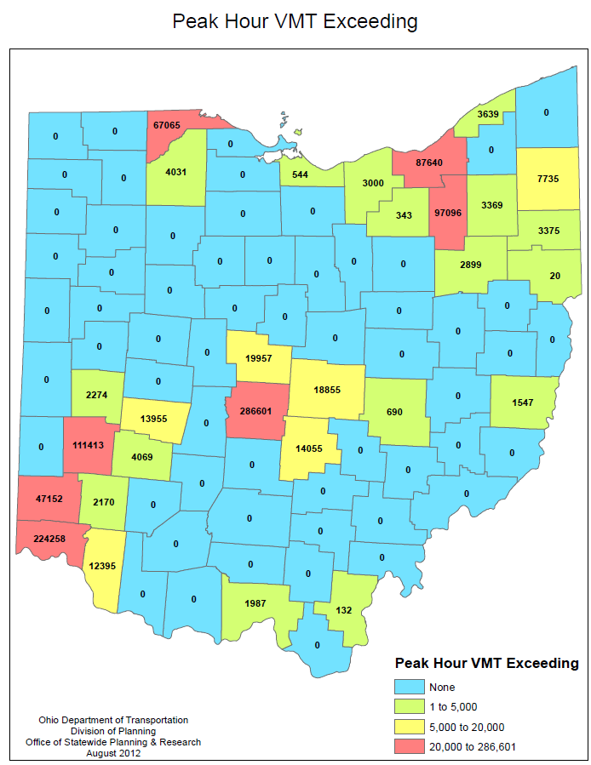
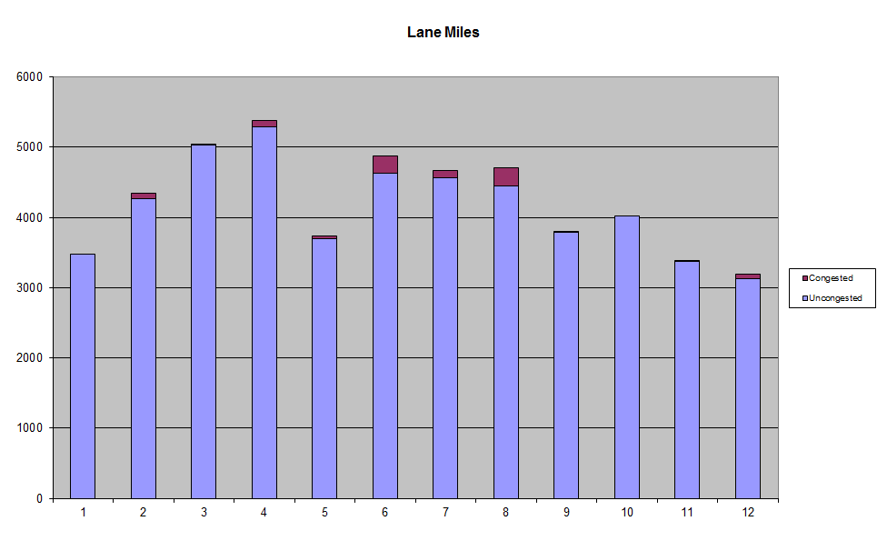
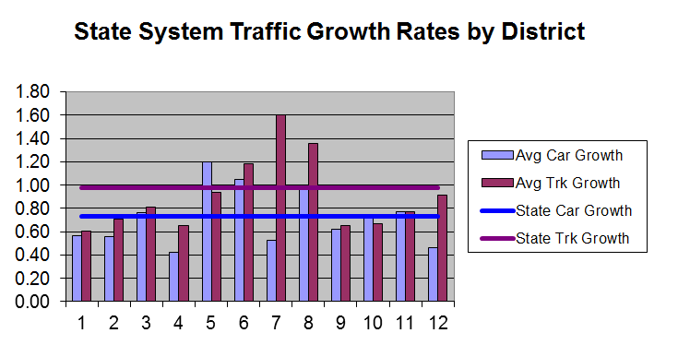
System Conditions: Etc.
Notes:
We want our clients to notice and understand this important difference.
We want them to see that together, we have more to offer them.
And we can offer these services in an integrated way. Across the entire project life cycle.
Our brand must convey this transformation to our clients.

Slide 20
Corridor Analysis
Corridor based plan (NOT A PROJECT PLAN!)
  Highway
  Also aviation, bike, maritime, rail and transit
Corridor level will be used to set future priorities
Recommended corridors include:
  National corridor
  Statewide primary corridor
  Statewide secondary corridor
  Beltways and connectors
  Local corridors
Corridor matrix under development
Notes:
We want our clients to notice and understand this important difference.
We want them to see that together, we have more to offer them.
And we can offer these services in an integrated way. Across the entire project life cycle.
Our brand must convey this transformation to our clients.

Slide 21
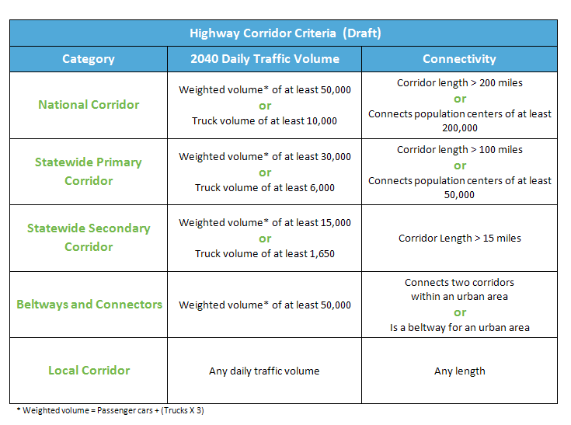
Highway Corridor Analysis
Exploratory analysis with model looked at various other measures such as detailed market segmentation available in model for defining and prioritizing corridors
Notes:
We want our clients to notice and understand this important difference.
We want them to see that together, we have more to offer them.
And we can offer these services in an integrated way. Across the entire project life cycle.
Our brand must convey this transformation to our clients.

Slide 22
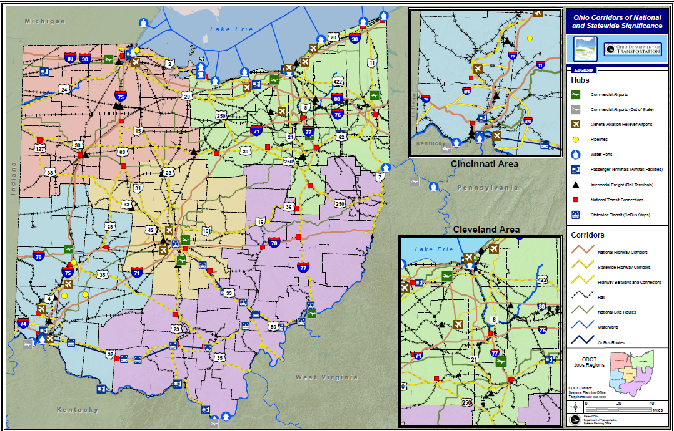
Corridor Analysis
Notes:
We want our clients to notice and understand this important difference.
We want them to see that together, we have more to offer them.
And we can offer these services in an integrated way. Across the entire project life cycle.
Our brand must convey this transformation to our clients.

Slide 23
Corridor Analysis
Corridors will be compared using these measures (under development)
  Corridor characteristics:
    Volume: miles/segment; 2010 ADT, 2040 ADT, % Change ADT, 2010 ADTT, 2040 ADTT, % change ADTT, value of commodities, % GSP, weighted volume
    Classification: state functional classification
    Connectivity: state evacuation plan, MPO, # jobs, MPO area’s population, # of multimodal facilities
  Performance Attributes (AOSTS Goal Areas)
    Preservation: pavement performance, bridge deficiency
    Safety: highway fatality safety score, highway serious injury safety score
    Mobility and Efficiency: Travel time reliability index #, volume/capacity 2010 and volume/capacity 2040
Notes:
We want our clients to notice and understand this important difference.
We want them to see that together, we have more to offer them.
And we can offer these services in an integrated way. Across the entire project life cycle.
Our brand must convey this transformation to our clients.

Slide 24
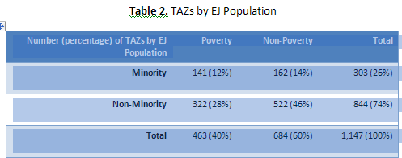
Environmental Justice Methodology
Identify the affected population using socio-economic data
  Minority
  Poverty
  Disadvantaged
Notes:
We want our clients to notice and understand this important difference.
We want them to see that together, we have more to offer them.
And we can offer these services in an integrated way. Across the entire project life cycle.
Our brand must convey this transformation to our clients.

Slide 25
Environmental Justice Methodology
Estimate the nature and extent of the impacts using ODOT post processor tool.
The post-processor tool uses model accessibility to generate a score using 16 employment categories as a function of travel time and available modes of transportation. These scores are then combined, based on types of employment, into five metrics:
  Accessibility to Jobs
  Accessibility to Goods and Services
  Accessibility to Health Care
  Accessibility to Schools
  Accessibility to Population
Each access metric is then weighted by the corresponding population subgroup.
  Base Year 2010
  Future 2040 Existing and Committed Network (2040 E&C)
  Future 2040 Build Network (2040 Build)
Notes:
We want our clients to notice and understand this important difference.
We want them to see that together, we have more to offer them.
And we can offer these services in an integrated way. Across the entire project life cycle.
Our brand must convey this transformation to our clients.

Slide 26
Environmental Justice Methodology
Assess whether the impacts are equitable by comparing access outputs for each TAZ for different scenarios with respect to:
  Percentage change in access
  Pair-wise statistical hypothesis testing
  Geographic overlay of impacts and EJ populations
Ohio Non-MPO % change in Job Access
  2040 E+C vs. 2040 build
  2010 vs. 2040 build
See flash drive for info on tool and report on results.
Notes:
We want our clients to notice and understand this important difference.
We want them to see that together, we have more to offer them.
And we can offer these services in an integrated way. Across the entire project life cycle.
Our brand must convey this transformation to our clients.

Slide 27
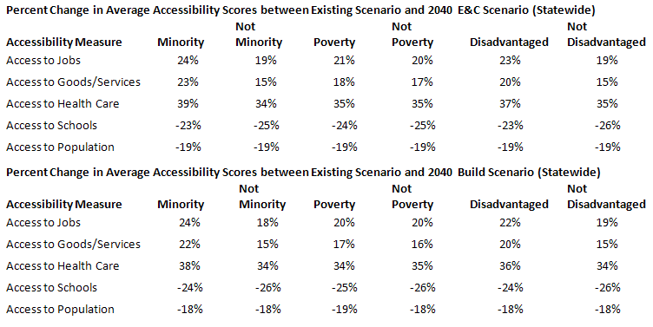
Environmental Justice Analysis
Notes:
We want our clients to notice and understand this important difference.
We want them to see that together, we have more to offer them.
And we can offer these services in an integrated way. Across the entire project life cycle.
Our brand must convey this transformation to our clients.

Slide 28
Environmental Justice Analysis
Access Ohio Background
Notes:
We want our clients to notice and understand this important difference.
We want them to see that together, we have more to offer them.
And we can offer these services in an integrated way. Across the entire project life cycle.
Our brand must convey this transformation to our clients.

Slide 29
Economic Analysis
While AOSTS is not a project plan, it will assess the economic impact of ODOT’s currently planned program of projects
Two components:
  TRAC (Transportation Review Advisory Council) projects which are all major new capacity projects, TRAC projects form the long range plan build network
  All other capacity projects in the STIP (STIP-TRAC = the long range plan no build network)*
  *some TRAC projects are in the STIP if they are near term, other are not if they are projected to open longer term
Notes:
We want our clients to notice and understand this important difference.
We want them to see that together, we have more to offer them.
And we can offer these services in an integrated way. Across the entire project life cycle.
Our brand must convey this transformation to our clients.

Slide 30
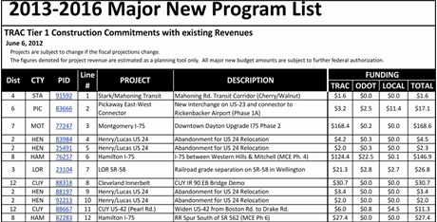
Economic Analysis: Tier 1 Projects
Notes:
We want our clients to notice and understand this important difference.
We want them to see that together, we have more to offer them.
And we can offer these services in an integrated way. Across the entire project life cycle.
Our brand must convey this transformation to our clients.

Slide 31
Economic Analysis
Networks are currently being updated in the model to represent the latest TRAC and STIP systems
In just a couple weeks, we have needed to code 300+ projects to advance network from 2007 to 2010 base, almost 500 projects to obtain 2015 no build network (TIP-TRAC) and about 90 TRAC projects to create build networks through 2040
Notes:
We want our clients to notice and understand this important difference.
We want them to see that together, we have more to offer them.
And we can offer these services in an integrated way. Across the entire project life cycle.
Our brand must convey this transformation to our clients.

Slide 32
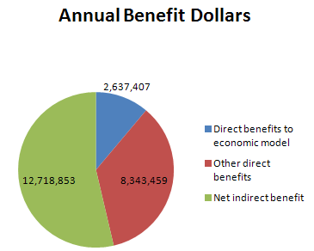
Economic Analysis
When complete we will rerun models through 2040 and then use ODOT’s CMAQ/User Benefit Process to generate economic impacts (the next presentation covers that in more detail)
Notes:
We want our clients to notice and understand this important difference.
We want them to see that together, we have more to offer them.
And we can offer these services in an integrated way. Across the entire project life cycle.
Our brand must convey this transformation to our clients.

Slide 33
Lessons Learned
Ongoing model updates can delay the final product.
Don’t reinvent the wheel, use what is already there as much as possible
Techniques used for LRTPs seem to vary significantly from state to state. Perhaps a synthesis is needed soon.
Long range plan process is more important than long range plan documents, agency staff need to be intimately involved, consultant’s provide number crunching and documentation support
Notes:
We want our clients to notice and understand this important difference.
We want them to see that together, we have more to offer them.
And we can offer these services in an integrated way. Across the entire project life cycle.
Our brand must convey this transformation to our clients.

