Slide 1
Breaking the Static Barrier: Building Regional Support for Implementation of Dynamic Traffic Assignment in Long-Range Planning Processes
Peter Bosa, Senior Researcher and Modeler
Metro (Portland, OR)
TRB Planning Applications Conference
May 5th, 2013

Slide 2
Breaking the Static Barrier
Portland Metro has spent 3+ years developing regional DTA tools
Detailed networks, adjusted trip tables
Conversion of networks to DTA
Sample outputs
How to convince regional partners to adopt/use new tools? Demonstrating value in additional costs?
DTA training and workshops
Collaborative projects
DTA applications in Portland, OR
Clackamas County Transportation System Plan
Southwest Corridor Plan

Slide 3
DTA in Portland, OR Networks
2010 Network
Built from NAVTEQ base, 6” aerial photos, Google Earth and Streetview
zones : 2,162
nodes : 12,600
signalized : 2,200
stop signs : 2,200
links : 32,100
2035 Network
Built up from 2010 using regional transportation plan project list
zones : 2,162
nodes : 12,800
signalized : 2,350
stop signs : 2,450
links : 33,000

Slide 4
DTA in Portland, OR Future year peak spreading
Excess Demand
‘Spread’
Demand
‘Spread’
Demand

Slide 5
DTA in Portland, OR Future year peak spreading
Corridor at or above capacity
peak spreading occurs
Corridor with excess capacity
no peak spreading necessary
5

Slide 6
DTA in Portland, OR Conversion to DTA
Base networks stored in VISUM, adjusted trip tables loaded from regional TDM
Static assign in VISUM to produce project subarea, optimize signals
Conversion to Dynameq and/or DynusT

Slide 7
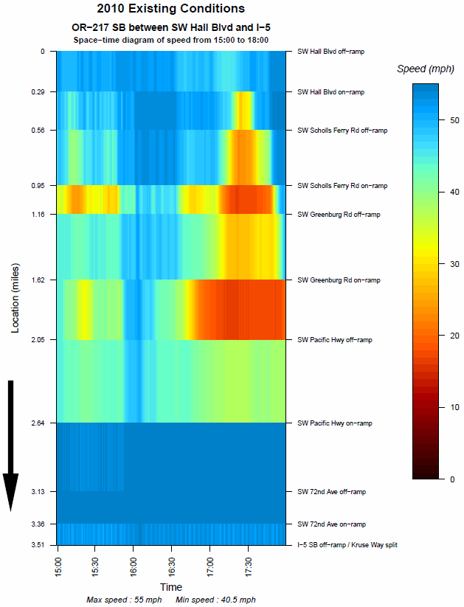
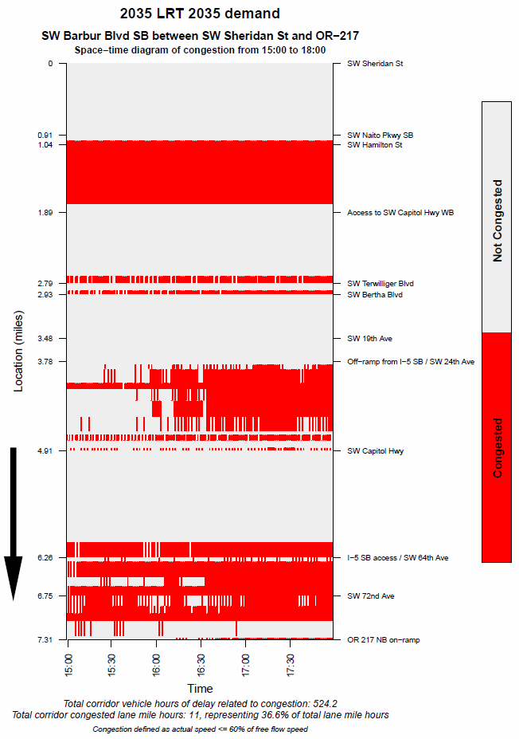
Development of Tools and Outputs Space-time diagrams

Slide 8
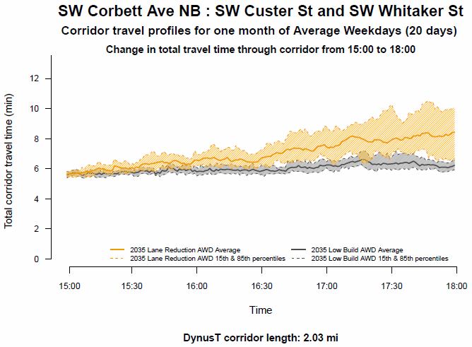
Development of Tools and Outputs Travel time and reliability plots

Slide 9
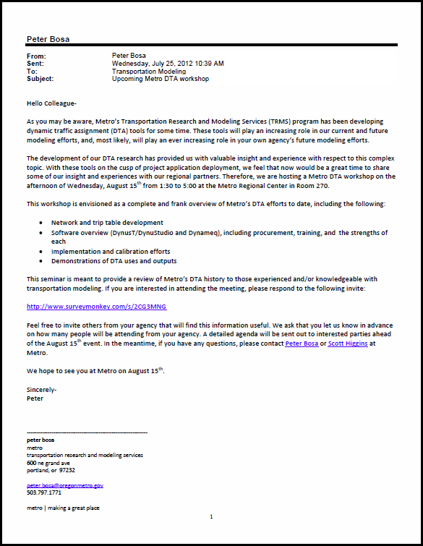
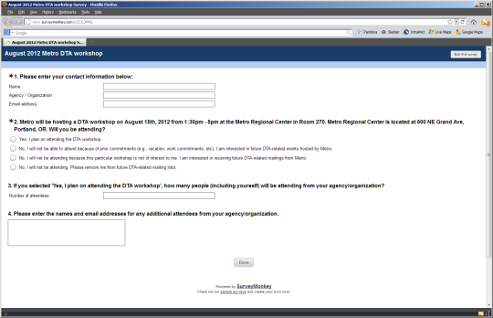
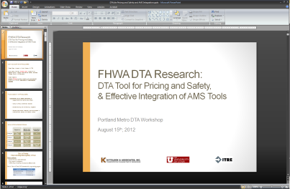
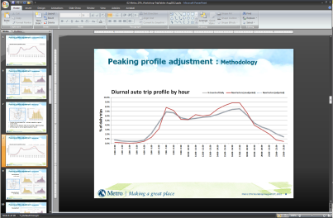
Building Regional Support DTA seminars
Regular meetings with regional partners
Representatives of state, county, city DOTs within Metro jurisdiction
Interested local consultants
Limited outside-of-region people
First round of meetings meant to introduce
Concepts explained to key stakeholders
Metro-hosted open house to discuss research
Developers invited to speak
Held in parallel with training opportunities
Second round of meetings meant to update
Status of Metro DTA tool development
Consultants asked to present on local DTA efforts
Lessons learned to date
Proof of concept examples
Third round of meetings meant to demonstrate
Presentation of results from DTA application
Ask collaborating partners to present

Slide 10
Building Regional Support Collaborative teams
Local Jurisdiction
Identified project, Local knowledge and experience
Consultant
DTA tools and experience, TDM compatibility
Independent party, Provides technical oversight

Slide 11
DTA Applications in Portland, OR Clackamas County Transportation System Plan
Local Jurisdiction
Clackamas County
Consultants
Kittelson & Assoc (KAI)
University of Utah

Slide 12
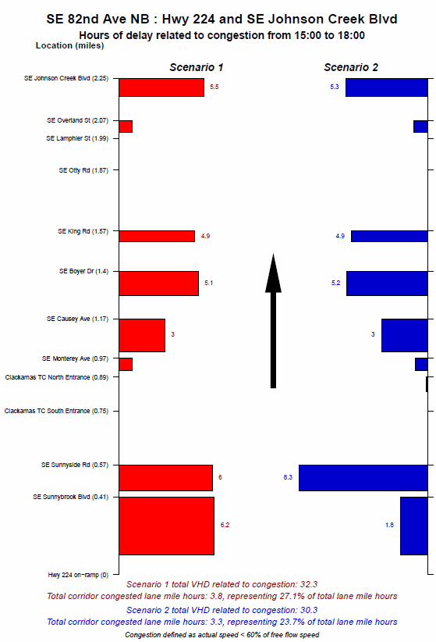
DTA Applications in Portland, OR Clackamas County Transportation System Plan
Analyze cost-benefit of building arterial extension using transportation funds in Urban Renewal Area
Six alternatives studied for year 2035
Full build, capacity improvements, mix of both
Alternatives evaluated on impact to local intersections, outflow capacity of local streets
Lessons-learned:
Importance of signal timing to DTA
Signal optimization for future years
DTA packages vary in effort needed for calibration effort vs. level of detail provided by tool

Slide 14
DTA Applications in Portland, OR Southwest Corridor Project
Local Jurisdiction
Oregon DOT
City of Portland
Metro
Consultant
DKS Associates

Slide 15
DTA Applications in Portland, OR Clackamas County Transportation System Plan
Broad level analysis of capacity restriction on arterial related to potential high capacity transit line (LRT or BRT)
Two alternatives studied: Baseline vs. Build
Decision makers looking at potential auto diversion impacts
Local streets vs. freeway
‘Unserved demand’ related to capacity constraints in super-saturated corridor
Lessons-learned:
Nuances of traffic flow theory for developing accurate models for subarea
Ramp meters become EXTREMELY important in future years

Slide 16
Data
Animation intended for illustration purposes only
Produced by DKS Associates on behalf of SW Corridor project
Data provided by Metro

Slide 17
Summary and Next Steps
Development of new tools does not necessarily imply early adoption
Important to educate, update, and demonstrate to clients / potential partner agencies
Collaborative efforts with public / private partners builds comfort with tools while providing a framework for increased knowledge building
Develop additional outputs for showcasing benefits of DTA
Implement DTA in Regional Transportation Plan studies
More robust integration of DTA into travel demand modeling process, including DTA transit and model feedback

Slide 18
Acknowledgements and Questions?
Partner agencies
Clackamas County
Oregon Department of Transportation
City of Portland
Partner consultants
Kittelson Associates Inc (KAI) / University of Utah
DKS Associates
Transportation Research and Modeling Services – Metro
600 NE Grand Ave.
Portland, OR 97232
(503) 797-1700
Peter Bosa
Peter.Bosa@oregonmetro.gov

