Slide 1
Transit Beyond Travel Time and Cost
Incorporation of Premium Transit Service Attributes in the Chicago Activity-Based Model
Notes:
Background
GO TO 2040
Existing CMAP ABM
Enhance transit components for better policy analysis

Slide 2
Project Team
Chicago Metropolitan Agency for Planning (CMAP)
Kermit Wies & Matt Stratton
Parsons Brinckerhoff (PB)
Peter Vovsha, Joel Freedman, Ben Stabler, Binny Paul, Roshan Kumar
Resource Systems Group (RSG)
Maren Outwater, Bill Woodford, & Jeff Frkonja
Notes:
Our project team consists of myself and Kermit Wies as project managers and providers of local color.
The team from PB first developed our ABM in 2011 and is the lead contractor on this project. The team from RSG is a sub, and brings their expertise and knowledge gained from the TCRP H-37 research on premium transit service attributes that affect mode choice.

Slide 3
Sources of Inspiration
TCRP H-37
SANDAG, MAG, SACOG
Chicago New Starts Model
Portland Metro
LACMTA/FTA
Notes:
TCRP H-37 has shown that indeed transit riders are sensitive to service attributes beyond cost. Cleanliness, fare policy, reliability, crowding, and many other variables do play an important role in mode choice. “Characteristics of Premium Transit Services that Affect Choice of Mode”
SANDAG, MAG, and SACOG have all helped lead the way in introducing finer spatial resolution to their models. From census blocks at SANDAG to parcels at SACOG.
The Chicago New Starts model introduced finer spatial resolution to better handle transit access.
Portland Metro - “Understanding & Modeling Transit Preferences”
LACMTA/FTA - “Incorporation of Transit Capacity Constraints, Crowding and Reliability in Travel Models

Slide 4
Model Improvements
Model Component | Phase 1 | Phase 2
Advanced “non-labeled” mode choice | X | X
Transit access / spatial resolution |  | X
Station characteristics | X | X
In-vehicle characteristics | X | X
Capacity constraints |  | X
Crowding effects |  | X
Service reliability |  | X
Transit frequency / wait time | X | X
Fare / cost structures | X | X
Individualized transit path choice |  | X
Mobility attributes and modality |  | X
Notes:
So, we clearly had a tall task in front of us. These are the model components that we set out to improve (or create) in the two phases of our project. Phase 1 consisted of introducing a calibrating more ABM components related to transit and then introducing a new skimming procedure that skimmed all time periods. Phase 2 was about collecting a lot of transit service data, coding it into the model transit networks, and then estimating transit users’ sensitivities to these new attributes like crowding, reliability, cleanliness, etc.

Slide 5
Non-Labeled Mode Approach
Refer to actual service characteristics and understand traveler perceptions
Limit mode & geography-specific constants
Notes:
Another component of this project was to get away from using mode and geography constants in our procedures. This approach as been promoted by FTA and is the essence of TCRP H-37.
As opposed to using mode labels to a greater degree, this approach allows the users to see the various services as generic. The user should not care what label is on a service as long as it has a high utility for their particular trip.
Fewer modes in choice set
Transit user sees generic transit service where different modes and lines can be used
Access modes (Walk, PNR, KNR) as distinct options
Path choice sensitive to person and transit attributes

Slide 6
Mode Choice Alternatives
Previous (Labeled) >> | Phase 1 (Interim) >> | Phase 2 (Final)
Walk to bus | Walk to conventional transit | Walk to transit
Walk to rail | Walk to premium transit
Drive to rail | PNR | PNR
Drive to bus | KNR | KNR
Notes:
These are the mode choice alternatives from the various phases of our project. Notice that as you work across the table, the access modes become the key grouping criteria. As opposed to grouping the mode choices based on line haul mode and access mode.
Walk to Transit, PNR, and KNR will each have 3 nested modes, defined by user path preferences (walk distance sensitivity, transfer sensitivity).

Slide 7
Spatial Resolution
17K MAZs nested in 2K TAZs
All transit trip ends at MAZ geography
Transit Access Points (TAPs)
Virtual path building
Access/egress time (Python)
12 threads
Station-to-station time (EMME)
Access/egress + Station-to-station time (Java)
Notes:
Our ABM initially used about 2000 TAZ’s as the base geography. However, for the Chicago model region, this has long been an inadequate number of zones, not only for transit, but also on the highway side. CMAP and it’s predecessor CATS have long maintained a system of micro-analysis zones that nest within the TAZ. These micro zones are based on PLSS quarter sections and have long been the base geography for trip generation in our 4-step model. This project sought to utilize this finer geography for transit trip ends in the ABM. However, our consultant team had to find a new approach for path building since 17K by 17K matrices are not feasible.
Using our a real street network, they first calculated micro-zone to transit station shortest paths in a Python script, then used EMME’s station to station skims, and finally used a Java procedure to combine these components into path alternatives.

Slide 8
Transit Virtual Path Building
Characteristic | Origin TAP | TAP-to-TAP | Dest. TAP
Station type | X | X | X
Real-time information | X | X | X
Formal parking capacity | X |  | X
Informal parking capacity | X |  | X
Parking cost | X |  | X
Parking lot walk time | X |  | X
KNR convenience category | X |  | X
Buffered area crime rate | X |  | X
Buffered retail density | X |  | X
First boarding fare | X
Boarding (traversal) time |  | X
Ease of boarding |  | X
Station cleanliness |  | X

Slide 10
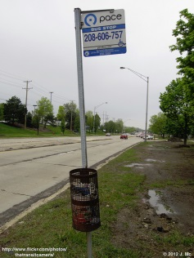
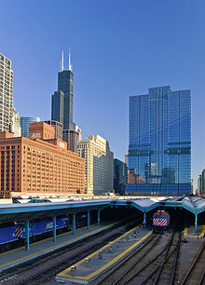
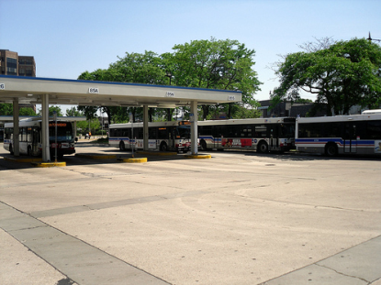
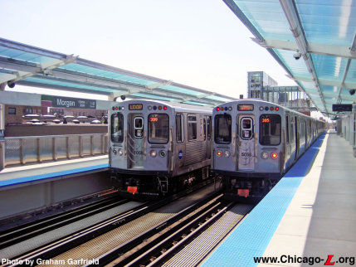
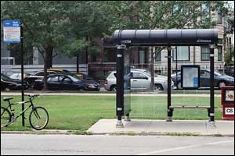
Transit Stop Types
Pole
Bus Shelter
Bus Plaza
Rail Station
Major Terminal
Notes:
Built from GTFS stops (37K). Collapsed to <6K “transit access points” located at current model network nodes. These are the new zone centroids for transit demand.
Our stops were classified into 5 types based on the level of comfort and service provided. They range from the basic curb-side “pole” bus stops to the high amenity commuter rail terminals in downtown Chicago.

Slide 11
Transit Stop Parameters
Additional variables considered
Proximity to commercial services
Stop/station environment (wait convenience)
Ease of paying (fare policy & media)
Ease of boarding (in combination with vehicle type)
Cleanliness
Security
Notes:
For phase 2, we introduced other variables to better represent the transit environment (such as commercial services nearby, ease of fare payment, ease of boarding at a particular stop or vehicle type, stop and vehicle cleanliness, and personal safety).
These are all represented as extra weights on access, egress, and waiting time.
Stop/station environment
- Bus poles least convenient, rail terminals most convenient
Cleanliness
- Base value for all stop types; becomes less clean with more use (unless environment is not controlled by transit agency)

Slide 12
Transit Stop Wait Time
Physical time
Perceptional multiplier
Schedule
headway
Wait time
fraction
Effective
multiplier
Station-specific
wait convenience
×
×
×
Station
cleanliness
Extra unreliability wait
Notes:
This illustrates how perceived waiting time at a stop or station is calculated. The actual time (a function of headway, wait time, effective headway, and unreliability) is multiplied by factors representing the convenience of waiting at each stop and the cleanliness of the surrounding stop’s environment.
Talk about CTA bus data and how it was processed and used.

Slide 13
Extra Average Wait Time
Time-of-day impact
×
Inverse impact of headway
Scheduled headway
Crowding impact
Cumulative route distance effect
Notes:
We also are building in transit unreliability as an additional weight on wait time and IVT.
Function of:
- Transit mode (bus only in model)
- Scheduled frequency
- Accumulated roadway saturation
Accumulated route length
Crowding
Headway
Time of day
- Accumulated number of stops
- Accumulated transit stop activity

Slide 14
In-Vehicle Parameters
Additional variables considered
Seating comfort
Unreliability
Crowding
Productivity (work, sleep, socialize)
Cleanliness
On-board amenities
Socio-economic compatibility between riders
Notes:
We also wanted to estimate in-vehicle parameters for various user classes. Things like comfort of seating, ability to be productive, vehicle cleanliness, on-board amenities, and social compatibility were considered. While often difficult to collect such data (particularly cleanliness and socio-economic compatibility), we realized these variables actually played a role in the decision to use a particular type of transit. In the absence of observed data, we used plausible place holders and used the skimming procedures to fill some of these variables.

Slide 15
In-Vehicle Time
Physical time
Base perceptional multiplier
Additional perceptional multiplier
1
Crowd. for seat.
×
Prob. seat
Comfort
Convenience
Temperature
Amenities
Average time
×
×
Crowd. for stand.
×
Prob. stand
Unreliability
Productivity
×
Prob. seat
Social environment
On-board cleanliness
Notes:
This is how the in-vehicle perception factors were applied to the actual IVT.

Slide 16
In-Vehicle Crowding
Crowd. factor
Standing
2.00
Seating
1.50
1.20
1.00
0
Max.
Convenience
Seated
Capacity
Total
Capacity
Volume
Notes:
This illustrates how the crowding factors increase for standing and seated passengers as passenger volume increases.

Slide 17
In-Vehicle Social Environment
Proportion of Class 1
×
Perception of Class 1 by X
IVT multiplier component for Class X
=
Proportion of Class 2
×
Perception of Class 2 by X
Proportion of Class 3
×
Perception of Class 3 by X
Modeled passenger | Perception of other passengers as additional IVT weight
 | Class 1 | Class 2 | Class 3
Class 1 | 0.00 | 0.00 | 0.00
Class 2 | 0.10 | 0.00 | 0.00
Class 3 | 0.50 | 0.00 | 0.00
Notes:
Social Environment. Not often modeled, but it certainly can play a role in the choices of some riders. Like the previous variables, our hypothesis is that each user class exhibits different sensitivities to in-vehicle conditions, which in this case are the mix of other user classes. In our model structure, we create skims that store the mix of user classes that one would encounter making a given trip on a given mode. User classes are defined by age and HH income.
Rarely modeled, but unpleasant social experiences discourage transit use
Can be modeled
Proportion of different user classes encountered
User classes defined by age and HH income
Socio-economic friction factor part of perceived IVT multiplier
The table illustrates of how the IVT weights are applied based on the mix of user-classes (defined by age and HH income).

Slide 18
In-Vehicle Productivity
Mode-vehicle type | Fixed IVT productivity bonus
 | User class 1 | User class 2 | User class 3
Local Bus | 0.00 | 0.00 | 0.00
Express Bus | -0.05 | -0.05 | -0.10
Metro | 0.00 | 0.00 | 0.00
Commuter Rail | -0.05 | -0.10 | -0.20
Notes:
For seated passengers using each mode.
This illustrates our initial productivity bonus multipliers for each user class using each distinct mode. Notice that Local Bus and Metro offer no productivity bonus for any user class, while the other modes offer varying bonuses to each user class. The idea here is that user class 3 (generally higher income and older) is more concerned with finding a seat and therefore being more productive, while user class 1 (generally lower income and younger) is less concerned. This hypothesis is to be tested as the project concludes in the next few months. Heuristics; not based on survey.

Slide 19
Conclusions
ABM is a better platform for testing a variety of transit attributes
ABM required little modification
Lots of data development
Final Tasks
Finalize measurable transit service attributes
Estimate individual path choice preferences
Incorporate in operational ABM & transit network procedures

Slide 20
Questions?
Matt Stratton, mstratton@cmap.illinois.gov
Peter Vovsha, vovsha@pbworld.com
Ben Stabler, stabler@pbworld.com
Maren Outwater, maren.outwater@rsginc.com

