Slide 1
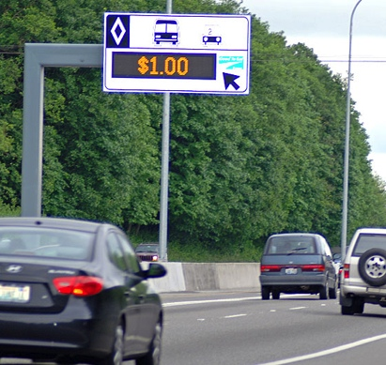
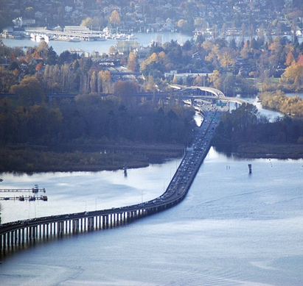
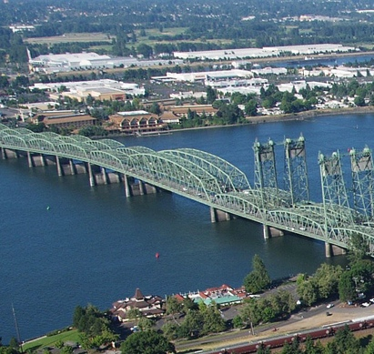
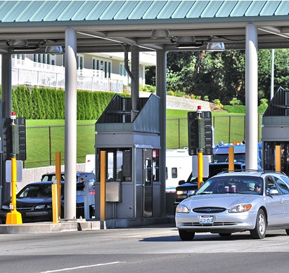
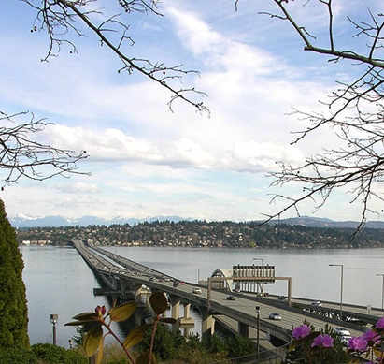
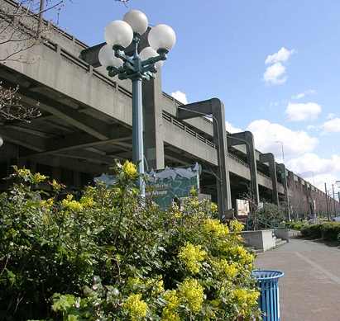
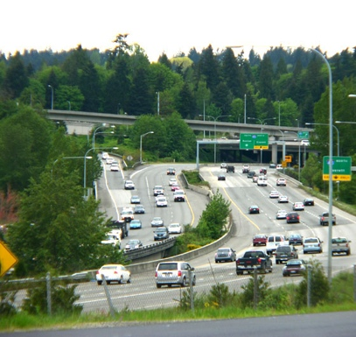
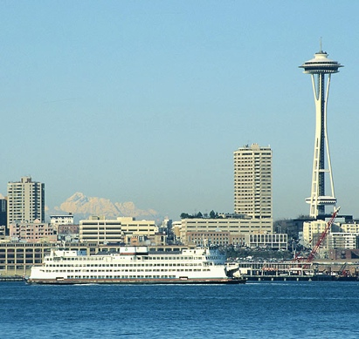
Application of SHRP2 Decision Support Tool to SR 509 Corridor Planning
Shuming Yan, PE
Deputy Director, UPO
Delwar Murshed
Senior Planner, UPO
Lynn Peterson
Secretary of Transportation
The 14th TRB National Transportation Planning Applications Conference May 8, 2013

Slide 2
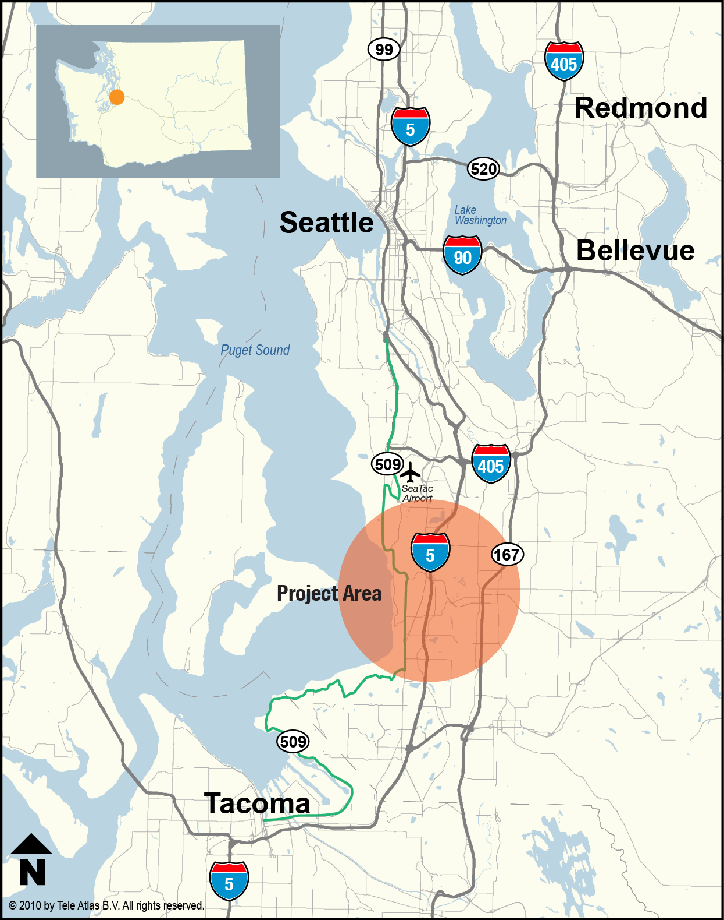
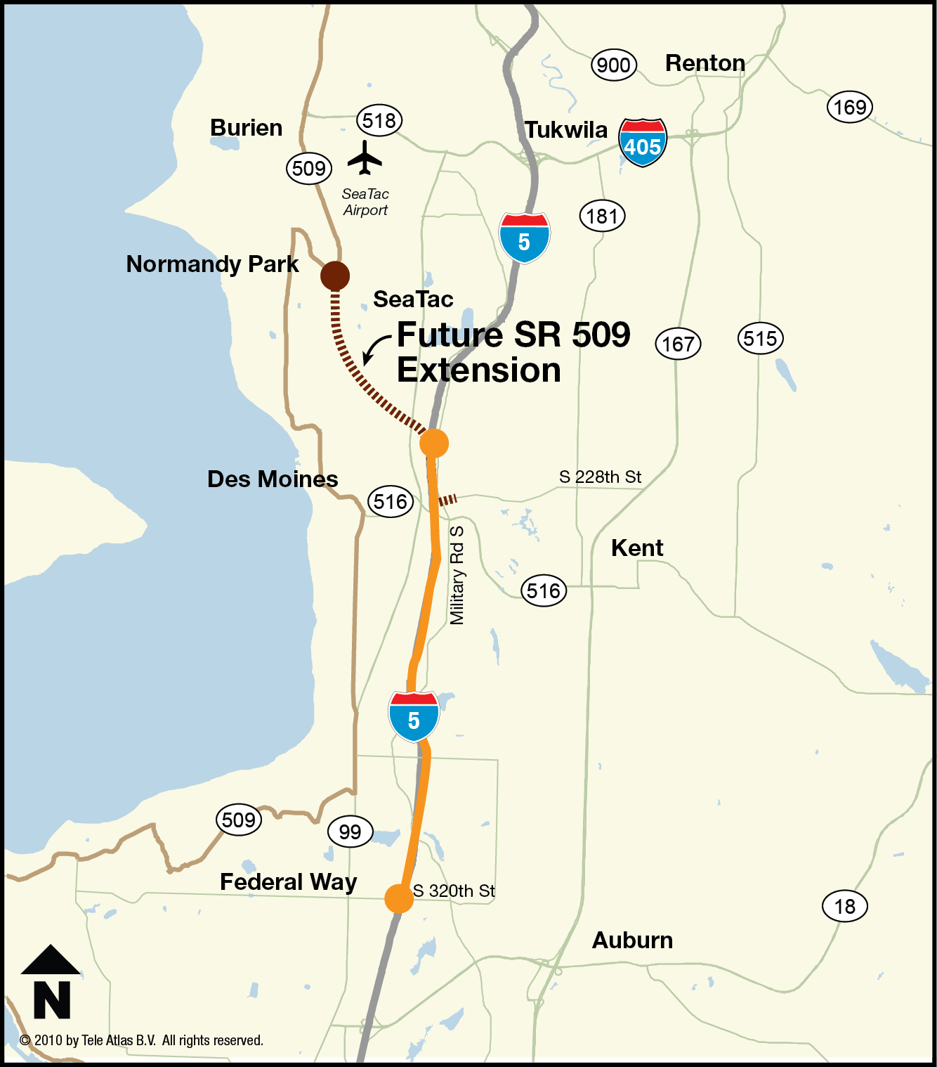
SR 509 Extension Status Overview
Project Location
Notes:
MISSING LINK
Its completion is expected to:
Relieve congestion on local roads and other highways
Move freight faster, more safely and more economically
Improve regional mobility
Insert vicinity map

Slide 3
SR 509 Extension Status Overview
The Master Plan
509 Extension: Complete SR 509 by building three miles of missing freeway link and connecting to I-5 with three lanes each direction (two general purpose lanes and one HOV lane).
I-5: Widen more than eight miles of I-5 from the SR 509 extension to SR 18 and rebuild several interchanges.
Airport Access: Include a freeway connector that provides direct access to the Sea-Tac International Airport from the south.
Kent Valley Access: Provide a direct connection from SR 509/I-5 to the Kent Valley, a major freight corridor.

Slide 4
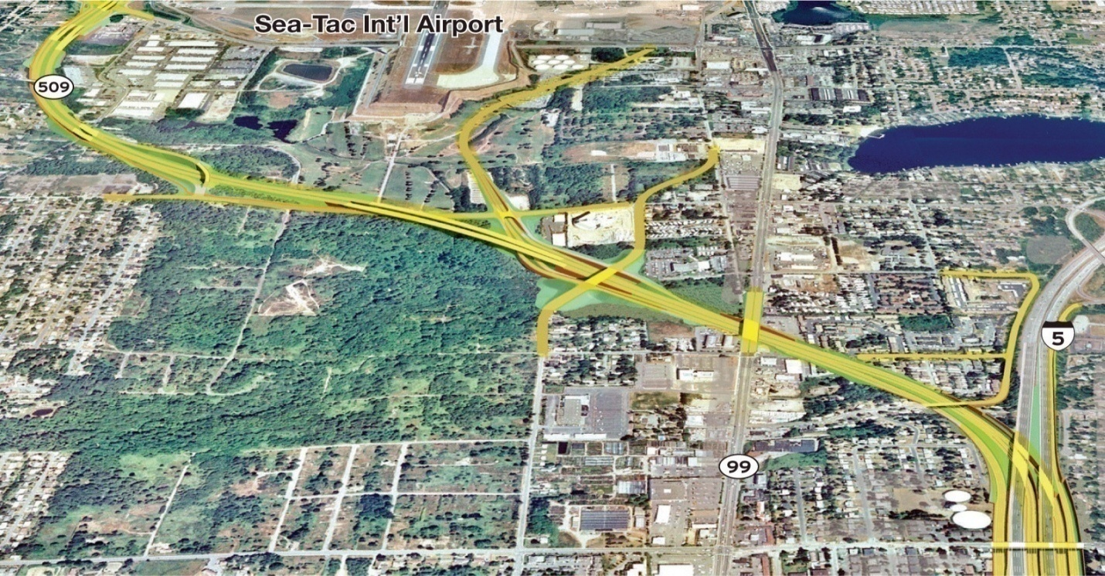
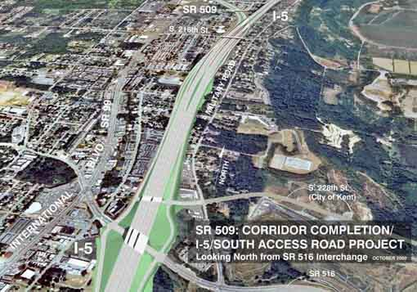
SR 509 Extension Status Overview
What has been done so far?
$86M invested to date
  EIS/ROD complete in 2003
  30% of design work
  40% of ROW acquired
  Early environmental construction
$1.2 billion needed.
Several funding attempts have failed.
Notes:
MISSING LINK
Its completion is expected to:
Relieve congestion on local roads and other highways
Move freight faster, more safely and more economically
Improve regional mobility
Insert vicinity map

Slide 5
How to Finance the project?
The 2009 Washington State legislature directed WSDOT to study the feasibility of tolling to help fund the project
The study found that tolling is feasible. It would:
  Generate revenue
  Reduce the demand, create phasing opportunity

Slide 6
Toll rate, traffic and revenue relationship
Notes:
The X axis represents toll rate, the Y axis shows traffic volume. The red line depicts traffic volume, the green line depicts revenue.
As the toll rate increases initially, the revenue increases, but the traffic volume decreases. As the rate increases to a certain point, the traffic volume drops so much that yield lower revenue.
Two way of tolling, toll to generate max revenue, or toll to maximize corridor and system performance.

Slide 7
2030 Travel Demand Forecast
Full Build – Toll Free vs. Tolled

Slide 8
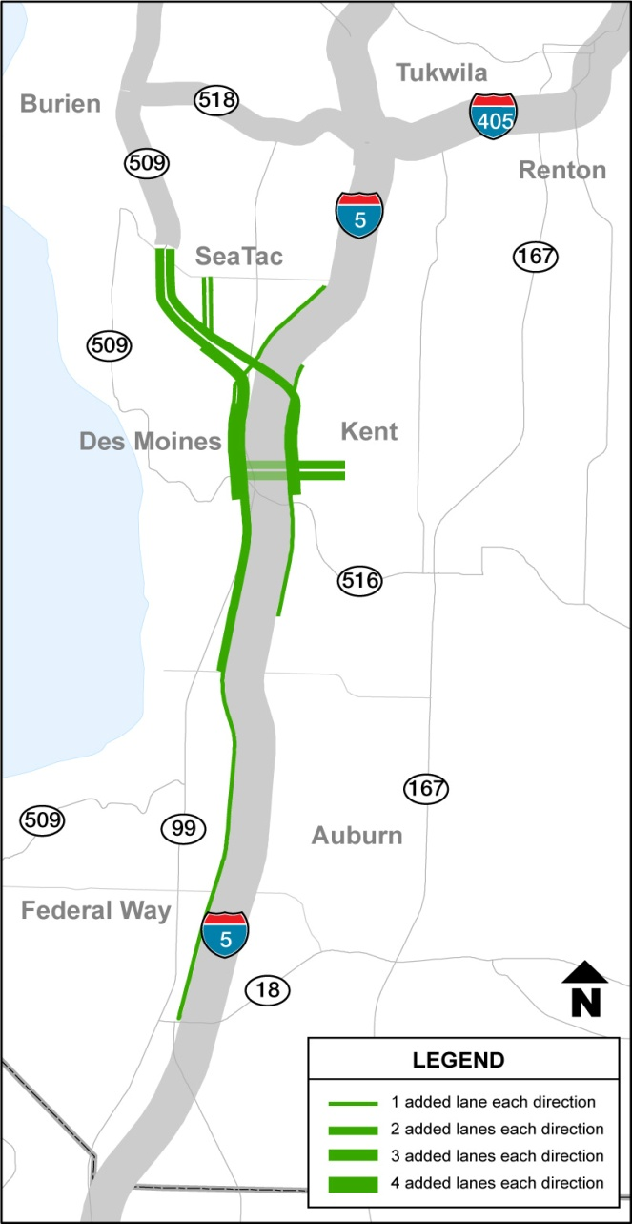
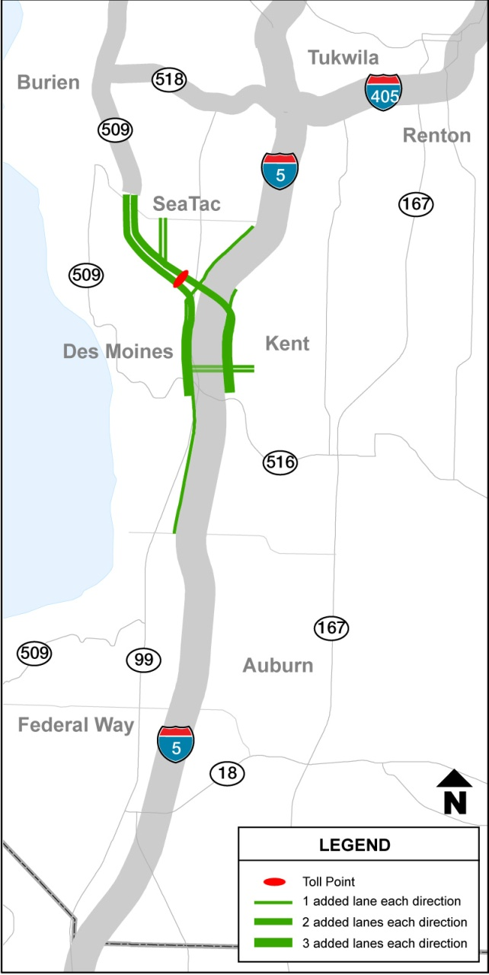
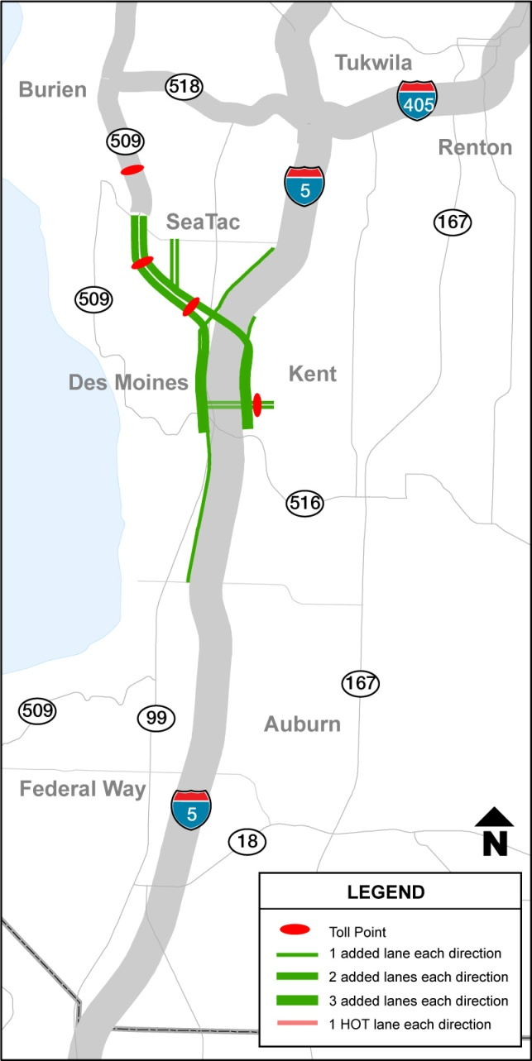
Current Design
SR 509 Toll Concepts
Option 1
Option 1a

Slide 9
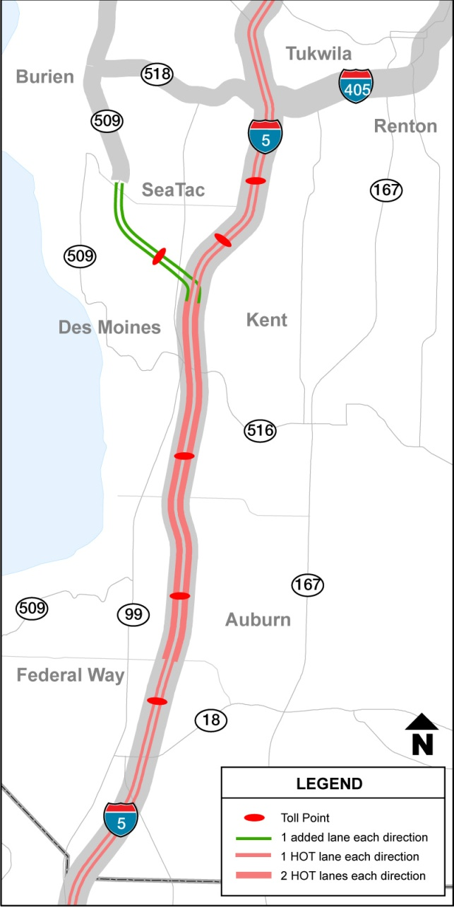
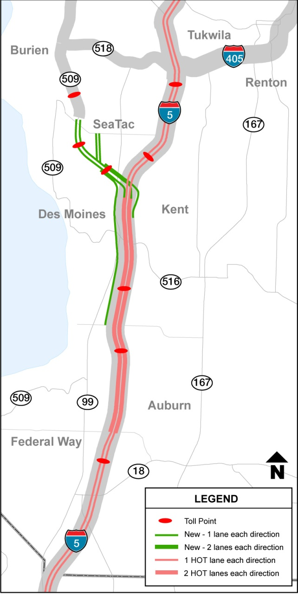
SR 509 Toll Concepts (Cont’d)
Current Design
Option 2
Option 3

Slide 10
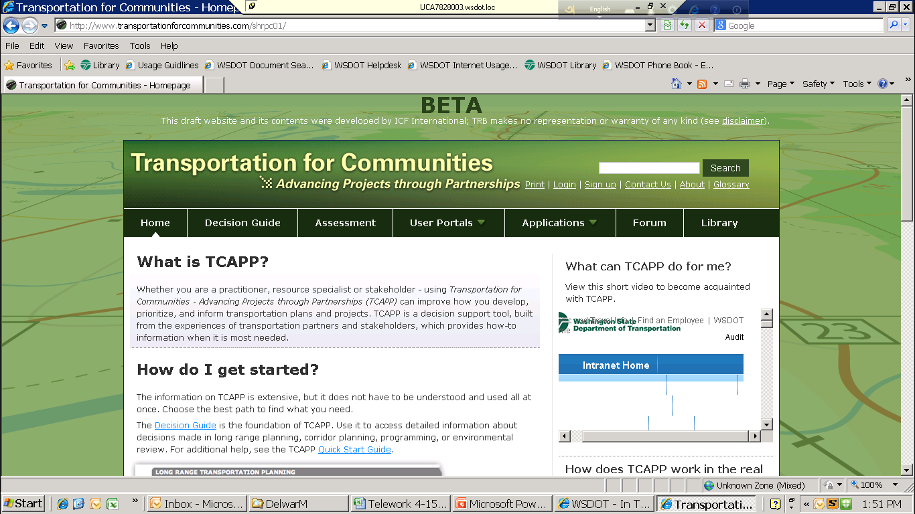
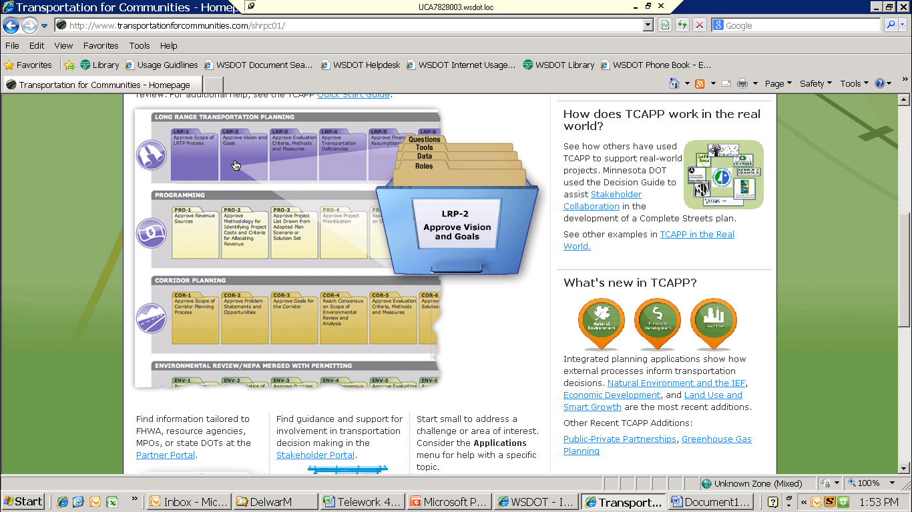
How to Phase the Project?
This is where TCAPP comes into play

Slide 11
What is TCAPP?
TCAPP stands for “Transportation for Communities – Advancing Projects through Partnerships”
It is a web based decision support tool, developed by Transportation Research Board under the second Strategic Highway Research Program (SHRP2).
  TCAPP is about making good decisions that stick:
    Collaborative
    Right people
    Right time
    Right information

Slide 12
The Objectives of the Pilot Test
● Define Phase 1 of the project for implementation by taking tolling into consideration.
● Pilot test the TCAPP tool
● Provide feedbacks to SHRP2 for refining the tool

Slide 13
Features and Functionality of TCAPP Used in the Study
Stakeholder involvement techniques
Decision making authority definition
Stakeholder collaboration assessment
Corridor Planning Decision Guide
Examples included in Case studies

Slide 14
Corridor Planning KDPs Applied

Slide 15
KDP Driven Scheduling
Provide right information at the right time

Slide 16
Value of TCAPP to the Project
1. Involved all key stakeholders
Expanded stakeholder committees to include representatives from:
  Legislature
  Freight community
  Business community
  Residents

Slide 17
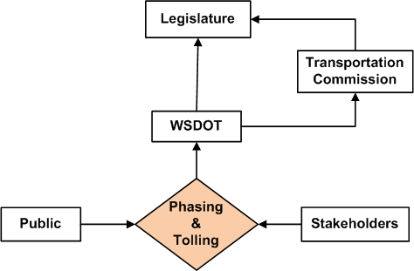
Value of TCAPP to the Project
2. Defined decision making authority

Slide 18
Value of TCAPP to the Project
3. Applied collaboration assessment techniques

Slide 19
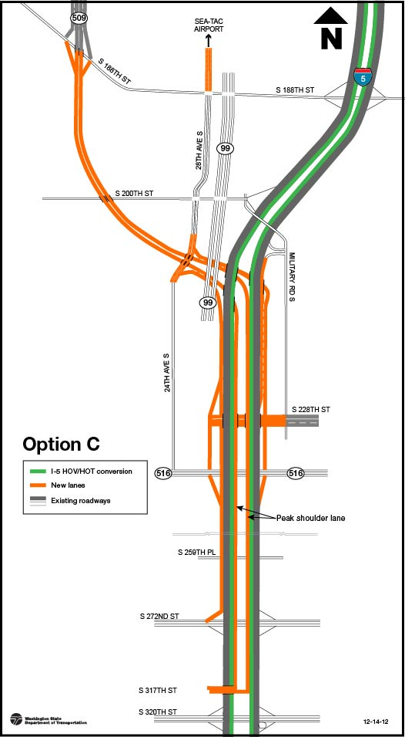
Value of TCAPP to the Project
Outcome: unanimous agreement on Phase 1 scope
Reduces initial construction cost by $400 million from the master plan.
SR 509: 1 lane/dir. from 188th to 24th /26th, 2 lanes/dir. from 24th/26th to I-5
Improved airport access via local connections.
Direct access to I-5 from Kent Valley from 228th
More sustainable solution: I-5 hard shoulder running and conversion of HOV lanes to express toll lanes.

Slide 20
Suggestions for Improvement
A few of WSDOT recommendations of the pilot test are:
Downloadable web content for ease of use
In depth discussion, perhaps through case studies, on how performance measures, including quantitative and qualitative measures, are integrated to help reach consensus and decisions.
More real world examples, perhaps by commonly encountered corridor study types on key subjects (i.e., problem statements, goals and objectives, performance measures, and analysis methodologies, etc.)

