Slide 1
Effects of Traffic Operation and Technology on Transit Bus Emissions
Ahsan Alam, PhD Student
Dr. Marianne Hatzopoulou, Assistant Professor
Dept. of Civil Engg. And Applied Mechanics
McGill University, Montreal, Canada

Slide 2
Background
Transportation benefits us by moving people and goods.
More demand, more traffic on road.
Result:
Traffic congestion
Road collisions
Environmental pollution

Slide 3
Background
Environmental effect
Global warming: greenhouse gas emissions
Transportation is responsible:
23% of total GHG emissions (worldwide)
26% of total GHG emissions (Canada)
74% of transportation emissions: roadway
Health effect
Respiratory, cardiovascular diseases
Premature mortality

Slide 4
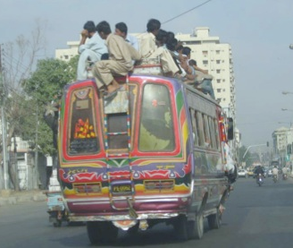
Motivation
Public Transit:
Considered environmentally friendly
But transit can be as polluting as car (per passenger basis) based on
Age
Fuel
Maintenance
Speed
Passenger volume

Slide 5
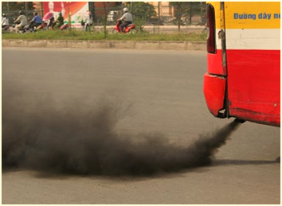
Research Question
How to reduce transit emissions?

Slide 6
Research Question
How to reduce transit emissions:
By using alternative fuels?
or
By improving traffic operation?

Slide 7
Outline
Simulate transit emissions along the busy corridor in Montreal, Canada (PTV VISSIM)
Compare the emissions of transit buses (using MOVES)
For 2 alternative fuels:
Ultra low sulfur diesel (15 ppm sulfur content)
Compressed natural gas (CNG)
Under different traffic operation:
Transit signal priority (TSP)
Relocation of bus stops
Queue jumper lane

Slide 8
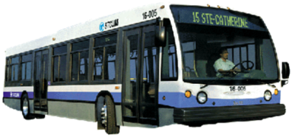
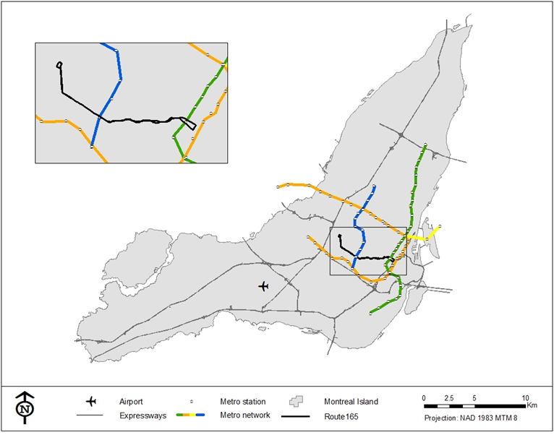
Study Area
165 Bus Route
downtown

Slide 9
Base Case Emission Modelling
One bus is tracked over an entire route (NB and SB) through links and bus stops
Link based emissions:
NB: 30 links & SB: 34 links
Sec-by-sec speed profile for each link
Age distribution:
58.39% are of 2010 model & 41.61% are of 2009 model
Fuel:
Ultra Low Sulfur Diesel (ULSD)
Compressed Natural Gas (CNG)
Meteorology:
Temperature & Humidity

Slide 10
Base Case Traffic Simulation

Slide 11
Simulated Bus Speed Profile
Variables | SB | NB
Length (mile) | 4.74 | 4.09
Number of bus stops | 34 | 30
Length of longest link (mile) | 0.3 | 0.3
Length of shortest link (km) | 0.0775 | 0.05
Total travel time (min) | 50.03 | 30.10
Average journey speed (mph) | 5.68 | 8.15
Maximum speed | 28.83 | 27.43
Time spent (sec) during journey | 2,579 | 1,228
Between 0- 1 mph | 1,296 | 279
Between 2-5 mph | 301 | 147
Between 6-15 mph | 517 | 336
Between 15-25 mph | 369 | 437
>25 mph | 96 | 29

Slide 12
Base Case Emissions
Running Emissions (g/mile)
Dwell Emissions at Bus Stops (g)
 | SB |  |  | NB
 | Diesel | CNG | Reduction (%) | Diesel | CNG | Reduction (%)
CO_{2-eq.} | 3504.17 | 3092.31 | 11.75 | 2835.85 | 2608.23 | 8.03
PM_{2.5} | 0.04631 | 0.00704 | 84.79 | 0.03562 | 0.00403 | 88.68
 | SB |  |  | NB
 | Diesel | CNG | Reduction (%) | Diesel | CNG | Reduction (%)
CO₂-eq | 1719.47 | 1358.38 | 21.00 | 668.93 | 528.45 | 21.00
PM_{2.5} | 0.03544 | 0.00486 | 86.28 | 0.01379 | 0.00189 | 86.28

Slide 13
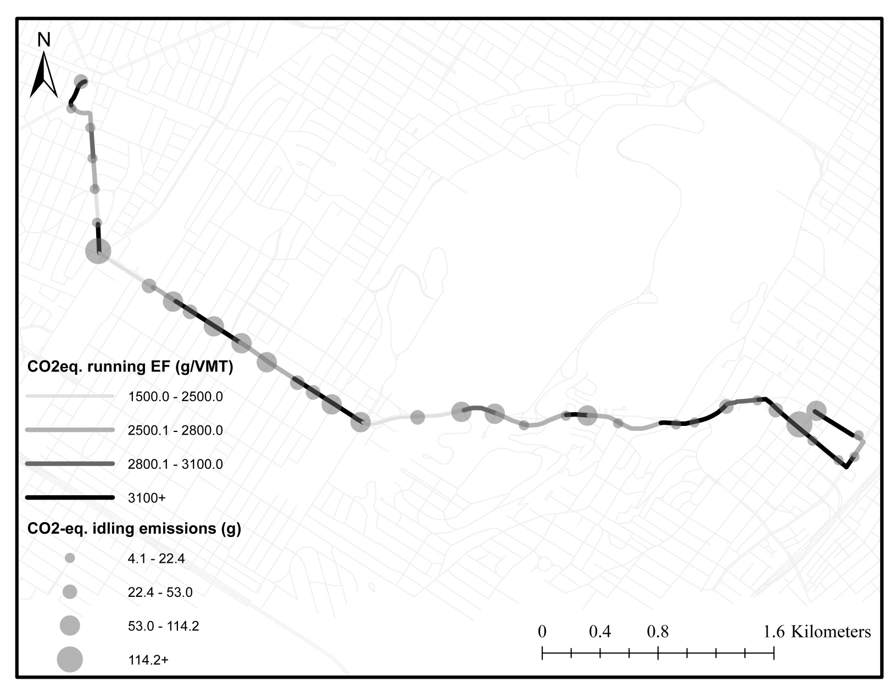
Base Case Emissions (SB)
downtown

Slide 14
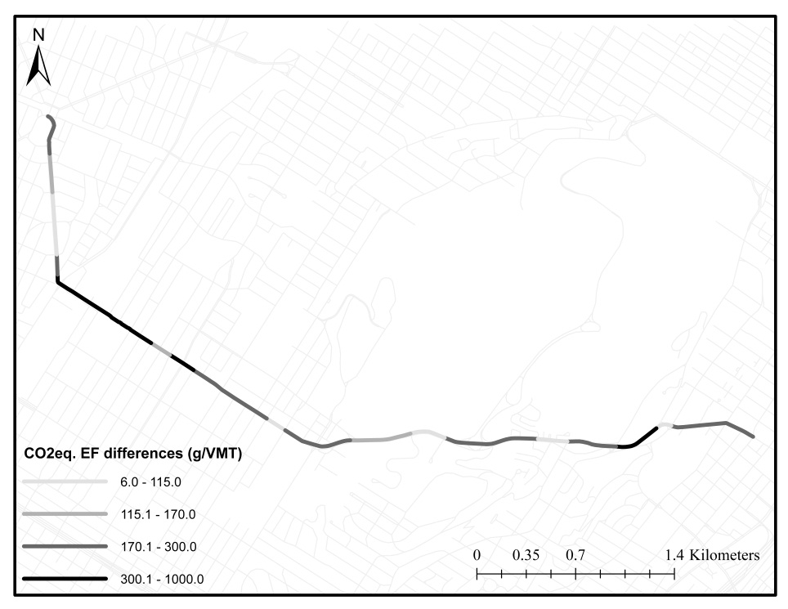
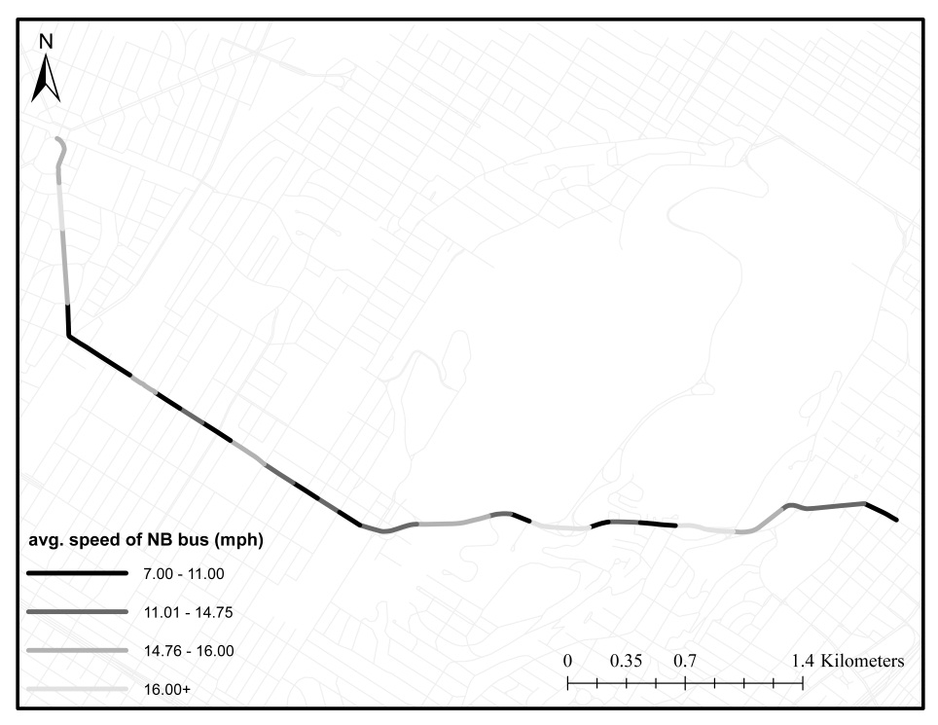
Base Case Emissions (NB)
Changes in CO_{2eq.} EFs
Avg. Speed of the NB Bus

Slide 15
Scenario Analysis
Traffic operation based scenario:
Transit signal priority (TSP)
Bus-stop relocation
TSP+ Bus-stop relocation
Queue jumper lane
TSP+Bus-stop relocation+Queue jumper lane

Slide 16
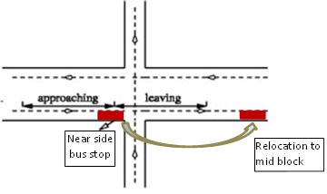
Scenario Analysis
Traffic operation based scenario:
Transit signal priority (TSP)
Bus-stop relocation
TSP+ Bus-stop relocation
Queue jumper lane
TSP+Bus-stop relocation+Queue jumper lane

Slide 17
Scenario Analysis
Traffic operation based scenario:
Transit signal priority (TSP)
Bus-stop relocation
TSP+ Bus-stop relocation
Queue jumper lane
TSP+Bus-stop relocation+Queue jumper lane

Slide 18
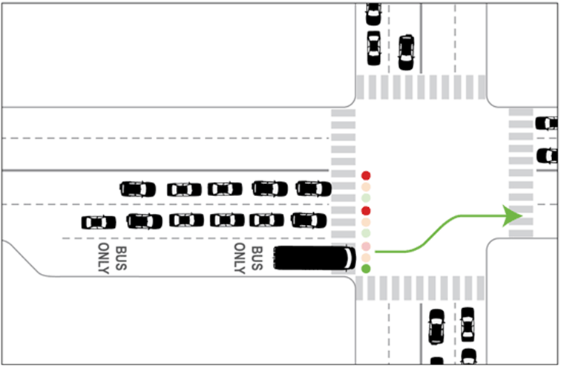
Scenario Analysis
Traffic operation based scenario:
Transit signal priority (TSP)
Bus-stop relocation
TSP+ Bus-stop relocation
Queue jumper lane
TSP+Bus-stop relocation+Queue jumper lane

Slide 19
Scenario Analysis
Traffic operation based scenario:
Transit signal priority (TSP)
Bus-stop relocation
TSP+ Bus-stop relocation
Queue jumper lane
TSP+Bus-stop relocation+Queue jumper lane

Slide 20
Scenario Analysis
Scenario Description | CO_{2eq} (g/mile) for Diesel |  | CO_{2eq} (g/mile) for CNG
 | SB | NB | SB | NB
Base | 3504.17 (0%) | 2835.85 (0%) | 3092.31 (11.75%) | 2608.23 (8.03%)
Introduction of TSP | 3031.62 (13.49%)* | 2668.13 (5.91%) | 2709.99 (22.66%) | 2438.94 (14.00%)
Relocating bus-stops to mid-block | 3191.55 (8.92%) | 2849.25 (-0.47%) | 2869.31 (18.12%) | 2639.98 (6.94%)
Introducing TSP and mid-block bus-stop relocation | 3062.49 (12.60%) | 2776.40 (2.09%) | 2770.66 (20.93%) | 2548.81 (10.12%)
Introducing queue jumper lane | 2987.94 (14.73%) | 2802.61 (1.17%) | 2692.23 (23.17%) | 2542.80 (10.33%)
Introducing TSP, queue jumper lane and relocating bus-stops to mid-block | 2887.56 (17.61%) | 2732.60 (3.64%) | 2654.13 (24.26%) | 2504.10 (11.70%)
* Percent reduction in emissions compared to base case

Slide 21
Results Found
Switching from diesel to CNG fuel could reduce CO_{2-eq.} emissions by 8 to 12 percent.
As the levels of congestion rise, the reduction benefits become higher indicating that the benefit of switching to CNG becomes more apparent under congested conditions.

Slide 22
Results Found
TSP alone has the ability to reduce emissions significantly for both directions, congested and uncongested.
When TSP is combined with other measures reduction is significant only in the congested direction.
CNG in combination with operational changes further improves emission reductions.
However, many operational changes can achieve better reductions than switching to CNG and maintaining base-case operations.

Slide 23
Future Research Plan
The effects of varying congestion levels on the performance of traffic operation and technology.
To understand the effects of grade and passenger load factor on transit emissions.

Slide 24
Present Research
Grade -7.5%
Passenger Load Factor (PLF) 0
Average speed: 6mph
Grade -5.0%
Passenger Load Factor (PLF) 0.5
Passenger Load Factor (PLF) 1.0
Grade -2.5%
Drive cycle
Average speed: 9mph
Passenger Load Factor (PLF) 1.5
Grade 0%
Passenger Load Factor (PLF) 2.0
Average speed: 16mph
Grade 2.5%
Grade 5.0%
Grade 7.5%

Slide 25
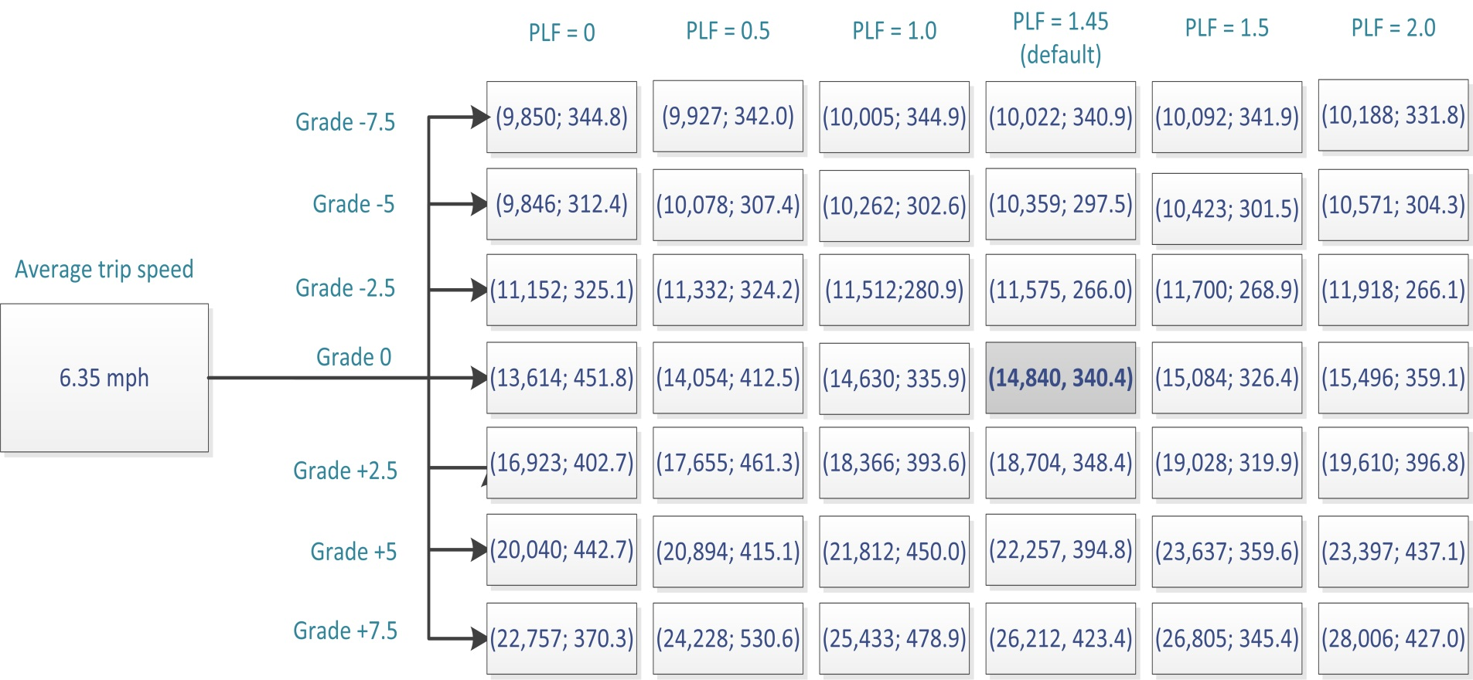
Present Research

Slide 26
Present Research
Avg. speed of 16mph
Box plots
Random seeds

Slide 27
Present Research
At zero slope

Slide 28
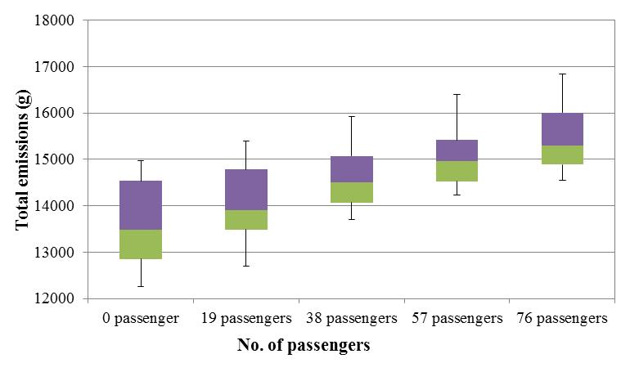
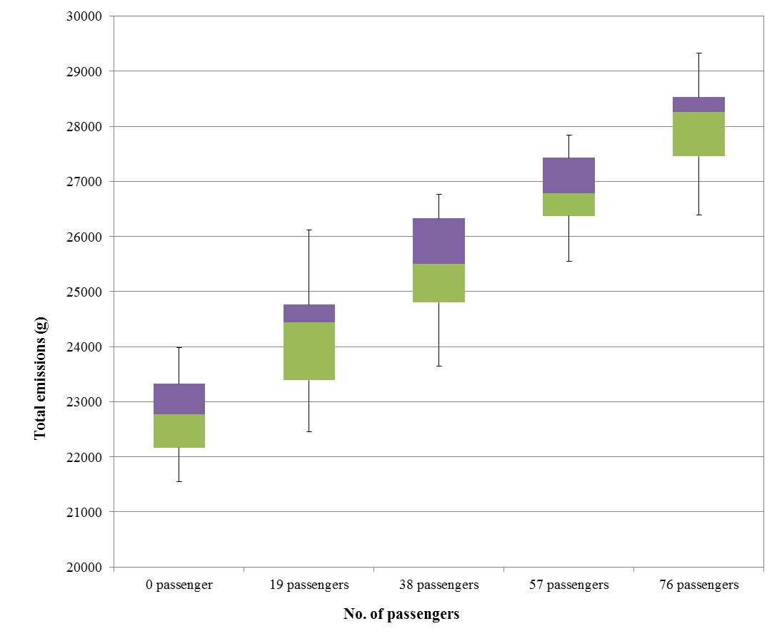
Present Research
At zero slope
At +7.5% slope

Slide 29
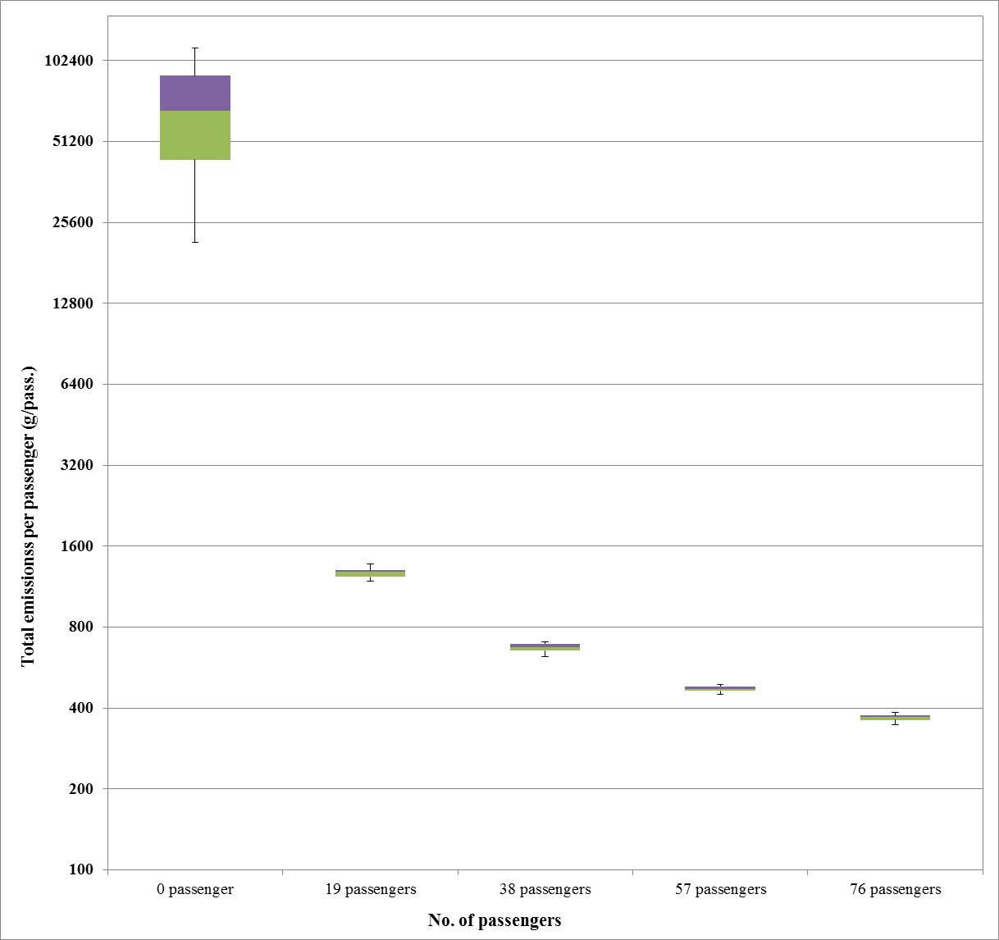
Present Research
At 7.5% slope

Slide 30
Present Research

Slide 31
THANK
YOU!
http://traq-research.mcgill.ca/Students/Students.html
ahsan.alam2@mail.mcgill.ca

Slide 32
Traffic Simulation

