Slide 1
Tri-level freight modeling: A simulation of trucks going near and far
Rolf Moeckel
Parsons Brinckerhoff
Sabya Mishra
University of Maryland
TRB Planning Applications Conference ⋅ Reno, Nevada ⋅ 9 May 2011

Slide 2
Outline
Maryland Statewide Transportation Model (Brief Background)
Freight Model
Freight Scenarios
Results and Discussion
Conclusion and Future Research

Slide 3
Maryland Statewide Transportation Model (Brief Background)

Slide 4
Brief Background
Uniqueness of Maryland Geography
Modeling Urban, Suburban, and Rural Trip Making
Synergies with MPO Models
Regional Person Travel
Regional Freight Travel
Effects of statewide land use scenarios on transportation

Slide 5
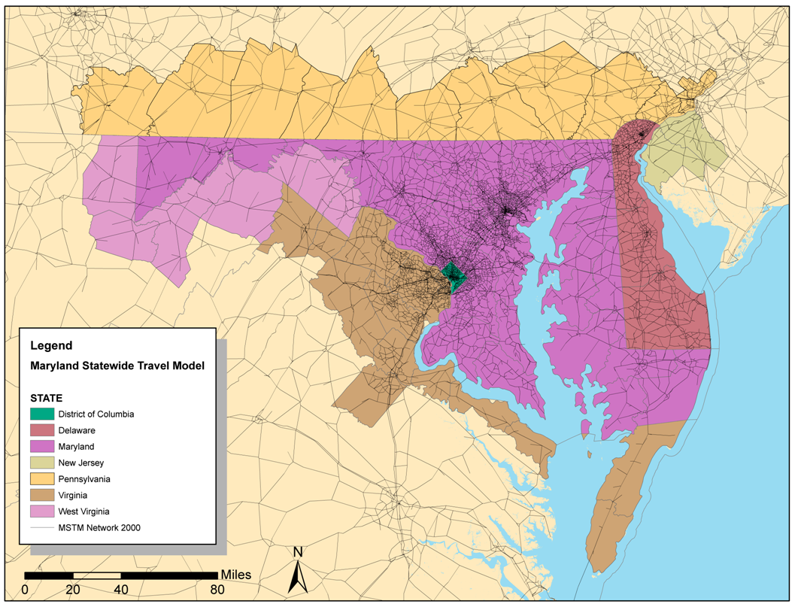

Slide 6
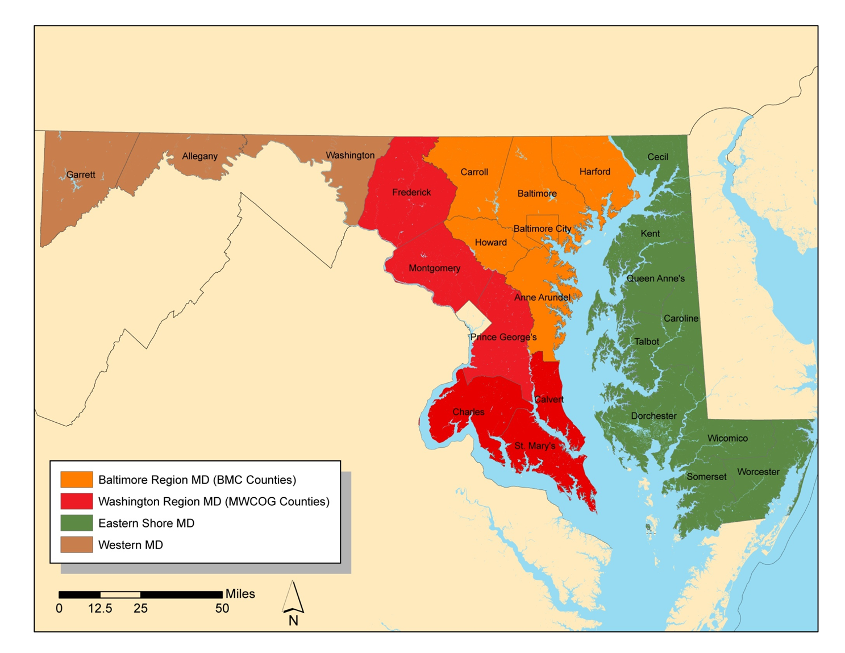

Slide 7
Three-level approach
National or global level
Regional level
MPO

Slide 8
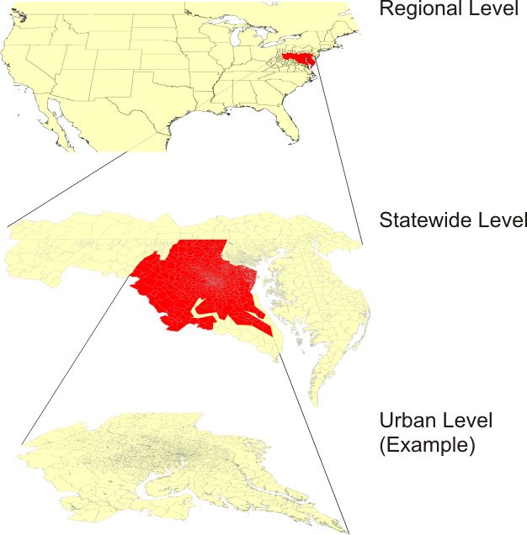
Three levels of the Maryland Statewide Model
Notes:
The regional level covers North America in 132 zones, with more detail around Maryland and less detail further away.
The statewide level covers in 1607 zones Maryland, Delaware, Washington D.C., and parts of New Jersey, Pennsylvania, Virginia and West Virginia.
The urban level covers selected urban areas, such as the Baltimore or the Washington urban region.

Slide 9
Model Design
National Model
Economic Growth Forecast
NHTS
Statewide Model
Land Use Model
FAF2
Person Travel
Trucks
Visitor Model &
Long-Distance Travel Model
Trip Generation
Trip Generation
Flow Estimation
Trip Distribution
Trip Distribution
Disaggregation
Mode Choice
II trips
II trips
EI/IE/EE trips
Temporal Allocation
EI/IE/EE trips
Urban Model Reconciliation
Multiclass Assignment

Slide 10
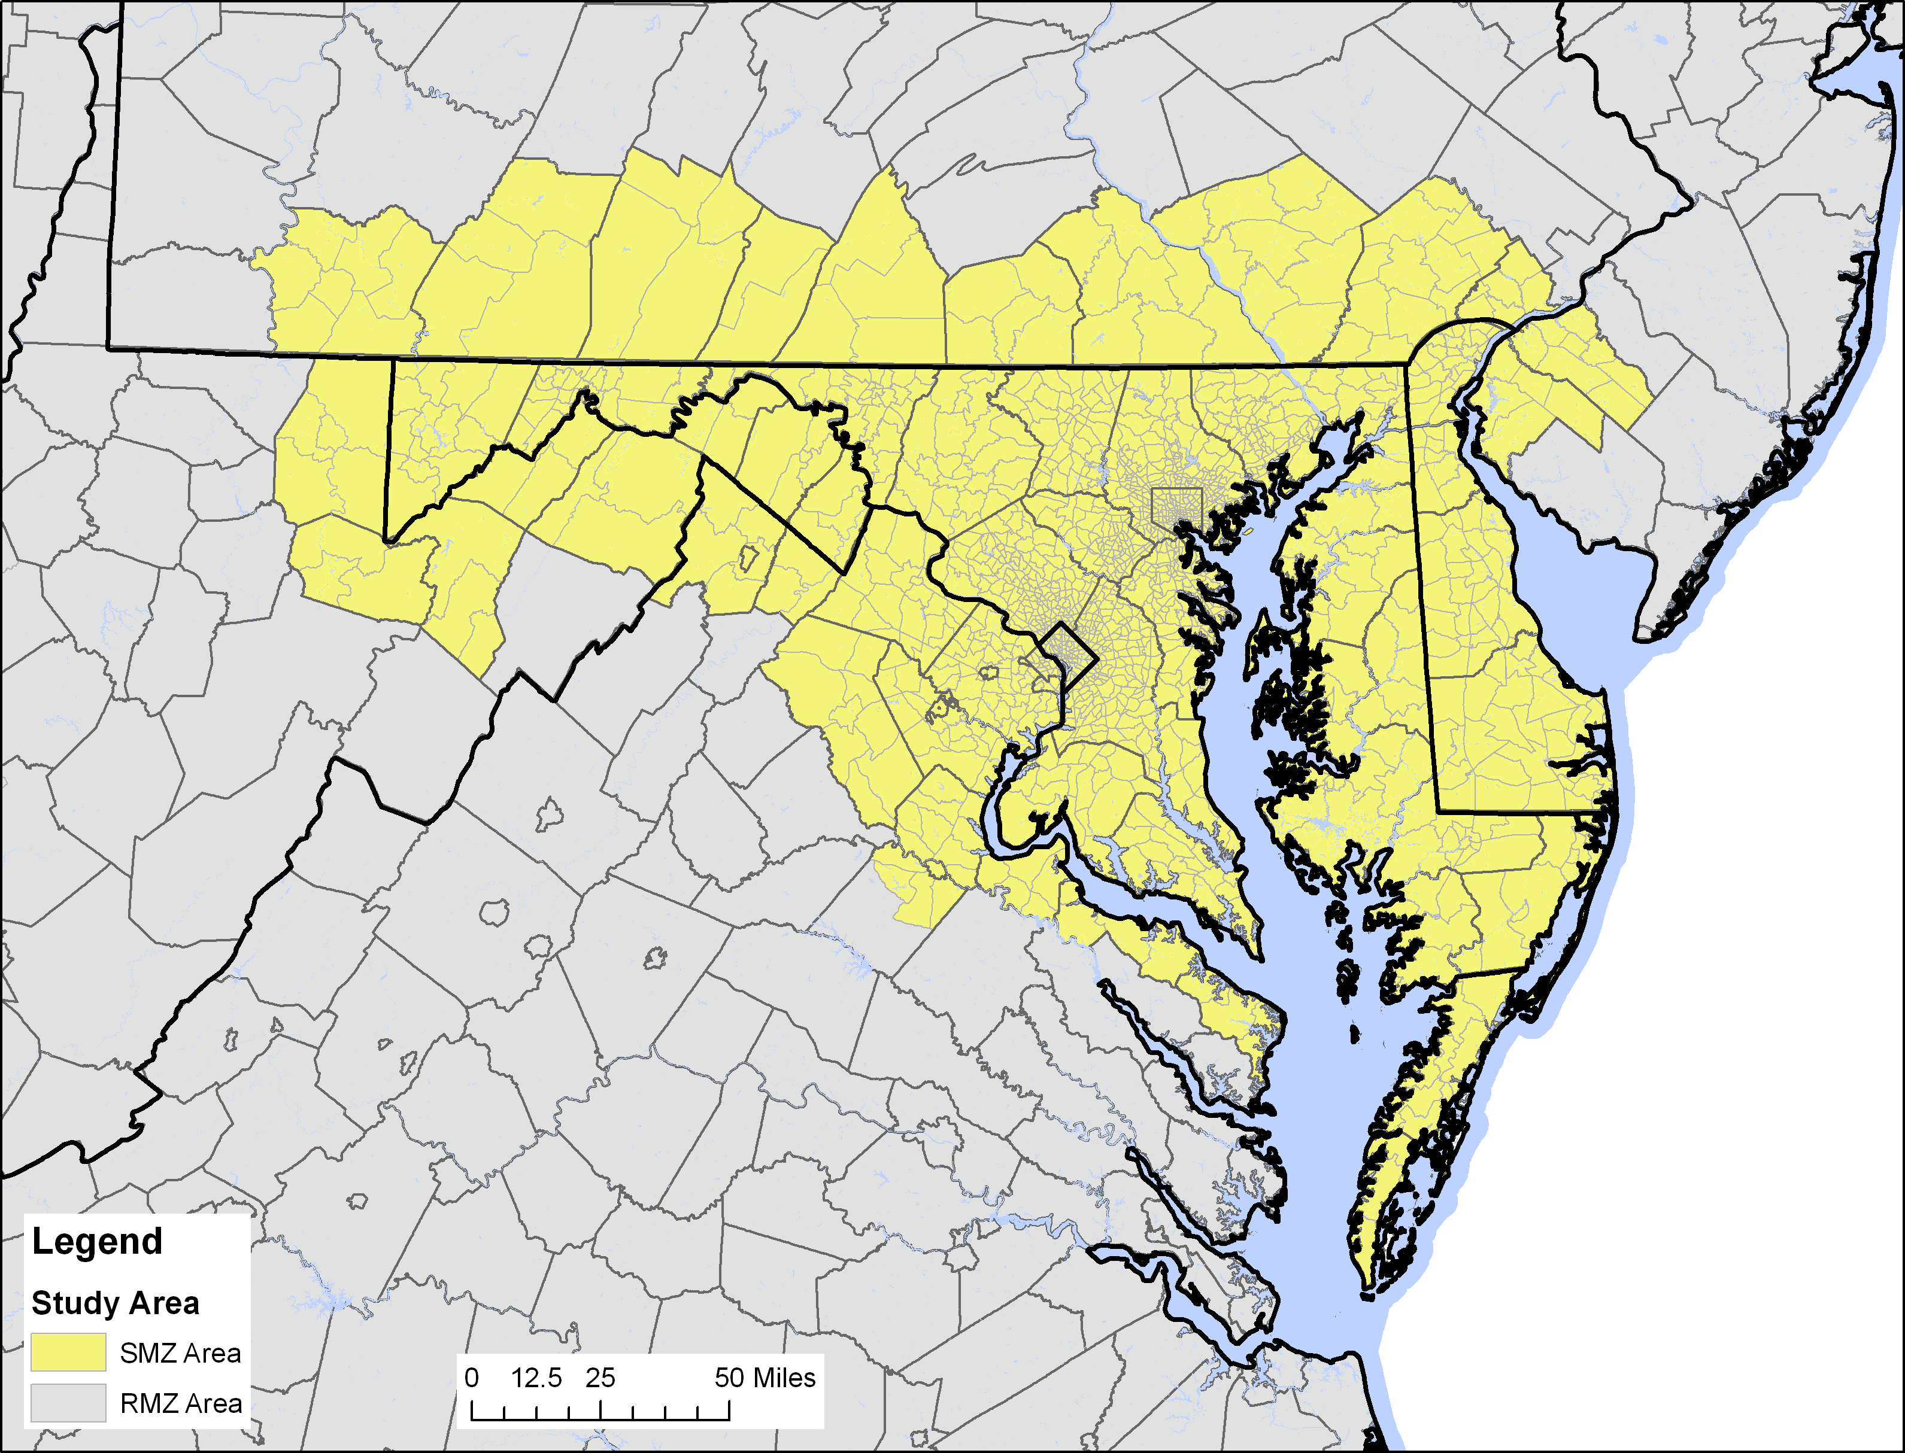
Two-Level Approach
EE
II
IE and EI

Slide 11
Freight Model

Slide 12
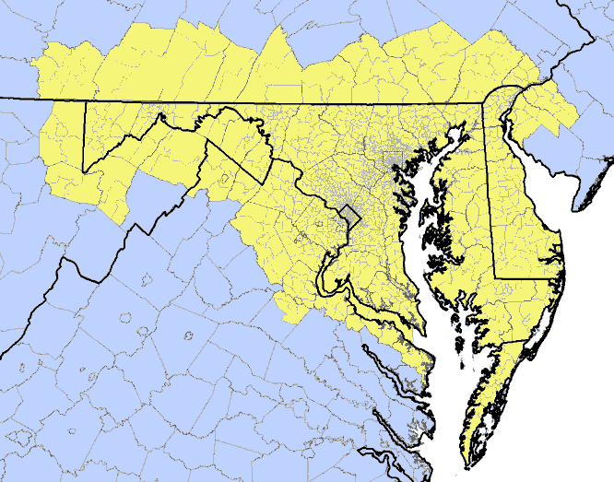
Statewide Truck Model
The Statewide Truck Model is an application of the
- BMC Commercial Vehicle Model and the
- BMC Truck Model,
which were developed by William G. Allen in 2002.
Employment and Households by SMZ are used as truck generators, and a gravity model is used to distribute truck trips.

Slide 13
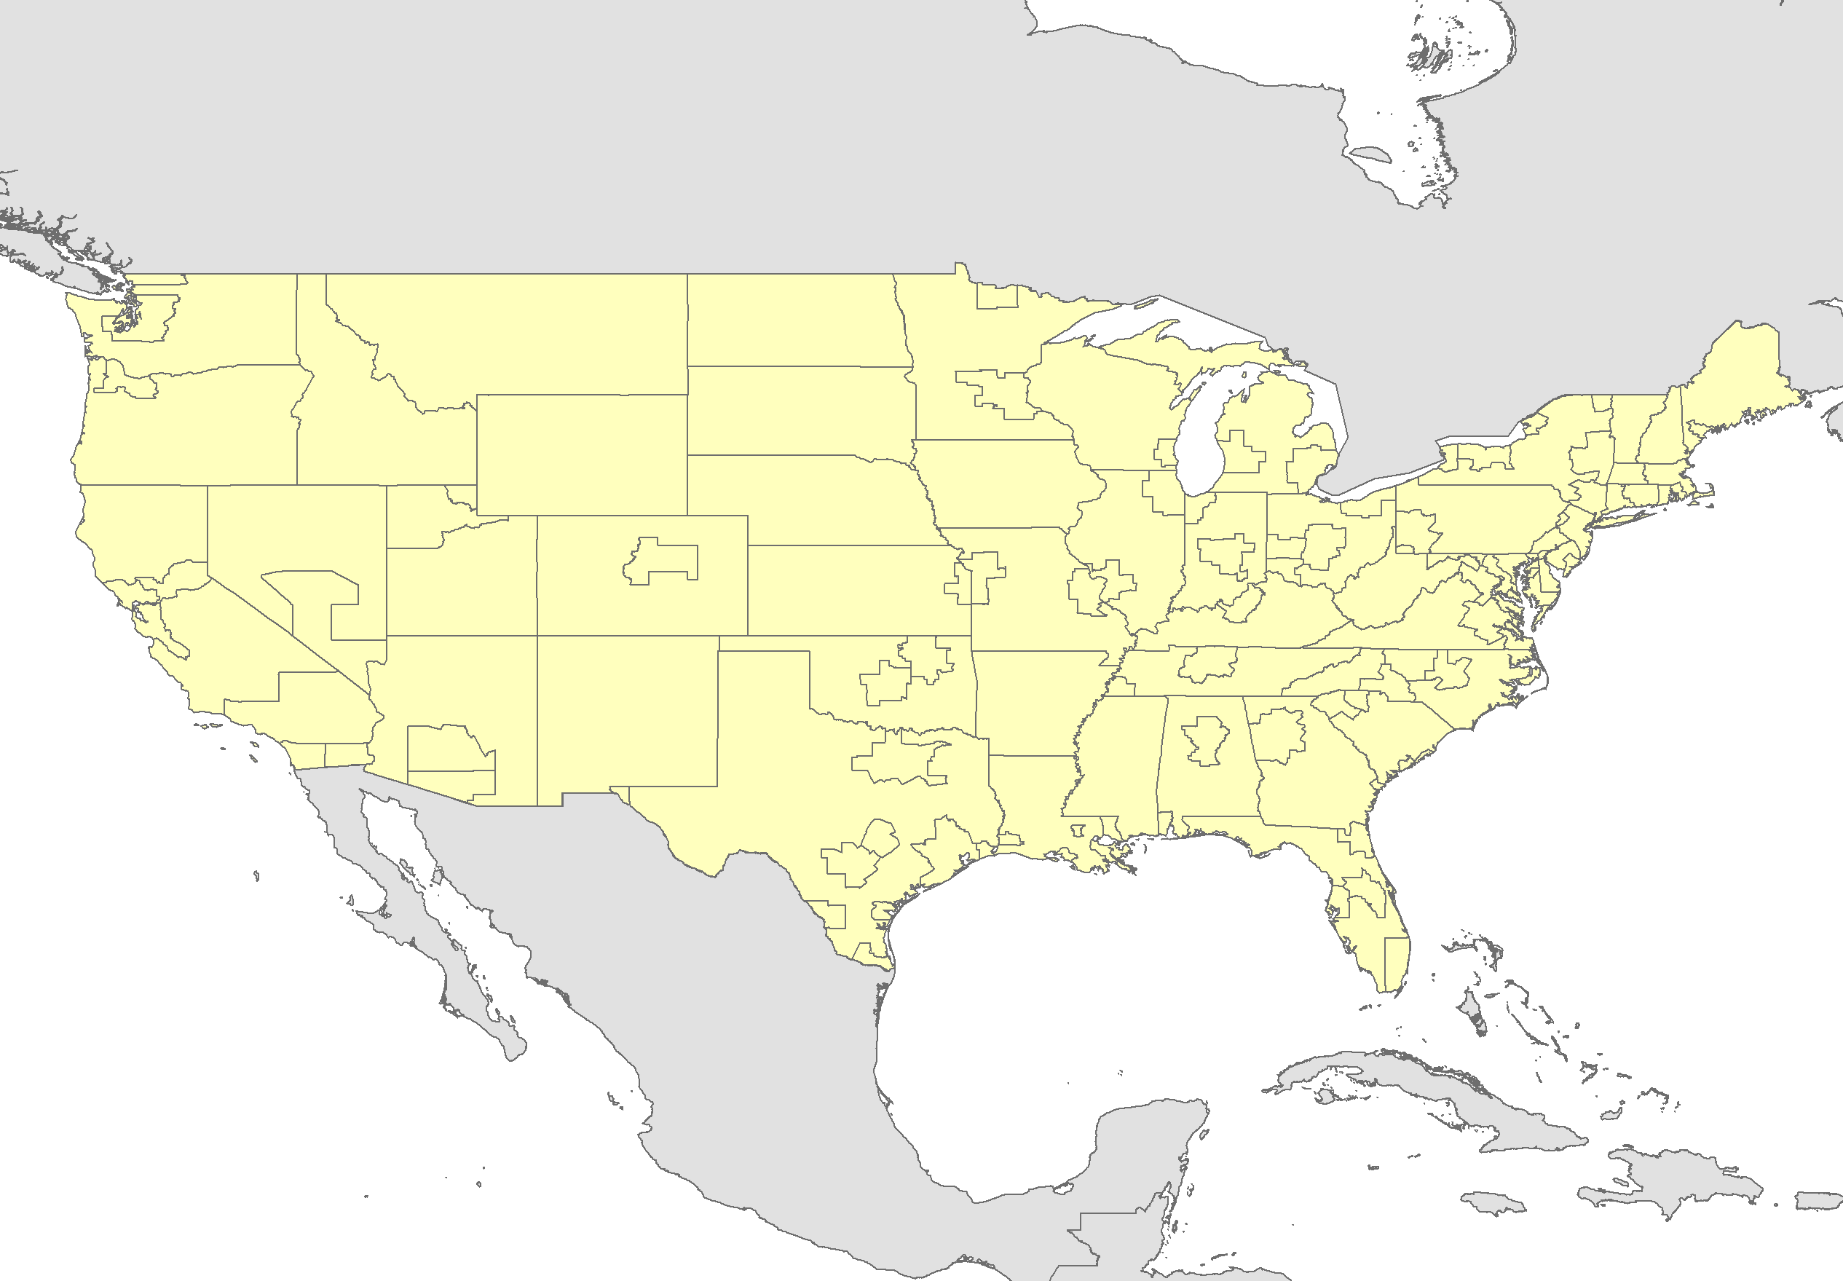
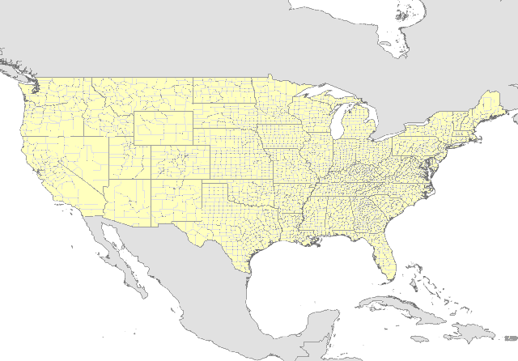
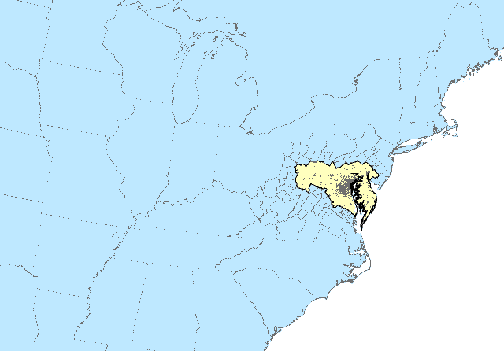
Disaggregation and Aggregation of Freight Flows
FAF Zones
Counties
SMZ and RMZ
disaggregate
aggregate
RMZ
disaggregate
SMZ
study
area

Slide 14
Truck Generation
Truck trips are generated by
- Industrial Employment,
- Retail Employment,
- Office Employment and
- Households.
The model distinguishes
- Commercial Vehicles,
- Medium-Heavy Duty Trucks and
- Heavy-Heavy Duty Trucks.
Notes:
14

Slide 15
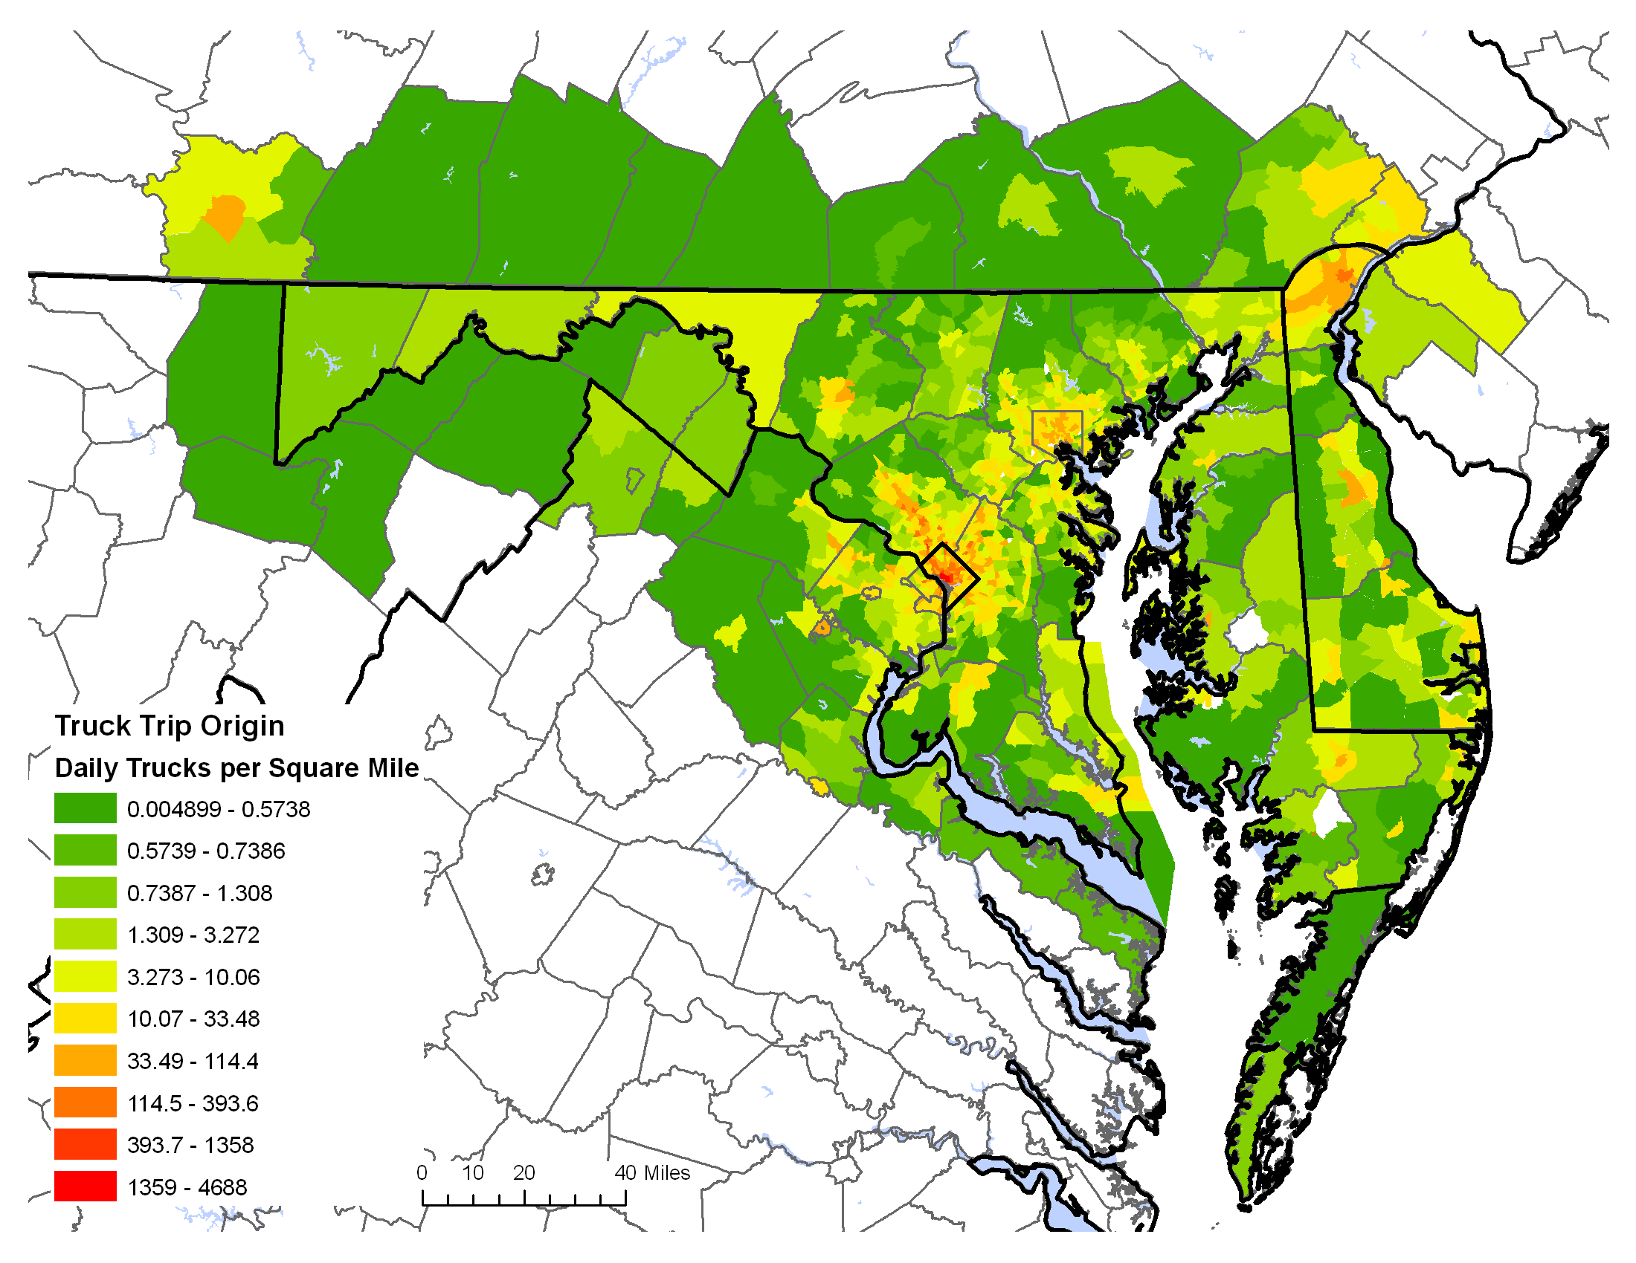
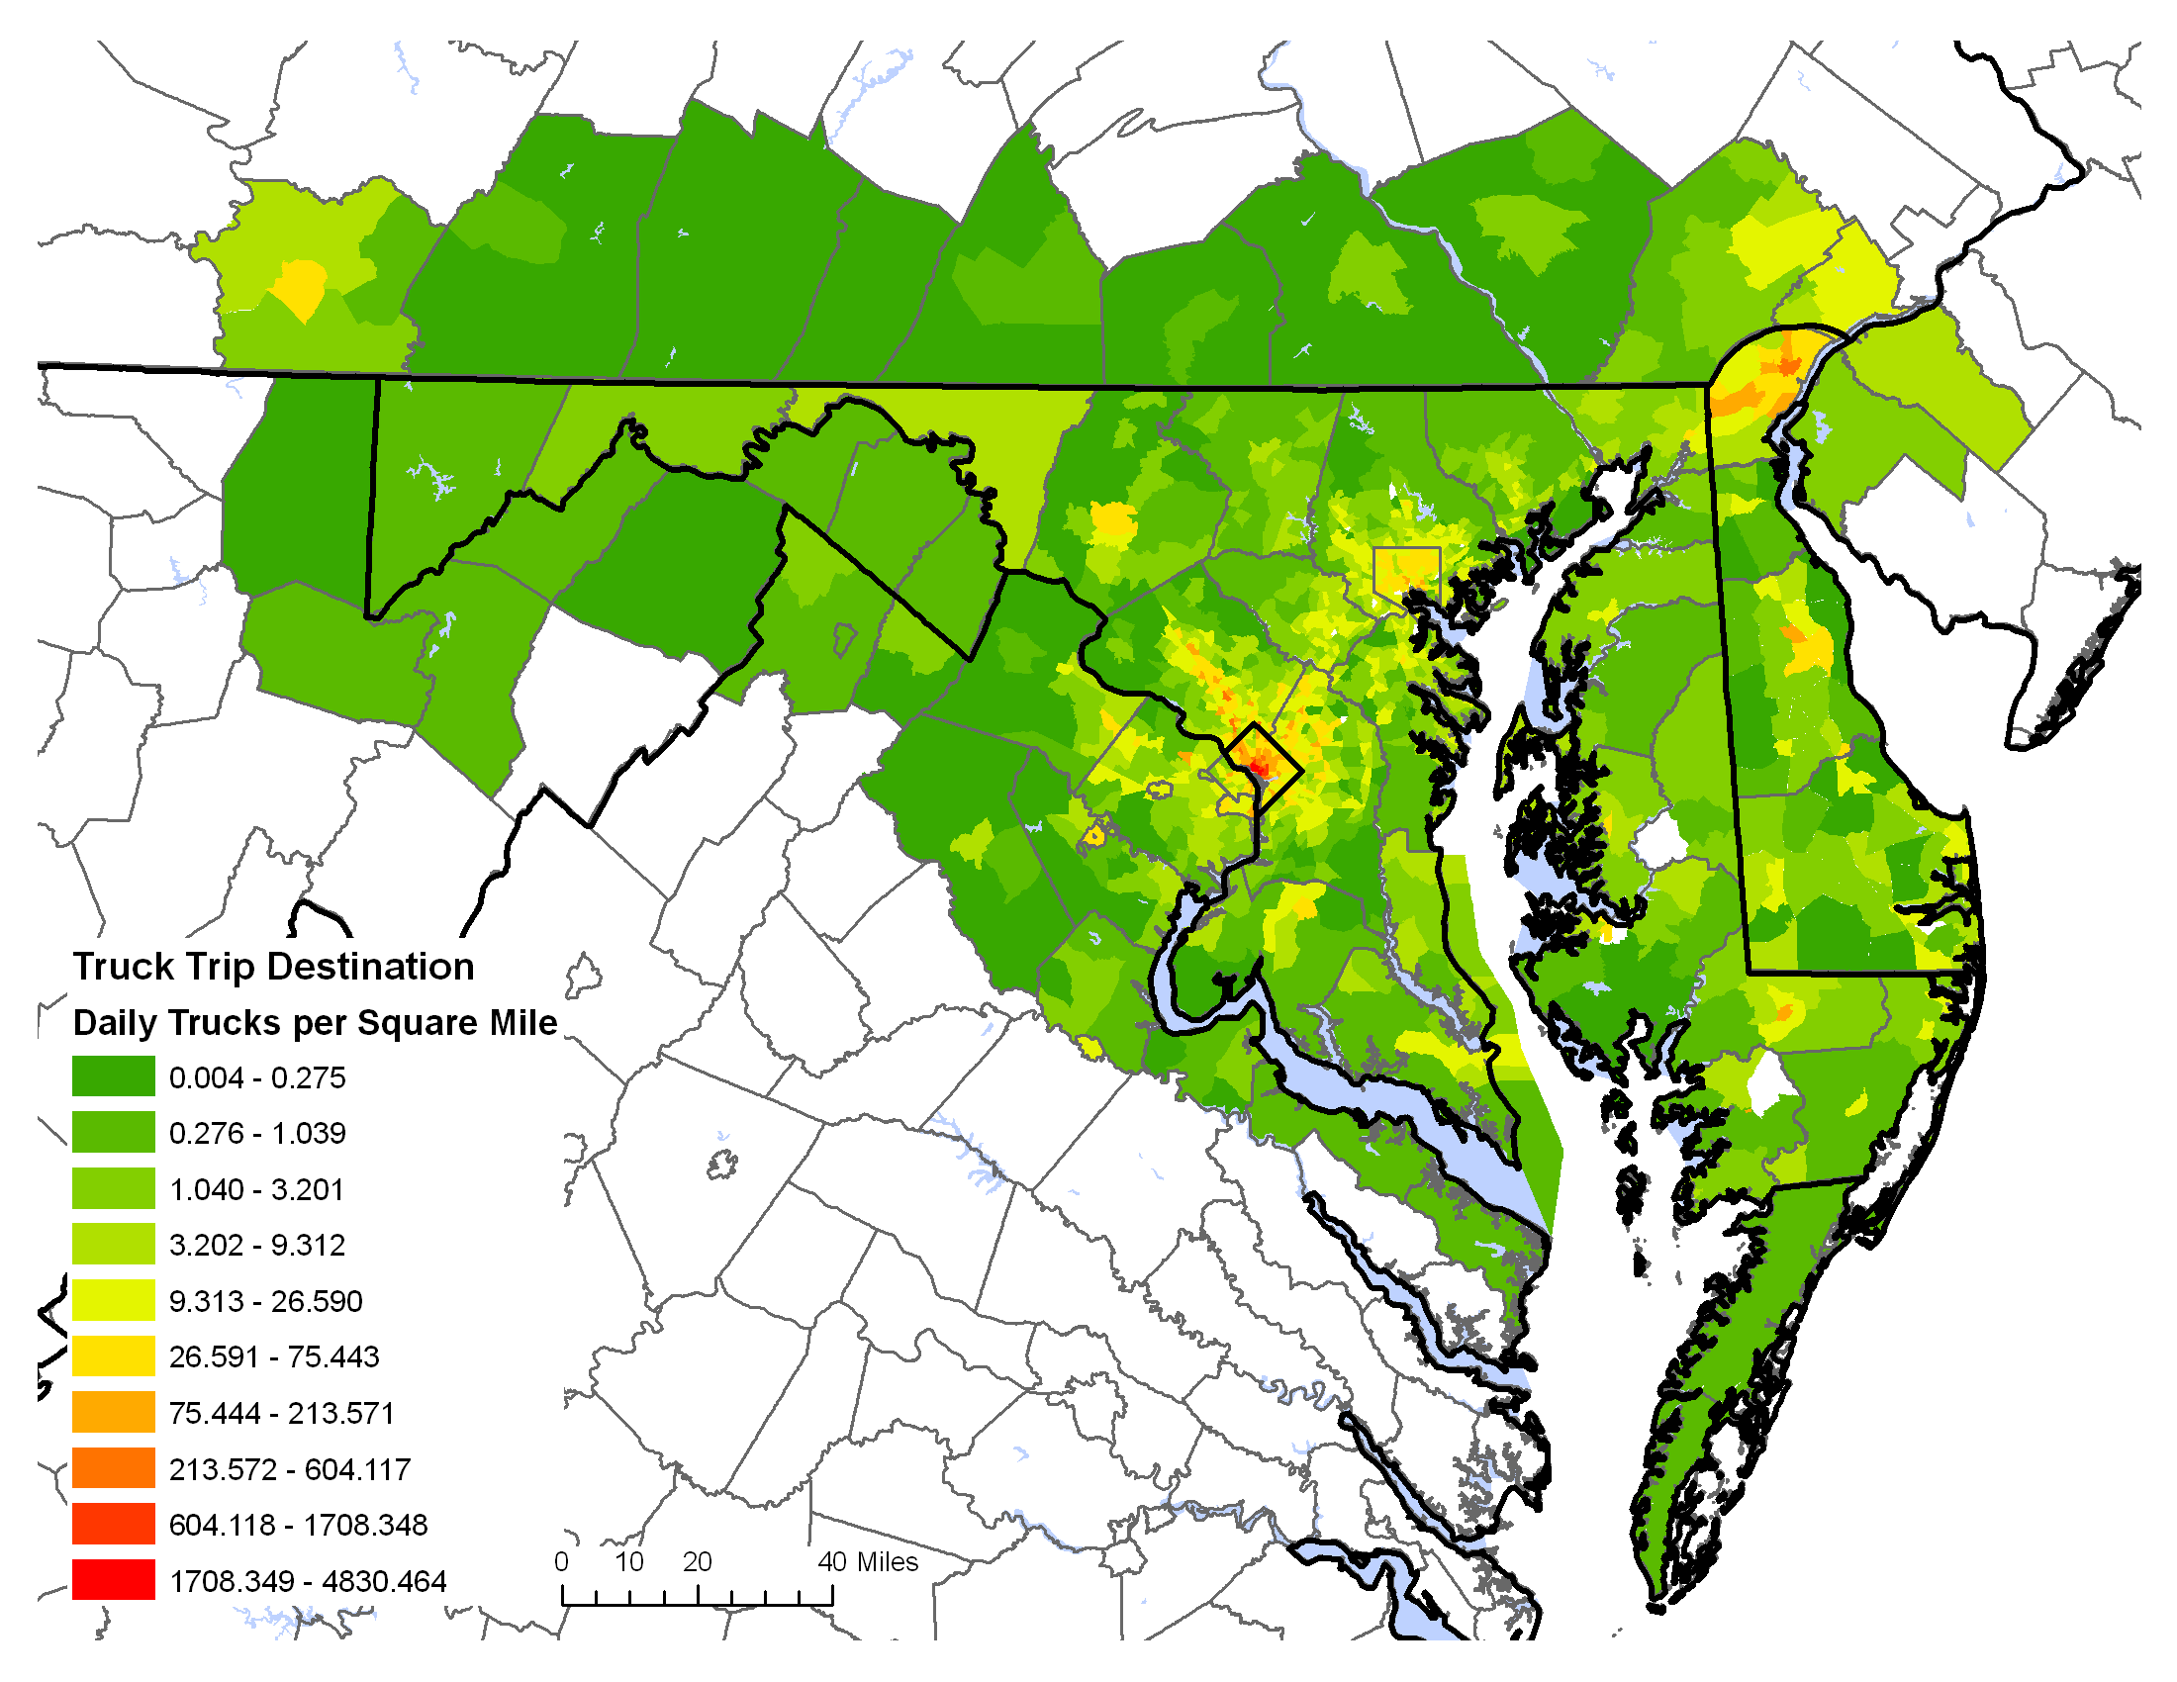
Statewide Truck Generation
Truck productions
Truck attractions
Notes:
15

Slide 16
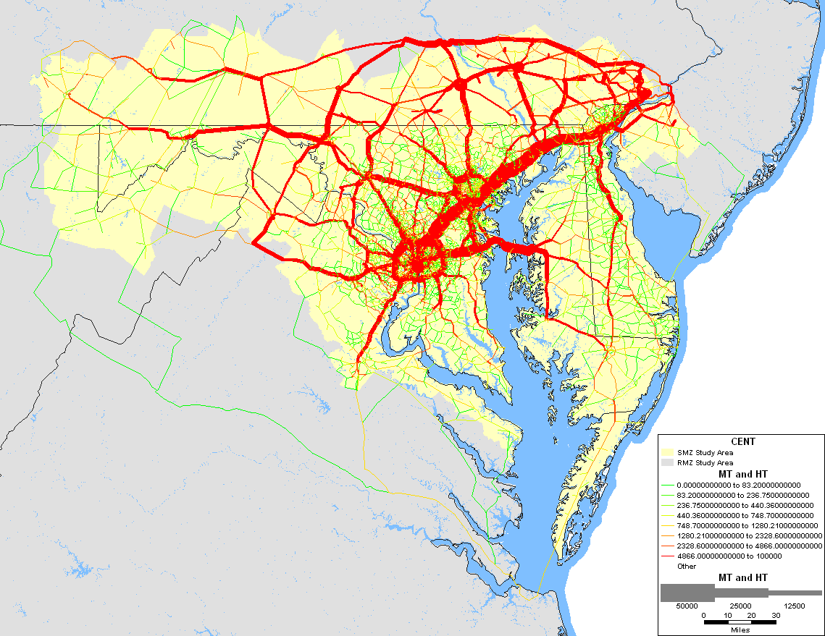
Assignment of MT and HT
Notes:
16

Slide 17
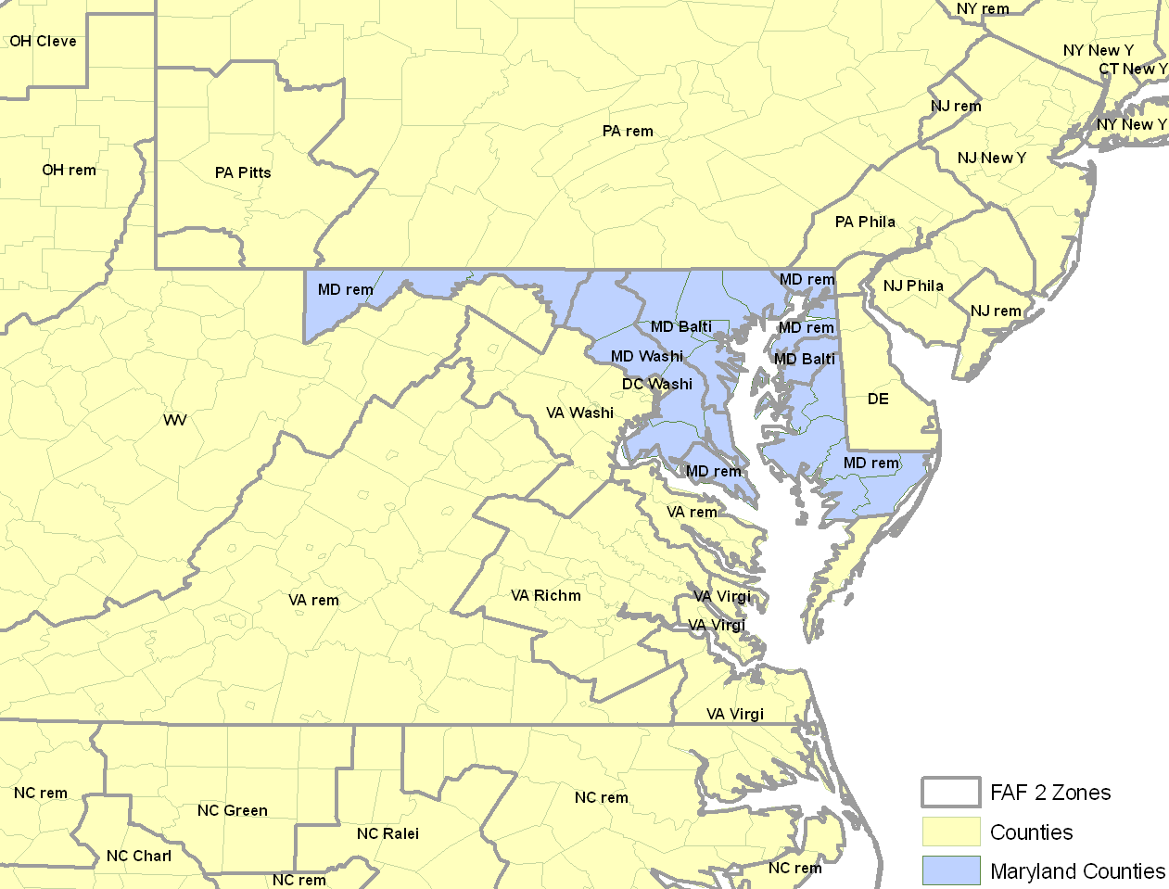
FAF Regions and Counties
Notes:
17

Slide 18
Regional Truck Trips
Freight flows given by the Freight Analysis Framework 2 (FAF2) are used to generate truck trips.
Commodity flows between 130 FAF zones
Ave. payload factors
Truck trips between 130 FAF zones
Disaggregate using make/use coefficients
disaggre-
gate
1,607 SMZ
Truck trips between 3,241 counties
aggre-
gate
132 RMZ
Notes:
18

Slide 19
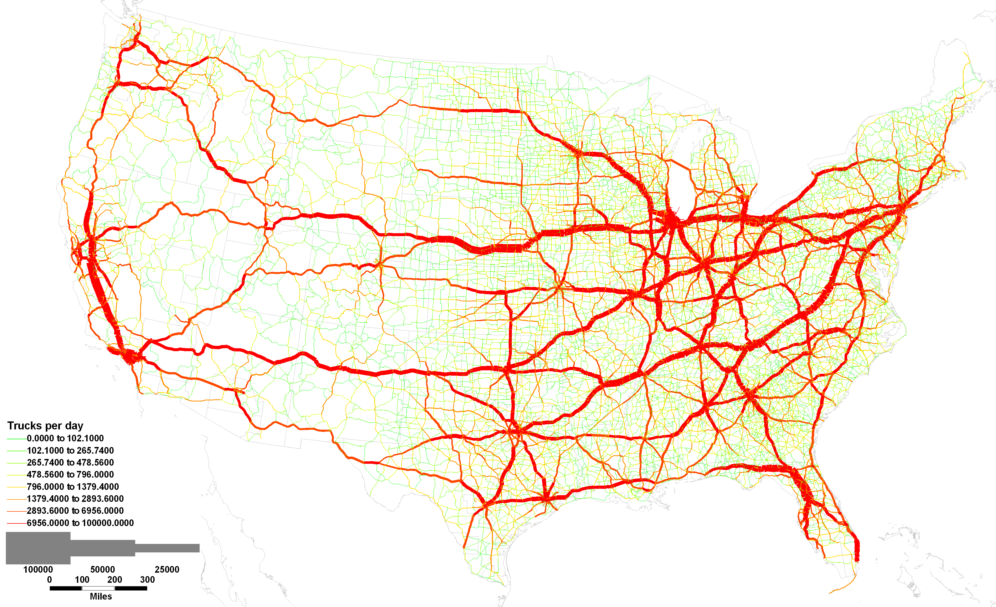
Regional Truck Trips in the U.S.
Notes:
19

Slide 20
Truck Trip Reconciliation
 | Destination SMZ | Destination RMZ
Origin SMZ | II: Statewide Truck Model | IE: Regional Truck Model
Origin RMZ | EI: Regional Truck Model | EE: Regional Truck Model
Notes:
20

Slide 21
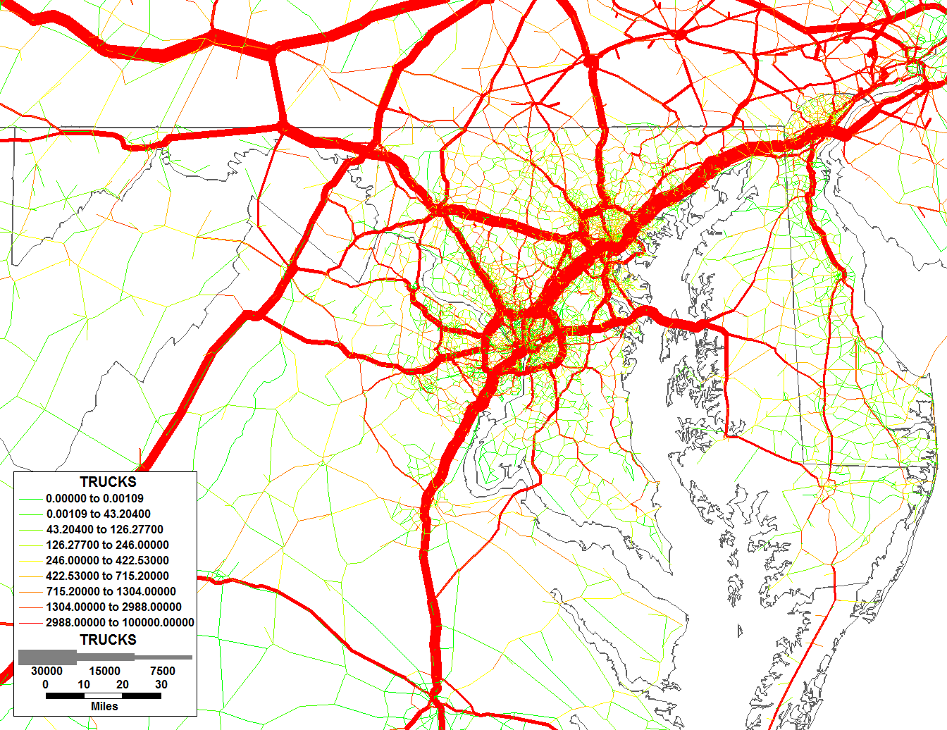
Regional and Statewide Truck Trips
Notes:
21

Slide 22
Freight Scenarios
Increase in Freight Demand
Growth in Baltimore Port

Slide 23
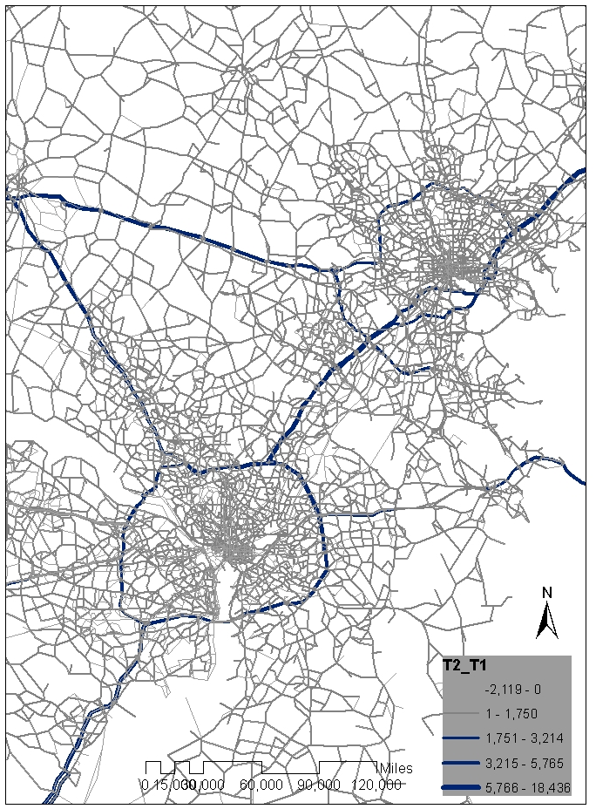
Scenario: Increase in Freight Demand
Freight demand is increased by 50%
All Other Parameters Remain Same
The Plot Shows Difference Between Scenario Case and Base Case Total Truck Flow

Slide 24
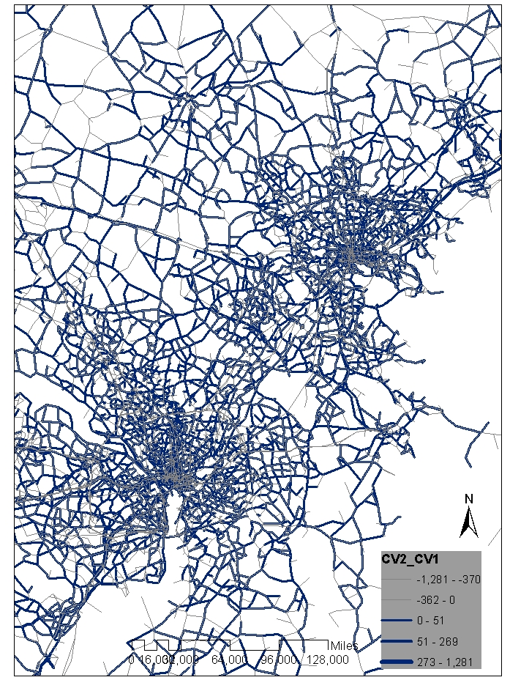
Scenario: Increase in Freight Demand
The Plot Shows Difference Between Scenario Case and Base Case Commercial Vehicle Flow

Slide 25
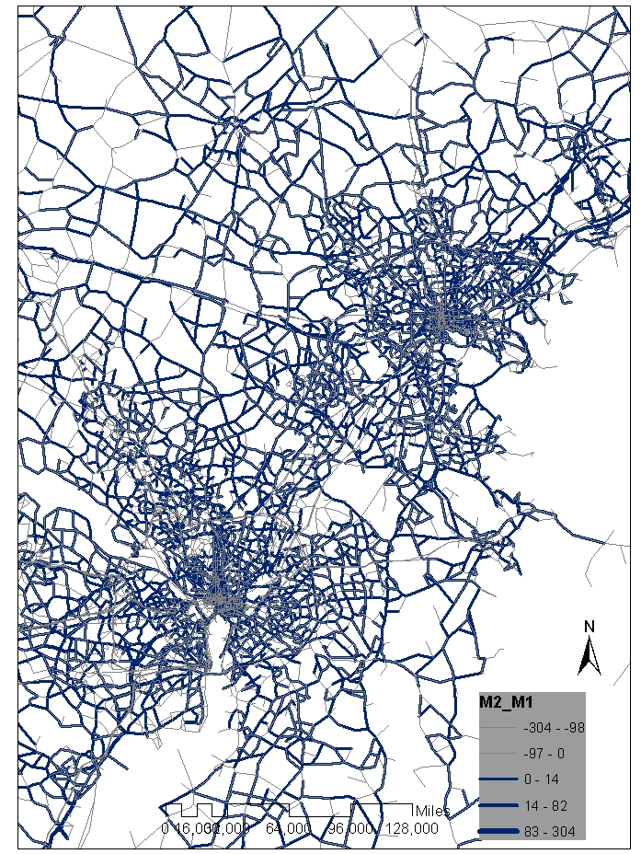
Scenario: Increase in Freight Demand
The Plot Shows Difference Between Scenario Case and Base Case Medium Heavy Duty Truck Flow

Slide 26
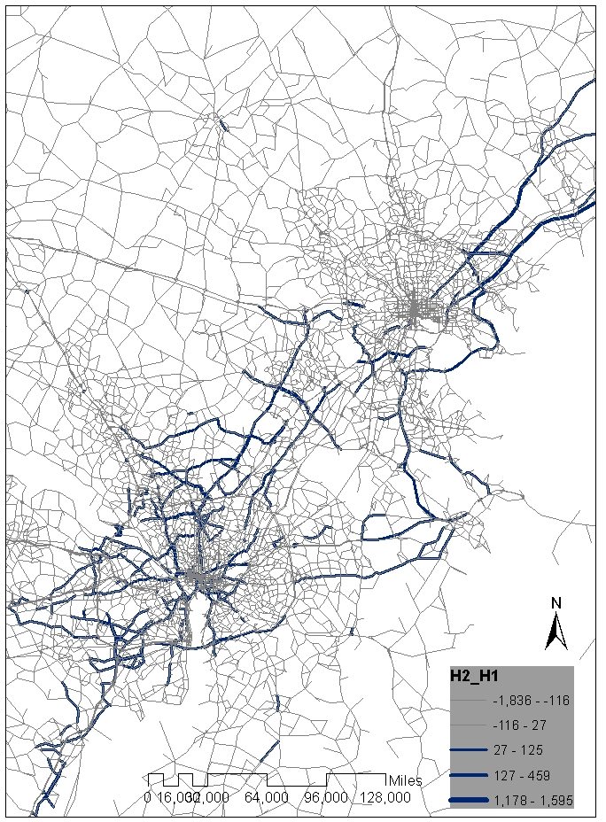
Scenario: Increase in Freight Demand
The Plot Shows Difference Between Scenario Case and Base Case Heavy- Heavy Duty Truck Flow

Slide 27
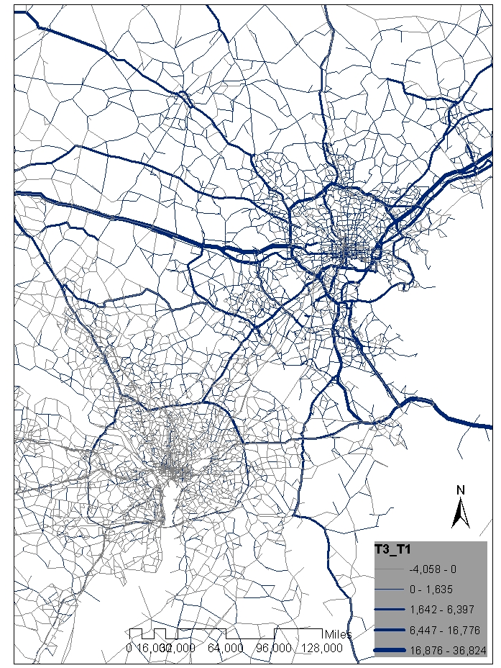
Scenario: Growth in Baltimore Port
The Plot Shows Difference Between Scenario Case and Base Case Total Truck Flow

Slide 28
Changes in VMT
Scenario | Trucks | CV | Med | Hvy
Scenario-1 | 3.47% | 0.08% | 0.05% | -0.08%
Scenario-2 | 10.96% | 0.85% | 0.78% | 0.11%

Slide 29
Conclusions

Slide 30
Conclusions
The three-layer model may be applied to study a variety on policy scenarios, such as
Pricing
Zoning
Infrastructure improvements
Changes in economy

Slide 31
Conclusions
Reconciliation with MPO models has improved the statewide model and may improve MPO models in the future
A multi-layer approach helps simulating different traffic markets

Slide 32
Acknowledgements
Maryland State Highway Administration (SHA)

