Slide 1
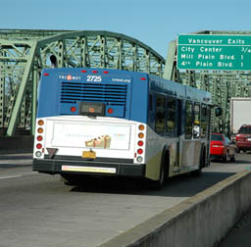
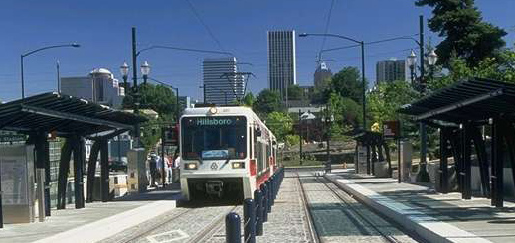
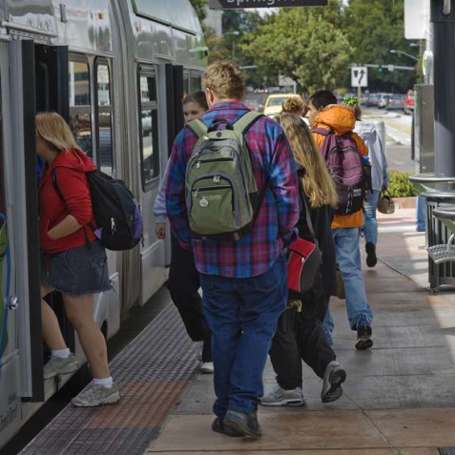



Understanding and Modeling Transit Preferences
In Portland, Oregon
TRB Planning Applications Conference
Reno, Nevada
2011-05-09
Mark Bradley Research & Consulting

Slide 2
Purpose & Need
Measure:
  Perceptions of ride time due to vehicle type
  Perceptions of wait time due to stop characteristics
Reduce reliance on alternative-specific constants!
  De-couple transit mode characteristics from transit stop characteristics
Why? To better explain ridership/benefits associated with different system changes:
  BRT, Streetcar, LRT, Commuter Rail
  Transit shelters, information systems, other amenities

Slide 3
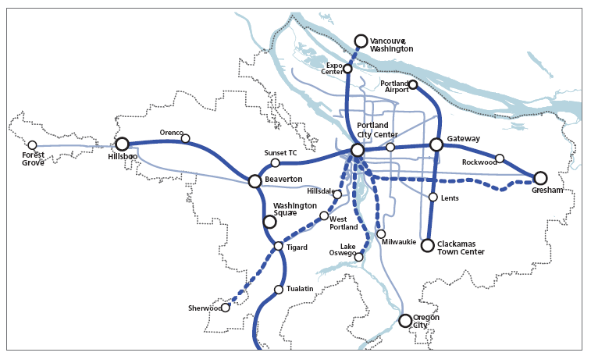
Existing, Planned, and Near-Term Regional Priority High Capacity Transit Corridors
Source: 2035 Regional High Capacity Transit System Plan: Summary Report, June 2010,
Portland Metro
Notes:
Portland has a well-developed LRT system, and there are plans to extend it and fill in with Streetcar and other types of HCT

Slide 4
Stated Preference Survey
Web-based survey
1,200 Resident Responses
  75% transit users, 25% auto users
Recruitment via postcard handout at transit locations, hotels (visitors), Powell’s books, other locations, email lists
On-site surveys at several locations
Data collection in early to mid-November

Slide 5
Survey Design
3 main choice options
  Base transit – an option that closely resembles their revealed transit trip (or likely transit trip for auto users)
  Alternative transit – an option that represents an alternative to their current trip
  Auto – a reasonable auto option for their revealed trip (or revealed auto trip for auto users)
Each transit alternative coupled with one of five stop types
Each drive-transit alternative coupled with one of two 2 parking options

Slide 6
Survey Design
Transit alternatives
  Walk-Bus
  Walk-LRT
  Walk-Streetcar
  Walk-Bus-LRT (Combo)
  Drive-Bus
  Drive-LRT
Parking options
  Formal parking lot
  No parking provided
Stop Types
  A: Large plaza stop, urban
  B: Large plaza stop, suburban
  C: Along street, medium shelter
  D: Along street, small shelter
  E: Along Street, no shelter

Slide 7
Survey Design
Varied:
  Transit in-vehicle time, wait time, access/egress time
  Stop type (not all stop types available for all modes)
  Parking availability (for drive-transit modes)
  Auto time, parking cost for auto trips.
12 scenarios
  Alternatives held constant across 4 scenarios, but frequency, stop type, and access time varied
Based transit variables on revealed transit trip
  Skims used to determine base transit values for auto trips and base auto values for transit trips

Slide 8
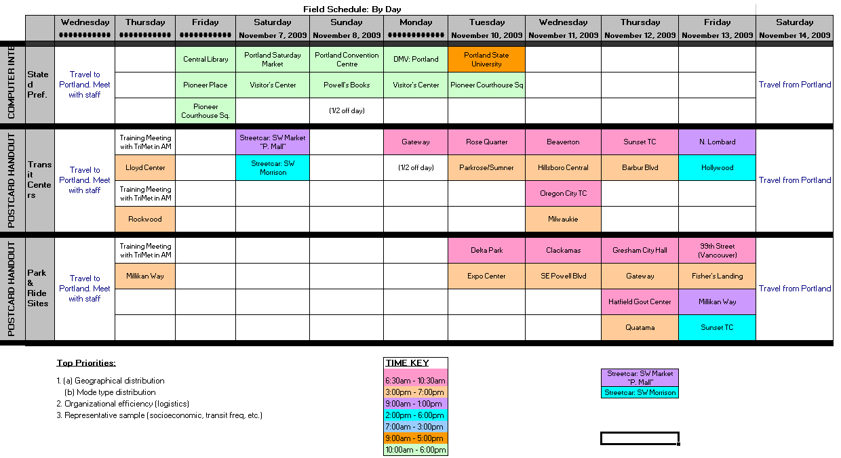
Notes:
Survey sites

Slide 9

Notes:
Recruitment via postcard

Slide 10
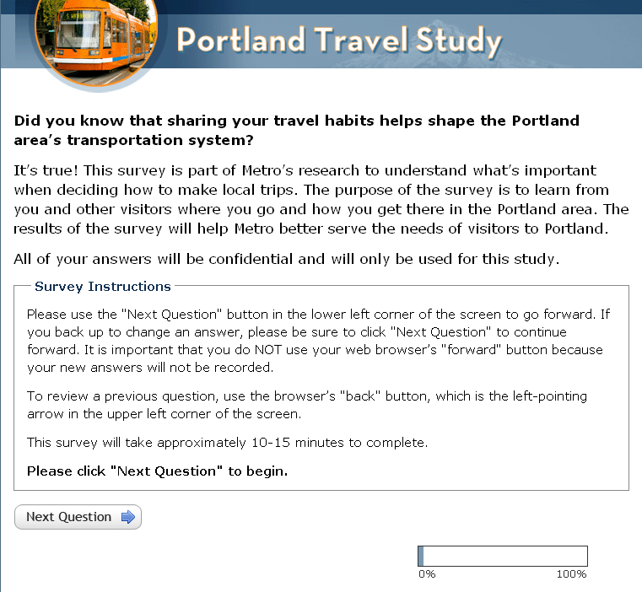
Notes:
Intro screen

Slide 11
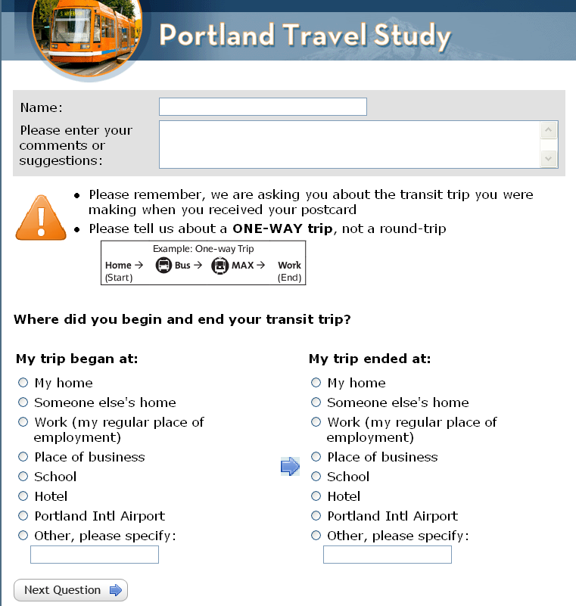
Notes:
RP trip collection

Slide 12
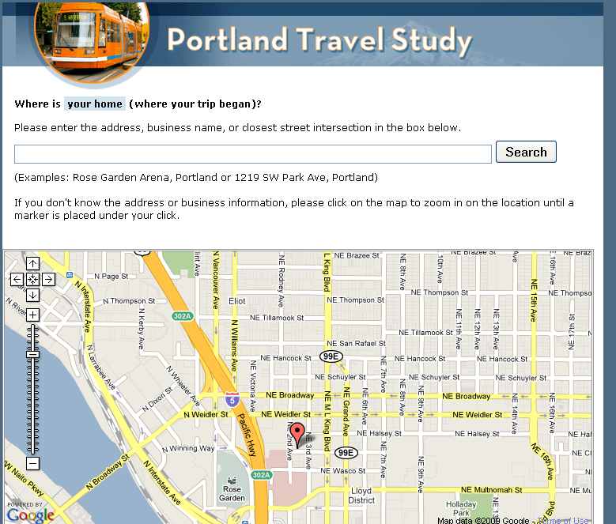
Notes:
Automated geocoding

Slide 13
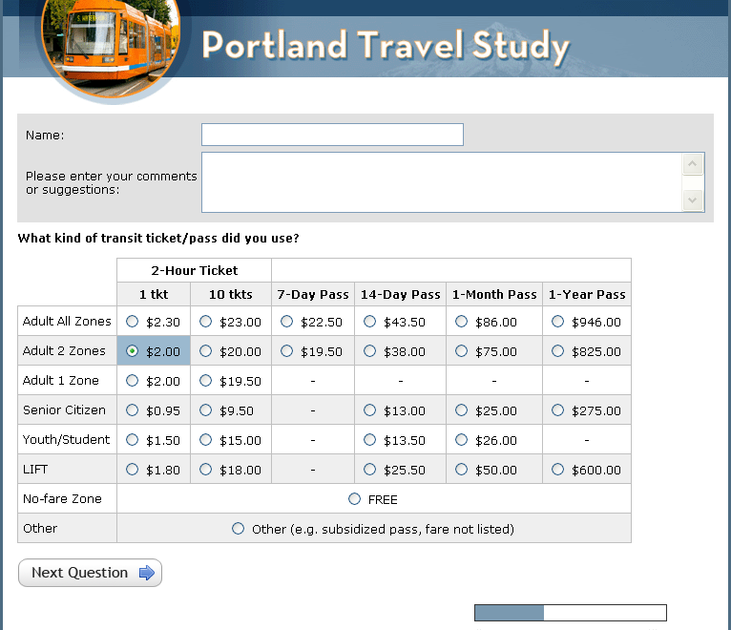
Notes:
Transit fare

Slide 14
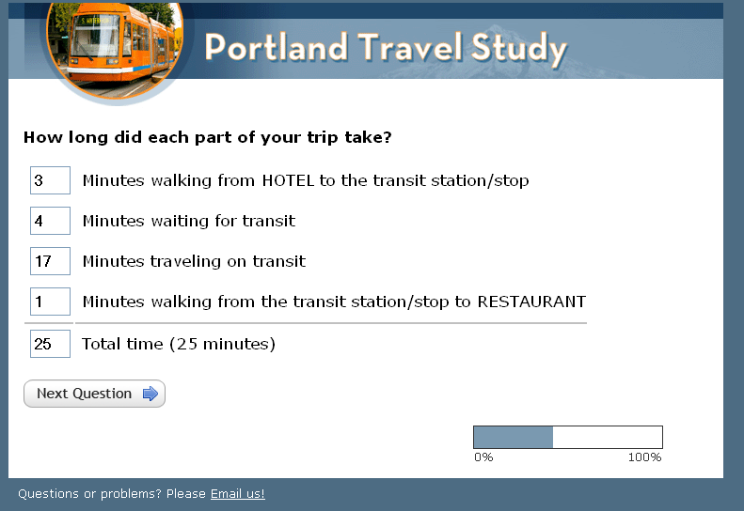

Slide 15
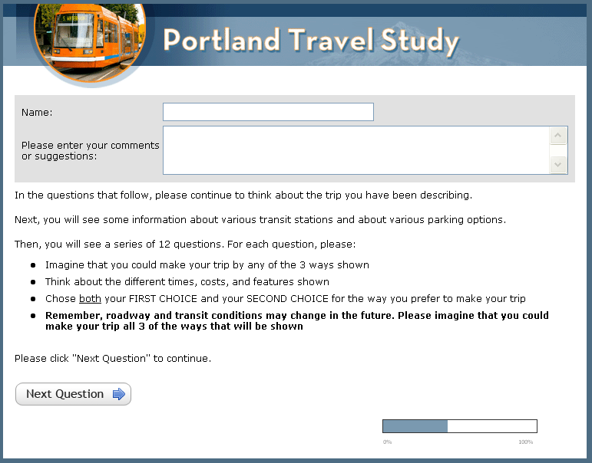

Slide 16
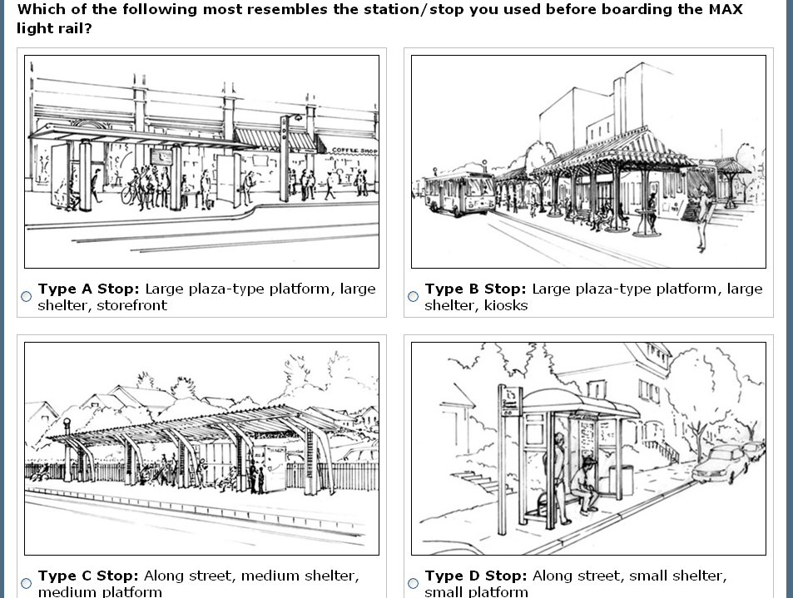
Notes:
Stop drawings

Slide 17
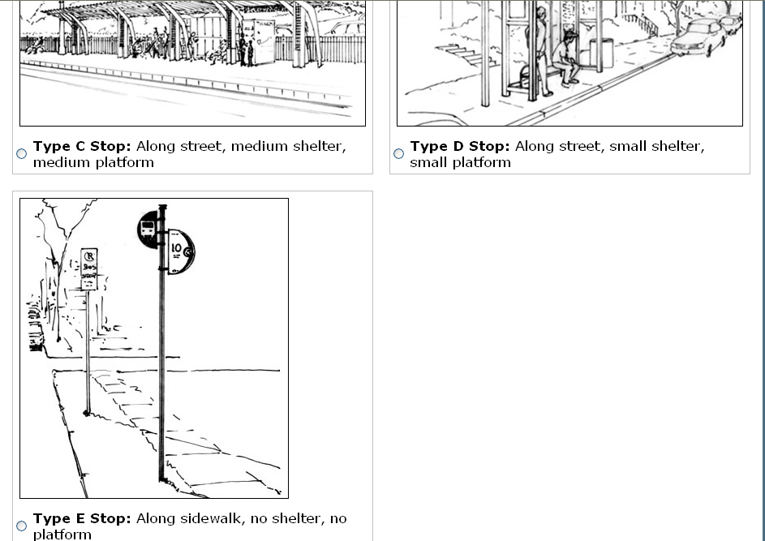
Notes:
Stop drawings con’d

Slide 18
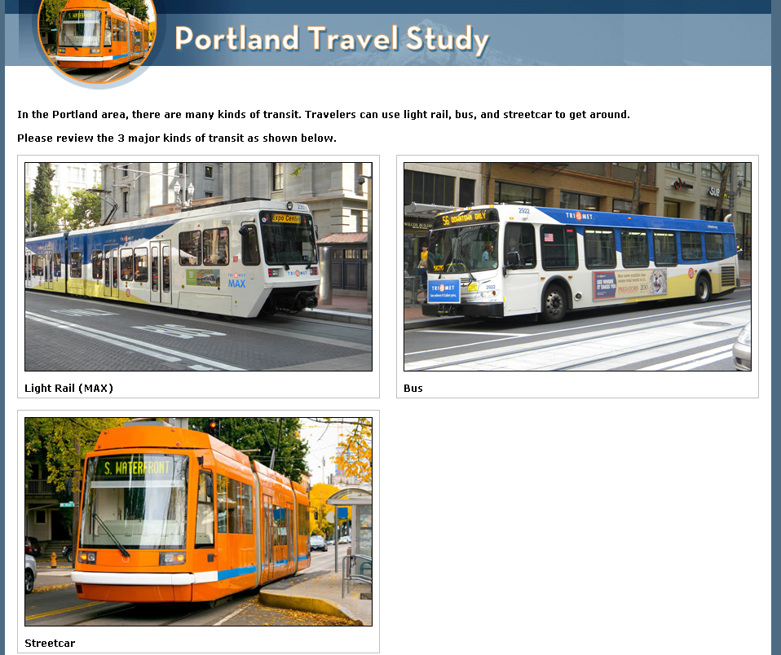
Notes:
Vehicle types

Slide 19
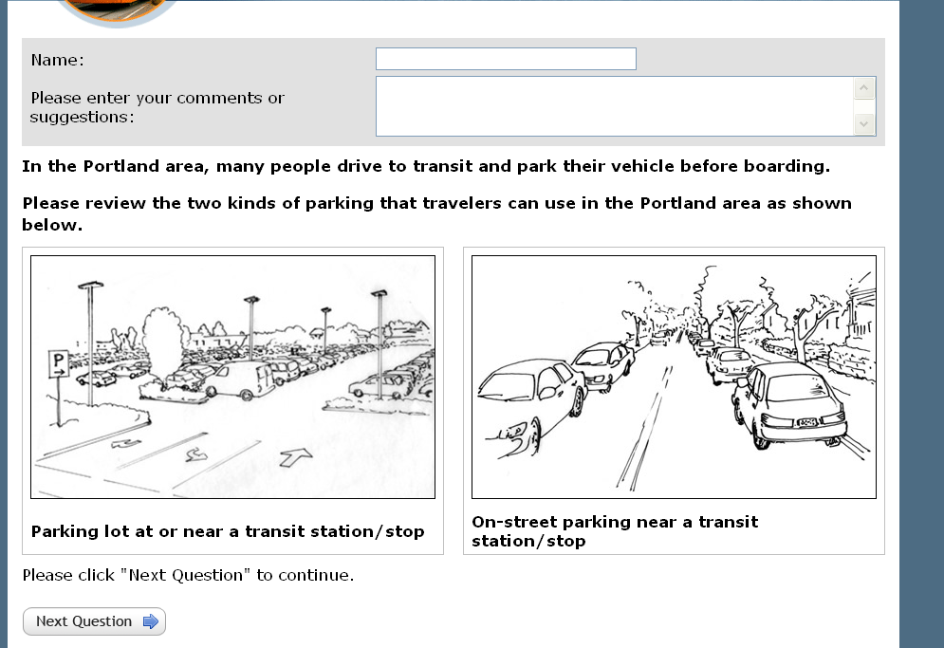
Notes:
Parking availability

Slide 20
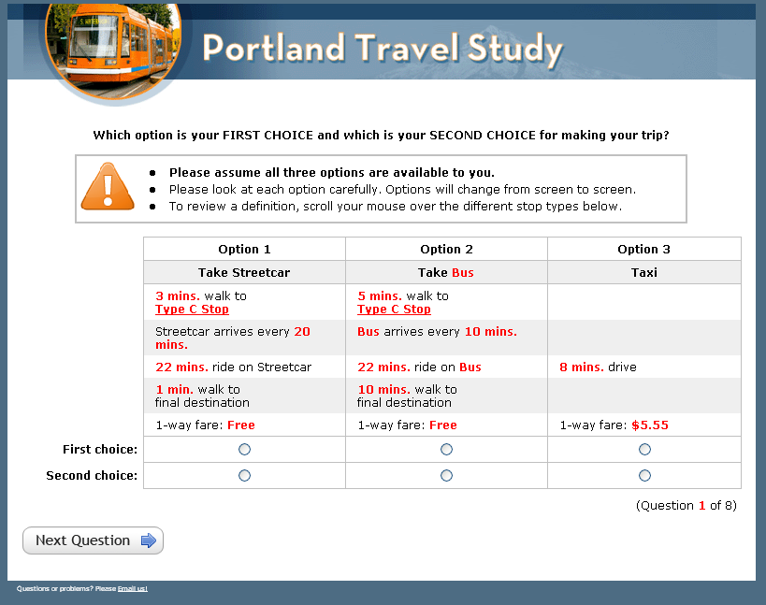
Notes:
Scenario

Slide 21
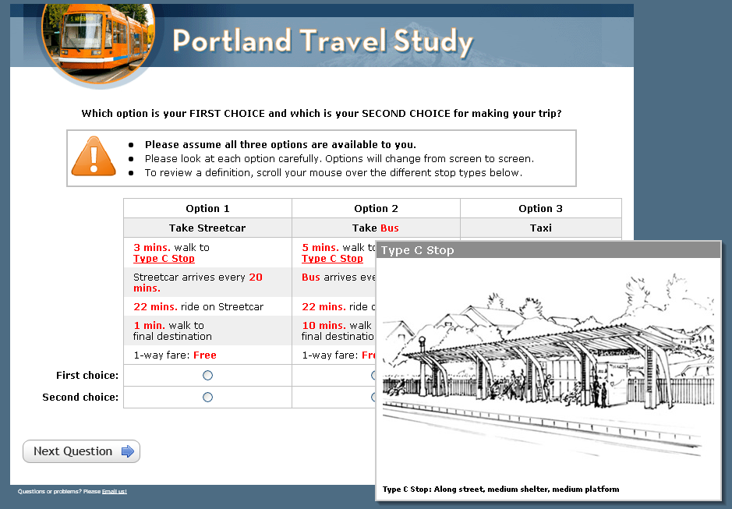
Notes:
Mouse-overs

Slide 22
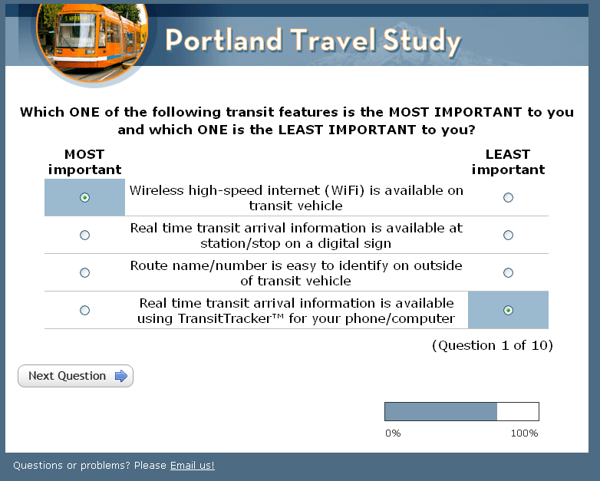
Notes:
Questions for attribute importance ranking

Slide 23
Data Analysis & Findings I
Significant and reasonable interactions between vehicle type and transit in-vehicle time
Less significant interactions between stop type and transit wait time
  Stop types A, B, and C combined in final model (“Full amenities”, “Shelter\Seat”, “Pole”)
Difficult to estimate model with both interactions and alternative-specific constants simultaneously

Slide 24
Data Analysis & Findings II
  In-vehicle interactions
    LRT in-vehicle time equivalent to approx. 85% of Local Bus
    No estimated Streetcar in-vehicle time benefit compared to Local Bus for work purpose (crowding concerns during peak period)
  Wait time interactions
    Wait time at “Full amenities” stop approx. 88% of wait at Pole
    Wait time at “Shelter\Seat” approx 93% of Pole

Slide 25
Data Analysis & Findings III
Notes:
No work constant for streetcar – estimations yielded negative constant for work. Comments indicate dissatisfaction with crowding on streetcar during peak periods.

Slide 26
Data Analysis & Findings IV
Assuming 30 minutes in-vehicle time, 15 minutes wait time, no transfers

Slide 27
Implementation I
Transit path-building/assignment implemented in Emme software
All modes available – Bus, Streetcar, LRT
  In-vehicle weights represented by segment-specific in-vehicle time parameters
  Stop wait times represented by node-specific wait time parameters
  Stop constants represented by node-specific variables, compiled additively along path and divided by boardings to calculate average constant (do not influence paths)
Wait time calculation = headway/2 * 1.6 * stop factor * spread factor
Spread factor controls number of attractive paths and influence of service frequency on path choice

Slide 28
Implementation II
Average weighted stop constant calculation (2 transfers):
Stop Type:
Pole
Full Amenities
Shelter\Seat
Constant:
0
0.1582
0.0531
Average stop constant = (0 + 0.1582 + 0.0531)/3 = 0.0704 utiles, or approx. 2 minutes IVT
Average weighted mode constant calculation (1 transfer):
Local Bus
Light-Rail
10 minutes
20 minutes
Constant:
0
0.184
Average mode constant = (10 * 0 + 20 * 0.184)/30 = 1.2267 utiles, or approx. 3.4 minutes IVT

Slide 29
Conclusions
The SP survey indicates that transit travelers perceive differences in:
  Ride time depending on the characteristics of transit vehicles
  Wait time depending on the characteristics of transit stops
De-coupling transit mode and stop characteristics is possible - and allows one to measure benefits of transit mode and stop improvements separately
Interaction effects logically take into account the amount of time that a traveler experiences the vehicle and stop attribute
It’s all possible using available software!

Slide 30
Thanks and Acknowledgements
Co-authors
  Ben Stabler, Parsons Brinckerhoff
  Dick Walker, Portland Metro
  Mark Bradley, Mark Bradley Research & Consulting
  Elizabeth Green, Resource Systems Group
Other contributors
  Scott Higgins, Portland Metro
  Aaron Breakstone, Portland Metro
  Bud Reiff, Portland Metro

Slide 31
Questions?

