Slide 1
Transit Path Choice Model Using Smart Card Data
(A Logit Model for Transit Path Choice Behavior)
Alireza Khani, Neema Nassir, Sang Gu Lee, Hyunsoo Noh, and Mark Hickman
The University of Arizona, Tucson, AZ
13th TRB National Planning Applications Conference
Reno, NV, Monday May 9, 2011

Slide 2
Introduction
Objective:
- Calibration of a path choice model using smart card data (Metro Transit in Minneapolis)
Metro Transit (www.metrotransit.org)
- Serving Minneapolis/St. Paul area, MN
Data available for 30 days in November 2008 (including AFC, APC, and AVL)
We used Monday, November 10, 2008 (84,413 records)
Google’s General Transit Feed Specification (GTFS ) (www.gtfs-data-exchange.com)
- Stops: 14,601
Stop ID, Stop Name, Latitude, Longitude, etc.
- Trips: 9,369 (Weekdays Service)
Route ID, Trip ID, Service ID, Trip Head-sign, etc.
- Stop Times: 488,105 (Weekdays Service)
Trip ID, Stop ID, Arrival/Departure Time, Stop Sequence, etc

Slide 3
Available Data
AFC transactions contain:
Special Serial Number (i.e. unique personal ID)
Fare Card Type (e.g., Metro Pass, U-Pass, C-Pass, Stored Value, ADA, …)
Transaction Time and GPS Location of the transaction
Route Number, Bus ID, Run ID
GTFS contains:
Trip IDs served by each Route
Bus schedule of each trip at each stop
Location of stop (Latitude, Longitude)
OD Estimation algorithm gives:
Origin and Destination Stop of each person
Trip trajectory (boarding/alighting stops and alighting time(s))
Transfers as well as activities between consecutive trips

Slide 4
Stop-Level OD Estimation
Transit Stop-Level O-D Estimation Using Transit Schedule and Automated Data Collection System, TRB 2011, Paper # 11-2949
For each passenger we know:
Transaction time of the boarding
GPS location of the boarding
Route number (no information about direction)
We infer the trajectory and estimate OD:
Boarding stop, trip ID (direction), and alighting stop
- Whether a transfer has happened or an
activity has taken place between two trips
Trip Chain Assumptions:
- Passengers don’t use any other mode than transit
in the sequence of their trips
- The last trip of the day ends at the origin of the first trip of the day
2nd Dest.
1st Dest.
Bus
Walk
Transaction
Bus Stop
Home
Transfer

Slide 5
Inferring the boarding and alighting stops
1- Find the nearest stop to the first transaction’s location.
2- If distance is less than D1 (0.1 mi) keep the stop (boarding).
3- Find the most probable bus trip serving that stop at the transaction time based on the schedule.
4- Find the nearest stop among the stops on that trip to the next transaction location.
5- If distance is less than D2 (0.5 mi) keep the stop (alighting).
First transaction
Second transaction
First route
Second route
Bus stop
Boarding stop
inferred
Alighting stop
inferred

Slide 6
Detecting Transfers
SPACE
W: Estimated walking time, including possible delay
t_{acc}: Time from which the boarding stop becomes accessible for the passenger
L: Time duration between the estimated arrival time to the boarding stop and the actual boarding time
N_{opp}: Number of bus runs lying in the time interval from t_{acc} to the actual boarding
K^{th}_{opp}: K^{th} bus run that is available to the passenger
Scheduled Bus Departures
1st_{OPP}
2nd_{OPP}
K^{th}_{OPP}
tacc
Boarding
Alighting
W
TIME
L
IF L >= 90 min
Non-transfer
IF Nopp>1
Non-transfer
IF 30 < L < 90 min
Transfer
Transfer
IF Nopp<=1
IF L <= 30 min

Slide 7
Route Choice Set
Bus
Walk
Transaction
Bus Stop
Destination
Destination
Destination
Origin
Origin
Origin
Passenger 1
Passenger 2
Choice set

Slide 8
Alternative Generation
Generated Alternatives
Passenger 1
Path A
Observed Paths
Passenger 1
Path B
Passenger 1
Path C
Passenger 1
Path A
Passenger 2
Path A
Passenger 2
Path B
Passenger 2
Path B
Passenger 3
Path C
Passenger 2
Path C
Passenger 3
Path A
Passenger 3
Path B
Passenger 3
Path C

Slide 9
Choice Attributes and Fare Card Coverage
Attribute |  | Definition
In Vehicle Time | VT | Sum of the times spent on rides of all legs of the path
Number of Transfers | TR | Number of bus transfers for the path
Waiting Time | WT | Sum of waiting times for all the transfers in the path
Walking Distance | WD | Sum of walking distances for all the transfers in the path
Express Route | EX | Indicates whether path contains any express routes or not
Downtown Route | DT | Indicates whether path contains a leg in downtown or not
Covers Express | CEX | Indicates whether the user’s pass covers the express fare or the passenger has to pay more
Covers Downtown | CDT | Indicates whether the user’s pass covers the downtown fare or the passenger has to pay more

Slide 10
Fares Variations
Category | Bus Type | Non-Rush Hours | Rush Hours
Adults | Regular Express | $1.75 $2.25 | $2.25 $3.00
Seniors | Regular Express | $0.75 $0.75 | $2.25 $3.00
Youth | Regular Express | $0.75 $0.75 | $2.25 $3.00
Medicare Card Holders | Regular Express | $0.75 $0.75 | $2.25 $3.00
Persons with Disability | Regular Express | $0.75 $0.75 | $0.75 $0.75
Downtown Zone | Regular | $0.50 | $0.50

Slide 11
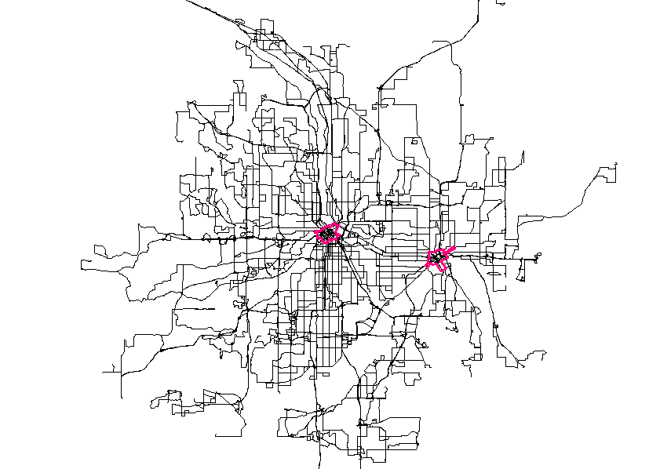
Downtown Minneapolis and Downtown St. Paul
Downtown St. Paul
Downtown Minneapolis

Slide 12
Utility Function Variables
Alternative Specific Variables:
- In Vehicle Time: VT
- Number of Transfers: TR
- Waiting Time: WT
- Walking Distance: WD
- Express Route: EX
User Specific Variables (fare):
- Express Cost: (EXCost) = EX * (1 – CEX)
- Downtown Cost: (DTCost) = DT * (1 – CDT)

Slide 13
Correlation of the Variables
 | VT | TR | WD | WT | EX | EXcost | DTcost
VT | 1.00 | 0.33 | 0.26 | 0.17 | 0.25 | 0.03 | -0.08
TR | 0.33 | 1.00 | 0.62 | 0.66 | 0.32 | -0.02 | -0.03
WD | 0.26 | 0.62 | 1.00 | 0.27 | 0.25 | -0.01 | -0.02
WT | 0.17 | 0.66 | 0.27 | 1.00 | 0.13 | -0.01 | -0.02
EX | 0.25 | 0.32 | 0.25 | 0.13 | 1.00 | 0.46 | -0.02
EXcost | 0.03 | -0.02 | -0.01 | -0.01 | 0.46 | 1.00 | -0.01
DTcost | -0.08 | -0.03 | -0.02 | -0.02 | -0.02 | -0.01 | 1.00
Red: High correlation Green: Low correlation

Slide 14
Independence of Irrelative Alternatives (IIA)
What is IIA?
Adding another alternative or changing the attributes of one alternative does not affect the relative odds between the two alternatives considered.
Example:
Red/Blue Bus Vs Auto
Why is IIA important?
Failure to consider the fact that red bus and blue bus are perfect substitutes
How did we detect the violation of IIA?
Alternatives with a common leg (unlinked trip)
How many cases with violating IIA property?
AM: 8 out of 481 (2%)
MD: 62 out of 588 (10%)
PM: 14 out of 744 (2%)
NT: 10 out of 107 (9%)

Slide 15
Data Sets and Calibration Tool
Category | Data Set | Time Period | No. of Observations
Disaggregate | AM | 6:00AM – 9:00AM | 481
 | MD | 9:00AM – 3:00PM | 588
 | PM | 3:00PM – 6:30PM | 744
 | NT | 6:30PM – 6:00AM | 107
Aggregate | Rush-Hours | AM and PM | 1225
 | Non-Rush Hours | MD and NT | 695
 | All-Day | All the day | 1922
Calibration Tools:
- Easy Logit Modeler (ELM) (http://www.elm-works.com/)
- Biogeme (http://biogeme.epfl.ch/)

Slide 16
Disaggregate Models
Time Period | Model | Rho² | t-statistics
AM | TR: -1.270 WT: -0.071 | 0.026 0.016 | -3.69 -2.71
MD | VT: -0.039 TR: -0.887 WD: -3.997 WT: -0.051 | 0.016 0.032 0.015 0.025 | -2.93 -4.09 -2.99 -3.88
PM | VT: -0.034 TR: -1.005 WT: -0.053 | 0.003 0.029 0.022 | -2.20 -5.20 -4.37
NT | TR: -1.640 WD: -58.10 | 0.066 0.067 | -2.93 -2.66

Slide 17
Aggregate Models
Period | Model | Rho² | t-statistics
Rush-Hours | -0.270 VT -1.076 TR -0.057 WT | 0.003 0.029 0.021 | -2.30 -6.41 -5.13
Non-Rush Hours | -0.037 VT -1.010 TR -4.340 WD -0.054 WT | 0.013 0.038 0.015 0.025 | -2. 87 -4.76 -3.14 -4.17
All-Day | -0.032 VT -1.055 TR -3.095 WD -0.056 WD | 0.006 0.032 0.004 0.022 | -3.76 -7.96 -3.18 -6.61

Slide 18
Test of Taste Variation
What is Taste Variation?
Statistical test indicating the significance of difference between a model estimated for an aggregated set of observations and models estimated for different segments of the same data set.
How does the test work?
Equality of the Vector of Coefficients
Null Hypotheses: β_{a} = β_{s1} = β_{s2}
Likelihood Ratio: LR = -2 * ( LL_{a} - ∑ LL_{s} )
Degrees of freedom: DF = ∑ K_{s} – K_{a}
when k is the number of variables in the utility function.
The null hypothesis is tested using Chi-square test (χ²_{DF})
Individual Coefficient Test:
Testing a similar hypotheses for each coefficient using t-statistic calculated by:
(β_{s1} – β_{s2})/(var(β_{s1}) – Var(β_{s2}))

Slide 19
Result of the Taste Variation Test
Period | Model | Chi²-statistics (LR) | Chi² value (DOF=1) | t-statistics
Rush-Hours | -1.076 TR | -0.48 | 3.84 | -0.25
Non-Rush Hours | -1.010 TR | 2.00 | 3.84 | -0.34
All-Day | -1.055 TR | 2.51 | 3.84 | -0.25

Slide 20
Conclusion
We proposed an algorithm for estimating transit OD and trajectory of each passenger using smart card data. The model can detect the transfer points.
The results of the algorithm were used to estimate a utility function for transit route choice model in different time periods of a day.
Estimation results shows that the number of transfers is the most important factor in transit route choice in all data sets (disaggregate and aggregate).
Test of taste variation shows that the aggregation of the datasets for different time periods toward all the day dataset cannot be rejected and a unique utility function can be used for transit route choice in different time periods of the day.

Slide 21
Questions?

