Slide 1
Building a Database for Estimation of an Advanced Activity-Based Travel Model from the NHTS
Vladimir Livshits, Petya Maneva,
Maricopa Association of Governments (MAG), Phoenix, AZ
Peter Vovsha, Surabhi Gupta,
Parsons Brinckerhoff, New York, NY

Slide 2
Details of Survey Dataset
NHTS add-on survey for
Phoenix – Maricopa Association of Governments (MAG)
Tucson – Pima Association of Governments (PAG)
Completed in 2008
7,068 Households, Single day
Weekday Travel
5,067 households (615 incomplete)
10,956 Persons
41,444 Trips

Slide 3
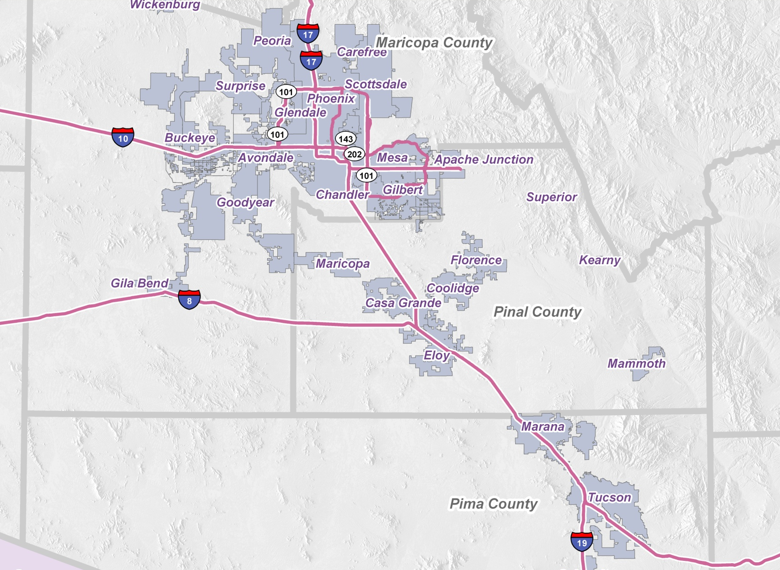
Survey Area

Slide 4
Data Processing

Slide 5
Quality Checks
Validity of the tour mode and each half-tour mode
Completeness of tours -start and end at home
Consistency of time-related tour attributes
Fullness of trip end destination coding
Mode symmetry between outbound and inbound directions

Slide 6
Quality Checks: Half-Tour and Tour Mode
Mode | Which Trips? | Half- Tour Mode | Tour Mode
Unknown | Some Trips on Half-Tour | Can Identify | Can Identify
 | All Trips on Half-Tour | Can not identify | From other half-tour (Symmetry)
 | All Trips on Tour | Can not identify | Can not identify
Known, Not Available | Some or All Trips | Not Available | Not Available

Slide 7
Quality Check: Start/End at Home
Completeness of tours in terms of starting and ending at home; the following cases are distinguished:
Start/End | Example | Validity | Remark
Start not from Home | Trip from Airport/Outside of Region | Valid reason
 | Missing previous Trip | Invalid reason | Frequent Case
End not at Home | Trip to Airport/ Outside of Region | Valid reason
 | Missing last trip | Invalid reason | Frequent Case

Slide 8
Quality Checks
Consistency of time-related tour attributes
Missing Departure / Arrival Trip Time
Conflicting trip/activity time chain
Arrival time before departure time
Moving backward in daily schedule
Unrealistic reported trip duration vs. mode-specific skims from model
Fullness of trip destination coding
Missing/unknown destination zones
Destination outside the modeled region (intercity trips)

Slide 9
Cross-Region Comparison
 | SAN DIE GO (SANDAG) | ATLANTA (ARC) | BAY AREA (MTC) | CHICAGO (CMAP) | PHOENIX – TUCSON (MAG/PAG) NHTS
Survey Year | 2006 | 2001 | 2000 | 2007-08 | 2008
#HHs | 3,651 | 8,069 | 15,064 | 14,315 | 7,068
#Days | 1 | 2 | 2 | 1-2 | 1
Notes:
The paper describes the recent experience with using the NHTS survey for development an advanced Activity-Based travel Model (ABM) for the Phoenix-Tucson, AZ region. An NHTS add-on survey was completed for both cities in fall 2008 collecting 7,000 households.
MAG – 5067 weekday households …. 615 incomplete HHs

Slide 10
Completeness of Trip Records

Slide 11
Completeness of Tour Records

Slide 12
Tours by Purpose & Person Type (MAG/PAG NHTS)
Person Type | Work | School | University | Others
Full-time worker | 2,834 | 0 | 4 | 2,176
Part-time worker | 482 | 0 | 0 | 1,048
University student | 102 | 0 | 249 | 251
Non-worker | 64 | 4 | 5 | 2,636
Retiree | 19 | 0 | 0 | 3,046
Driving Age school child | 28 | 232 | 0 | 151
Pre-driving age school child | 3 | 1,016 | 0 | 616
Pre-school child | 0 | 88 | 0 | 53

Slide 13
Daily Tour Rate by Person Type
No Travel Reported for Children under 5 years

Slide 14
Imputing Trips for Household Members – under 5 years
Identify HH members age less than 5 years
Extract joint trips of other HH members with kids under 5 years reported
Is trip part of fully and partially joint tours ?
Fully Joint Tour – same trip information
Partially Joint Tour - identify drop off or pick up?
Drop-off – set destination purpose to school*
Pick-up – set origin purpose to school*
Imputed Trips = 1,961, Tours = 828

Slide 15
Daily Tour Rate by Person Type
AFTER SYNTHESIZING TRIPS

Slide 16
Joint Activities
Consistency of reported joint activities
Resolve data conflicts and create a consistent entire-household pattern
Impute Trips for Joint Travel
Only for Fully Joint Tours
No conflict of schedule with other reported trips
292 trips, 127 Tours imputed
Notes:
Building entire-household daily activity-travel patterns including joint activities and travel by several household members. Consistency of reported joint activities and trips is one of the weakest points of the conventional survey technology. Thus, a special algorithm for resolving data conflicts and creating a consistent entire-household pattern was developed and applied. This step helps impute many trips missing in the survey (primary for auto passengers and specifically for children escorted by adults).

Slide 17
Reconcile Trip Records with Land Use at Destination
Logical checks
Jobs (for worker occupation) available in Work location TAZ?
Workers are classified by 5 occupation categories
Sales, marketing
Clerical, administrative, retail,
Production, construction, farming, transport
Professional, managerial, technical
Personal care or services
Jobs in each TAZ are classified by 2-digit NAICS codes (26 categories) – correspond to 5 occupation categories
Students – student type (k-8, high school, college) vs. enrollment

Slide 18
Reconcile Trip Records with Land Use at Destination
Logical checks: Non-Mandatory trips by purpose
Employment or Other Land Use | Shopping | Maintenance | Eating Out | Visiting | Discretionary
Retail | √ | √ | √ |  | √
Information |  | √
Real Estate, Renting, Leasing |  | √
Health Care, Social Assistance |  | √ |  | √
Arts, Entertainment |  |  | √ |  | √
Accommodation, Food Services | √ |  | √ |  | √
Public Admin |  | √
# Households |  |  |  | √ | √

Slide 19
Reconcile Trip Records with Land Use at Destination
Analysis of discrepancies & fixes (manual):
Geo-coding errors
Problem with Land Use data
Survey coding errors
Worker job type
Student type definition

Slide 20
Reconcile Trip Records with Level-of-Service (LOS) Skims
Logical checks:
Availability of reported mode
Transit IVT = 0 (by mode)
Drive option for person under 16 yrs
Unrealistic reported trip duration vs. mode-specific skims from model
Number of records by modes
No valid observations for Commuter Rail & Urban Rail
Very few cases for Express/Rapid bus

Slide 21
Tours by Purpose & Mode (MAG/PAG NHTS)

Slide 22
Tours by Purpose & Aggregate Mode (MAG/PAG NHTS)

Slide 23
Reconcile Trip Records with Level-of-Service (LOS) Skims
Analysis of discrepancies and fixes (manual):
Survey mode coding errors
Compare reported trip duration to skims
Trip Duration = β*Skim
PAG skims are a bit too fast; Revision is underway
Geo-coding fixes for availability of Express/Rapid Bus
Trip Mode | β (MAG) | β (PAG)
Highway | 1.01 | 1.15
Transit (Bus) | 0.85 | 1.20

Slide 24
Conclusions - MAG/PAG NHTS Survey
Good quality overall:
Reasonable trip & tour rates per person & HH comparable to other regions
Validity and completeness of trip records at the level of other surveys or better
Can be used for development of advanced ABM but requires processing & imputations
Problems and lessons learned:
Incomplete HHs with missing persons
Very small sample of transit users
No travel records for small children U-5
Inconsistencies between joint travel records (GPS, automatic logic checks)
Many problems can be fixed by time-taking manual analysis

Slide 25
Thank You !! Questions??

