Slide 1
SHRP2 C10A
Sensitivity Testing of an Integrated Regional Travel Demand and Traffic Microsimulation Model
TRB Planning
Applications Conference
May 8 - 12, 2011
Reno, NV
Joe Castiglione, Brian Grady & Stephen Lawe
Resource Systems Group
John Bowman
Bowman Research and Consulting
Mark Bradley
Mark Bradley Research & Consulting
David Roden & Krishna Patnam
AECOM
Notes:
1

Slide 2
Overview
C10A project
DaySim-TRANSIMS-MOVES model system
Initial Sensitivity tests
  Pricing (freeway tolling, auto operating costs)
  Travel demand management
  Operational improvements

Slide 3
C10A Project Objectives
Address limited sensitivity of models to dynamic interplay between network conditions and behavior
  Temporal detail (reflect variations in supply and demand)
  Behavioral detail (VOTs, reliability)
  Spatial detail (small scale improvements)
Exploit advances in activity-based demand modeling and DTA
  Capacity expansion
  Variable road pricing / tolling
  Operational improvements
  Travel demand management
  Travel time reliability
  Time-of-day shifting

Slide 4
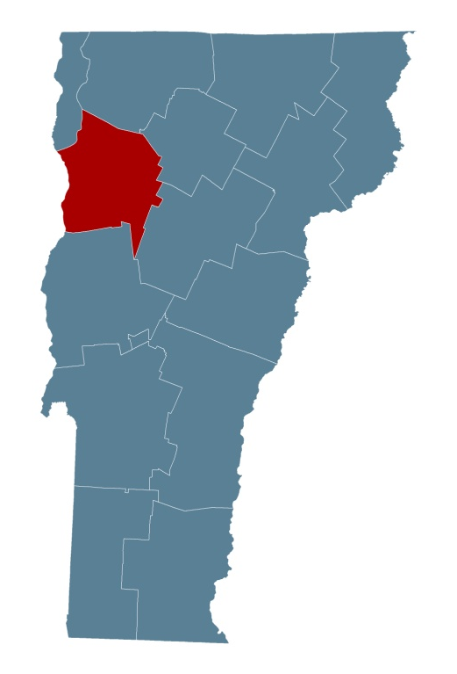
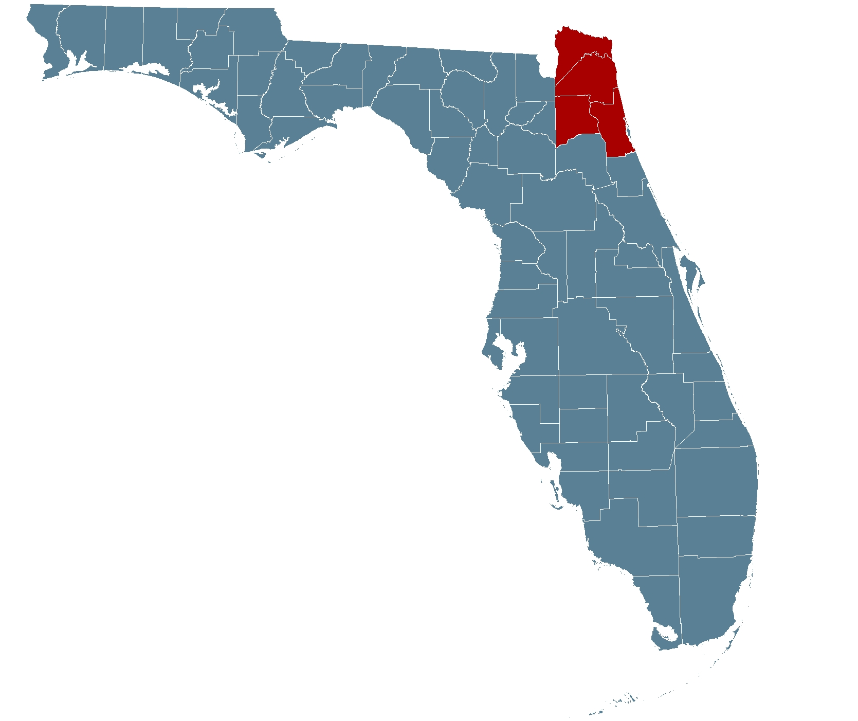
C10A: Two Distinct Project Geographies
Burlington, VT test-bed
1-county
620 sq.miles
55,000 households
525,000 daily trips
Jacksonville, FL
4-counties
3,100 sq.miles
525,000 households
5 million daily trips

Slide 5
C10A Integrated Model System
Develop a integrated model in Jacksonville, FL and Burlington, VT
  DaySim: Provides detailed estimates of travel demand
  TRANSIMS: Provides detailed estimates of network performance
  MOVES: Provides estimates of air quality
Impedance Skims
DaySim
Exogenous Trips
TRANSIMS STUDIO
Demand File
Iteration/Convergence
File Manager
TRANSIMS
MOVES
MOEs / Indicators

Slide 6
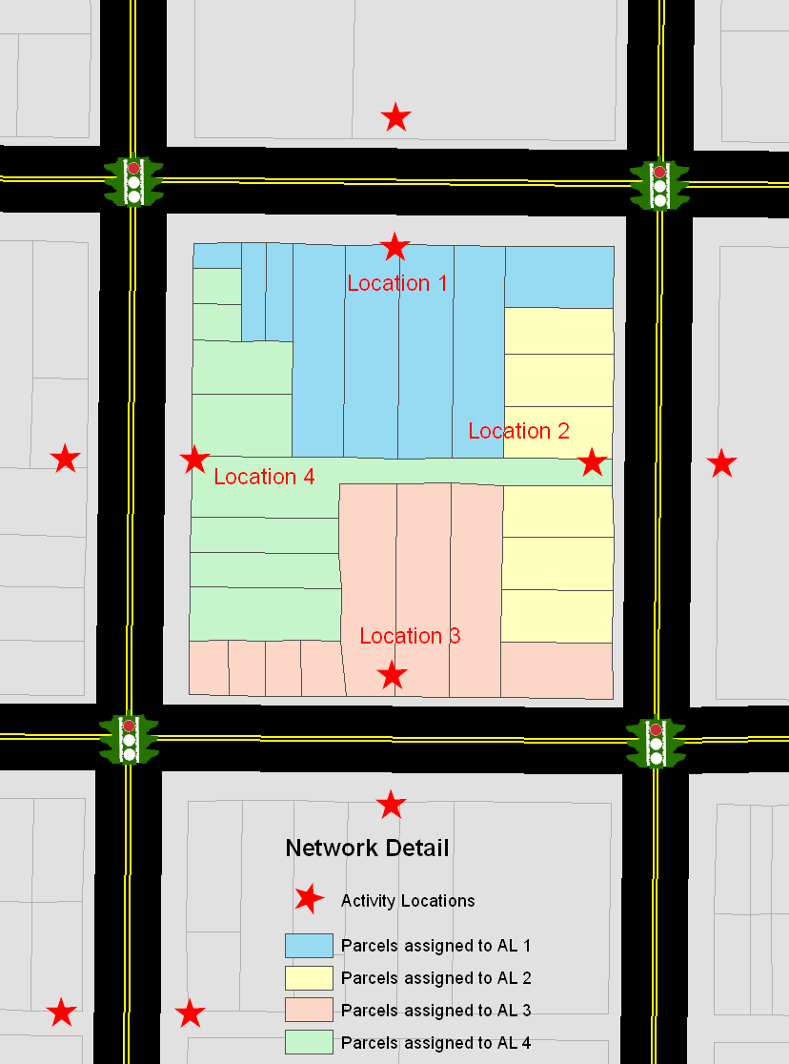
DaySim →TRANSIMS Integration
DaySim
  Spatial resolution of parcels
  Temporal resolution of half-hours, disaggregated to minutes
TRANSIMS
  Spatial resolution of activity locations
  Temporal resolution of minutes and seconds
DaySim provides an activity list (trips are linked as tours) to TRANSIMS at the level of minutes and activity locations

Slide 7
TRANSIMS → DaySim: Temporal Resolution
Current skim resolution: 22 time periods, TAZ-level
Future skim resolution: 48 time periods, “activity-level” resolution
Microsimulated network and TRANSIMS tools easily and flexibly support skim development

Slide 8
Convergence
Convergence is necessary to:
  ensure the behavioral integrity of the model system
  ensure that the model system will be useful as an analysis tool
FHWA-funded Sacramento DaySim-TRANSIMS project is investigating convergence measures and methods
Preliminary results have informed this effort
  Use of disaggregate “trip gap”
  Identifying sufficient numbers of assignment and system iterations
  Network temporal resolution

Slide 9
Initial Sensitivity Testing Scenarios
Initial tests performed using the Burlington testbed
  Smaller region allows for more rapid testing and debugging
  Burlington demand increased to reflect more congestion
Pricing
  Freeway tolling by time-of-day
  Auto operating costs
Travel Demand Management
  Flexible work schedule
Operation Improvements
  Signal progression

Slide 10
Freeway Tolling
Costs may be imposed on travelers
  using certain roads
  traversing certain screenlines
  travelling to certain areas
Costs may be either fixed, or vary by time-of-day or in response to congestion
3 freeway tolling by time-of-day scenarios tested

Slide 11
Freeway Tolling: Demand Impacts
Trips shift out of peaks and midday and into evening and early AM
Higher tolls increases the magnitude of this shift
Time shifting varies by purpose
Work trips shift into early AM and out of AM peak
Social/recreation trips shift significantly out of peaks and primarily into the evening

Slide 12
Freeway Tolling: Supply Impacts
Freeway VHT significantly affected by time varying toll scenarios
VHT on minor arterials impacted significantly more than major arterials

Slide 13
Freeway Tolling: Supply Impacts
Increased delay on non-freeway facilities leads to higher overall system delay
No sustained congestion in Burlington, even with increases in assumed pop / emp
No optimization of tolls to address peak congestion

Slide 14
Auto Operating Costs
Auto Operating Costs
  Costs associated with operating the vehicle (gas, maintenance)
  Assessed on a per mile basis
In DaySim, long-term and short-term models affected by changes in costs
  Long-term: Auto ownership, usual work and school location
  Short-term: Day pattern, tour/stop destination, mode choice
Scenarios tested
  Base ($0.12/mile)
  0.5x ($0.06/mile)
  2x ($0.24/mile)
  5x ($0.60/mile)

Slide 15
Auto Operating Costs: Demand Impacts
Auto ownership decreases with higher costs
Overall tour-making decreases slightly with higher costs

Slide 16
Auto Operating Costs: Demand & Supply Impacts
Trip lengths decrease slightly with higher costs
VMT, VHT and Delay also decline with higher costs
But time-of-day is largely unaffected

Slide 17
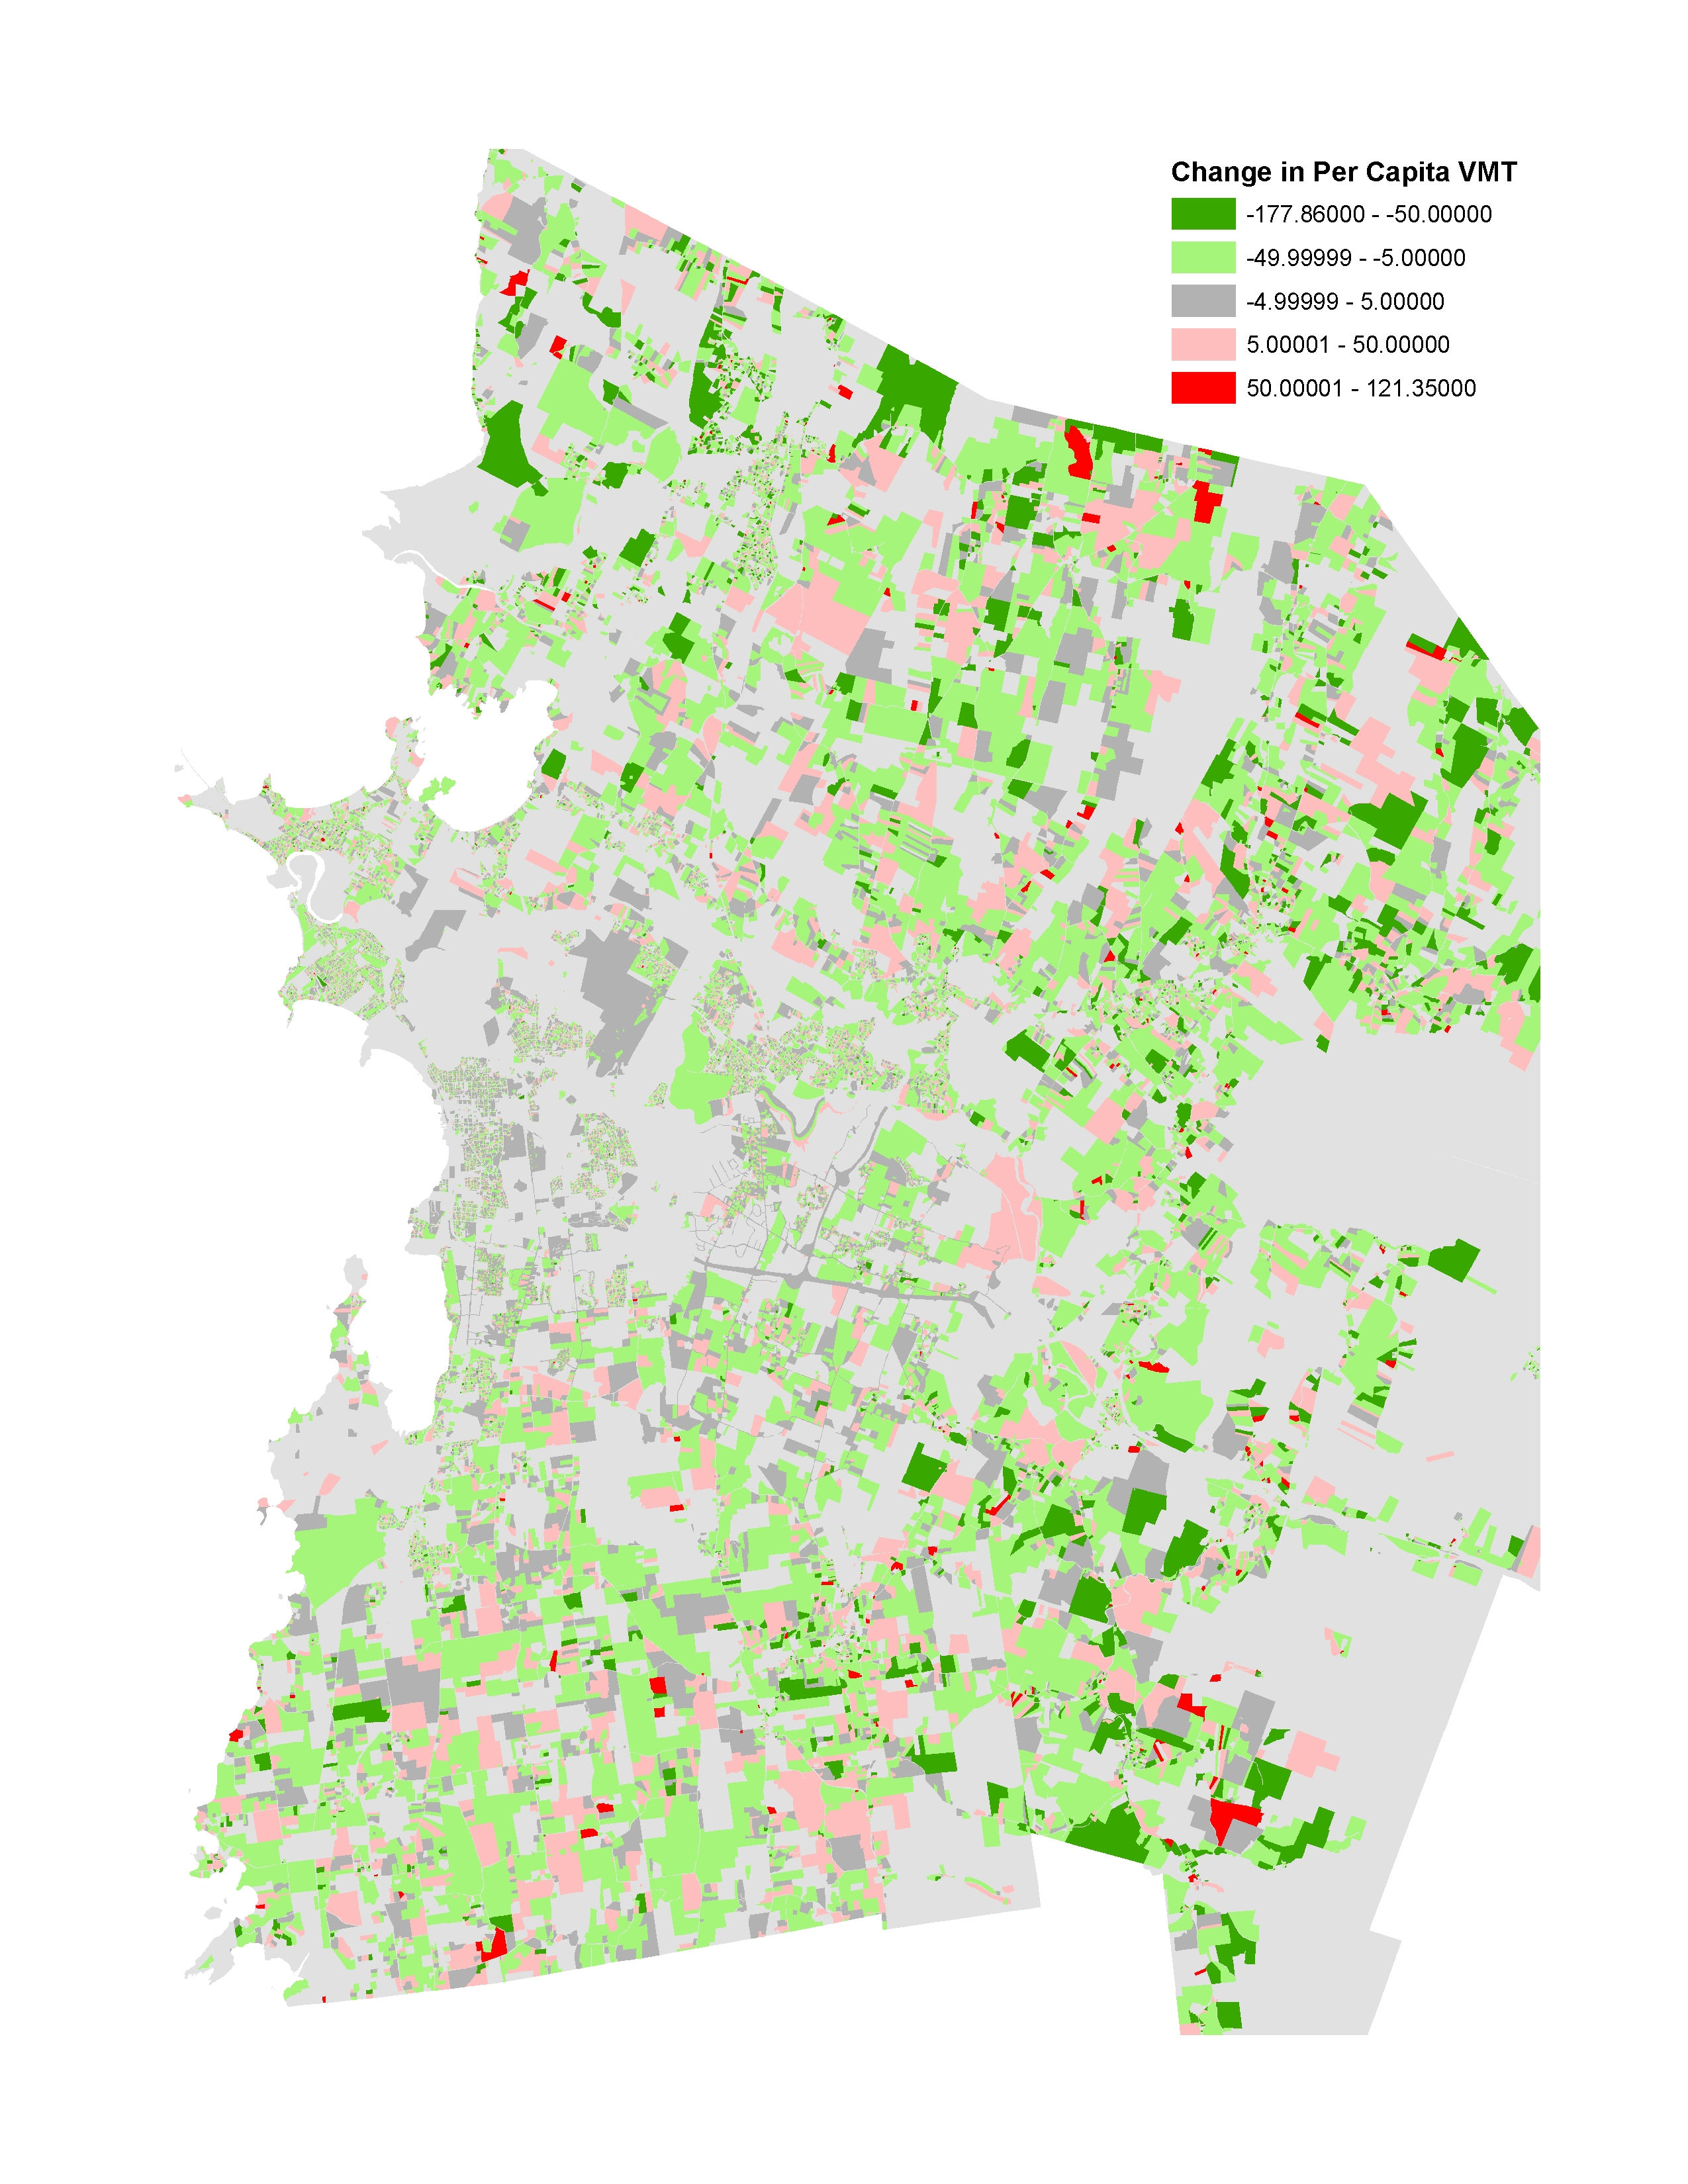
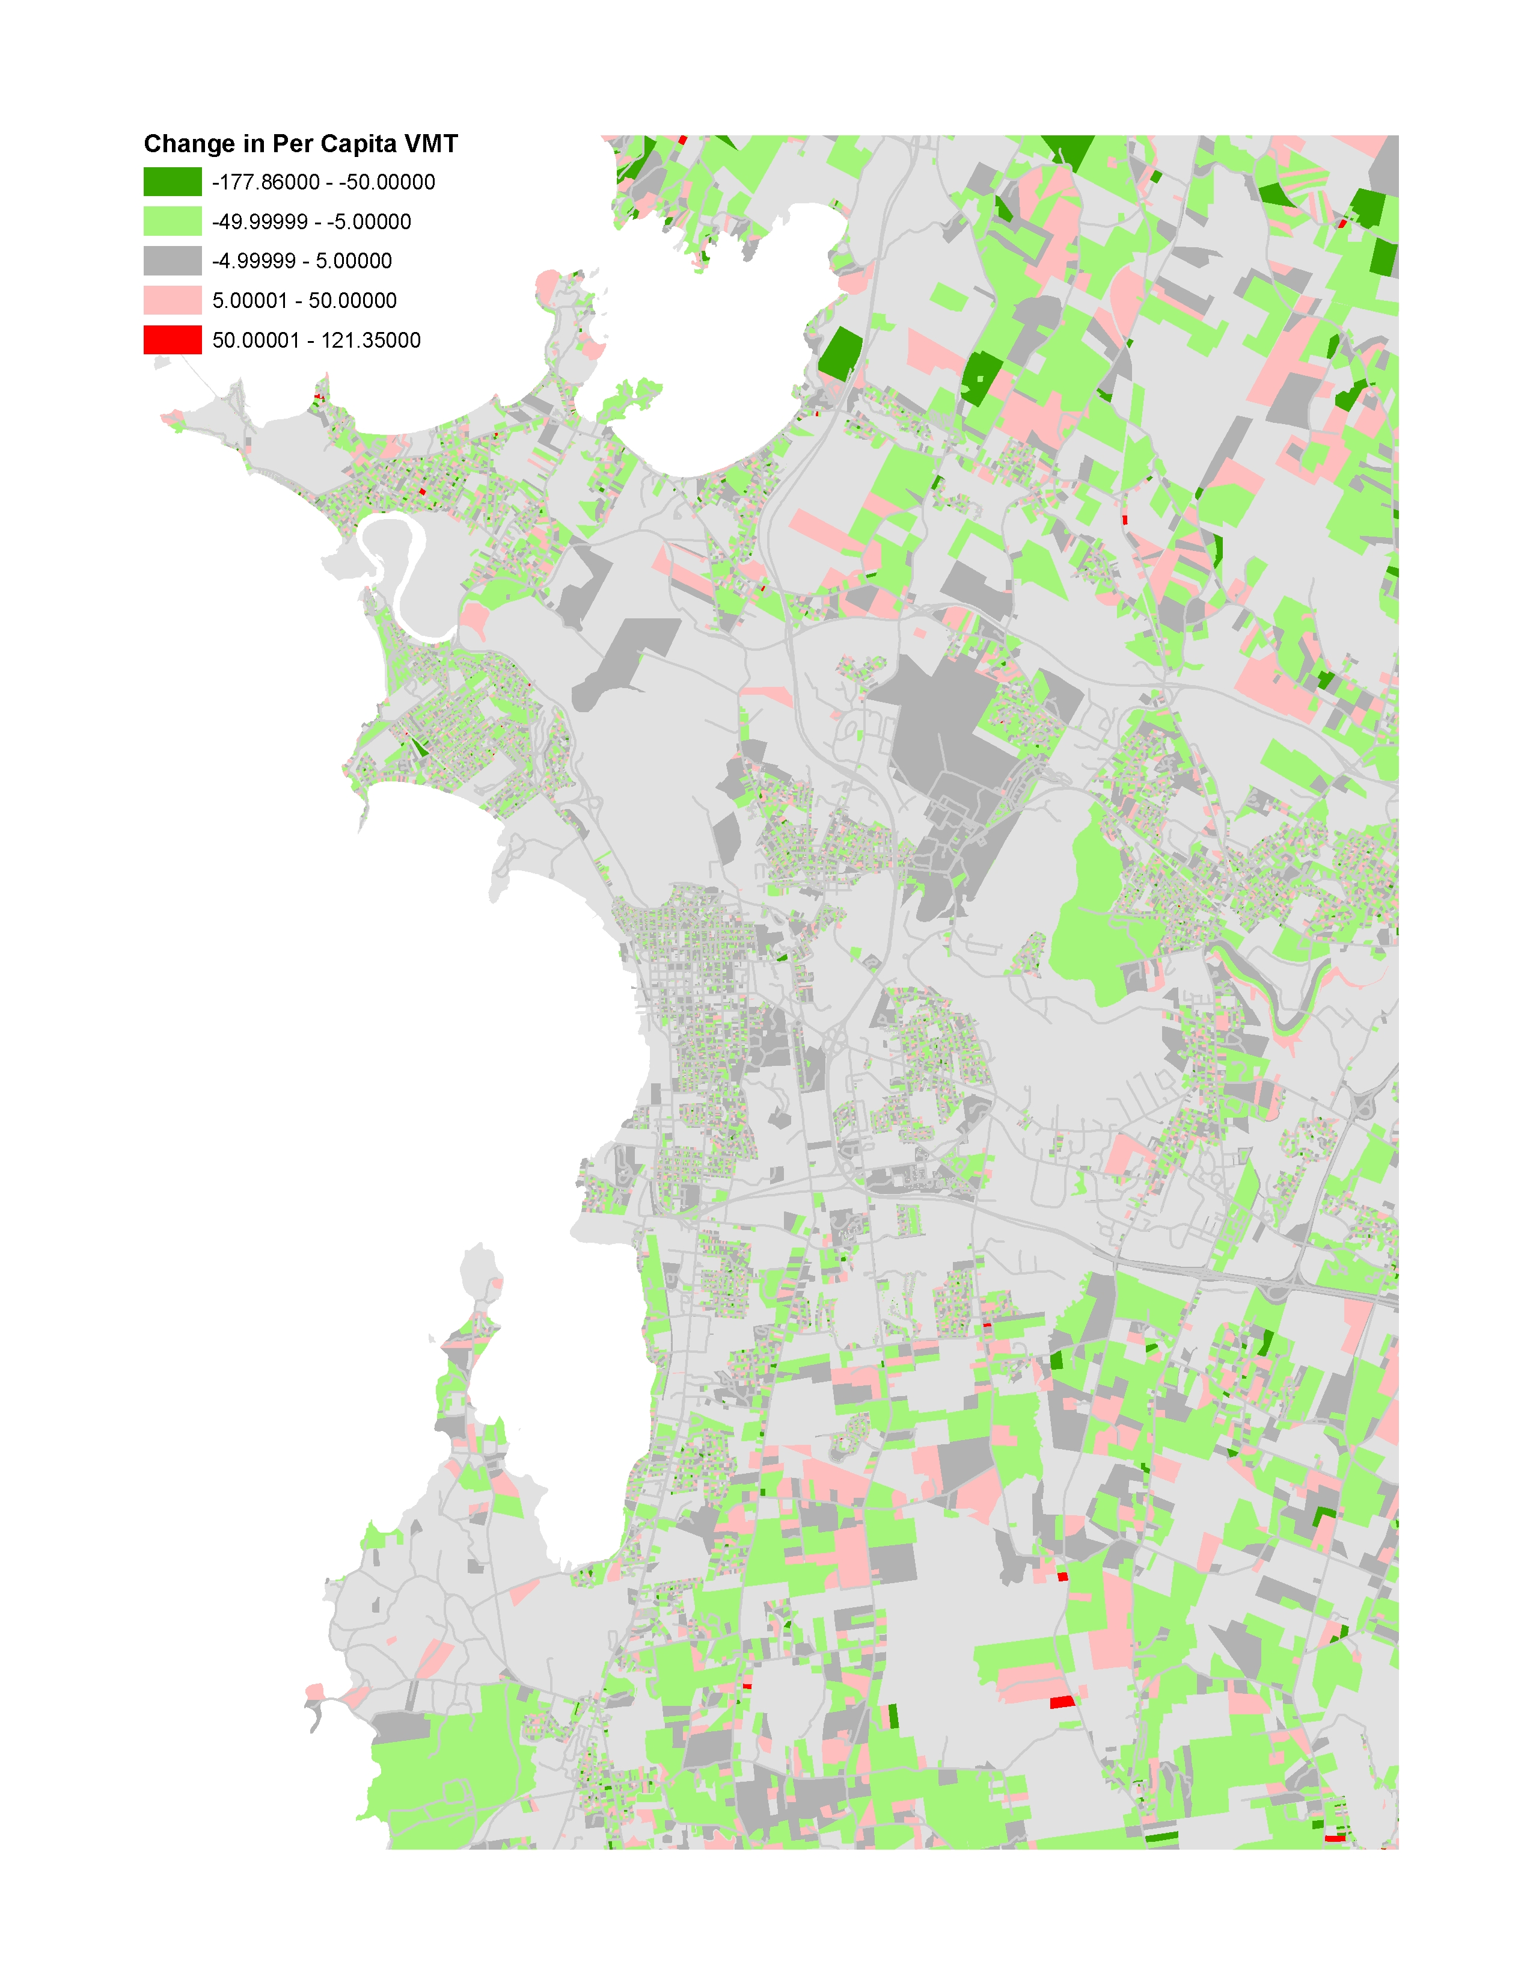
Auto Operating Costs: Change in Per Capita VMT

Slide 18
Travel Demand Management
Strategies to change travel behavior in order to reduce congestion and improve mobility
  Work-at-home
  Flexible work schedules (off-peak)
  Shared ride
Advanced integrated model system captures interaction between demand and supply models
Scenario-based approaches necessary
  Model system captures the effects of TDM policy outcomes
  Cannot identify which policies will affect flexible work schedules
  But can estimate the impact on transportation system performance of shift from a 5-day 8-hour work week to a 4-day 9+ hour work week

Slide 19
Travel Demand Management
“Flexible Schedule” scenario
Asserted assumptions about:
  Fewer individual work activities
  Longer individual work durations
  Aggregate work durations constant
Target: Fulltime Workers

Slide 20
Travel Demand Management: Demand Impacts
~4% Reduction in overall trips
Reduced peak period and midday travel
More early AM travel and evening travel
Fewer, and earlier, work trips
More nonwork trips in morning and evening with fewer in midday

Slide 21
Travel Demand Management: Supply Impacts
Total VMT declines slightly
Reduced peak period and midday VMT, increased VMT in evening
Reduced peak period and midday delay across all facility types, additional delay in the evening

Slide 22
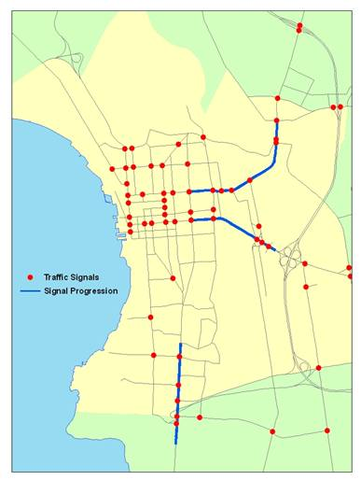
Operational Improvements
Cost-effective strategies to address congestion and mobility challenges
Travel demand forecasting models typically cannot represent TSM improvements or impacts
  Bottleneck improvements: intersection controls, signal timing and phasing, ramp metering
  Corridor improvements: Coordinated signal systems, speed harmonization
  Parking: Supply, pricing, subsidies
Signal progression implemented in 3 corridors
  Route 7
  Main Street
  Colchester Ave
Signal progression corridors in downtown Burlington, VT

Slide 23
Operational Improvements: Demand Impacts
Signal progression on a limited number of corridors has little impact on regional tripmaking by time-of-day
Marginal differences in AM peak nonwork trips

Slide 24
Operational Improvements: Supply Impacts
Total VMT unaffected by local signal progression improvements
AM peak delay reduced across all facility types
PM delay largely unaffected, though changes are observable by facility type

Slide 25
Operational Improvements: Supply Impacts
Improvements (or lack of) in speed can be observed at the level of individual link directions and corridors
Results are from fully linked model system with no additional post-processing

Slide 26
Lessons Learned
Convergence is key
Runtimes are still a challenge
Consistency between demand and supply assumptions is essential
Evaluating operational improvements requires significant care

Slide 27
Next Steps
Incorporate enhanced DaySim
Incorporate TRANSIMS v5
Address new sensitivities (reliability)
Improve model runtimes
Policy testing in Jacksonville

